Slide 1
Advanced Programming in the UNIX Environment
Advanced Programming in the UNIX
Environment
–
File I/O, File Sharing
Department of Software Engineering
International School of Software
Chen Gang
chenzuolin@whu.edu.cn
http://iss.whu.edu.cn/blog.html?author=chengang
Lecture 02: File I/O, File Sharing

Slide 2
Advanced Programming in the UNIX Environment
File Descriptors
A ﬁle descriptor (or ﬁle handle) is a small, non-negative integer which
identiﬁes a ﬁle to the kernel.
Lecture 02: File I/O, File Sharing

Slide 3
Advanced Programming in the UNIX Environment
File Descriptors
A ﬁle descriptor (or ﬁle handle) is a small, non-negative integer which
identiﬁes a ﬁle to the kernel.
Traditionally, stdin, stdout and stderr are 0, 1 and 2 respectively.
Lecture 02: File I/O, File Sharing

Slide 4
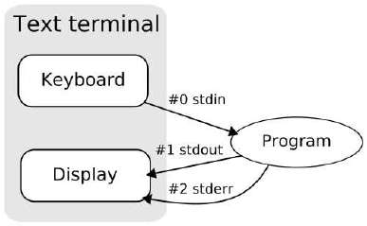
Advanced Programming in the UNIX Environment
File Descriptors
A ﬁle descriptor (or ﬁle handle) is a small, non-negative integer which
identiﬁes a ﬁle to the kernel.
Traditionally, stdin, stdout and stderr are 0, 1 and 2 respectively.
Lecture 02: File I/O, File Sharing

Slide 5
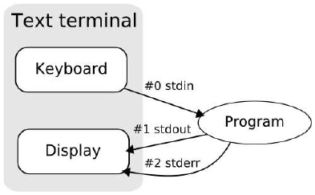
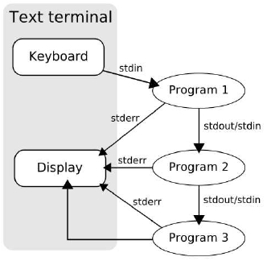
Advanced Programming in the UNIX Environment
File Descriptors
A ﬁle descriptor (or ﬁle handle) is a small, non-negative integer which
identiﬁes a ﬁle to the kernel.
Traditionally, stdin, stdout and stderr are 0, 1 and 2 respectively.
Lecture 02: File I/O, File Sharing

Slide 6
Advanced Programming in the UNIX Environment
File Descriptors
A ﬁle descriptor (or ﬁle handle) is a small, non-negative integer which
identiﬁes a ﬁle to the kernel.
Traditionally, stdin, stdout and stderr are 0, 1 and 2 respectively.
Relying on “magic numbers” is BadTM. Use STDIN_FILENO,
STDOUT_FILENO and STDERR_FILENO.
Lecture 02: File I/O, File Sharing

Slide 7
Advanced Programming in the UNIX Environment
File Descriptors
A ﬁle descriptor (or ﬁle handle) is a small, non-negative integer which
identiﬁes a ﬁle to the kernel.
Traditionally, stdin, stdout and stderr are 0, 1 and 2 respectively.
Relying on “magic numbers” is BadTM. Use STDIN_FILENO,
STDOUT_FILENO and STDERR_FILENO.
openmax.c
See also: https://en.wikipedia.org/wiki/File_descriptor
Lecture 02: File I/O, File Sharing

Slide 8
Advanced Programming in the UNIX Environment
Standard I/O
Basic File I/O: almost all UNIX ﬁle I/O can be performed using these ﬁve
functions:
open(2)
close(2)
lseek(2)
read(2)
write(2)
Processes may want to share recources. This requires us to look at:
atomicity of these operations
ﬁle sharing
manipulation of ﬁle descriptors
Lecture 02: File I/O, File Sharing

Slide 9


Advanced Programming in the UNIX Environment
creat(2)
#include <fcntl.h>
int creat(const char *pathname, mode_t mode);
Returns: ﬁle descriptor if OK, -1 on error
http://is.gd/x4KPa2
Lecture 02: File I/O, File Sharing

Slide 10
Advanced Programming in the UNIX Environment
creat(2)
#include <fcntl.h>
int creat(const char *pathname, mode_t mode);
Returns: ﬁle descriptor if OK, -1 on error
This interface is made obsolete by open(2).
Lecture 02: File I/O, File Sharing

Slide 11
open(2)
Advanced Programming in the UNIX Environment
#include <fcntl.h>
int open(const char *pathname, int oflag, ... /* mode_t mode */ );
Returns: ﬁle descriptor if OK, -1 on error
oﬂag must be one (and only one) of:
O_RDONLY – Open for reading only
O_WRONLY – Open for writing only
O_RDWR – Open for reading and writing
and may be OR’d with any of these:
O_APPEND – Append to end of ﬁle for each write
O_CREAT – Create the ﬁle if it doesn’t exist. Requires mode argument
O_EXCL – Generate error if O_CREAT and ﬁle already exists. (atomic)
O_TRUNC – If ﬁle exists and successfully open in O_WRONLY or O_RDWR, make length = 0
O_NOCTTY – If pathname refers to a terminal device, do not allocate the device as a controlling terminal
O_NONBLOCK – If pathname refers to a FIFO, block special, or char special, set nonblocking mode (open and I/O)
O_SYNC – Each write waits for physical I/O to complete
Lecture 02: File I/O, File Sharing

Slide 12
open(2) variants
Advanced Programming in the UNIX Environment
#include <fcntl.h>
int open(const char *pathname, int oflag, ... /* mode_t mode */ );
int openat(int dirfd, const char *pathname, int oflag, ... /* mode_t mode */ );
Returns: ﬁle descriptor if OK, -1 on error
openat(2) is used to handle relative pathnames from different working
directories in an atomic fashion.
On some platforms additional oﬂags may be supported:
O_EXEC – Open for execute only
O_SEARCH – Open for search only (applies to directories)
O_DIRECTORY – If path resolves to a non-directory ﬁle, fail and set errno to ENOTDIR.
O_DSYNC – Wait for physical I/O for data, except ﬁle attributes
O_RSYNC – Block read operations on any pending writes.
O_PATH – Obtain a ﬁle descriptor purely for fd-level operations. (Linux >2.6.36 only)
Lecture 02: File I/O, File Sharing

Slide 13

Advanced Programming in the UNIX Environment
close(2)
#include <unistd.h>
int close(int fd);
Returns: 0 if OK, -1 on error
closing a ﬁledescriptor releases any record locks on that ﬁle (more on
that in future lectures)
ﬁle descriptors not explicitly closed are closed by the kernel when the
process terminates.
to avoid leaking ﬁle descriptors, always close(2) them within the
same scope
Lecture 02: File I/O, File Sharing

Slide 14
Advanced Programming in the UNIX Environment
open(2) and close(2)
$ make code-clean
$ make openex
$ ./openex
Lecture 02: File I/O, File Sharing

Slide 15

Advanced Programming in the UNIX Environment
read(2)
#include <unistd.h>
ssize_t read(int filedes, void *buff, size_t nbytes );
Returns: number of bytes read, 0 if end of ﬁle, -1 on error
http://is.gd/qI5r8E
Lecture 02: File I/O, File Sharing

Slide 16
Advanced Programming in the UNIX Environment
read(2)
#include <unistd.h>
ssize_t read(int filedes, void *buff, size_t nbytes );
Returns: number of bytes read, 0 if end of ﬁle, -1 on error
There can be several cases where read returns less than the number of
bytes requested:
EOF reached before requested number of bytes have been read
Reading from a terminal device, one ”line” read at a time
Reading from a network, buffering can cause delays in arrival of data
Record-oriented devices (magtape) may return data one record at a
time
Interruption by a signal
read begins reading at the current offset, and increments the offset by
the number of bytes actually read.
Lecture 02: File I/O, File Sharing

Slide 17
Advanced Programming in the UNIX Environment
write(2)
#include <unistd.h>
ssize_t write(int filedes, void *buff, size_t nbytes );
Returns: number of bytes written if OK, -1 on error
write returns nbytes or an error has occurred
for regular ﬁles, write begins writing at the current offset (unless
O_APPEND has been speciﬁed, in which case the offset is ﬁrst set to
the end of the ﬁle)
after the write, the offset is adjusted by the number of bytes actually
written
Lecture 02: File I/O, File Sharing

Slide 18
Advanced Programming in the UNIX Environment
read(2) and write(2)
$
$
$
$
make code-clean
make rwex
./rwex
tail rwex.c
Lecture 02: File I/O, File Sharing

Slide 19
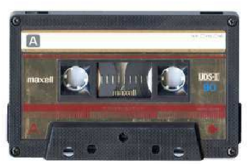
Advanced Programming in the UNIX Environment
lseek(2)
#include <sys/types.h>
#include <fcntl.h>
off_t lseek(int filedes, off_t offset, int whence );
Returns: new ﬁle offset if OK, -1 on error
http://is.gd/3fp5Vx
Lecture 02: File I/O, File Sharing

Slide 20
Advanced Programming in the UNIX Environment
lseek(2)
#include <sys/types.h>
#include <fcntl.h>
off_t lseek(int filedes, off_t offset, int whence );
Returns: new ﬁle offset if OK, -1 on error
The value of whence determines how offset is used:
SEEK_SET bytes from the beginning of the ﬁle
SEEK_CUR bytes from the current ﬁle position
SEEK_END bytes from the end of the ﬁle
“Weird” things you can do using lseek(2):
seek to a negative offset
seek 0 bytes from the current position
seek past the end of the ﬁle
Lecture 02: File I/O, File Sharing

Slide 21
Advanced Programming in the UNIX Environment
lseek(2)
$ cc -Wall lseek.c
$ ./a.out < lseek.c
seek OK
$ cat lseek.c | ./a.out
cannot seek
$ mkfifo fifo
$ ./a.out <fifo
Lecture 02: File I/O, File Sharing

Slide 22
Advanced Programming in the UNIX Environment
lseek(2)
$ cc -Wall hole.c
$ ./a.out
$ ls -l file.hole
-rw------- 1 jschauma wheel 10240020 Sep 18 17:20
$ hexdump -c file.hole
file.hole
0000000 a b c d e f g h i j \0
0000010 \0 \0 \0 \0 \0 \0 \0 \0 \0 \0 \0
\0
\0
\0
\0
\0
\0
\0
\0
\0
\0
*
09c4000 \0 \0 \0 \0 \0 \0 \0 \0 \0 \0 A
B
C
D
E
F
09c4010 G H I J
09c4014
$ cat file.hole > file.nohole
$ ls -ls file.*
96 -rw------- 1 jschauma wheel 10240020 Sep 18
20064 -rw-r--r-- 1 jschauma wheel 10240020 Sep 18
17:20 file.hole
17:21 file.nohole
https://en.wikipedia.org/wiki/Sparse_file (not on HFS+ / NFS)
Lecture 02: File I/O, File Sharing

Slide 23
Advanced Programming in the UNIX Environment
I/O Efficiency
Caveats with the program simple-cat.c from the last class:
assumes that stdin and stdout have been set up appropriately
Lecture 02: File I/O, File Sharing

Slide 24
Advanced Programming in the UNIX Environment
I/O Efficiency
Caveats with the program simple-cat.c from the last class:
assumes that stdin and stdout have been set up appropriately
works for “text” and “binary” ﬁles since there is no such distinction in
the UNIX kernel
Lecture 02: File I/O, File Sharing

Slide 25
Advanced Programming in the UNIX Environment
I/O Efficiency
Caveats with the program simple-cat.c from the last class:
assumes that stdin and stdout have been set up appropriately
works for “text” and “binary” ﬁles since there is no such distinction in
the UNIX kernel
how do we know the optimal BUFFSIZE?
Lecture 02: File I/O, File Sharing

Slide 26
Advanced Programming in the UNIX Environment
I/O Efficiency
$ make tmpfiles
$ for n in $(seq 10); do
dd if=/dev/urandom of=tmp/file$n count=204800
done
$ i=1; for n in 1048576 32768 16384 4096 512 256 128 64 1 ; do
cc -Wall -DBUFFSIZE=$n simple-cat.c;
i=$(( $i + 1 ));
time ./a.out <tmp/file$i >tmp/file$i.copy;
done
$ make catio
$ stat -f "%k" tmp/file1 # stat -c "%o" tmp/file1
Note: results vary depending on OS/ﬁlesystem.
Lecture 02: File I/O, File Sharing

Slide 27
Advanced Programming in the UNIX Environment
Hooray!
5 Minute Break
Lecture 02: File I/O, File Sharing

Slide 28
Advanced Programming in the UNIX Environment
File Sharing
Since UNIX is a multi-user/multi-tasking system, it is conceivable (and
useful) if more than one process can act on a single ﬁle simultaneously.
In order to understand how this is accomplished, we need to examine
some kernel data structures which relate to ﬁles. (See: Stevens, pp 75 ff)
Lecture 02: File I/O, File Sharing

Slide 29
Advanced Programming in the UNIX Environment
File Sharing
Since UNIX is a multi-user/multi-tasking system, it is conceivable (and
useful) if more than one process can act on a single ﬁle simultaneously.
In order to understand how this is accomplished, we need to examine
some kernel data structures which relate to ﬁles. (See: Stevens, pp 75 ff)
each process table entry has a table of ﬁle descriptors, which contain
the ﬁle descriptor ﬂags (ie FD_CLOEXEC, see fcntl(2))
a pointer to a ﬁle table entry
Lecture 02: File I/O, File Sharing

Slide 30
Advanced Programming in the UNIX Environment
File Sharing
Since UNIX is a multi-user/multi-tasking system, it is conceivable (and
useful) if more than one process can act on a single ﬁle simultaneously.
In order to understand how this is accomplished, we need to examine
some kernel data structures which relate to ﬁles. (See: Stevens, pp 75 ff)
each process table entry has a table of ﬁle descriptors, which contain
the ﬁle descriptor ﬂags (ie FD_CLOEXEC, see fcntl(2))
a pointer to a ﬁle table entry
the kernel maintains a ﬁle table; each entry contains
ﬁle status ﬂags (O_APPEND, O_SYNC, O_RDONLY, etc.)
current offset
pointer to a vnode table entry
Lecture 02: File I/O, File Sharing

Slide 31
Advanced Programming in the UNIX Environment
File Sharing
Since UNIX is a multi-user/multi-tasking system, it is conceivable (and
useful) if more than one process can act on a single ﬁle simultaneously.
In order to understand how this is accomplished, we need to examine
some kernel data structures which relate to ﬁles. (See: Stevens, pp 75 ff)
each process table entry has a table of ﬁle descriptors, which contain
the ﬁle descriptor ﬂags (ie FD_CLOEXEC, see fcntl(2))
a pointer to a ﬁle table entry
the kernel maintains a ﬁle table; each entry contains
ﬁle status ﬂags (O_APPEND, O_SYNC, O_RDONLY, etc.)
current offset
pointer to a vnode table entry
a vnode structure contains
vnode information
inode information (such as current ﬁle size)
Lecture 02: File I/O, File Sharing

Slide 32
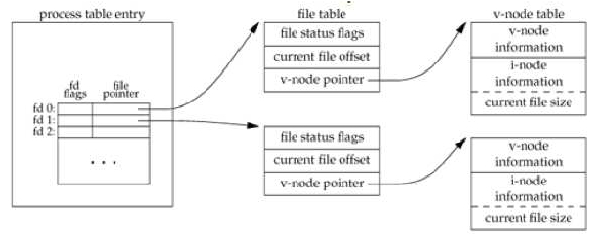
Advanced Programming in the UNIX Environment
File Sharing
Lecture 02: File I/O, File Sharing

Slide 33
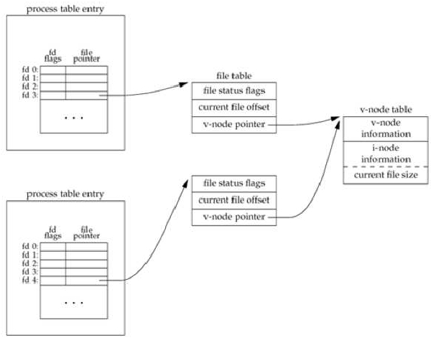
Advanced Programming in the UNIX Environment
File Sharing
Lecture 02: File I/O, File Sharing

Slide 34
Advanced Programming in the UNIX Environment
File Sharing
Knowing this, here’s what happens with each of the calls we discussed
earlier:
after each write completes, the current ﬁle offset in the ﬁle table
entry is incremented. (If current_ﬁle_offset > current_ﬁle_size, change
current ﬁle size in i-node table entry.)
If ﬁle was opened O_APPEND set corresponding ﬂag in ﬁle status ﬂags
in ﬁle table. For each write, current ﬁle offset is ﬁrst set to current ﬁle
size from the i-node entry.
lseek simply adjusts current ﬁle offset in ﬁle table entry
to lseek to the end of a ﬁle, just copy current ﬁle size into current ﬁle
offset.
Lecture 02: File I/O, File Sharing

Slide 35
Advanced Programming in the UNIX Environment
Atomic Operations
In order to ensure consistency across multiple writes, we require
atomicity in some operations.
An operation is atomic if either all of the steps are performed or none of
the steps are performed.
Suppose UNIX didn’t have O_APPEND (early versions didn’t). To append,
you’d have to do this:
if (lseek(fd, 0L, 2) < 0) { /* position to EOF */
fprintf(stderr, "lseek error\n");
exit(1);
}
if (write(fd, buff, 100) != 100) { /* ...and write */
fprintf(stderr, "write error\n");
exit(1);
}
What if another process was doing the same thing to the same ﬁle?
Lecture 02: File I/O, File Sharing

Slide 36
Advanced Programming in the UNIX Environment
pread(2) and pwrite(2)
#include <unistd.h>
ssize_t pread(int fd, void *buf, size_t count, off_t offset);
ssize_t pwrite(int fd, void *buf, size_t count, off_t offset);
Both return number of bytes read/written, -1 on error
Atomic read/write at offset without invoking lseek(2).
Current offset is not updated.
Lecture 02: File I/O, File Sharing

Slide 37
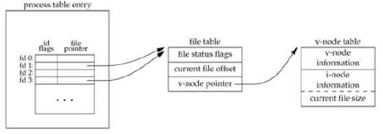
Advanced Programming in the UNIX Environment
dup(2) and dup2(2)
#include <unistd.h>
int dup(int oldd);
int dup2(int oldd, int newd);
Both return new ﬁle descriptor if OK, -1 on error
An existing ﬁle descriptor can be duplicated with dup(2) or duplicated to
a particular ﬁle descriptor value with dup2(2). As with open(2), dup(2)
returns the lowest numbered unused ﬁle descriptor.
Note the difference in scope of the ﬁle descriptor ﬂags and the ﬁle status
ﬂags compared to distinct processes.
Lecture 02: File I/O, File Sharing

Slide 38
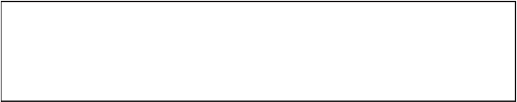
Advanced Programming in the UNIX Environment
fcntl(2)
#include <sys/types.h>
#include <unistd.h>
#include <fcntl.h>
int fcntl(int filedes, int cmd, ...
/* int arg */);
Returns: depend on cmd if OK, -1 on error
fcntl(2) is on of those ”catch-all” functions with a myriad of purposes.
Here, they all relate to changing properties of an already open ﬁle. It can:
cmd
F_DUPFD
F_GETFD
F_SETFD
F_GETFL
F_SETFL
eﬀect
duplicate ﬁledes (FD_CLOEXEC ﬁle descriptor ﬂag is cleared
get the ﬁle descriptor ﬂags for ﬁledes
set the ﬁle descriptor ﬂags to the value of the third argument
get the ﬁle status ﬂags
set the ﬁle status ﬂags
return value
new ﬁledes
descriptor ﬂags
not -1
status ﬂags
not -1
...as well as several other functions.
Lecture 02: File I/O, File Sharing

Slide 39
Advanced Programming in the UNIX Environment
fcntl(2)
$
$
$
$
cc -Wall sync-cat.c -o scat
sed -e ’s/\(.*O_SYNC.*\)/\/\/\1/’ sync-cat.c > async-cat.c
cc -Wall async-cat.c -o ascat
time ./scat <file >out
$ time ./ascat <file >out
$ make sync async
Note: results will differ depending on the ﬁlesystem (-options).
Lecture 02: File I/O, File Sharing

Slide 40

Advanced Programming in the UNIX Environment
ioctl(2)
#include <unistd.h> /* SVR4 */
#include <sys/ioctl.h> /* 4.3+BSD */
int ioctl(int filedes, int request, ...);
Returns: -1 on error, something else if OK
Another catch-all function, this one is designed to handle device
speciﬁcs that can’t be speciﬁed via any of the previous function calls. For
example, terminal I/O, magtape access, socket I/O, etc.
Mentioned here mostly for completeness’s sake.
Lecture 02: File I/O, File Sharing

Slide 41
Advanced Programming in the UNIX Environment
/dev/fd
$ ls -l /dev/stdin /dev/stdout /dev/stderr
lr-xr-xr-x 1 root wheel 0 Sep 7 13:56 /dev/stderr -> fd/2
lr-xr-xr-x 1 root wheel 0 Sep 7 13:56 /dev/stdin -> fd/0
lr-xr-xr-x 1 root wheel 0 Sep 7 13:56 /dev/stdout -> fd/1
$ ls -l /dev/fd/
total 0
crw--w---- 1 jschaumann tty 16, 4 Sep 8 21:48 0
crw--w---- 1 jschaumann tty 16, 4 Sep 8 21:48 1
crw--w---- 1 jschaumann tty 16, 4 Sep 8 21:48 2
drw-r--r-- 93 jschaumann staff 3162 Sep 8 21:40 3
dr--r--r-- 1 root wheel 0 Sep 7 13:56 4
$ echo first >file1
$ echo third >file2
$ echo second | cat file1 /dev/fd/0 file2
first
second
third
Lecture 02: File I/O, File Sharing

Slide 42
Advanced Programming in the UNIX Environment
Homework
Reading:
manual pages for the functions covered
Stevens Chap. 3, 4
Thinking:
Stevens # 3.4
Stevens # 3.5 (bourne shell syntax “> &”)
Coding:
required: tcp(1) (see website)
extra credit: tcpm(1) (see website)
Lecture 02: File I/O, File Sharing

