Slide 1
Advanced Programming in the UNIX Environment
Advanced Programming in the UNIX
Environment
–
File Systems, System Data Files, Time & Date
Department of Software Engineering
International School of Software
Chen Gang
chenzuolin@whu.edu.cn
http://iss.whu.edu.cn/blog.html?author=chengang
Lecture 04: File Systems, System Data Files, Time & Date

Slide 2
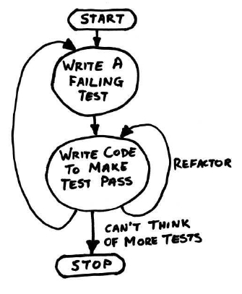
Advanced Programming in the UNIX Environment
HW#2 Notes
https://www.cs.stevens.edu/~jschauma/631/testcp.sh
Lecture 04: File Systems, System Data Files, Time & Date

Slide 3
Advanced Programming in the UNIX Environment
HW#2 Notes: Avoid useless comments
/* check input size */
if (argc != 3) {
// open src file for read only mode
if ((fd_src= open (src,O_RDONLY)) == -1) {
int bytes_read; /* The bytes of read() read from stream*/
int bytes_write;/* The bytes of write() write from stream *
int fd_source; /* The file descriptor of source file */
int fd_target; /* The file descriptor of target file
Lecture 04: File Systems, System Data Files, Time & Date

Slide 4
Advanced Programming in the UNIX Environment
HW#2 Notes
Errors go to stderr, please! Use strerror(3)/perror(3).
printf("tcp: missing file operand\n");
exit(EXIT_FAILURE);
Lecture 04: File Systems, System Data Files, Time & Date

Slide 5
Advanced Programming in the UNIX Environment
HW#2 Notes
Errors go to stderr, please! Use strerror(3)/perror(3).
printf("tcp: missing file operand\n");
exit(EXIT_FAILURE);
Don’t generate useless output!
printf(" Open input success\n");
Lecture 04: File Systems, System Data Files, Time & Date

Slide 6
Advanced Programming in the UNIX Environment
HW#2 Notes
Errors go to stderr, please! Use strerror(3)/perror(3).
printf("tcp: missing file operand\n");
exit(EXIT_FAILURE);
Don’t generate useless output!
printf(" Open input success\n");
Spell-check your comments / output!
/*isdir() function is for cheak dir
/*get file addres*/
file_to = maskDir(argv[2], file_from);
/*check what kina of cy opertion it is*/
Lecture 04: File Systems, System Data Files, Time & Date

Slide 7
Advanced Programming in the UNIX Environment
HW#2 Notes: Whitespace counts
Use spaces or tabs, but be consistent.
char * target;
char * tmp;
char * slash="/";
char buf[BUFFSIZE];
struct stat in_st;
if(argc!=3){
usage();
Lecture 04: File Systems, System Data Files, Time & Date

Slide 8
Advanced Programming in the UNIX Environment
HW#2 Notes: Whitespace counts
Give your code room to breathe. (Spaces don’t cost you anything.)
if(out_opened==0&&(out=open(argv[2], O_DIRECTORY))<0){
perror(argv[2]);
return OUTPUT_OPEN_FAIL;
}else{
target=(char*)malloc(strlen(argv[2])+strlen(argv[1])+2)
strcat(target,argv[2]);
strcat(target,slash);
tmp=(char*)malloc(strlen(argv[1])+1);
strcat(tmp, argv[1]);
strcat(target, basename(tmp));
Lecture 04: File Systems, System Data Files, Time & Date

Slide 9
Advanced Programming in the UNIX Environment
HW#2 Notes: Whitespace counts
Avoid waterfall code.
if (condition) {
if (condition) {
if (condition) {
if (condition) {
if (condition) {
something
}
}
} else {
if (condition) {
something
} else
something
}
Lecture 04: File Systems, System Data Files, Time & Date

Slide 10
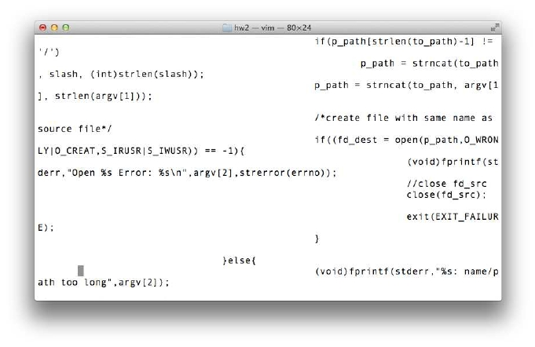
Advanced Programming in the UNIX Environment
HW#2 Notes: Whitespace counts
Lecture 04: File Systems, System Data Files, Time & Date

Slide 11
Advanced Programming in the UNIX Environment
HW#2 Notes: Check all return codes!
new_dest=malloc(strlen(name_src)+strlen(argv[2])+1);
strncat(new_dest,argv[2],strlen(argv[2]));
strncat(new_dest,"/",1);
dst = (char *)malloc(sizeof(argv[2]) + 1 + sizeof(src_fname));
sprintf(dst, "%s/%s", argv[2], src_fname);
fstat(sfd, &mod);
if ((tfd = open(tar, O_WRONLY | O_CREAT | O_TRUNC, mod.st_mode)) < 0){
Lecture 04: File Systems, System Data Files, Time & Date

Slide 12
Advanced Programming in the UNIX Environment
HW#2 Notes: Don’t overﬂow your buffers!
Use of strcat(3) etc. considered harmful.
if(S_ISDIR(statbuf.st_mode))
argv[2] = strcat(argv[2], basename(argv[1]));
char str[MAX_INPUT];
strcpy(str, argv[2]);
tar_tmp = argv[2];^M
char *tar = (char*) malloc ((strlen(src) + strlen(tar_tmp)^M
+ 1) * sizeof(char*));^M
strcpy(tar, tar_tmp);^M
char target[200];
strcpy(target,argv[2]);
Use strlcat(3)/strlcpy(3) etc. instead.
Lecture 04: File Systems, System Data Files, Time & Date

Slide 13
Advanced Programming in the UNIX Environment
File Systems
System Data Files, Time & Date
Lecture 04: File Systems, System Data Files, Time & Date

Slide 14
Advanced Programming in the UNIX Environment
File Systems
a disk can be divided into logical partitions
Lecture 04: File Systems, System Data Files, Time & Date

Slide 15
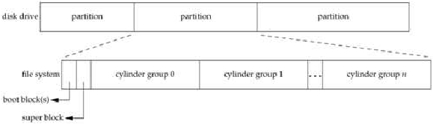
Advanced Programming in the UNIX Environment
File Systems
a disk can be divided into logical partitions
each logical partition may be further divided into ﬁle systems
containing cylinder groups
Lecture 04: File Systems, System Data Files, Time & Date

Slide 16
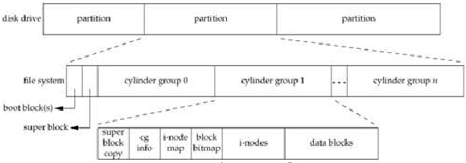
Advanced Programming in the UNIX Environment
File Systems
a disk can be divided into logical partitions
each logical partition may be further divided into ﬁle systems
containing cylinder groups
each cylinder group contains a list of inodes (i-list) as well as the
actual directory- and data blocks
Lecture 04: File Systems, System Data Files, Time & Date

Slide 17
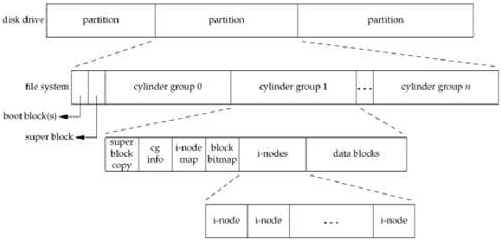
Advanced Programming in the UNIX Environment
File Systems
a disk can be divided into logical partitions
each logical partition may be further divided into ﬁle systems
containing cylinder groups
each cylinder group contains a list of inodes (i-list) as well as the
actual directory- and data blocks
Lecture 04: File Systems, System Data Files, Time & Date

Slide 18
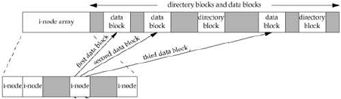
Advanced Programming in the UNIX Environment
File Systems
a disk can be divided into logical partitions
each logical partition may be further divided into ﬁle systems
containing cylinder groups
each cylinder group contains a list of inodes (i-list) as well as the
actual directory- and data blocks
Lecture 04: File Systems, System Data Files, Time & Date

Slide 19
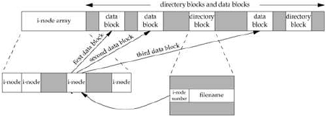
Advanced Programming in the UNIX Environment
File Systems
a disk can be divided into logical partitions
each logical partition may be further divided into ﬁle systems
containing cylinder groups
each cylinder group contains a list of inodes (i-list) as well as the
actual directory- and data blocks
a directory entry is really just a hard link mapping a “ﬁlename” to an
inode
Lecture 04: File Systems, System Data Files, Time & Date

Slide 20
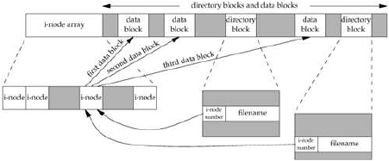
Advanced Programming in the UNIX Environment
File Systems
a disk can be divided into logical partitions
each logical partition may be further divided into ﬁle systems
containing cylinder groups
each cylinder group contains a list of inodes (i-list) as well as the
actual directory- and data blocks
a directory entry is really just a hard link mapping a “ﬁlename” to an
inode
you can have many such mappings to the same ﬁle
Lecture 04: File Systems, System Data Files, Time & Date

Slide 21
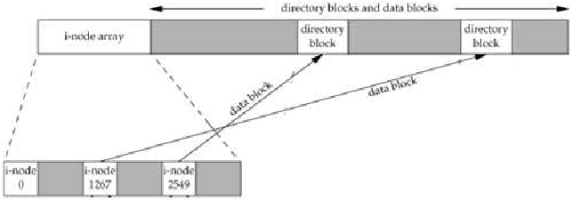
Advanced Programming in the UNIX Environment
Directories
directories are special ”ﬁles” containing hardlinks
Lecture 04: File Systems, System Data Files, Time & Date

Slide 22
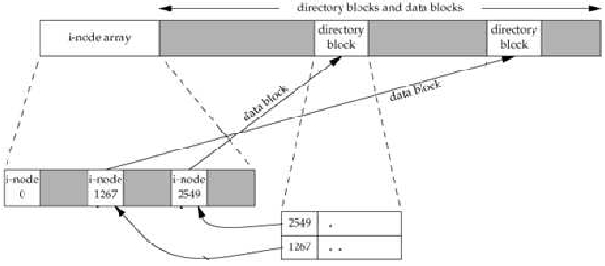
Advanced Programming in the UNIX Environment
Directories
directories are special ”ﬁles” containing hardlinks
each directory contains at least two entries:
. (this directory)
.. (the parent directory)
Lecture 04: File Systems, System Data Files, Time & Date

Slide 23
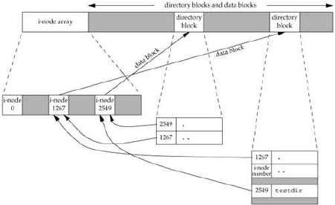
Advanced Programming in the UNIX Environment
Directories
directories are special ”ﬁles” containing hardlinks
each directory contains at least two entries:
. (this directory)
.. (the parent directory)
the link count (st_nlink) of a directory is at least 2
Lecture 04: File Systems, System Data Files, Time & Date

Slide 24
Advanced Programming in the UNIX Environment
Inodes
the inode contains most of information found in the stat structure.
Lecture 04: File Systems, System Data Files, Time & Date

Slide 25
Advanced Programming in the UNIX Environment
Inodes
the inode contains most of information found in the stat structure.
every inode has a link count (st_nlink): it shows how many “things”
point to this inode. Only if this link count is 0 (and no process has the
ﬁle open) are the data blocks freed.
Lecture 04: File Systems, System Data Files, Time & Date

Slide 26
Advanced Programming in the UNIX Environment
Inodes
the inode contains most of information found in the stat structure.
every inode has a link count (st nlink): it shows how many “things”
point to this inode. Only if this link count is 0 (and no process has the
ﬁle open) are the data blocks freed.
inode number in a directory entry must point to an inode on the same
ﬁle system (no hardlinks across ﬁlesystems)
Lecture 04: File Systems, System Data Files, Time & Date

Slide 27
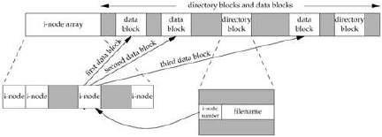
Advanced Programming in the UNIX Environment
Inodes
the inode contains most of information found in the stat structure.
every inode has a link count (st nlink): it shows how many “things”
point to this inode. Only if this link count is 0 (and no process has the
ﬁle open) are the data blocks freed.
inode number in a directory entry must point to an inode on the same
ﬁle system (no hardlinks across ﬁlesystems)
to move a ﬁle within a single ﬁlesystem, we can just ”move” the
directory entry (actually done by creating a new entry, and deleting
the old one).
Lecture 04: File Systems, System Data Files, Time & Date

Slide 28
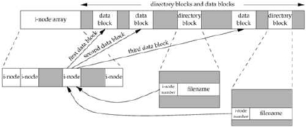
Advanced Programming in the UNIX Environment
Inodes
the inode contains most of information found in the stat structure.
every inode has a link count (st_nlink): it shows how many “things”
point to this inode. Only if this link count is 0 (and no process has the
ﬁle open) are the data blocks freed.
inode number in a directory entry must point to an inode on the same
ﬁle system (no hardlinks across ﬁlesystems)
to move a ﬁle within a single ﬁlesystem, we can just ”move” the
directory entry (actually done by creating a new entry, and deleting
the old one).
Lecture 04: File Systems, System Data Files, Time & Date

Slide 29
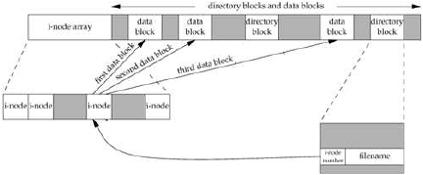
Advanced Programming in the UNIX Environment
Inodes
the inode contains most of information found in the stat structure.
every inode has a link count (st nlink): it shows how many “things”
point to this inode. Only if this link count is 0 (and no process has the
ﬁle open) are the data blocks freed.
inode number in a directory entry must point to an inode on the same
ﬁle system (no hardlinks across ﬁlesystems)
to move a ﬁle within a single ﬁlesystem, we can just ”move” the
directory entry (actually done by creating a new entry, and deleting
the old one).
Lecture 04: File Systems, System Data Files, Time & Date

Slide 30

Advanced Programming in the UNIX Environment
link(2)
#include <unistd.h>
int link(const char *name1, const char *name2);
Returns: 0 if OK, -1 on error
Creates a link to an existing ﬁle (hard link).
POSIX.1 allows links to cross ﬁlesystems, most implementations
(SVR4, BSD) don’t.
only uid(0) can create links to directories (loops in ﬁlesystem are bad)
Lecture 04: File Systems, System Data Files, Time & Date

Slide 31


Advanced Programming in the UNIX Environment
link(2) and unlink(2)
#include <unistd.h>
int link(const char *name1, const char *name2);
Returns: 0 if OK, -1 on error
Creates a link to an existing ﬁle (hard link).
POSIX.1 allows links to cross ﬁlesystems, most implementations
(SVR4, BSD) don’t.
only uid(0) can create links to directories (loops in ﬁlesystem are bad)
#include <unistd.h>
int unlink(const char *path);
Returns: 0 if OK, -1 on error
removes directory entry and decrements link count of ﬁle
if ﬁle link count == 0, free data blocks associated with ﬁle (...unless
processes have the ﬁle open)
Lecture 04: File Systems, System Data Files, Time & Date

Slide 32
Advanced Programming in the UNIX Environment
link(2) and unlink(2)
$ cc -Wall wait-unlink.c
$ ./a.out
$ df .
Lecture 04: File Systems, System Data Files, Time & Date

Slide 33
Advanced Programming in the UNIX Environment
rename(2)
#include <stdio.h>
int rename(const char *from, const char *to);
Returns: 0 if OK, -1 on error
If oldname refers to a ﬁle:
if newname exists and it is not a directory, it’s removed and oldname
is renamed newname
Lecture 04: File Systems, System Data Files, Time & Date

Slide 34
Advanced Programming in the UNIX Environment
rename(2)
#include <stdio.h>
int rename(const char *from, const char *to);
Returns: 0 if OK, -1 on error
If oldname refers to a ﬁle:
if newname exists and it is not a directory, it’s removed and oldname
is renamed newname
if newname exists and it is a directory, an error results
Lecture 04: File Systems, System Data Files, Time & Date

Slide 35
Advanced Programming in the UNIX Environment
rename(2)
#include <stdio.h>
int rename(const char *from, const char *to);
Returns: 0 if OK, -1 on error
If oldname refers to a ﬁle:
if newname exists and it is not a directory, it’s removed and oldname
is renamed newname
if newname exists and it is a directory, an error results
must have w+x perms for the directories containing old/newname
Lecture 04: File Systems, System Data Files, Time & Date

Slide 36
Advanced Programming in the UNIX Environment
rename(2)
#include <stdio.h>
int rename(const char *from, const char *to);
Returns: 0 if OK, -1 on error
If oldname refers to a ﬁle:
if newname exists and it is not a directory, it’s removed and oldname
is renamed newname
if newname exists and it is a directory, an error results
must have w+x perms for the directories containing old/newname
If oldname refers to a directory:
if newname exists and is an empty directory (contains only . and ..), it
is removed; oldname is renamed newname
Lecture 04: File Systems, System Data Files, Time & Date

Slide 37
Advanced Programming in the UNIX Environment
rename(2)
#include <stdio.h>
int rename(const char *from, const char *to);
Returns: 0 if OK, -1 on error
If oldname refers to a ﬁle:
if newname exists and it is not a directory, it’s removed and oldname
is renamed newname
if newname exists and it is a directory, an error results
must have w+x perms for the directories containing old/newname
If oldname refers to a directory:
if newname exists and is an empty directory (contains only . and ..), it
is removed; oldname is renamed newname
if newname exists and is a ﬁle, an error results
Lecture 04: File Systems, System Data Files, Time & Date

Slide 38
Advanced Programming in the UNIX Environment
rename(2)
#include <stdio.h>
int rename(const char *from, const char *to);
Returns: 0 if OK, -1 on error
If oldname refers to a ﬁle:
if newname exists and it is not a directory, it’s removed and oldname
is renamed newname
if newname exists and it is a directory, an error results
must have w+x perms for the directories containing old/newname
If oldname refers to a directory:
if newname exists and is an empty directory (contains only . and ..), it
is removed; oldname is renamed newname
if newname exists and is a ﬁle, an error results
if oldname is a preﬁx of newname an error results
Lecture 04: File Systems, System Data Files, Time & Date

Slide 39
Advanced Programming in the UNIX Environment
rename(2)
#include <stdio.h>
int rename(const char *from, const char *to);
Returns: 0 if OK, -1 on error
If oldname refers to a ﬁle:
if newname exists and it is not a directory, it’s removed and oldname
is renamed newname
if newname exists and it is a directory, an error results
must have w+x perms for the directories containing old/newname
If oldname refers to a directory:
if newname exists and is an empty directory (contains only . and ..), it
is removed; oldname is renamed newname
if newname exists and is a ﬁle, an error results
if oldname is a preﬁx of newname an error results
must have w+x perms for the directories containing old/newname
Lecture 04: File Systems, System Data Files, Time & Date

Slide 40

Advanced Programming in the UNIX Environment
Symbolic Links
#include <unistd.h>
int symlink(const char *name1, const char *name2);
Returns: 0 if OK, -1 on error
ﬁle whose ”data” is a path to another ﬁle
anyone can create symlinks to directories or ﬁles
certain functions dereference the link, others operate on the link
How do we get the contents of a symlink? open(2) and read(2)?
Lecture 04: File Systems, System Data Files, Time & Date

Slide 41
Advanced Programming in the UNIX Environment
Symbolic Links
#include <unistd.h>
int symlink(const char *name1, const char *name2);
Returns: 0 if OK, -1 on error
ﬁle whose ”data” is a path to another ﬁle
anyone can create symlinks to directories or ﬁles
certain functions dereference the link, others operate on the link
#include <unistd.h>
int readlink(const char *path, char *buf, size_t bufsize);
Returns: number of bytes placed into buffer if OK, -1 on error
This function combines the actions of open, read, and close.
Note: buf is not NUL terminated.
Lecture 04: File Systems, System Data Files, Time & Date

Slide 42

Advanced Programming in the UNIX Environment
File Times
#include <sys/types.h>
int utimes(const char *path, const struct timeval times[2]);
int lutimes(const char *path, const struct timeval times[2]);
int futimes(int fd, const struct timeval times[2]);
Returns: 0 if OK, -1 on error
If times is NULL, access time and modiﬁcation time are set to the current
time (must be owner of ﬁle or have write permission). If times is
non-NULL, then times are set according to the timeval struct array.
For this, you must be the owner of the ﬁle (write permission not enough).
Note that st_ctime is set to the current time in both cases.
For the effect of various functions on the access, modiﬁcation and
changes-status times see Stevens, p. 117.
Note: some systems implement lutimes(3) (library call) via utimes(2)
syscalls.
Lecture 04: File Systems, System Data Files, Time & Date

Slide 43

Advanced Programming in the UNIX Environment
mkdir(2) and rmdir(2)
#include <sys/types.h>
#include <sys/stat.h>
int mkdir(const char *path, mode_t mode);
Returns: 0 if OK, -1 on error
Creates a new, empty (except for . and .. entries) directory. Access
permissions speciﬁed by mode and restricted by the umask(2) of the
calling process.
#include <unistd.h>
int rmdir(const char *path);
Returns: 0 if OK, -1 on error
If the link count is 0 (after this call), and no other process has the
directory open, directory is removed. Directory must be empty (only .
and .. remaining)
Lecture 04: File Systems, System Data Files, Time & Date

Slide 44

Advanced Programming in the UNIX Environment
Reading Directories
#include <sys/types.h>
#include <dirent.h>
DIR *opendir(const char *filename);
Returns: pointer if OK, NULL on error
struct dirent *readdir(DIR *dp);
Returns: pointer if OK, NULL at end of dir or on error
void rewinddir(DIR *dp);
int closedir(DIR *dp);
Returns: 0 if OK, -1 on error
read by anyone with read permission on the directory
format of directory is implementation dependent (always use readdir
and friends)
opendir, readdir and closedir should be familiar from our small ls
clone. rewinddir resets an open directory to the beginning so readdir
will again return the ﬁrst entry.
For directory traversal, consider fts(3) (not available on all UNIX
versions).
Lecture 04: File Systems, System Data Files, Time & Date

Slide 45

Advanced Programming in the UNIX Environment
Moving around directories
#include <unistd.h>
char *getcwd(char *buf, size_t size);
Returns: buf if OK, NULL on error
Get the kernel’s idea of our process’s current working directory.
#include <unistd.h>
int chdir(const char *path);
int fchdir(int fd);
Returns: 0 if OK, -1 on error
Allows a process to change its current working directory. Note that chdir
and fchdir affect only the current process.
$ cc -Wall cd.c
$ ./a.out /tmp
Lecture 04: File Systems, System Data Files, Time & Date

Slide 46
Advanced Programming in the UNIX Environment
Password File
Called a user database by POSIX and usually found in /etc/passwd, the
password ﬁle contains the following ﬁelds:
Description
struct passwd member POSIX.1
username
encrypted passwd
numerical user id
numerical group id
comment ﬁeld
initial working directory
initial shell
char *pw_name
char *pw_passwd
uid_t pw_uid
gid_t pw_gid
char *pw_gecos
char *pw_dir
char *pw_shell
x
x
x
x
x
Encrypted password ﬁeld is a one-way hash of the users password.
Some ﬁelds can be empty:
password empty implies no password
shell empty implies /bin/sh
Lecture 04: File Systems, System Data Files, Time & Date

Slide 47

Advanced Programming in the UNIX Environment
Password File
#include <sys/types.h>
#include <pwd.h>
struct passwd *getpwuid(uid_t uid);
struct passwd *getpwnam(const char *name);
Returns: pointer if OK, NULL on error
#include <sys/types.h>
#include <pwd.h>
struct passwd *getpwent(void);
Returns: pointer if OK, NULL on error
void setpwent(void);
void endpwent(void);
getpwent returns next password entry in ﬁle each time it’s called, no
order
setpwent rewinds to ”beginning” of entries
endpwent closes the ﬁle(s)
See also: getspnam(3)/getspent(3) (where available)
Lecture 04: File Systems, System Data Files, Time & Date

Slide 48
Advanced Programming in the UNIX Environment
Group File
Called a group database by POSIX and usually found in /etc/group, the
group ﬁle contains the following ﬁelds:
Description
struct group member POSIX.1
groupname
encrypted passwd
numerical group id
array of pointers to user names
char *gr_name
char *gr_passwd
uid_t gr_uid
char **gr_mem
x
x
x
The gr mem array is terminated by a NULL pointer.
Lecture 04: File Systems, System Data Files, Time & Date

Slide 49

Advanced Programming in the UNIX Environment
Group File
#include <sys/types.h>
#include <grp.h>
struct group *getgrgid(gid_t gid);
struct group *getgrnam(const char *name);
Returns: pointer if OK, NULL on error
These allow us to look up an entry given a user’s group name or
numerical GID. What if we need to go through the group ﬁle entry by
entry? Nothing in POSIX.1, but SVR4 and BSD give us:
#include <sys/types.h>
#include <grp.h>
struct group *getgrent(void);
Returns: pointer if OK, NULL on error
void setgrent(void);
void endgrent(void);
getgrent returns next group entry in ﬁle each time it’s called, no order
setgrent rewinds to ”beginning” of entries
endgrent closes the ﬁle(s)
Lecture 04: File Systems, System Data Files, Time & Date

Slide 50
Advanced Programming in the UNIX Environment
Supplementary Groups and other data ﬁles
#include <sys/types.h>
#include <unistd.h>
int getgroups(int gidsetsize, gid_t *grouplist);
Returns: returns number of suppl. groups if OK, -1 on error
Note: if gidsetsize == 0, getgroups(2) returns number of groups
without modifying grouplist.
Lecture 04: File Systems, System Data Files, Time & Date

Slide 51
Advanced Programming in the UNIX Environment
Other system databases
Similar routines as for password/group for accessing system data ﬁles:
Description Data ﬁle
Header Structure Additional lookup functions
hosts
/etc/hosts
<netbdb.h> hostent gethostbyname
gethostbyaddr
networks
protocols
services
/etc/networks <netbdb.h> netent getnetbyname
getnetbyaddr
/etc/protocols <netbdb.h> protoent getprotobyname
getprotobynumber
/etc/services <netbdb.h> servent getservbyname
getservbyport
Lecture 04: File Systems, System Data Files, Time & Date

Slide 52


Advanced Programming in the UNIX Environment
System Identiﬁcation
#include <sys/utsname.h>
int uname(struct utsname *name);
Returns: nonnegative value if OK, -1 on error
Pass a pointer to a utsname struct. This struct contains ﬁelds like
opsys name, version, release, architecture, etc.
This function used by the uname(1) command (try uname -a)
Not that the size of the ﬁelds in the utsname struct may not be large
enough to id a host on a network
To get just a hostname that will identify you on a TCP/IP network, use the
Berkeley-dervied:
#include <unistd.h>
int gethostname(char *name, int namelen);
Returns: 0 if OK, -1 on error
Lecture 04: File Systems, System Data Files, Time & Date

Slide 53
Advanced Programming in the UNIX Environment
Time and Date
#include <time.h>
time_t time(time_t *tloc);
Returns:
value of time if OK, -1 on error
Time is kept in UTC
Time conversions (timezone, daylight savings time) handled
”automatically”
Time and date kept in a single quantity (time_t)
Lecture 04: File Systems, System Data Files, Time & Date

Slide 54
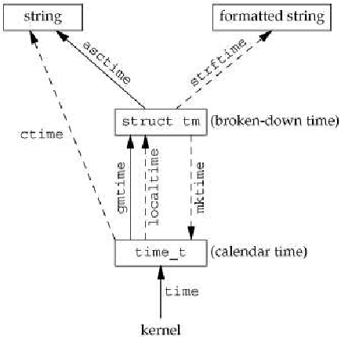
Advanced Programming in the UNIX Environment
Time and Date
Lecture 04: File Systems, System Data Files, Time & Date

Slide 55
Advanced Programming in the UNIX Environment
Time and Date
We can break this time t value into its components with either of the
following:
#include <time.h>
struct tm *gmtime(const time_t *calptr);
struct tm *localtime(const time_t *calptr);
Returns: pointer to broken down time
localtime(3) takes into account daylight savings time and the TZ
environment variable.
#include <time.h>
time_t mktime(struct tm *tmptr);
Returns: calendar time if OK, -1 on error
The mktime(3) function operates in the reverse direction.
Lecture 04: File Systems, System Data Files, Time & Date

Slide 56
Advanced Programming in the UNIX Environment
Time and Date
To output human readable results, use:
#include <time.h>
char *asctime(const struct tm *tmptr);
char *ctime(const struct tm *tmptr);
Returns: pointer to NULL terminated string
Lastly, there is a printf(3) like function for times:
#include <time.h>
size_t strftime(char *buf, size_t maxsize, const char *restricted format, const struct tm *timeptr);
Returns: number of characters stored in array if room, else 0
Lecture 04: File Systems, System Data Files, Time & Date

Slide 57
Advanced Programming in the UNIX Environment
Homework
Reading:
Stevens, Chapter 4 and 6
Falsehoods Programmers believe about time: http://is.gd/yFSYR0
Other:
Try to implement your idea using the functions learnt so far!
Lecture 04: File Systems, System Data Files, Time & Date

