Slide 1
Advanced Programming in the UNIX Environment
Advanced Programming in the UNIX
Environment
–
Process Environment, Process Control
Department of Software Engineering
International School of Software
Chen Gang
chenzuolin@whu.edu.cn
http://iss.whu.edu.cn/blog.html?author=chengang
Lecture 05: Process Environment, Process Control

Slide 2
Advanced Programming in the UNIX Environment
The main function
int main(int argc, char **argv);
Lecture 05: Process Environment, Process Control

Slide 3
Advanced Programming in the UNIX Environment
The main function
int main(int argc, char **argv);
C program started by kernel (by one of the exec functions)
special startup routine called by kernel which sets up things for main
(or whatever entrypoint is deﬁned)
argc is a count of the number of command line arguments (including
the command itself)
argv is an array of pointers to the arguments
it is guaranteed by both ANSI C and POSIX.1 that argv[argc] ==
NULL
Lecture 05: Process Environment, Process Control

Slide 4
Advanced Programming in the UNIX Environment
Process Creation
On Linux:
$ cc -Wall entry.c
$ readelf -h a.out | more
ELF Header:
[...]
Entry point address:
Start of program headers:
Start of section headers:
$ objdump -d a.out
[...]
0000000000400460 <_start>:
0x400460
64 (bytes into file)
4432 (bytes into file)
400460: 31 ed
400462: 49 89 d1
[...]
$
xor
mov
%ebp,%ebp
%rdx,%r9
Lecture 05: Process Environment, Process Control

Slide 5
Advanced Programming in the UNIX Environment
Process Creation
glibc/sysdeps/x86_64/start.S
0000000000401058 <_start>:
401058: 31 ed
40105a: 49 89 d1
40105d: 5e
40105e: 48 89 e2
401061: 48 83 e4 f0
401065: 50
401066: 54
xor
mov
pop
mov
and
push
push
%ebp,%ebp
%rdx,%r9
%rsi
%rsp,%rdx
$0xfffffffffffffff0,%rsp
%rax
%rsp
401067: 49 c7 c0 e0
40106e: 48 c7 c1 50
401075: 48 c7 c7 91
40107c: e8 2f 01 00
1a 40 00
1a 40 00
11 40 00
00
mov
mov
mov
callq
$0x401ae0,%r8
$0x401a50,%rcx
$0x401191,%rdi
4011b0 <__libc_start_main>
401081: f4
401082: 90
401083: 90
hlt
nop
nop
Lecture 05: Process Environment, Process Control

Slide 6
Advanced Programming in the UNIX Environment
Process Creation
glibc/csu/lic-start.c
STATIC int
LIBC_START_MAIN (int (*main) (int, char **, char ** MAIN_AUXVEC_DECL),
int argc, char **argv,
__typeof (main) init,
void (*fini) (void),
void (*rtld_fini) (void), void *stack_end)
{
[...]
result = main (argc, argv, __environ MAIN_AUXVEC_PARAM);
exit (result);
}
Lecture 05: Process Environment, Process Control

Slide 7
Advanced Programming in the UNIX Environment
Process Creation
On Linux:
$ cc -Wall entry.c
$ readelf -h a.out | more
ELF Header:
[...]
Entry point address:
Start of program headers:
Start of section headers:
$ objdump -d a.out
[...]
0000000000400460 <_start>:
0x400460
64 (bytes into file)
4432 (bytes into file)
400460: 31 ed
400462: 49 89 d1
[...]
$
xor
mov
%ebp,%ebp
%rdx,%r9
Lecture 05: Process Environment, Process Control

Slide 8
Advanced Programming in the UNIX Environment
Process Creation
On Linux:
$ cc -e foo entry.c
$ ./a.out
Foo for the win!
Memory fault
$ cc -e bar entry.c
$ ./a.out
bar rules!
$ echo $?
1
$ cc entry.c
$ ./a.out
Hooray main!
$ echo $?
13
$
Lecture 05: Process Environment, Process Control

Slide 9
Advanced Programming in the UNIX Environment
Process Termination
There are 8 ways for a process to terminate.
Normal termination:
return from main
calling exit
calling _exit (or _Exit)
return of last thread from its start routine
calling pthread_exit from last thread
Lecture 05: Process Environment, Process Control

Slide 10
Advanced Programming in the UNIX Environment
Process Termination
There are 8 ways for a process to terminate.
Normal termination:
return from main
calling exit
calling _exit (or _Exit)
return of last thread from its start routine
calling pthread_exit from last thread
Abnormal termination:
calling abort
terminated by a signal
response of the last thread to a cancellation request
Lecture 05: Process Environment, Process Control

Slide 11
Advanced Programming in the UNIX Environment
exit(3) and _exit(2)
#include <stdlib.h>
void exit(int status);
void _Exit(int status);
#include <unistd.h>
void _exit(int status);
_exit and _Exit
return to the kernel immediately
_exit required by POSIX.1
_Exit required by ISO C99
synonymous on Unix
exit does some cleanup and then returns
both take integer argument, aka exit status
Lecture 05: Process Environment, Process Control

Slide 12

Advanced Programming in the UNIX Environment
atexit(3)
#include <stdlib.h>
int atexit(void (*func)(void));
Registers a function with a signature of void funcname(void) to be
called at exit
Functions invoked in reverse order of registration
Same function can be registered more than once
Extremely useful for cleaning up open ﬁles, freeing certain resources,
etc.
exit-handlers.c
Lecture 05: Process Environment, Process Control

Slide 13
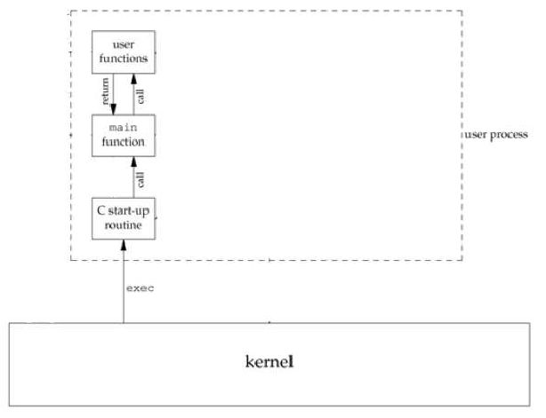
Advanced Programming in the UNIX Environment
Lifetime of a UNIX Process
Lecture 05: Process Environment, Process Control

Slide 14
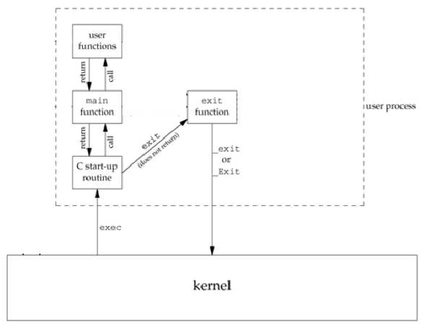
Advanced Programming in the UNIX Environment
Lifetime of a UNIX Process
Lecture 05: Process Environment, Process Control

Slide 15
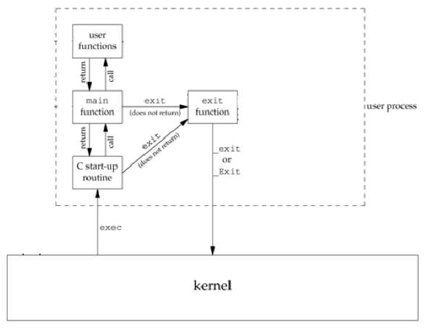
Advanced Programming in the UNIX Environment
Lifetime of a UNIX Process
Lecture 05: Process Environment, Process Control

Slide 16
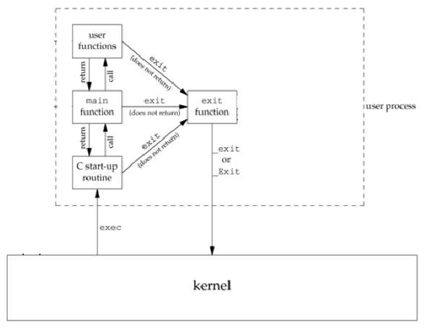
Advanced Programming in the UNIX Environment
Lifetime of a UNIX Process
Lecture 05: Process Environment, Process Control

Slide 17
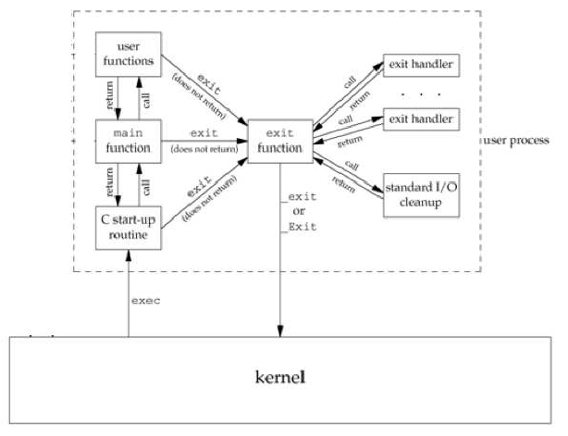
Advanced Programming in the UNIX Environment
Lifetime of a UNIX Process
Lecture 05: Process Environment, Process Control

Slide 18
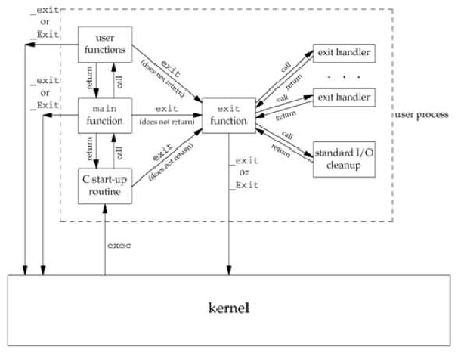
Advanced Programming in the UNIX Environment
Lifetime of a UNIX Process
Lecture 05: Process Environment, Process Control

Slide 19
Advanced Programming in the UNIX Environment
Exit codes
$ cc -Wall hw.c
hw.c: In function ’main’:
hw.c:7: warning: control reaches end of non-void function
$ ./a.out
Hello World!
$ echo $?
13
$
Lecture 05: Process Environment, Process Control

Slide 20
Advanced Programming in the UNIX Environment
Exit codes
$ cc -Wall hw.c
hw.c: In function ’main’:
hw.c:7: warning: control reaches end of non-void function
$ ./a.out
Hello World!
$ echo $?
10
$ cc -Wall --std=c99 hw.c
$ ./a.out
Hello World!
$ echo $?
0
$
Lecture 05: Process Environment, Process Control

Slide 21

Advanced Programming in the UNIX Environment
Environment List
Environment variables are stored in a global array of pointers:
extern char **environ;
The list is null terminated.
These can also be accessed by:
#include <stdlib.h>
char *getenv(const char *name);
int putenv(const char *string);
int setenv(const char *name, const char *value, int rewrite);
void unsetenv(cont char *name);
Lecture 05: Process Environment, Process Control

Slide 22
Advanced Programming in the UNIX Environment
Environment List
Environment variables are stored in a global array of pointers:
extern char **environ;
The list is null terminated.
These can also be accessed by:
#include <stdlib.h>
char *getenv(const char *name);
int putenv(const char *string);
int setenv(const char *name, const char *value, int rewrite);
void unsetenv(cont char *name);
int main(int argc, char **argv, char **anvp);
Lecture 05: Process Environment, Process Control

Slide 23
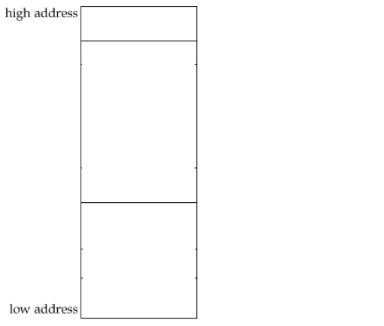
Advanced Programming in the UNIX Environment
Memory Layout of a C Program
Lecture 05: Process Environment, Process Control

Slide 24
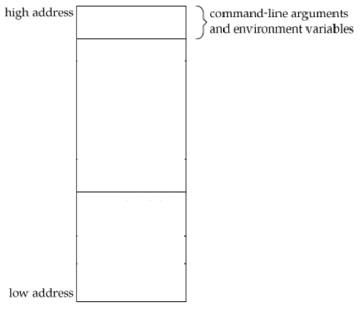
Advanced Programming in the UNIX Environment
Memory Layout of a C Program
Lecture 05: Process Environment, Process Control

Slide 25
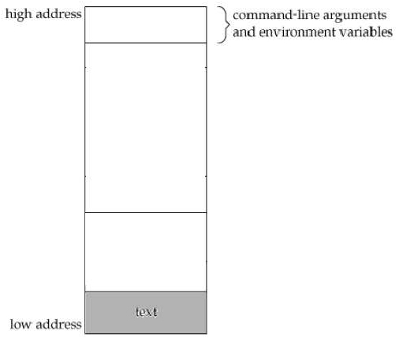
Advanced Programming in the UNIX Environment
Memory Layout of a C Program
Lecture 05: Process Environment, Process Control

Slide 26
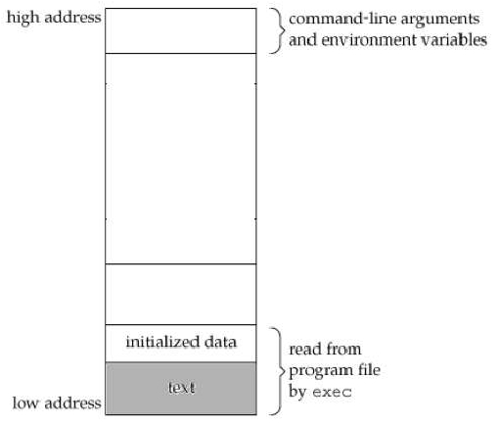
Advanced Programming in the UNIX Environment
Memory Layout of a C Program
Lecture 05: Process Environment, Process Control

Slide 27
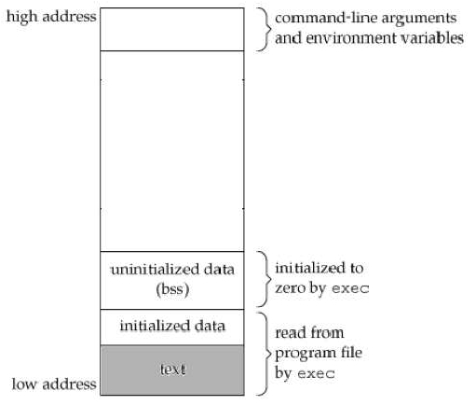
Advanced Programming in the UNIX Environment
Memory Layout of a C Program
Lecture 05: Process Environment, Process Control

Slide 28
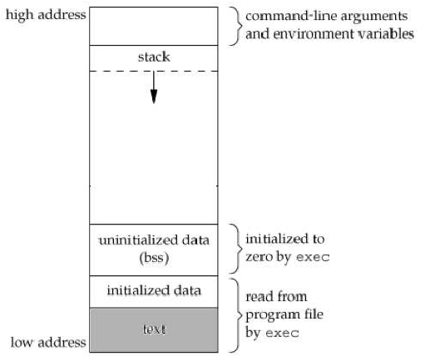
Advanced Programming in the UNIX Environment
Memory Layout of a C Program
Lecture 05: Process Environment, Process Control

Slide 29
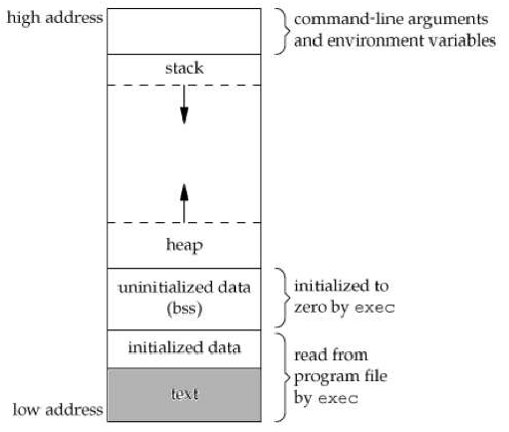
Advanced Programming in the UNIX Environment
Memory Layout of a C Program
Lecture 05: Process Environment, Process Control

Slide 30
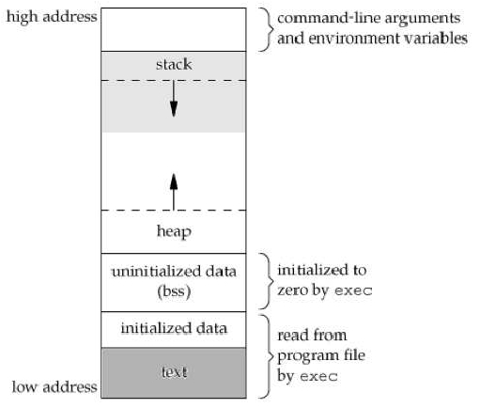
Advanced Programming in the UNIX Environment
Memory Layout of a C Program
Lecture 05: Process Environment, Process Control

Slide 31
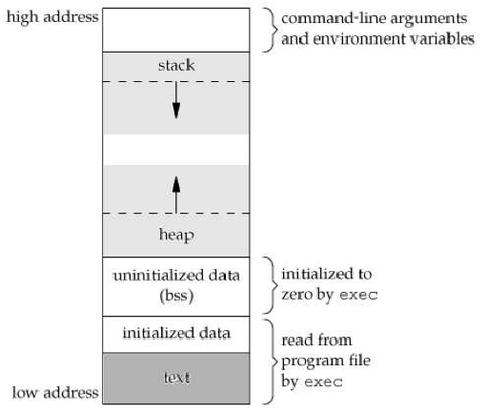
Advanced Programming in the UNIX Environment
Memory Layout of a C Program
Lecture 05: Process Environment, Process Control

Slide 32
Advanced Programming in the UNIX Environment
Memory Layout of a C Program
On NetBSD:
$ cc hw.c
$ file a.out
a.out: ELF 64-bit LSB executable, x86-64, version 1 (SYSV), dynamically
linked (uses shared libs), for NetBSD 5.0, not stripped
$ ldd a.out
a.out:
-lc.12 => /usr/lib/libc.so.12
$ size a.out
text data bss dec hex filename
2301 552 120 2973 b9d a.out
$ objdump -d a.out > obj
$ wc -l obj
271 obj
$
Lecture 05: Process Environment, Process Control

Slide 33
Advanced Programming in the UNIX Environment
Memory Layout of a C Program
On Mac OS X:
$ cc hw.c
$ file a.out
a.out: Mach-O 64-bit executable x86_64
$ otool -L a.out
a.out:
/usr/lib/libSystem.B.dylib (compatibility version 1.0.0,
current version 125.2.11)
$ size a.out
__TEXT __DATA __OBJC others dec hex
4096 4096 0 4294971392 4294979584 100003000
$ otool -t -v a.out > obj
$ wc -l obj
32 obj
$
Lecture 05: Process Environment, Process Control

Slide 34
Advanced Programming in the UNIX Environment
Memory Layout of a C Program
On Linux:
$ cc hw.c
$ file a.out
a.out: ELF 32-bit LSB executable, Intel 80386, version 1 (SYSV),
dynamically linked (uses shared libs), for GNU/Linux 2.6.15, not stripped
$ ldd a.out
linux-gate.so.1 => (0x00c66000)
libc.so.6 => /lib/tls/i686/cmov/libc.so.6 (0x006b4000)
/lib/ld-linux.so.2 (0x005fe000)
$ size a.out
text data bss dec hex filename
918 264 8 1190 4a6 a.out
$ objdump -d a.out >obj
$ wc -l obj
225 obj
$
Lecture 05: Process Environment, Process Control

Slide 35
Advanced Programming in the UNIX Environment
Memory Layout of a C Program
On NetBSD:
$ cc -static hw.c
$ file a.out
a.out: ELF 64-bit LSB executable, x86-64, version 1 (SYSV), statically
linked, for NetBSD 5.0, not stripped
$ ldd a.out
ldd: a.out: unrecognized file format2 [2 != 1]
$ size a.out
text data bss dec hex filename
151877 4416 16384 172677 2a285 a.out
$ size a.out.dyn
text data bss dec hex filename
2301 552 120 2973 b9d a.out
$ objdump -d a.out > obj
$ wc -l obj
35029 obj
$
Lecture 05: Process Environment, Process Control

Slide 36
Advanced Programming in the UNIX Environment
Memory Layout of a C Program
On Mac OS X:
$ cc -static hw.c
ld: library not found for -lcrt0.o
collect2: ld returned 1 exit status
$
Lecture 05: Process Environment, Process Control

Slide 37
Advanced Programming in the UNIX Environment
Memory Layout of a C Program
On Linux:
$ cc -static hw.c
$ file a.out
a.out: ELF 32-bit LSB executable, Intel 80386, version 1 (SYSV),
statically linked, for GNU/Linux 2.6.15, not stripped
$ ldd a.out
/usr/bin/ldd: line 161: /lib64/ld-linux-x86-64.so.2: cannot execute binary file
not a dynamic executable
$ size a.out
text data bss dec hex filename
510786 1928 7052 519766 7ee56 a.out
$ objdump -d a.out >obj
$ wc -l obj
114420 obj
$
Lecture 05: Process Environment, Process Control

Slide 38
Advanced Programming in the UNIX Environment
Memory Allocation
#include <stdlib.h>
void *malloc(size_t size);
void *calloc(size_t nobj, size_t size);
void *realloc(void *ptr, size_t newsize);
void *alloca(size_t size);
void free(void *ptr);
malloc – initial value is indeterminate.
calloc – initial value set to all zeros.
realloc – changes size of previously allocated area. Initial value of
any additional space is indeterminate.
alloca – allocates memory on stack
Lecture 05: Process Environment, Process Control

Slide 39
Advanced Programming in the UNIX Environment
Memory Allocation
#include <stdlib.h>
void
void
void
void
*malloc(size_t size);
*calloc(size_t nobj, size t size);
*realloc(void *ptr, size_t newsize);
*alloca(size_t size);
void free(void *ptr);
malloc – initial value is indeterminate.
calloc – initial value set to all zeros.
realloc – changes size of previously allocated area. Initial value of
any additional space is indeterminate.
alloca – allocates memory on stack
Knowing this, how does manipulation of the environment work?
Lecture 05: Process Environment, Process Control

Slide 40
Advanced Programming in the UNIX Environment
Process limits
$ ulimit -a
time(cpu-seconds)
file(blocks)
coredump(blocks)
data(kbytes)
stack(kbytes)
lockedmem(kbytes)
memory(kbytes)
nofiles(descriptors)
processes
vmemory(kbytes)
sbsize(bytes)
$
unlimited
unlimited
unlimited
262144
2048
249913
749740
128
160
unlimited
unlimited
Lecture 05: Process Environment, Process Control

Slide 41

Advanced Programming in the UNIX Environment
getrlimit(2) and setrlimit(2)
#include <sys/resource.h>
int getrlimit(int resouce, struct rlimit *rlp);
int setrlimit(int resouce, const struct rlimit *rlp);
Changing resource limits follows these rules:
a soft limit can be changed by any process to a value less than or
equal to its hard limit
any process can lower its hard limit greater than or equal to its soft
limit
only superuser can raise hard limits
changes are per process only
Lecture 05: Process Environment, Process Control

Slide 42
Advanced Programming in the UNIX Environment
getrlimit(2) and setrlimit(2)
#include <sys/resource.h>
int getrlimit(int resouce, struct rlimit *rlp);
int setrlimit(int resouce, const struct rlimit *rlp);
Changing resource limits follows these rules:
a soft limit can be changed by any process to a value less than or
equal to its hard limit
any process can lower its hard limit greater than or equal to its soft
limit
only superuser can raise hard limits
changes are per process only (which is why ulimit is a shell built-in)
Lecture 05: Process Environment, Process Control

Slide 43
Advanced Programming in the UNIX Environment
Process Control
Review from our ﬁrst class, the world’s simplest shell:
int
main(int argc, char **argv)
{
char buf[1024];
pid_t pid;
int status;
while (getinput(buf, sizeof(buf))) {
buf[strlen(buf) - 1] = ’\0’;
if((pid=fork()) == -1) {
fprintf(stderr, "shell: can’t fork: %s\n",
strerror(errno));
continue;
} else if (pid == 0) {
/* child */
execlp(buf, buf, (char *)0);
fprintf(stderr, "shell: couldn’t exec %s: %s\n", buf,
strerror(errno));
exit(EX_DATAERR);
}
if ((pid=waitpid(pid, &status, 0)) < 0)
fprintf(stderr, "shell: waitpid error: %s\n",
strerror(errno));
}
exit(EX_OK);
}
Lecture 05: Process Environment, Process Control

Slide 44
Advanced Programming in the UNIX Environment
Process Identiﬁers
#include <unistd.h>
pid_t getpid(void);
pid_t getppid(void);
Process ID’s are guaranteed to be unique and identify a particular
executing process with a non-negative integer.
Certain processes have ﬁxed, special identiﬁers. They are:
swapper, process ID 0 – responsible for scheduling
init, process ID 1 – bootstraps a Unix system, owns orphaned
processes
pagedaemon, process ID 2 – responsible for the VM system (some
Unix systems)
Lecture 05: Process Environment, Process Control

Slide 45
Advanced Programming in the UNIX Environment
fork(2)
#include <unistd.h>
pid_t fork(void);
fork(2) causes creation of a new process. The new process (child
process) is an exact copy of the calling process (parent process) except
for the following:
The child process has a unique process ID.
The child process has a different parent process ID (i.e., the process
ID of the parent process).
The child process has its own copy of the parent’s descriptors.
The child process’ resource utilizations are set to 0.
Note: no order of execution between child and parent is guaranteed!
Lecture 05: Process Environment, Process Control

Slide 46
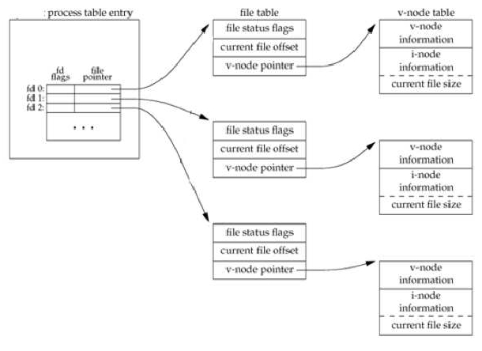
Advanced Programming in the UNIX Environment
fork(2)
Lecture 05: Process Environment, Process Control

Slide 47
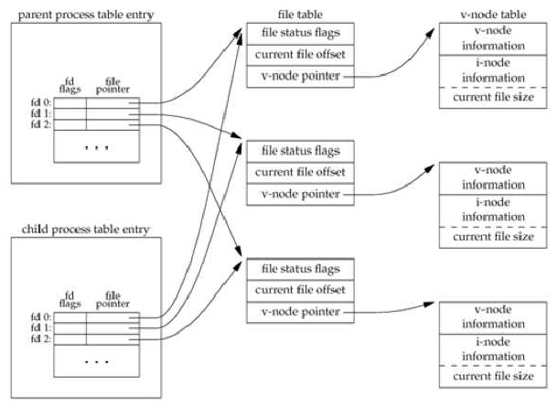
Advanced Programming in the UNIX Environment
fork(2)
Lecture 05: Process Environment, Process Control

Slide 48
Advanced Programming in the UNIX Environment
fork(2)
$ cc -Wall forkflush.c
$ ./a.out
a write to stdout
before fork
pid = 12149, glob = 7, var = 89
pid = 12148, glob = 6, var = 88
$ ./a.out | cat
a write to stdout
before fork
pid = 12153, glob = 7, var = 89
before fork
pid = 12151, glob = 6, var = 88
$
Lecture 05: Process Environment, Process Control

Slide 49

Advanced Programming in the UNIX Environment
The exec(3) functions
#include <unistd.h>
int execl(const char *pathname, const char *arg0, ...
int execv(const char *pathname, char * const argvp[]);
int execle(const char *pathname, const char *arg0, ...
/* (char *) 0 */);
/* (char *) 0, char *const envp[] */ );
int execve(const char *pathname, char * const argvp[], char * const envp[]);
int execlp(const char *filename, const char *arg0, ...
/* (char *) 0 */);
int execvp(const char *filename, char *const argv[]);
The exec() family of functions are used to completely replace a running
process with a a new executable.
if it has a v in its name, argv’s are a vector: const * char argv[]
if it has an l in its name, argv’s are a list: const char *arg0, ...
/* (char *) 0 */
if it has an e in its name, it takes a char * const envp[] array of
environment variables
if it has a p in its name, it uses the PATH environment variable to
search for the ﬁle
Lecture 05: Process Environment, Process Control

Slide 50
Advanced Programming in the UNIX Environment
wait(2) and waitpid(2)
#include <sys/types.h>
#include <sys/wait.h>
pid_t
pid_t
pid_t
pid_t
wait(int *status);
waitpid(pid_t wpid, int *status, int options);
wait3(int *status, int options, struct rusage *rusage);
wait4(pid_t wpid, int *status, int options, struct rusage *rusage);
A parent that calls wait(2) or waitpid(2) can:
block (if all of its children are still running)
return immediately with the termination status of a child
return immediately with an error
Lecture 05: Process Environment, Process Control

Slide 51
Advanced Programming in the UNIX Environment
wait(2) and waitpid(2)
Differences between wait(2), wait3(2), wait4(2) and waitpid(2):
wait(2) will block until the process terminates, waitpid(2) has an
option to prevent it from blocking
waitpid(2) can wait for a speciﬁc process to ﬁnish
wait3(2) and wait4(2) allow you to get detailed resource utilization
statistics
wait3(2) is the same as wait4(2) with a wpid value of -1
Lecture 05: Process Environment, Process Control

Slide 52
Advanced Programming in the UNIX Environment
wait(2) and waitpid(2)
Once we get a termination status back in status, we’d like to be able to
determined how a child died. We do this with the following macros:
WIFEXITED(status) – true if the child terminated normally. Then
execute WEXITSTATUS(status) to get the exit status.
WIFSIGNALED(status) – true if child terminated abnormally (by
receiving a signal it didn’t catch). The we call:
WTERMSIG(status) to retrieve the signal number
WCOREDUMP(status) to see if the child left a core image
WIFSTOPPED(status) – true if the child is currently stopped. Call
WSTOPSIG(status) to determine the signal that caused this.
Additionally, waitpid’s behavior can be modiﬁed by supplying WNOHANG as
an option, which says that if the requested pid has not terminated, return
immediately instead of blocking.
Lecture 05: Process Environment, Process Control

Slide 53
Advanced Programming in the UNIX Environment
What if we don’t wait(2)?
Lecture 05: Process Environment, Process Control

Slide 54

Advanced Programming in the UNIX Environment
What if we don’t wait(2)?
Lecture 05: Process Environment, Process Control

Slide 55
Advanced Programming in the UNIX Environment
What if we don’t wait(2)?
$ cc -Wall zombies.c
$ ./a.out
Let’s create some zombies!
====
15603 s003 S+ 0:00.00
15604 s003 Z+ 0:00.00
====
15603 s003 S+ 0:00.00
15604 s003 Z+ 0:00.00
15608 s003 Z+ 0:00.00
====
15603 s003 S+ 0:00.00
15604 s003 Z+ 0:00.00
15612 s003 Z+ 0:00.00
====
15603 s003 S+ 0:00.00
15604 s003 Z+ 0:00.00
15612 s003 Z+ 0:00.00
15616 s003 Z+ 0:00.00
./a.out
(a.out)
./a.out
(a.out)
(a.out)
./a.out
(a.out)
(a.out)
./a.out
(a.out)
(a.out)
(a.out)
Lecture 05: Process Environment, Process Control

Slide 56
Advanced Programming in the UNIX Environment
Notes and Homework
Reading:
Stevens, Chapter 7 and 8
Other:
work on your midterm project!
Lecture 05: Process Environment, Process Control

