Slide 1
Advanced Programming in the UNIX Environment
Advanced Programming in the UNIX
Environment
–
Process Groups, Sessions, Signals
Department of Software Engineering
International School of Software
Chen Gang
chenzuolin@whu.edu.cn
http://iss.whu.edu.cn/blog.html?author=chengang
Lecture 06: Process Groups, Sessions, Signals

Slide 2
Advanced Programming in the UNIX Environment
Login Process
Let’s revisit the process relationships for a login:
kernel ⇒ init(8) # explicit creation
Lecture 06: Process Groups, Sessions, Signals

Slide 3
Advanced Programming in the UNIX Environment
Login Process
Let’s revisit the process relationships for a login:
kernel ⇒ init(8)
# explicit creation
init(8) ⇒ getty(8) # fork(2)
Lecture 06: Process Groups, Sessions, Signals

Slide 4
Advanced Programming in the UNIX Environment
Login Process
Let’s revisit the process relationships for a login:
kernel
⇒ init(8)
# explicit creation
init(8)
⇒ getty(8) # fork(2)
getty(8) ⇒ login(1) # exec(3)
Lecture 06: Process Groups, Sessions, Signals

Slide 5
Advanced Programming in the UNIX Environment
Login Process
Let’s revisit the process relationships for a login:
kernel
⇒ init(8)
# explicit creation
init(8)
⇒ getty(8) # fork(2)
getty(8) ⇒ login(1) # exec(3)
login(1) ⇒ $SHELL # exec(3)
Lecture 06: Process Groups, Sessions, Signals

Slide 6
Advanced Programming in the UNIX Environment
Login Process
Let’s revisit the process relationships for a login:
kernel
⇒ init(8)
# explicit creation
init(8)
⇒ getty(8) # fork(2)
getty(8) ⇒ login(1) # exec(3)
login(1) ⇒ $SHELL # exec(3)
$SHELL ⇒ ls(1)
# fork(2) + exec(3)
Lecture 06: Process Groups, Sessions, Signals

Slide 7
Advanced Programming in the UNIX Environment
Login Process
init(8) # PID 1, PPID 0, EUID 0
Lecture 06: Process Groups, Sessions, Signals

Slide 8
Advanced Programming in the UNIX Environment
Login Process
init(8)
# PID 1, PPID 0, EUID 0
getty(8) # PID N, PPID 1, EUID 0
Lecture 06: Process Groups, Sessions, Signals

Slide 9
Advanced Programming in the UNIX Environment
Login Process
init(8)
# PID 1, PPID 0, EUID 0
getty(8) # PID N, PPID 1, EUID 0
login(1) # PID N, PPID 1, EUID 0
Lecture 06: Process Groups, Sessions, Signals

Slide 10
Advanced Programming in the UNIX Environment
Login Process
init(8)
# PID 1, PPID 0, EUID 0
getty(8) # PID N, PPID 1, EUID 0
login(1) # PID N, PPID 1, EUID 0
$SHELL # PID N, PPID 1, EUID U
Lecture 06: Process Groups, Sessions, Signals

Slide 11
Advanced Programming in the UNIX Environment
Login Process
init(8)
# PID 1, PPID 0, EUID 0
getty(8) # PID N, PPID 1, EUID 0
login(1) # PID N, PPID 1, EUID 0
$SHELL
ls(1)
# PID N, PPID 1, EUID U
# PID M, PPID N, EUID U
pstree -hapun | more
Lecture 06: Process Groups, Sessions, Signals

Slide 12
Advanced Programming in the UNIX Environment
Login Process
init(8)
reads /etc/ttys
Lecture 06: Process Groups, Sessions, Signals

Slide 13
Advanced Programming in the UNIX Environment
Login Process
init(8)
reads /etc/ttys
getty(8)
opens terminal
prints “login: ”
reads username
Lecture 06: Process Groups, Sessions, Signals

Slide 14
Advanced Programming in the UNIX Environment
Login Process
init(8)
reads /etc/ttys
getty(8)
opens terminal
prints “login: ”
reads username
login(1)
getpass(3), encrypt, compare to getpwnam(3)
Lecture 06: Process Groups, Sessions, Signals

Slide 15
Advanced Programming in the UNIX Environment
Login Process
init(8)
reads /etc/ttys
getty(8)
opens terminal
prints “login: ”
reads username
login(1)
getpass(3), encrypt, compare to getpwnam(3)
register login in system databases
Lecture 06: Process Groups, Sessions, Signals

Slide 16
Advanced Programming in the UNIX Environment
Login Process
init(8)
reads /etc/ttys
getty(8)
opens terminal
prints “login: ”
reads username
login(1)
getpass(3), encrypt, compare to getpwnam(3)
register login in system databases
read/display various ﬁles
Lecture 06: Process Groups, Sessions, Signals

Slide 17
Advanced Programming in the UNIX Environment
Login Process
init(8)
reads /etc/ttys
getty(8)
opens terminal
prints “login: ”
reads username
login(1)
getpass(3), encrypt, compare to getpwnam(3)
register login in system databases
read/display various ﬁles
initgroups(3)/setgid(2), initialize environment
Lecture 06: Process Groups, Sessions, Signals

Slide 18
Advanced Programming in the UNIX Environment
Login Process
init(8)
reads /etc/ttys
getty(8)
opens terminal
prints “login: ”
reads username
login(1)
getpass(3), encrypt, compare to getpwnam(3)
register login in system databases
read/display various ﬁles
initgroups(3)/setgid(2), initialize environment
chown(2) terminal device
Lecture 06: Process Groups, Sessions, Signals

Slide 19
Advanced Programming in the UNIX Environment
Login Process
init(8)
reads /etc/ttys
getty(8)
opens terminal
prints “login: ”
reads username
login(1)
getpass(3), encrypt, compare to getpwnam(3)
register login in system databases
read/display various ﬁles
initgroups(3)/setgid(2), initialize environment
chown(2) terminal device
chdir(2) to new home directory
Lecture 06: Process Groups, Sessions, Signals

Slide 20
Advanced Programming in the UNIX Environment
Login Process
init(8)
reads /etc/ttys
getty(8)
opens terminal
prints “login: ”
reads username
login(1)
getpass(3), encrypt, compare to getpwnam(3)
register login in system databases
read/display various ﬁles
initgroups(3)/setgid(2), initialize environment
chdir(2) to new home directory
chown(2) terminal device
setuid(2) to user’s uid, exec(3) shell
Lecture 06: Process Groups, Sessions, Signals

Slide 21
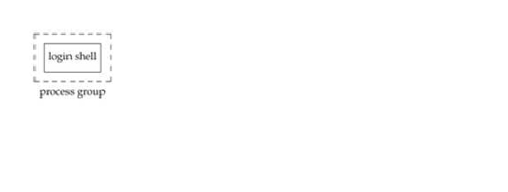
Advanced Programming in the UNIX Environment
Process Groups
init ⇒ login shell
$
Lecture 06: Process Groups, Sessions, Signals

Slide 22
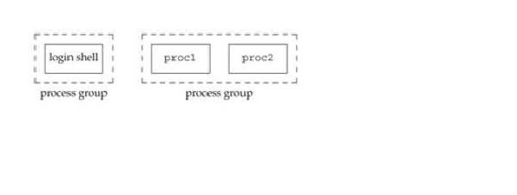
Advanced Programming in the UNIX Environment
Process Groups
init ⇒ login shell
$ proc1 | proc2 &
[1] 10306
$
Lecture 06: Process Groups, Sessions, Signals

Slide 23
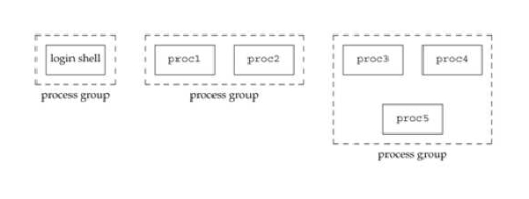
Advanced Programming in the UNIX Environment
Process Groups
init ⇒ login shell
$ proc1 | proc2 &
[1] 10306
$ proc3 | proc4 | proc5
Lecture 06: Process Groups, Sessions, Signals

Slide 24

Advanced Programming in the UNIX Environment
Process Groups
#include <unistd.h>
pid_t getpgrp(void);
pid_t getpgid(pid_t pid);
Returns: process group ID if OK, -1 otherwise
in addition to having a PID, each process also belongs to a process
group (collection of processes assocaited with the same job /
terminal)
each process group has a unique process group ID
process group IDs (like PIDs) are positive integers and can be stored
in a pid_t data type
each process group can have a process group leader
leader identiﬁed by its process group ID == PID
leader can create a new process group, create processes in the
group
a process can set its (or its children’s) process group using
setpgid(2)
Lecture 06: Process Groups, Sessions, Signals

Slide 25
Advanced Programming in the UNIX Environment
Process Groups and Sessions
#include <unistd.h>
pid_t setsid(void);
Returns: process group ID if OK, -1 otherwise
A session is a collection of one or more process groups.
If the calling process is not a process group leader, this function creates
a new session. Three things happen:
the process becomes the session leader of this new session
the process becomes the process group leader of a new process
group
the process has no controlling terminal
Lecture 06: Process Groups, Sessions, Signals

Slide 26
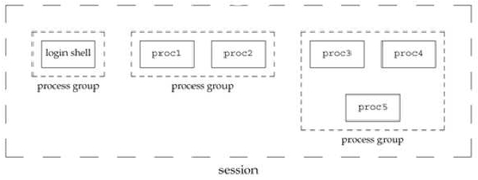
Advanced Programming in the UNIX Environment
Process Groups
init ⇒ login shell
$ proc1 | proc2 &
[1] 10306
$ proc3 | proc4 | proc5
Lecture 06: Process Groups, Sessions, Signals

Slide 27
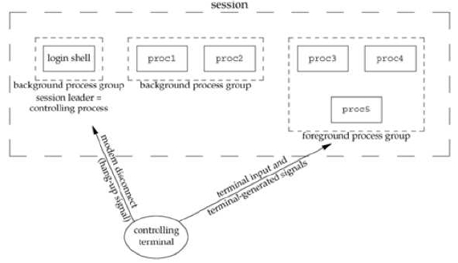
Advanced Programming in the UNIX Environment
Process Groups and Sessions
init ⇒ login shell
$ proc1 | proc2 &
[1] 10306
$ proc3 | proc4 | proc5
Lecture 06: Process Groups, Sessions, Signals

Slide 28
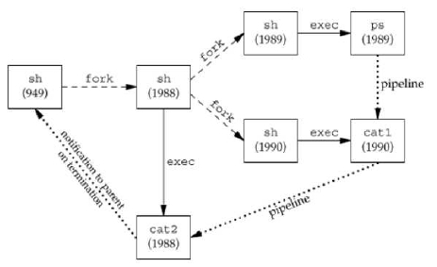
Advanced Programming in the UNIX Environment
Process Groups and Sessions
$ ps -o pid,ppid,pgid,sess,comm | ./cat1 | ./cat2
PID PPID PGRP SESS COMMAND
1989 949 7736 949 ps
1990 949 7736 949 cat1
1988 949 7736 949 cat2
949 21401 949 949 ksh
Lecture 06: Process Groups, Sessions, Signals

Slide 29
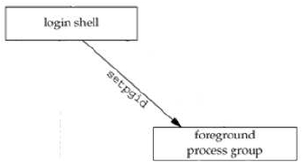
Advanced Programming in the UNIX Environment
Job Control
$ ps -o pid,ppid,pgid,sess,comm
PID PPID PGRP SESS COMMAND
24251 24250 24251 24251 ksh
24620 24251 24620 24251 ps
$
Lecture 06: Process Groups, Sessions, Signals

Slide 30
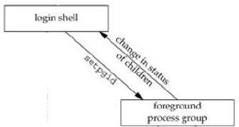
Advanced Programming in the UNIX Environment
Job Control
$ ps -o pid,ppid,pgid,sess,comm
PID PPID PGRP SESS COMMAND
24251 24250 24251 24251 ksh
24620 24251 24620 24251 ps
$ echo $?
0
$
Lecture 06: Process Groups, Sessions, Signals

Slide 31
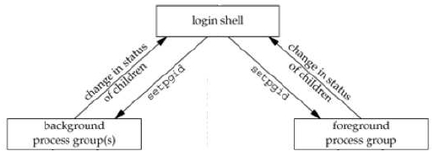
Advanced Programming in the UNIX Environment
Job Control
$ dd if=/dev/zero of=/dev/null bs=512 count=2048000 >/dev/null 2>&1 &
[1] 24748
$ ps -o pid,ppid,pgid,sess,comm
PID PPID PGRP SESS COMMAND
24251 24250 24251 24251 ksh
24748 24251 24748 24251 dd
24750 24251 24750 24251 ps
$
[1] + Done dd if=/dev/zero of=/dev/null bs=512 count=2048000 >/dev/null 2>&1 &
$
Lecture 06: Process Groups, Sessions, Signals

Slide 32
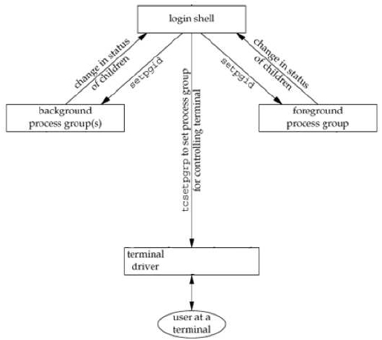
Advanced Programming in the UNIX Environment
Job Control
Lecture 06: Process Groups, Sessions, Signals

Slide 33
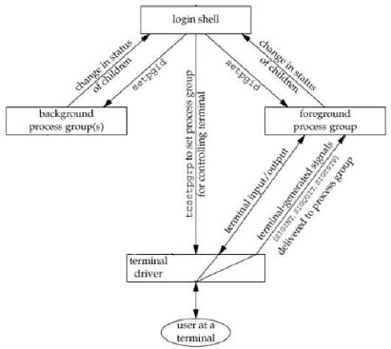
Advanced Programming in the UNIX Environment
Job Control
$ cat >file
Input from terminal,
Output to terminal.
^D
$ cat file
Input from terminal,
Output to terminal.
$ cat >/dev/null
Input from terminal,
Output to /dev/null.
Waiting forever...
Or until we send an interrupt signal.
^C
$
Lecture 06: Process Groups, Sessions, Signals

Slide 34
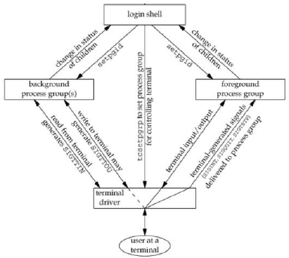
Advanced Programming in the UNIX Environment
Job Control
$ cat file &
[1] 2056
$ Input from terminal,
Output to terminal.
[1] + Done
$ stty tostop
$ cat file &
[1] 4655
$
[1] + Stopped(SIGTTOU)
$ fg
cat file
Input from terminal,
Output to terminal.
$
cat file &
cat file &
Lecture 06: Process Groups, Sessions, Signals

Slide 35

Advanced Programming in the UNIX Environment
Signals
Lecture 06: Process Groups, Sessions, Signals

Slide 36
Advanced Programming in the UNIX Environment
Signal Concepts
Signals are a way for a process to be notiﬁed of asynchronous events.
Some examples:
a timer you set has gone off (SIGALRM)
some I/O you requested has occurred (SIGIO)
a user resized the terminal ”window” (SIGWINCH)
a user disconnected from the system (SIGHUP)
...
See also: signal(2)/signal(3)/signal(7) (note: these man pages
vary signiﬁcantly across platforms!)
Lecture 06: Process Groups, Sessions, Signals

Slide 37
Advanced Programming in the UNIX Environment
Signal Concepts
Besides the asynchronous events listed previously, there are many ways
to generate a signal:
terminal generated signals (user presses a key combination which
causes the terminal driver to generate a signal)
Lecture 06: Process Groups, Sessions, Signals

Slide 38
Advanced Programming in the UNIX Environment
Signal Concepts
Besides the asynchronous events listed previously, there are many ways
to generate a signal:
terminal generated signals (user presses a key combination which
causes the terminal driver to generate a signal)
hardware exceptions (divide by 0, invalid memory references, etc)
Lecture 06: Process Groups, Sessions, Signals

Slide 39
Advanced Programming in the UNIX Environment
Signal Concepts
Besides the asynchronous events listed previously, there are many ways
to generate a signal:
terminal generated signals (user presses a key combination which
causes the terminal driver to generate a signal)
hardware exceptions (divide by 0, invalid memory references, etc)
kill(1) allows a user to send any signal to any process (if the user
is the owner or superuser)
Lecture 06: Process Groups, Sessions, Signals

Slide 40
Advanced Programming in the UNIX Environment
Signal Concepts
Besides the asynchronous events listed previously, there are many ways
to generate a signal:
terminal generated signals (user presses a key combination which
causes the terminal driver to generate a signal)
hardware exceptions (divide by 0, invalid memory references, etc)
kill(1) allows a user to send any signal to any process (if the user
is the owner or superuser)
kill(2) (a system call, not the unix command) performs the same
task
Lecture 06: Process Groups, Sessions, Signals

Slide 41
Advanced Programming in the UNIX Environment
Signal Concepts
Besides the asynchronous events listed previously, there are many ways
to generate a signal:
terminal generated signals (user presses a key combination which
causes the terminal driver to generate a signal)
hardware exceptions (divide by 0, invalid memory references, etc)
kill(1) allows a user to send any signal to any process (if the user
is the owner or superuser)
kill(2) (a system call, not the unix command) performs the same
task
software conditions (other side of a pipe no longer exists, urgent data
has arrived on a network ﬁle descriptor, etc.)
Lecture 06: Process Groups, Sessions, Signals

Slide 42
Advanced Programming in the UNIX Environment
kill(2) and raise(3)
#include <sys/types.h>
#include <signal.h>
int kill(pid_t pid, int signo);
int raise(int signo);
pid > 0 – signal is sent to the process whose PID is pid
pid == 0 – signal is sent to all processes whose process group ID
equals the process group ID of the sender
pid == -1 – POSIX.1 leaves this undeﬁned, BSD deﬁnes it (see
kill(2))
Lecture 06: Process Groups, Sessions, Signals

Slide 43
Advanced Programming in the UNIX Environment
Signal Concepts
Once we get a signal, we can do one of several things:
Ignore it. (note: there are some signals which we CANNOT or
SHOULD NOT ignore)
Lecture 06: Process Groups, Sessions, Signals

Slide 44
Advanced Programming in the UNIX Environment
Signal Concepts
Once we get a signal, we can do one of several things:
Ignore it. (note: there are some signals which we CANNOT or
SHOULD NOT ignore)
Catch it. That is, have the kernel call a function which we deﬁne
whenever the signal occurs.
Lecture 06: Process Groups, Sessions, Signals

Slide 45
Advanced Programming in the UNIX Environment
Signal Concepts
Once we get a signal, we can do one of several things:
Ignore it. (note: there are some signals which we CANNOT or
SHOULD NOT ignore)
Catch it. That is, have the kernel call a function which we deﬁne
whenever the signal occurs.
Accept the default. Have the kernel do whatever is deﬁned as the
default action for this signal
Lecture 06: Process Groups, Sessions, Signals

Slide 46
Advanced Programming in the UNIX Environment
Signal Concepts
$ cc -Wall ../01-intro/simple-shell.c
$ ./a.out
$$ ^C
$ echo $?
130
$ cc -Wall ../01-intro/simple-shell2.c
$ ./a.out
$$ ^C
Caught SIGINT!
$$
Lecture 06: Process Groups, Sessions, Signals

Slide 47
Advanced Programming in the UNIX Environment
signal(3)
#include <signal.h>
void (*signal(int signo, void (*func)(int)))(int);
Returns: previous disposition of signal if OK, SIG_ERR otherwise
Lecture 06: Process Groups, Sessions, Signals

Slide 48
Advanced Programming in the UNIX Environment
signal(3)
#include <signal.h>
void (*signal(int signo, void (*func)(int)))(int);
Returns: previous disposition of signal if OK, SIG_ERR otherwise
func can be:
SIG_IGN which requests that we ignore the signal signo
SIG_DFL which requests that we accept the default action for signal
signo
or the address of a function which should catch or handle a signal
Lecture 06: Process Groups, Sessions, Signals

Slide 49
Advanced Programming in the UNIX Environment
Signal Examples
$ cc -Wall siguser.c
$ ./a.out
^Z
$ bg
$ ps | grep a.ou[t]
11106 ttys002 0:00.00 ./a.out
$ kill -USR1 11106
received SIGUSR1
$ kill -USR2 11106
received SIGUSR2
$ kill -INT 11106
$
[2]- Interrupt ./a.out
$
Lecture 06: Process Groups, Sessions, Signals

Slide 50
Advanced Programming in the UNIX Environment
sigaction(2)
#include <signal.h>
int sigaction(int signo, const struct sigaction *act, struct sigaction *oact);
This function allows us to examine or modify the action associated with a
particular signal.
struct sigaction {
void (*sa_handler)();
sigset_t sa_mask;
int sa_flags;
/* addr of signal handler, or
SIG_IGN or SIG_DFL */
/* additional signals to block */
/* signal options */
};
signal(3) is (nowadays) commonly implemented via sigaction(2).
Lecture 06: Process Groups, Sessions, Signals

Slide 51
Advanced Programming in the UNIX Environment
More advanced signal handling via signal sets
int sigemptyset(sigset_t *set) – intialize a signal set to be empty
int sigfillset(sigset_t *set) – initialize a signal set to contain all
signals
int sigaddset(sigset_t *set, int signo)
int sigdelset(sigset_t *set, int signo)
int sigismember(sigset_t *set, int signo)
Lecture 06: Process Groups, Sessions, Signals

Slide 52
Advanced Programming in the UNIX Environment
Resetting Signal Handlers
Note: on some systems, invocation of the handler resets the disposition
to SIG DFL!
$ cc -DSLEEP=3 -Wall pending.c
$ ./a.out
=> Establishing initial signal hander via signal(3).
^\sig_quit: caught SIGQUIT (1), now sleeping
sig_quit: exiting (1)
=> Time for a second interruption.
^\sig_quit: caught SIGQUIT (2), now sleeping
sig_quit: exiting (2)
=> Establishing a resetting signal hander via signal(3).
^\sig_quit_reset: caught SIGQUIT (3), sleeping and resetting.
sig_quit_reset: restored SIGQUIT handler to default.
=> Time for a second interruption.
^\Quit: 3
$
Lecture 06: Process Groups, Sessions, Signals

Slide 53
Advanced Programming in the UNIX Environment
Signal Queuing
Signals arriving while a handler runs are queued.
$ ./a.out >/dev/null
^\sig_quit: caught SIGQUIT (1), now sleeping
^\^\^\^\^\^\sig_quit: exiting (1)
sig_quit: caught SIGQUIT (2), now sleeping
^\^\^\^\sig_quit: exiting (2)
sig_quit: caught SIGQUIT (3), now sleeping
^\sig_quit: exiting (3)
sig_quit: caught SIGQUIT (4), now sleeping
sig_quit: exiting (4)
[...]
(Note that ”simultaneously” delivered signals may be ”merged” into one.)
Lecture 06: Process Groups, Sessions, Signals

Slide 54
Advanced Programming in the UNIX Environment
Signal Queuing
Signals arriving while a handler runs are queued.
Unless they are blocked.
$ ./a.out
[...]
=> Establishing a resetting signal hander via signal(3).
^\sig_quit_reset: caught SIGQUIT (1), sleeping and resetting.
sig_quit_reset: restored SIGQUIT handler to default.
=> Time for a second interruption.
=> Blocking delivery of SIGQUIT...
=> Now going to sleep for 3 seconds...
^\
=> Checking if any signals are pending...
=> Checking if pending signals might be SIGQUIT...
Pending SIGQUIT found.
=> Unblocking SIGQUIT...
Quit: 3
Lecture 06: Process Groups, Sessions, Signals

Slide 55
Advanced Programming in the UNIX Environment
Signal Queuing
Multiple identical signals are queued, but you can receive a different
signal while in a signal handler.
$ ./a.out >/dev/null
^\sig_quit: caught SIGQUIT (1), now sleeping
^\^\^\^\^Csig_int: caught SIGINT (2), returning immediately
sig_quit: exiting (2)
sig_quit: caught SIGQUIT (3), now sleeping
^\^\sig_quit: exiting (3)
sig_quit: caught SIGQUIT (4), now sleeping
sig_quit: exiting (4)
[...]
Lecture 06: Process Groups, Sessions, Signals

Slide 56
Advanced Programming in the UNIX Environment
Program Startup
When a program is execed, the status of all signals is either default or
ignore.
Lecture 06: Process Groups, Sessions, Signals

Slide 57
Advanced Programming in the UNIX Environment
Program Startup
When a program is execed, the status of all signals is either default or
ignore.
When a process fork(2)s, the child inherits the parent’s signal
dispositions.
Lecture 06: Process Groups, Sessions, Signals

Slide 58
Advanced Programming in the UNIX Environment
Program Startup
When a program is execed, the status of all signals is either default or
ignore.
When a process fork(2)s, the child inherits the parent’s signal
dispositions.
A limitation of the signal(3) function is that we can only determine the
current disposition of a signal by changing the disposition.
Lecture 06: Process Groups, Sessions, Signals

Slide 59
Advanced Programming in the UNIX Environment
Interrupted System Calls
Some system calls can block for long periods of time (or forever). These
include things like:
read(2)s from ﬁles that can block (pipes, networks, terminals)
Lecture 06: Process Groups, Sessions, Signals

Slide 60
Advanced Programming in the UNIX Environment
Interrupted System Calls
Some system calls can block for long periods of time (or forever). These
include things like:
read(2)s from ﬁles that can block (pipes, networks, terminals)
write(2) to the same sort of ﬁles
Lecture 06: Process Groups, Sessions, Signals

Slide 61
Advanced Programming in the UNIX Environment
Interrupted System Calls
Some system calls can block for long periods of time (or forever). These
include things like:
read(2)s from ﬁles that can block (pipes, networks, terminals)
write(2) to the same sort of ﬁles
open(2) of a device that waits until a condition occurs (for example, a
modem)
Lecture 06: Process Groups, Sessions, Signals

Slide 62
Advanced Programming in the UNIX Environment
Interrupted System Calls
Some system calls can block for long periods of time (or forever). These
include things like:
read(2)s from ﬁles that can block (pipes, networks, terminals)
write(2) to the same sort of ﬁles
open(2) of a device that waits until a condition occurs (for example, a
modem)
pause(3), which purposefully puts a process to sleep until a signal
occurs
Lecture 06: Process Groups, Sessions, Signals

Slide 63
Advanced Programming in the UNIX Environment
Interrupted System Calls
Some system calls can block for long periods of time (or forever). These
include things like:
read(2)s from ﬁles that can block (pipes, networks, terminals)
write(2) to the same sort of ﬁles
open(2) of a device that waits until a condition occurs (for example, a
modem)
pause(3), which purposefully puts a process to sleep until a signal
occurs
certain ioctl(3)s
certain IPC functions
Lecture 06: Process Groups, Sessions, Signals

Slide 64
Advanced Programming in the UNIX Environment
Interrupted System Calls
Some system calls can block for long periods of time (or forever). These
include things like:
read(2)s from ﬁles that can block (pipes, networks, terminals)
write(2) to the same sort of ﬁles
open(2) of a device that waits until a condition occurs (for example, a
modem)
pause(3), which purposefully puts a process to sleep until a signal
occurs
certain ioctl(3)s
certain IPC functions
Catching a signal during execution of one of these calls traditionally led
to the process being aborted with an errno return of EINTR.
Lecture 06: Process Groups, Sessions, Signals

Slide 65
Advanced Programming in the UNIX Environment
Interrupted System Calls
Previously necessary code to handle EINTR:
again:
if ((n = read(fd, buf, BUFFSIZE)) < 0) {
if (errno == EINTR)
goto again; /* just an interrupted system call */
/* handle other errors */
}
Nowadays, many Unix implementations automatically restart certain
system calls.
Lecture 06: Process Groups, Sessions, Signals

Slide 66
Advanced Programming in the UNIX Environment
Interrupted System Calls
$ cc -Wall eintr.c
$ ./a.out
^C
read call was interrupted
||
$ ./a.out
^\a
read call was restarted
|a|
$
Lecture 06: Process Groups, Sessions, Signals

Slide 67
Advanced Programming in the UNIX Environment
Reentrant functions
An example of calling nonreentrant functions from a signal handler:
$ cc -Wall reentrant.c; ./a.out
in signal handler
in signal handler
in signal handler
no ’root’ found!
$ ./a.out
in signal handler
return value corrupted: pw_name = root
$ ./a.out
in signal handler
in signal handler
User jschauma not found!
$ ./a.out
in signal handler
in signal handler
Memory fault (core dumped)
Lecture 06: Process Groups, Sessions, Signals

Slide 68
Advanced Programming in the UNIX Environment
Reentrant Functions
If your process is currently handling a signal, what functions are you
allowed to use?
See p. 306 in Stevens for a list.
Lecture 06: Process Groups, Sessions, Signals

Slide 69
Advanced Programming in the UNIX Environment
Homework
Read, try, play with and understand all examples.
Lecture 06: Process Groups, Sessions, Signals

