Slide 1
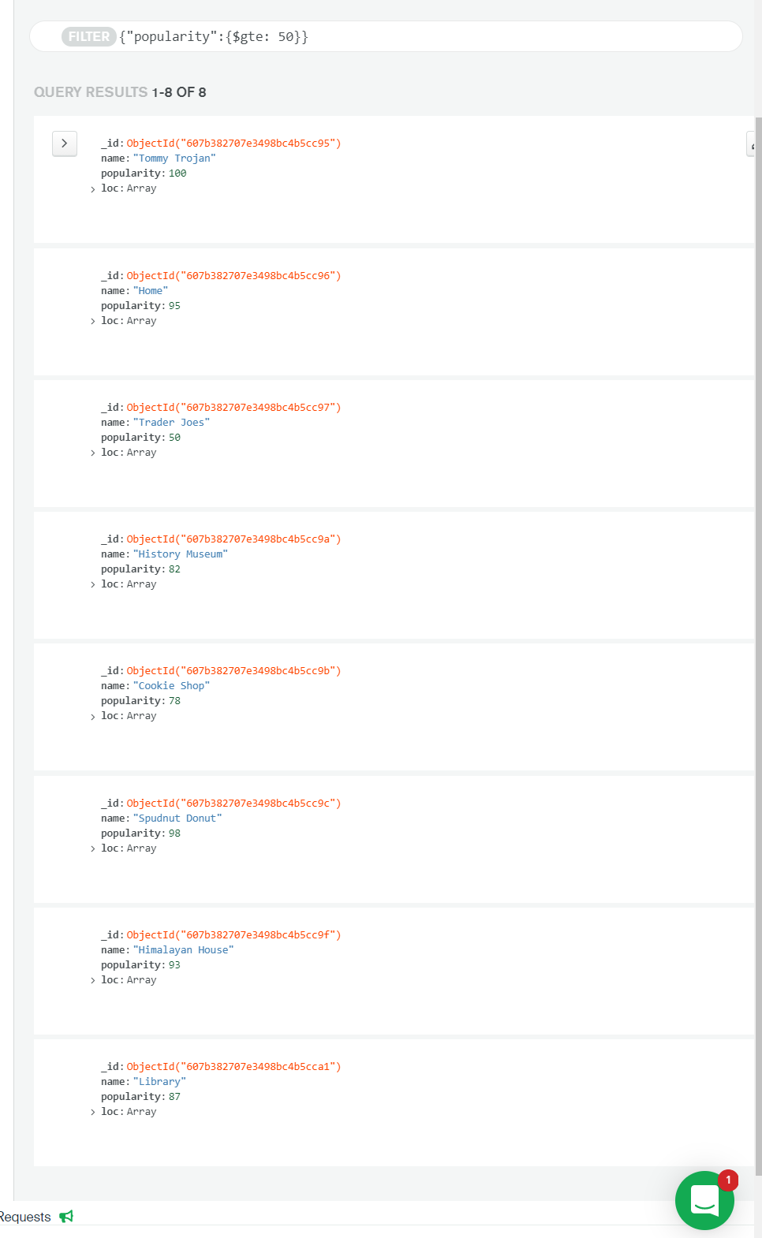
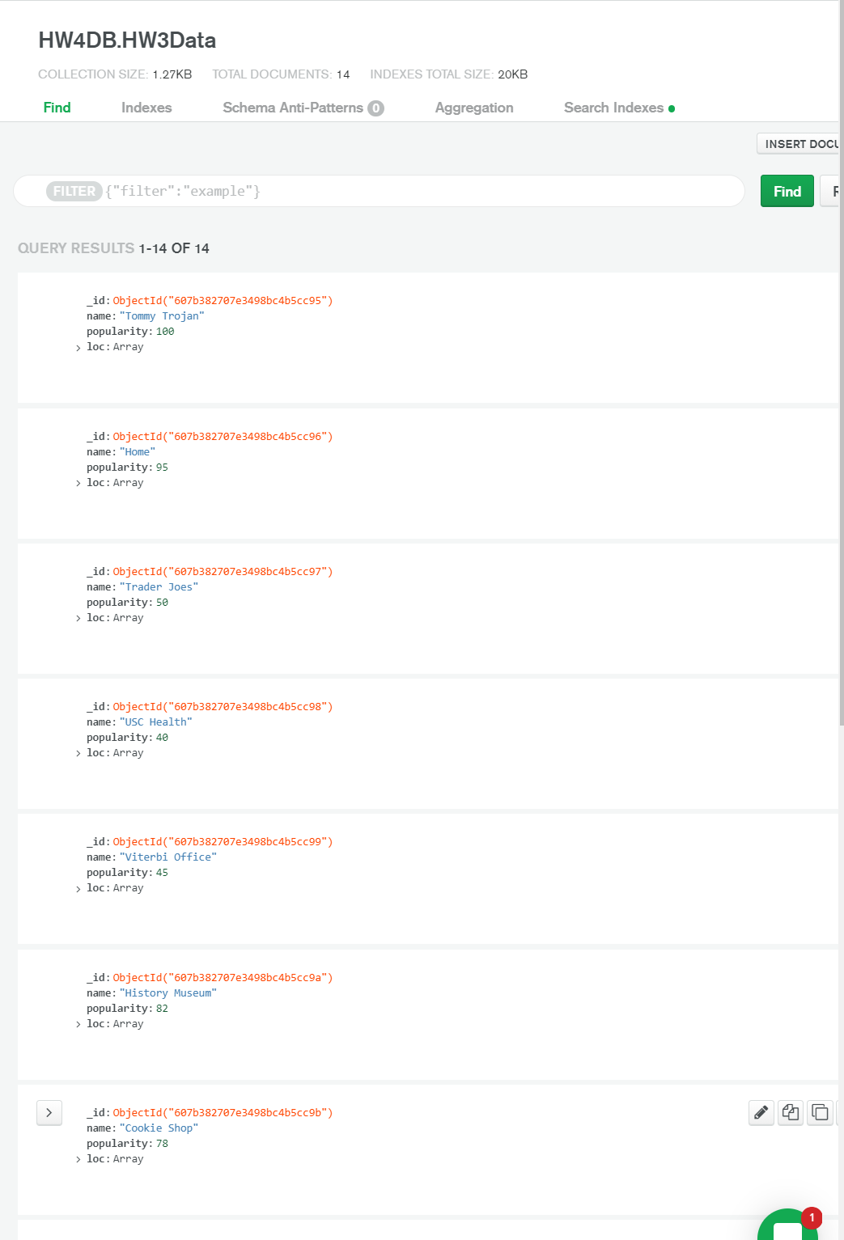
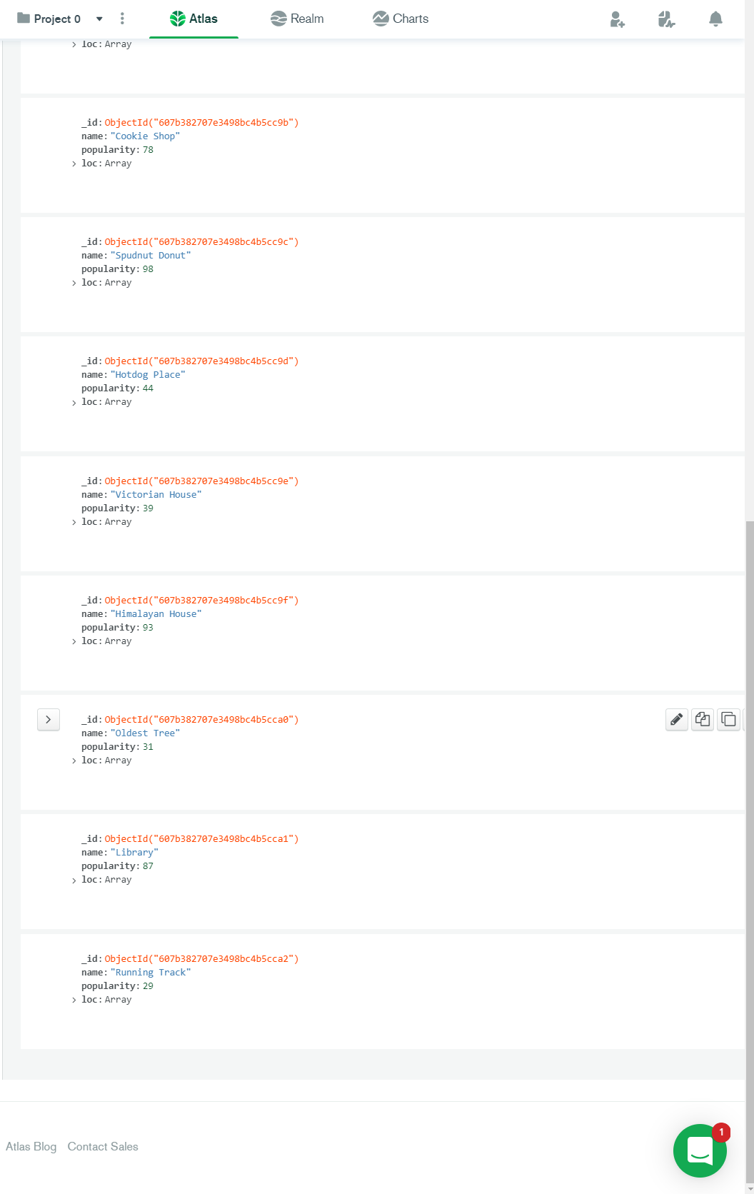
Query >=
Q1
All data (14 = 13 markers + Tommy Trojan! )
Query results (8)

Slide 2
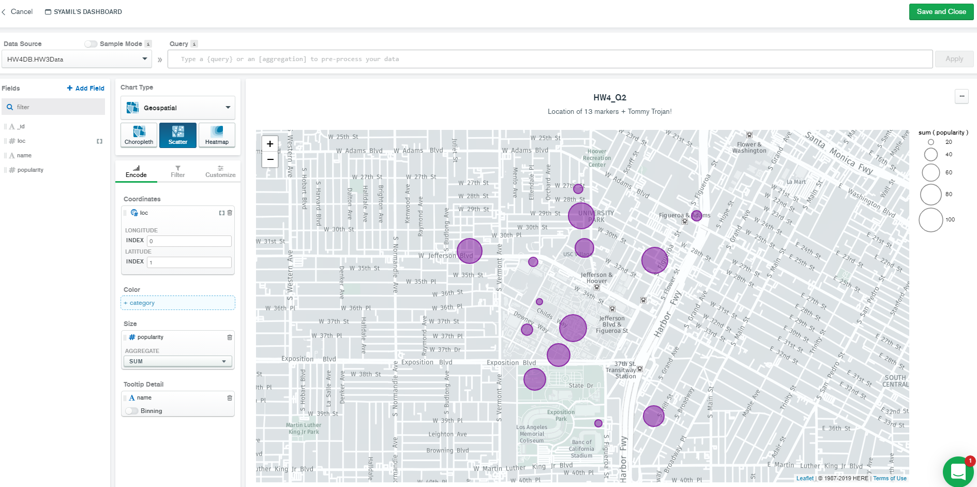
Q2
13 markers + Tommy Trojan!, marker size corresponds to popularity

Slide 3
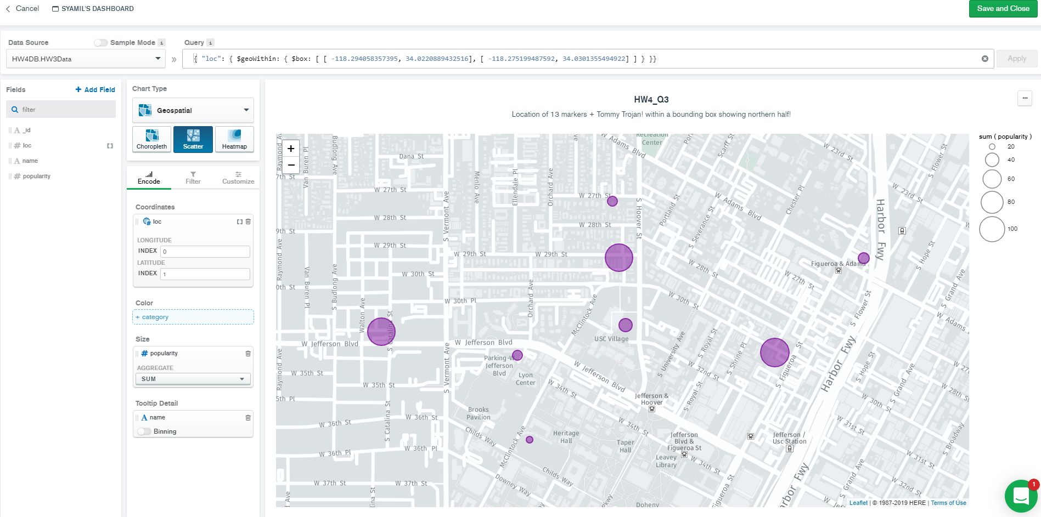
Q3
13 markers + Tommy Trojan!, marker size corresponds to popularity
Bounding box to show only northern half!
Query

Slide 4
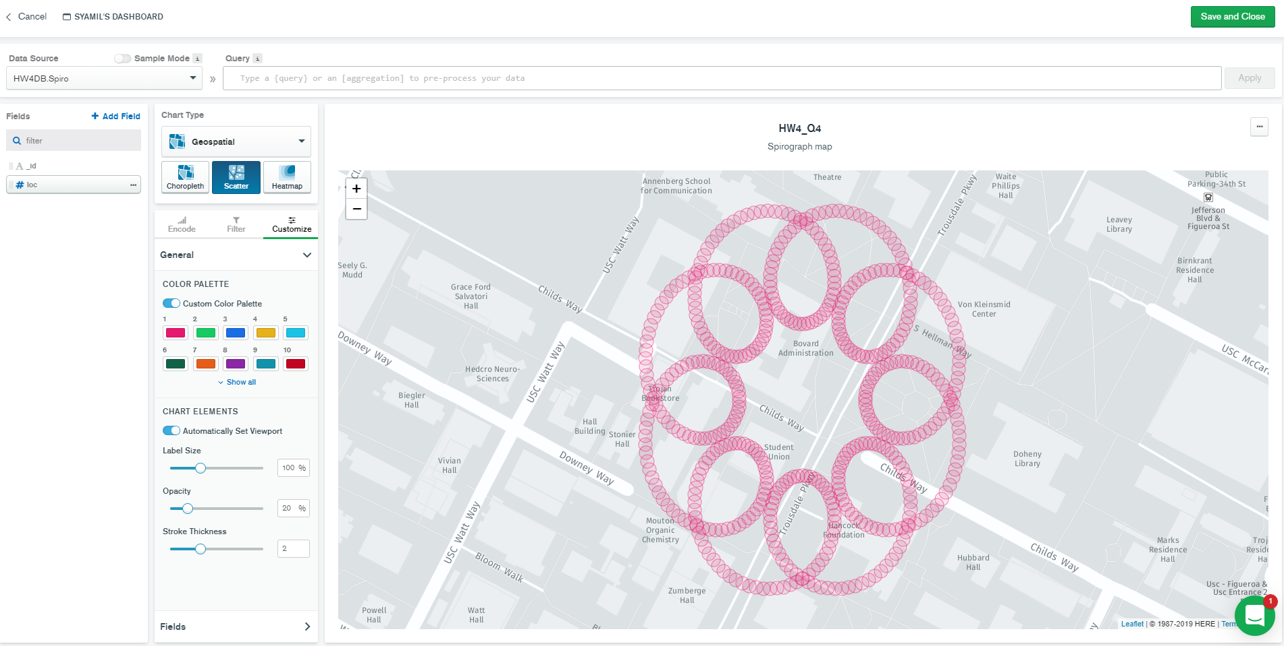
Q4
Link to generate Spiro coordinates: https://jsfiddle.net/mohdraza/a70L4xmv/34/

Slide 5
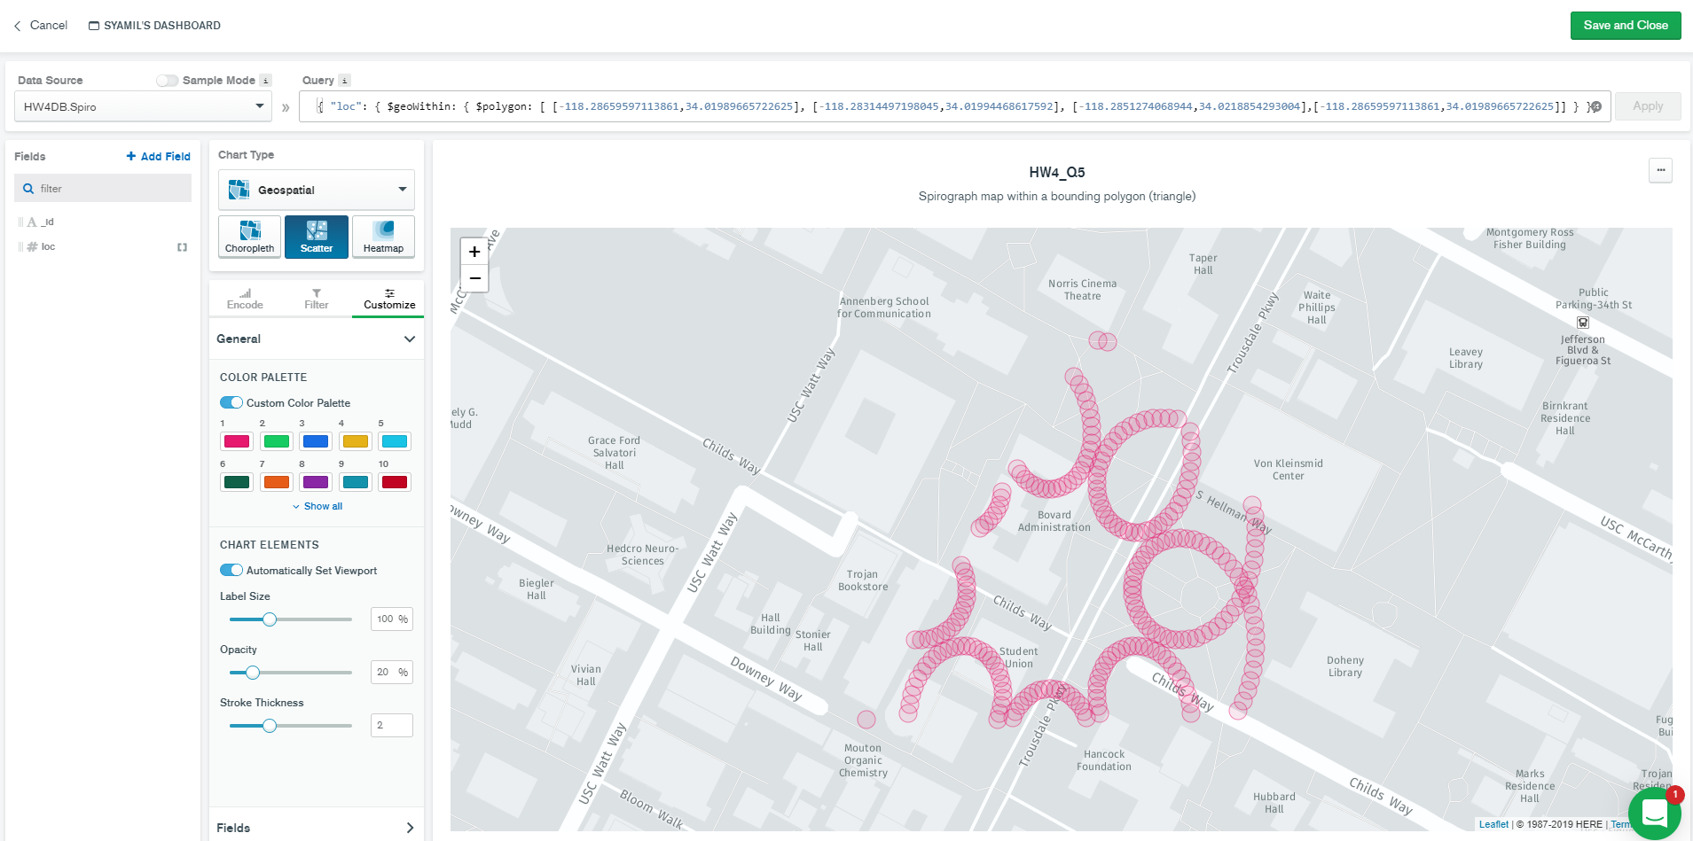
Q5
Triangles between ~Mouton Chem Building, Norris Cinema and Doheny Library
Query

Slide 6
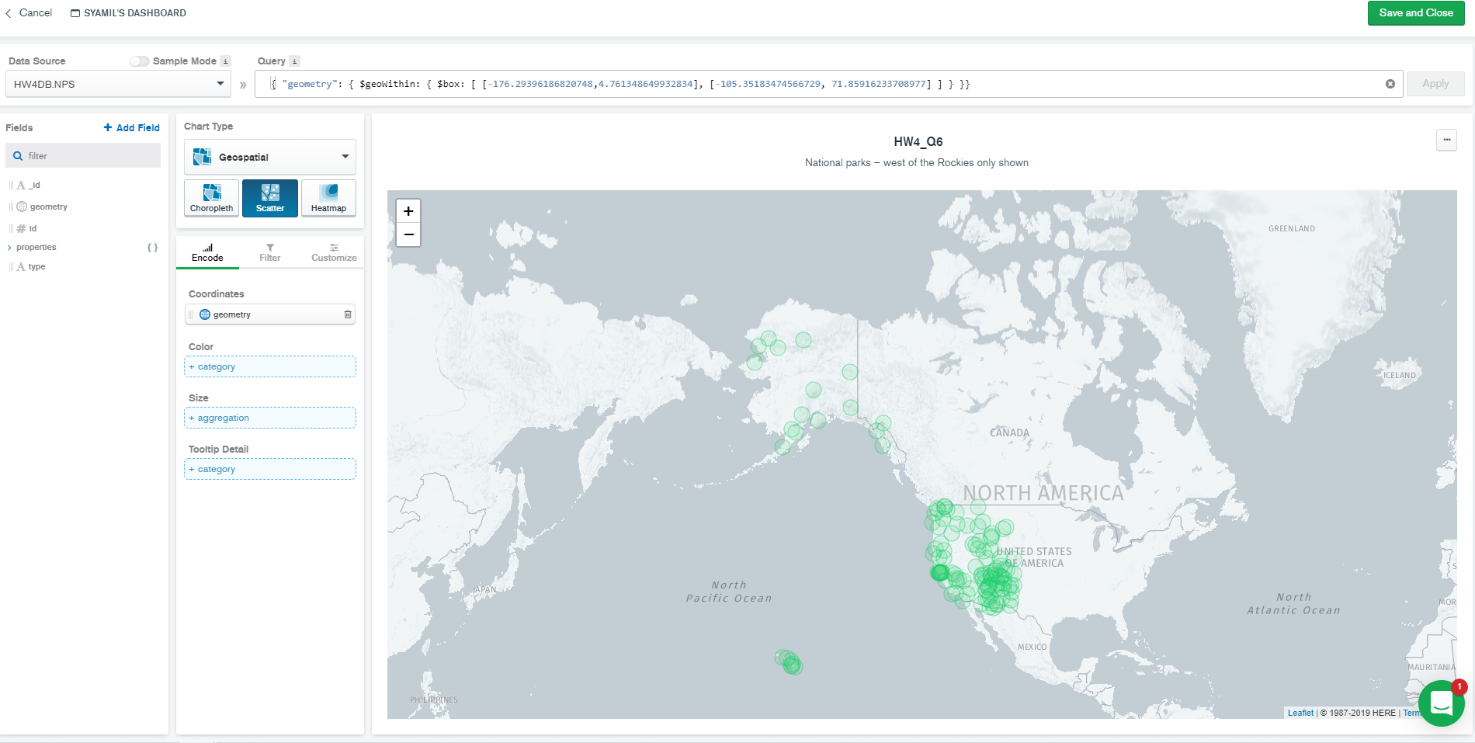
Q6
National parks – west of the Rockies NP
Query

