Slide 1

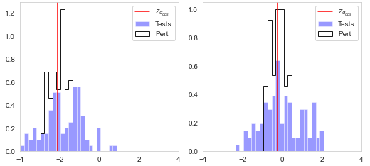
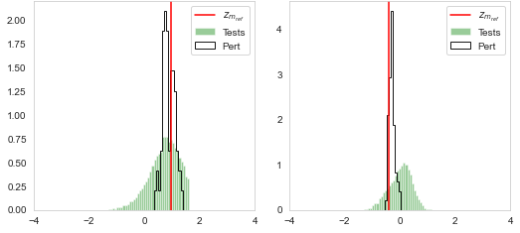







Observed data/signals
Data latent space
$+ ϵ$
Model latent space
Inversion solutions

