Slide 1


Research Update
Syamil Mohd Razak
Viterbi School of Engineering, University of Southern California
Group Meeting
Jan 28, 2022

Slide 2
Research Activities for 2022 & Beyond
Physics-Guided Deep Learning (PGDL) – finalize experiments and conference manuscripts by April
Synthetic example – use DCA function
Field example – use cumulative profile and exponential function
Highlight impact of residual learning
Transfer Learning under Uncertainty in Source Model – finalize experiments and conference manuscripts by April
Supervised learning method: Selection and relevance scoring in the latent space
Unsupervised learning method: Clustering and classification
Optimization of hydraulic fracture system
Dataset generation – single/multiple horizontal wells in a NFR
Objectives – design of fracturing parameters, predict fracturing outcome and identify sweet spots
Potential directions:
Ensemble learning methods with tree-based algorithms – for interpretability
Bayesian networks – modeling epistemic uncertainty so any prediction will come with an uncertainty estimate as the forward model is not known
Reinforcement learning
Fracture characterization

Slide 3
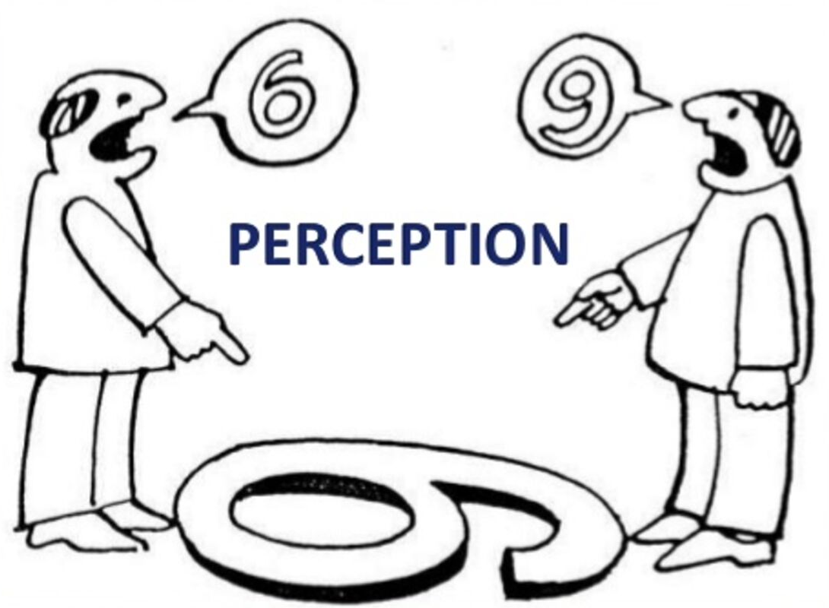
Perceptual Learning
Perceptual Learning (Eleanor Gibson, 1963):
Long-lasting changes in perception that result from practice or experience.
Perceptual vs learned inference
From Bredeche et al (2006) Perceptual Learning and Abstraction in Machine Learning: an application to autonomous robotics. INRIA. IEEE.
Perceptual problems:
Perceptual learning should be considered as an active process that embeds particular abstraction, reformulation and approximation
Focus on low-level abstraction mechanism instead of trying to rely on more complex algorithm
Particular abstraction that may help simplify a complex problem thanks to a more relevant representation
Non-perceptual problems:
Described by direct structured tabular features, continuous and discrete
Notes:
Why Tree-based Algorithms?
Perceptual problems -> deep learning
Non-perceptual problems -> tree-based algorithms

Slide 4
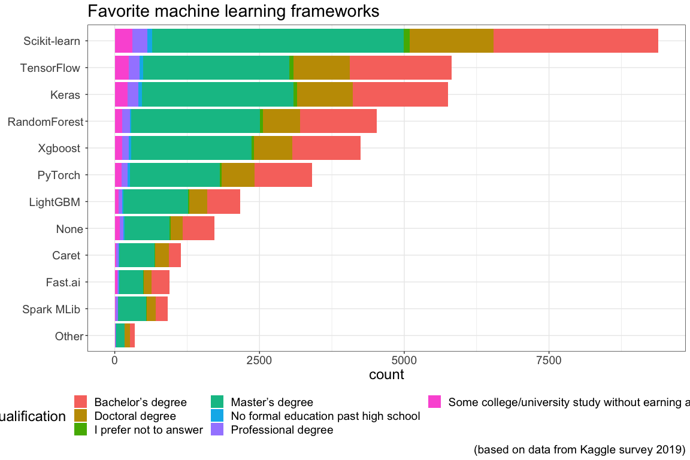
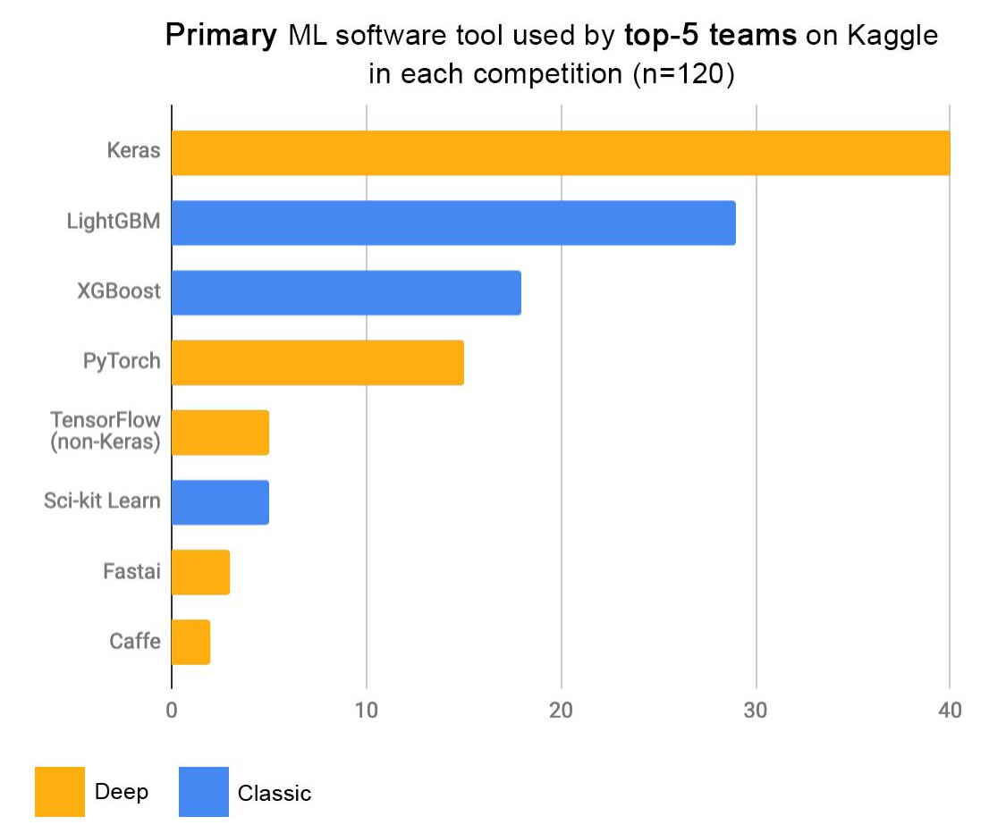
Top Learning Algorithms (Kaggle)
Tree-based algorithms are popular for non-perceptual problems

Slide 5

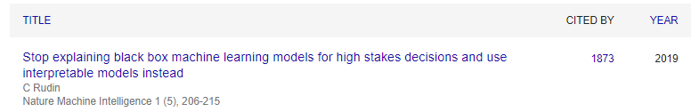
Interpretable Models?
Cynthia Rudin, winner of the 2022 $1 Million Artificial Intelligence Prize (Squirrel AI Award)
“The lack of transparency and accountability of predictive models can have (and has already had) severe consequences”
“Rather than trying to create models that are inherently interpretable, there has been a recent explosion of work on “Explainable ML,” where a second (posthoc) model is created to explain the first black box model. This is problematic.”
“instead use models that are inherently interpretable, they provide their own explanations, which are faithful to what the model actually computes”
“Interpretable models can entail significant effort to construct, in terms of both computation and domain expertise”
So much appetite for interpretable models!
Notes:
Squirrel AI Award for Artificial Intelligence for the Benefit of Humanity, Association for the Advancement of Artificial Intelligence (AAAI), 2022. The most prestigious award in the field of artificial intelligence. Like the Nobel prize and Turing award, it carries a $1M prize
https://arxiv.org/pdf/1811.10154.pdf?fbclid=IwAR01WIlfIiC1cgM99nhwIjAT0tHWYxHk7ZA_o9nEK9jJ75KdFMNZlv5Y0AU

Slide 6
Literature Search
Gradient Boosting
250 journal papers, 1813 proceeding papers from OnePetro
243 results from Journal of Petroleum Science and Engineering
Random Forest
112 journal papers, 791 proceeding papers from OnePetro
161 results from Journal of Petroleum Science and Engineering
XGBoost
14 journal papers, 128 proceeding papers from OnePetro
46 results from Journal of Petroleum Science and Engineering
Tang et al (2021) A New Ensemble Machine-Learning Framework for Searching Sweet Spots in Shale Reservoirs. SPE Journal.
Erofeev et al (2021) AI-Based Estimation of Hydraulic Fracturing Effect. SPE Journal.
Khan et al (2021) Boosting Algorithm Choice in Predictive Machine Learning Models for Fracturing Applications. SPE/IATMI Asia Pacific Oil & Gas Conference and Exhibition.
Baki et al (2021) Well Completion Optimization in Unconventional Reservoirs Using Machine Learning Methods. SPE Annual Technical Conference and Exhibition.
Temizel et al (2020) Production Forecasting in Shale Reservoirs through Conventional DCA and Machine/Deep Learning Methods. URTeC.
Liao et al (2020) Data Mining: A Novel Strategy for Production Forecast in Tight Hydrocarbon Resource in Canada by Random Forest Analysis. IPTC.
Wang et al (2021) Production forecast and optimization for parent-child well pattern in unconventional reservoirs. JPSE.
Duplyakov et al (2021) Data-driven model for hydraulic fracturing design optimization. Part II: Inverse problem. JPSE.
Wang et al (2018) Insights to fracture stimulation design in unconventional reservoirs based on machine learning modeling. JPSE.
Attanasi et al (2020) Well predictive performance of play-wide and Subarea Random Forest models for Bakken productivity. JPSE.
Tan et al (2021) Fracturing Productivity Prediction Model and Optimization of the Operation Parameters of Shale Gas Well Based on Machine Learning. Lithosphere 2021
Wang et al (2021) A Novel Reservoir Modeling Method based on Improved Hierarchical XGBoost. 2021 IEEE 5th Advanced Information Technology, Electronic and Automation Control Conference
Shi et al (2019) A hierarchical method based on weighted extreme gradient boostingin ECG heartbeat classification. Computer Methods.
Common theme:
Comparative work!

Slide 7
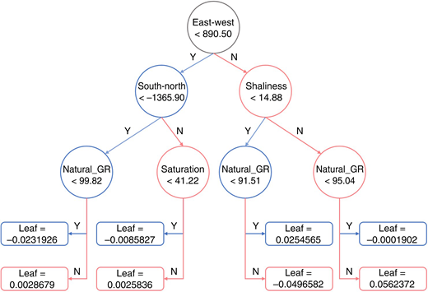
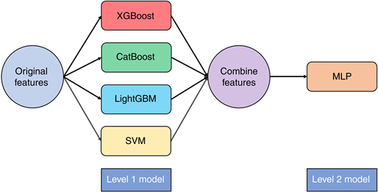
Literature Search: Highlights
Tang et al (2021) A New Ensemble Machine-Learning Framework for Searching Sweet Spots in Shale Reservoirs. SPE Journal.
XGBoost, CatBoost, LightGBM for identifying sweet spots in well-logs using labels of reservoir quality.
Proposed an ensemble learning framework (but saw improvement of 0.1 % only)
Notes:
Harvard

Slide 8
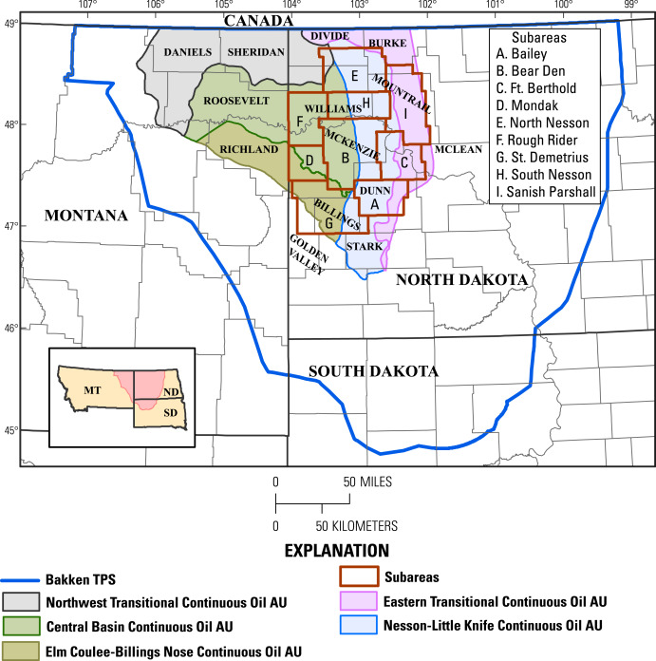
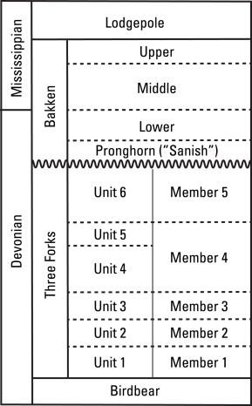
Literature Search: Highlights
Attanasi et al (2020) Well predictive performance of play-wide and Subarea Random Forest models for Bakken productivity. JPSE.
Random Forest models for different subareas (i.e., field) offers optimal performance over a single play-wide model
Effect of predictors (i.e., input) vary based on regions
Notes:
USGS paper

Slide 9
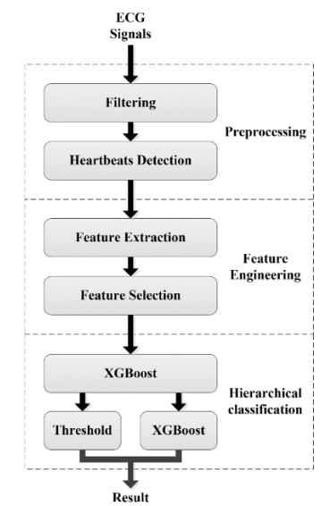
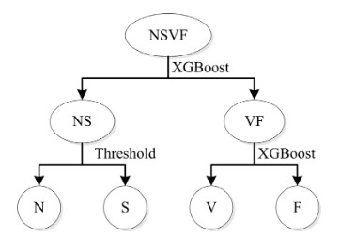
Literature Search: Highlights
Wang et al (2021) A Novel Reservoir Modeling Method based on Improved Hierarchical XGBoost. 2021 IEEE
Hierarchical XGBoost (h-XGBoost) extract key features from different reservoirs
Shi et al (2019) A hierarchical method based on weighted extreme gradient boostingin ECG heartbeat classification. Computer Methods.
Hierarchical XGBoost (h-XGBoost) does a better job than direct XGBoost

Slide 10
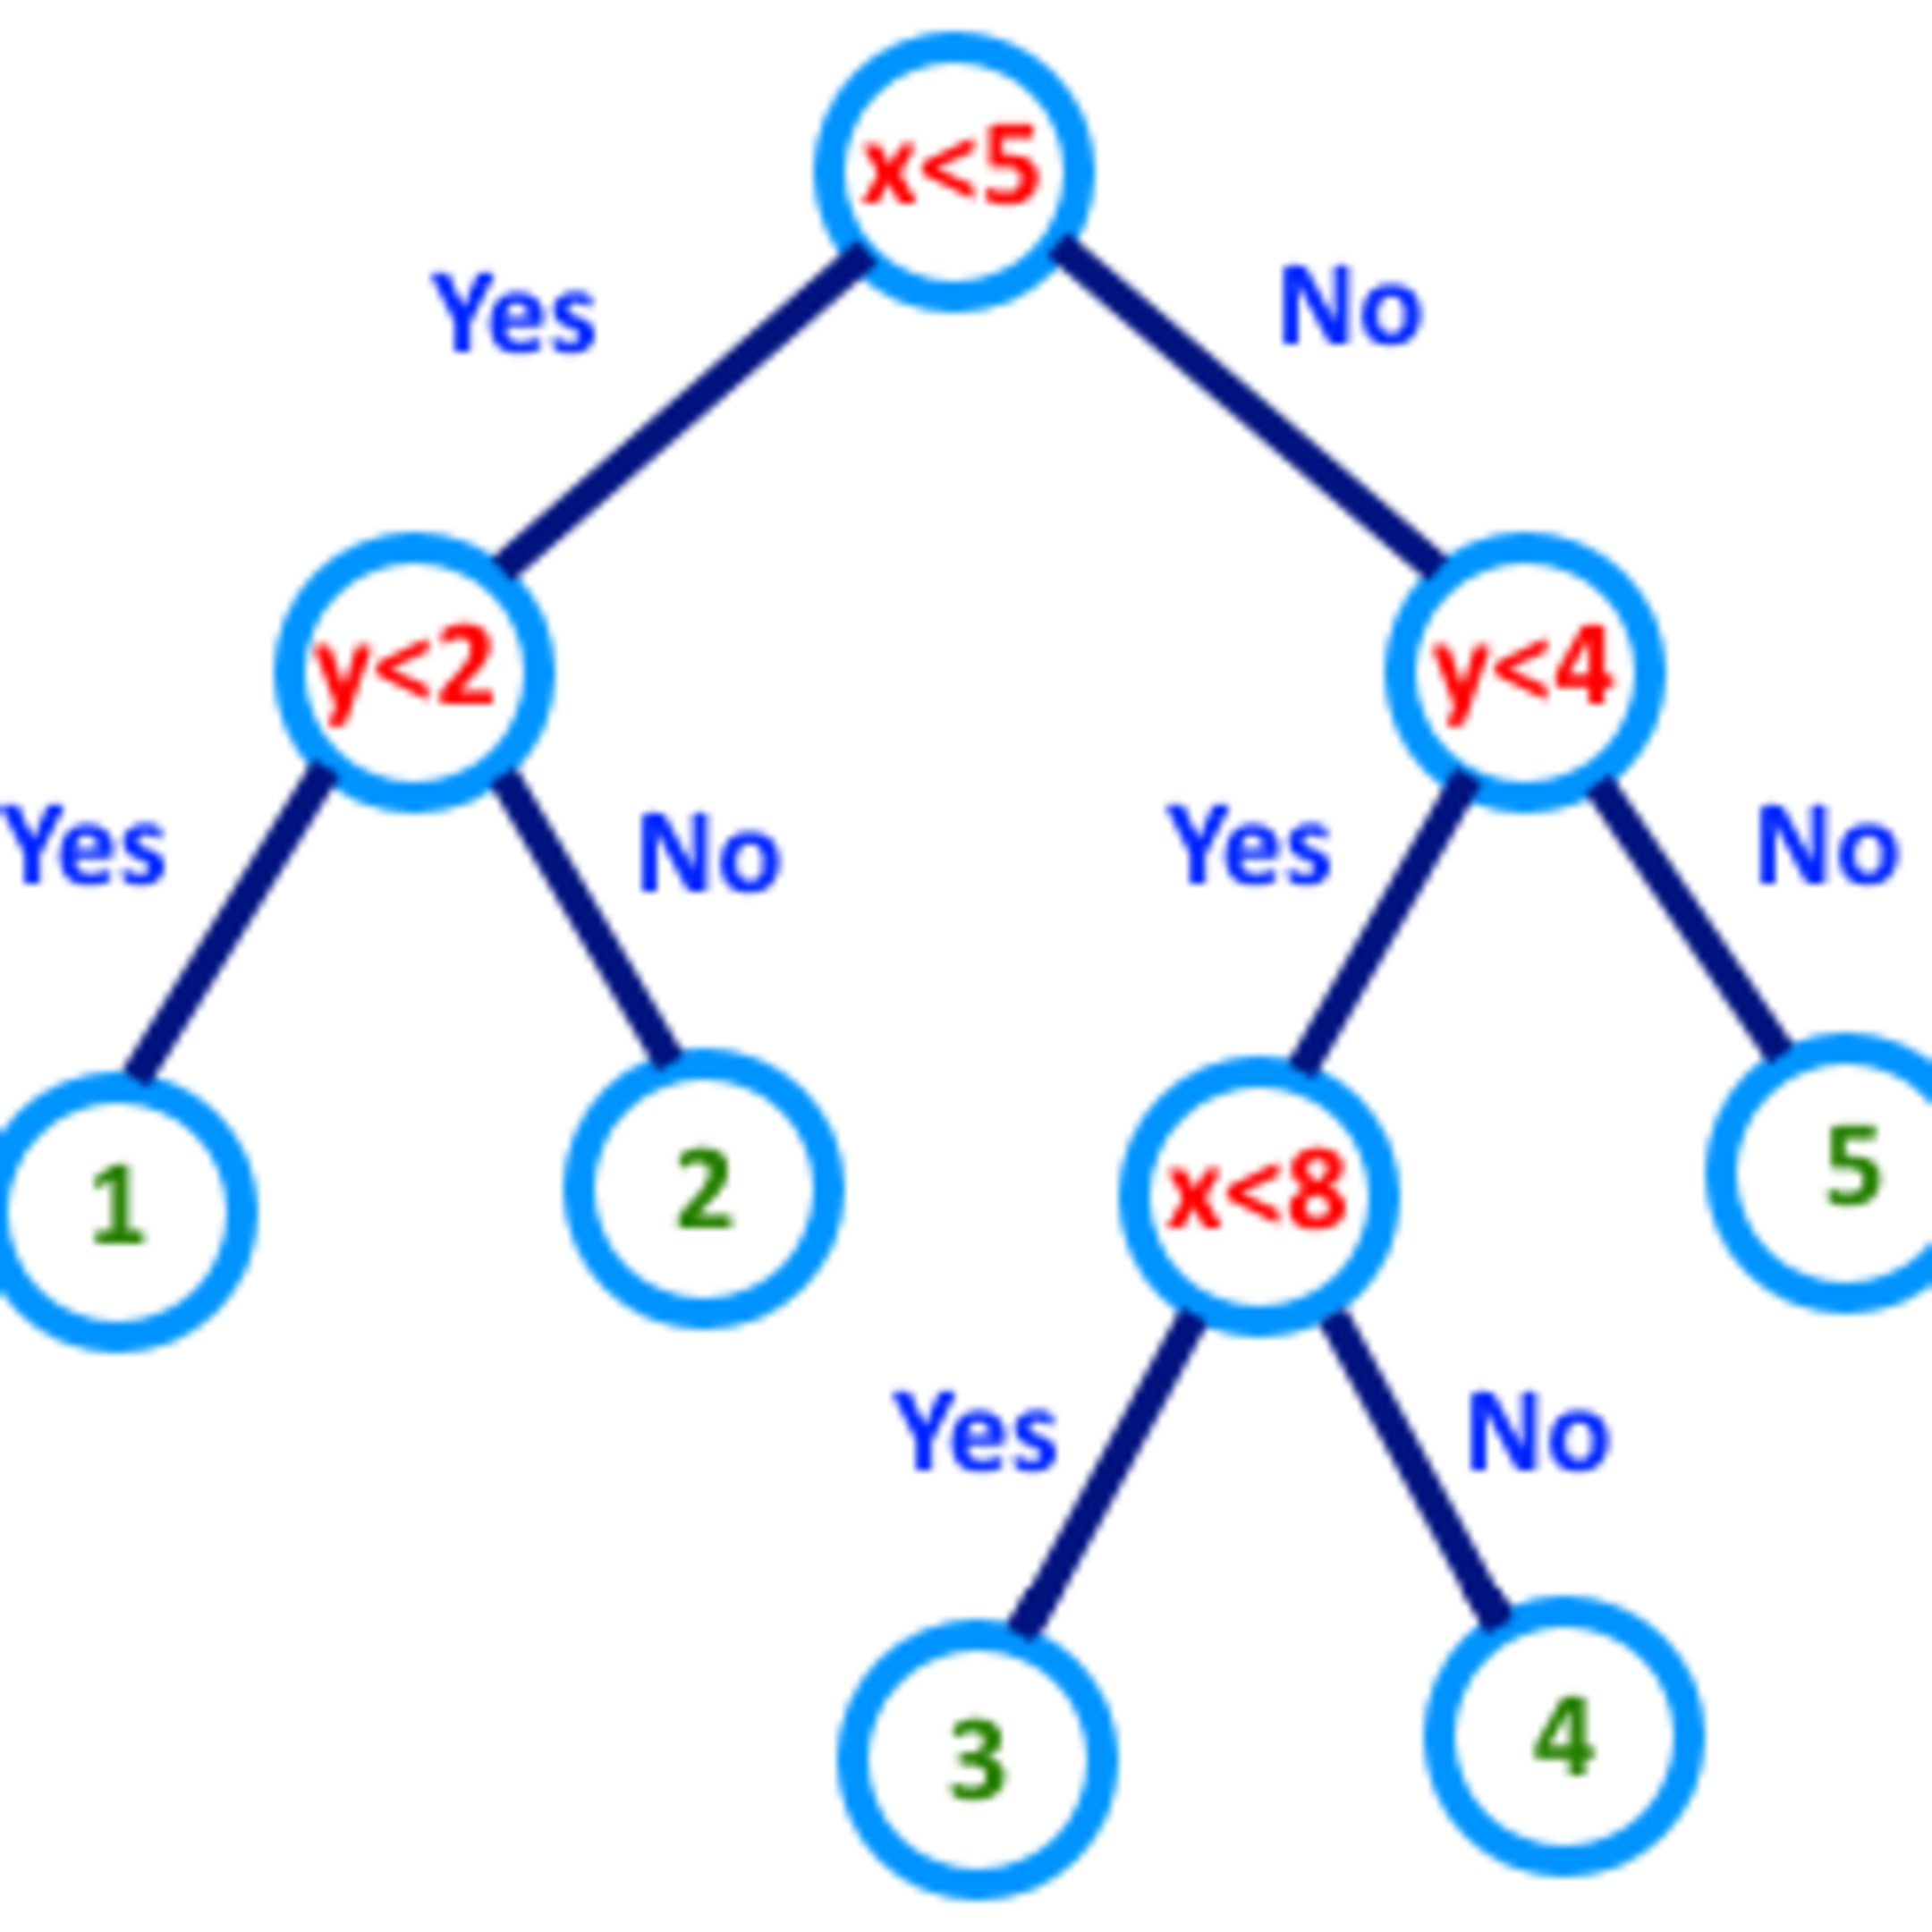
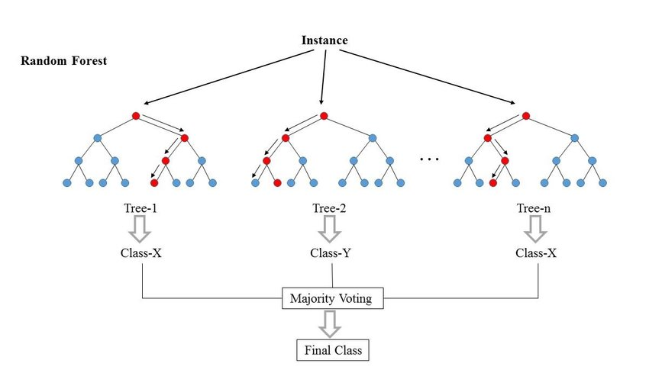
Tree-based Algorithms
Decision trees
Hard to generalize
How to find optimal orientation of hyperplanes?
Random forest
Bootstrap original data – same size, sample with replacement
Randomly use K subset of variables at each split step, build full trees independently
Aggregate votes with equal say (i.e., bagging)
Handling missing data:
Proximity matrix between training data points by running through all the trees – then calculate weighted average of features
Repeat until missing values converge
Proximity matrix leads to MDS plot to infer similarity of data points (can cluster with categorical values or combinations)
Notes:
Random Forest: Murthy et al (1993) OC1: randomized induction of oblique decision trees. In: Proceedings of the Eleventh National Conference on Artificial Intelligence, pp. 322–327.
-> Multivariate trees classify examples by testing linear combinations of the features at each non-leaf node of the tree. Each test is equivalent to a hyperplane at an oblique orientation to the axes. Because of the computational intractability of finding an optimal orientation for these hyperplanes, heuristic methods must be used to produce good trees

Slide 11
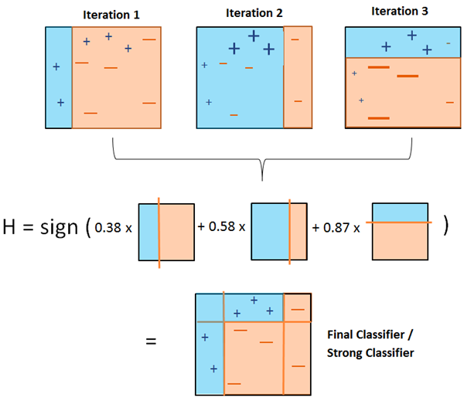
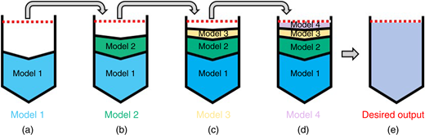
Tree-based Algorithms
AdaBoost
Uses stumps (a root and two leaves) as weak learners, built dependent on errors of preceding stumps
Aggregate votes with weighted say
Gradient boosting
Build trees, dependent on errors of preceding trees
Start with the mean value as prediction, build a tree to predict the residuals from the mean, final prediction adds the mean to the residual
Build more trees with successive residuals (i.e., gradient of the L2 loss function)
Learning rate for scaling contributions from each tree
Notes:
Boosting is a sequential technique which works on the principle of an ensemble. It combines a set of weak learners and delivers improved prediction accuracy. At any instant t, the model outcomes are weighed based on the outcomes of previous instant t-1. The outcomes predicted correctly are given a lower weight and the ones miss-classified are weighted higher. Note that a weak learner is one which is slightly better than random guessing.

Slide 12


XGBoost
XGBoost (Chen at al, 2016)
Build “XGBoost trees” using Gain (i.e., similarity of each leaf), dependent on errors of preceding trees
Regularization parameter to reduce overfitting (by dampening the similarity) and combining branches
Final prediction scales all previous predictions with minimal residual
Prediction:
Add up K functions (i.e., trees)
Training:
Loss function
Regularization term for each tree
T leaves in a tree
w is a vector of scores from the leaves
Notes:
https://www.kdd.org/kdd2016/papers/files/rfp0697-chenAemb.pdf
https://github.com/benedekrozemberczki/awesome-decision-tree-papers

Slide 13




XGBoost
Training at iteration t (not time):
Previous prediction (t-1) added with the prediction from tree t
Regularization term
Second order approximation of Taylor expansion:
First-order gradient
Second-order gradient
Note: for multi-class classification, one-against-all, i.e., out of K trees, B trees will be predicting for one class out of C classes – the total number of trees is K=BxC.

Slide 14
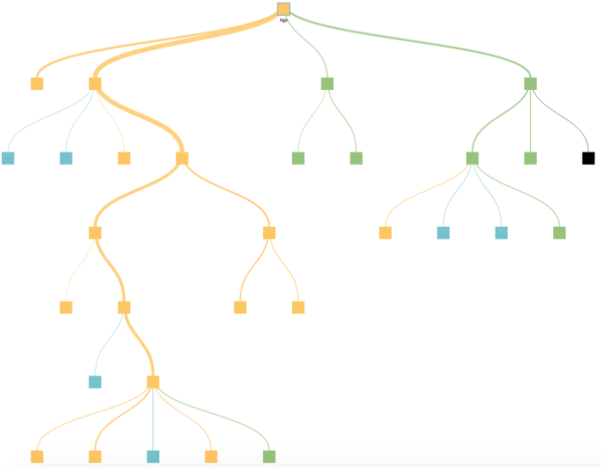
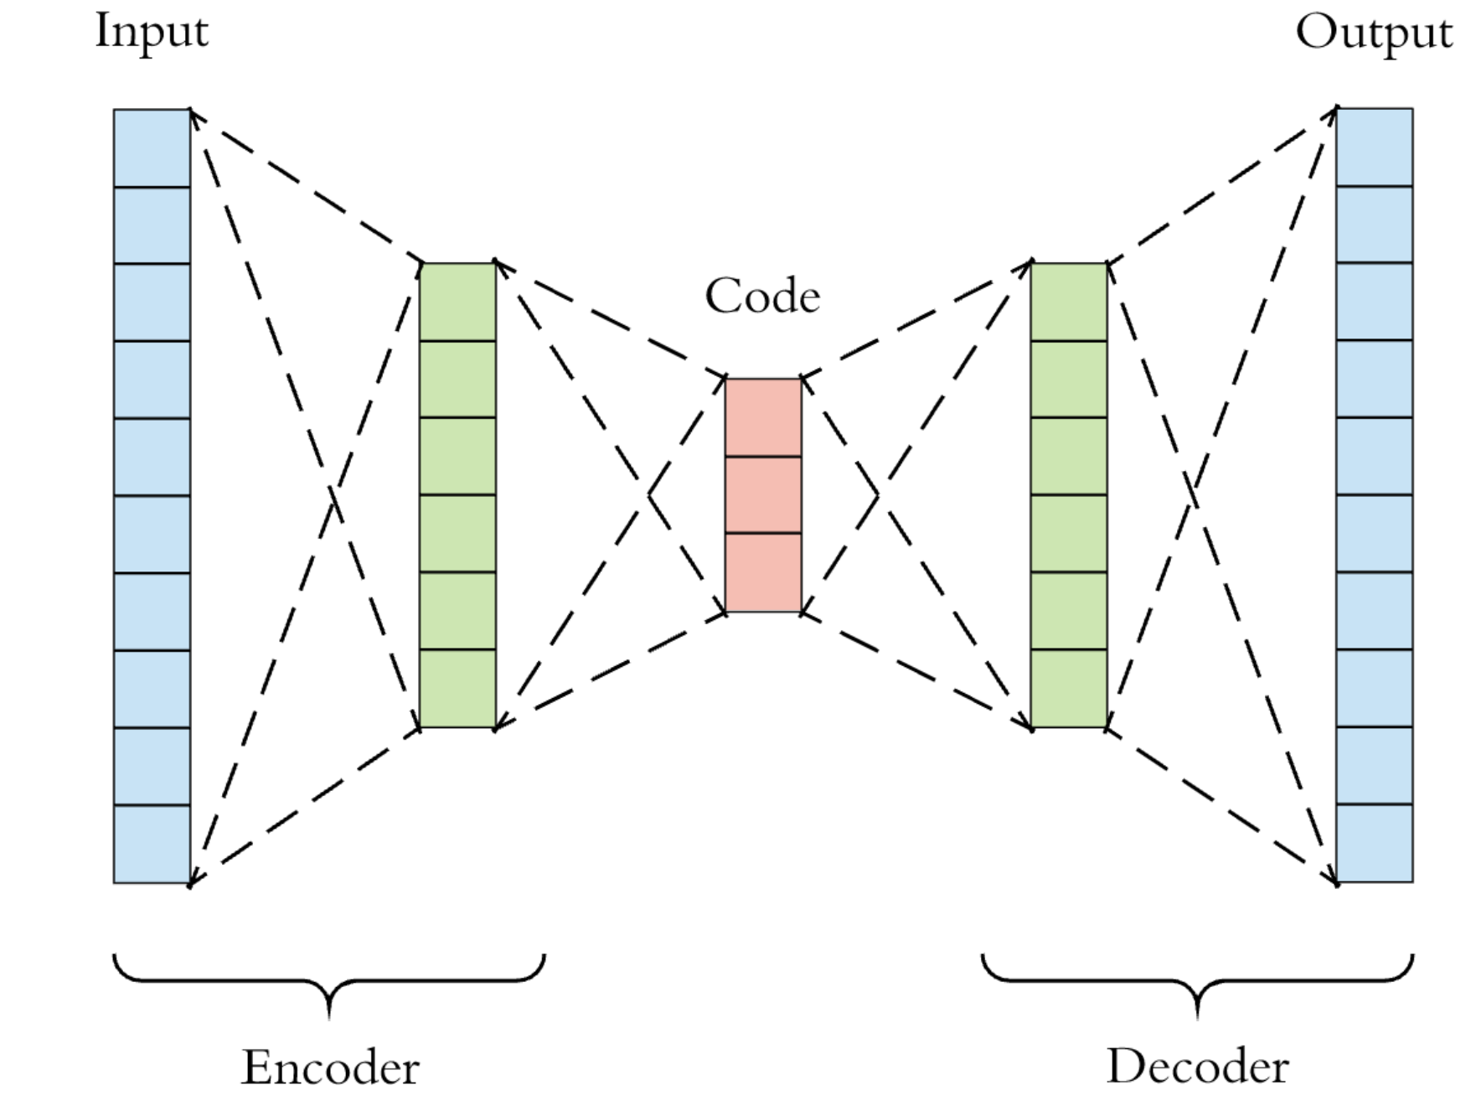
The Proposed Idea: Hybridization
Non-perceptual problems
Perceptual problems
Input
(Well properties)
Data latent variables
Multivariate production profiles
Motivations:
Increase interpretability
Enable application of tree-algorithms for high-dimensional problem (on the output side!)
Efficiently handle missing data on the input side, class imbalance
The right tool for the right problem
Notes:
When you see articles saying RF works well for high-dimensional problem, they mean the input features – some people take the high-dimensional input and take PCA approximation to reduce the dimension (but this removes interpretability!)
For unconventional problems, the input feature is already small anyway,
From https://proceedings.neurips.cc/paper/2018/file/39027dfad5138c9ca0c474d71db915c3-Paper.pdf, Feng et al (2018)
While non-differentiable models such as gradient boosting decision trees (GBDTs) are still the dominant methods for modeling discrete or tabular data, they are hard to incorporate with such representation learning ability.
Hybridization:
https://link.springer.com/content/pdf/10.1007/s40595-014-0024-7.pdf

Slide 15
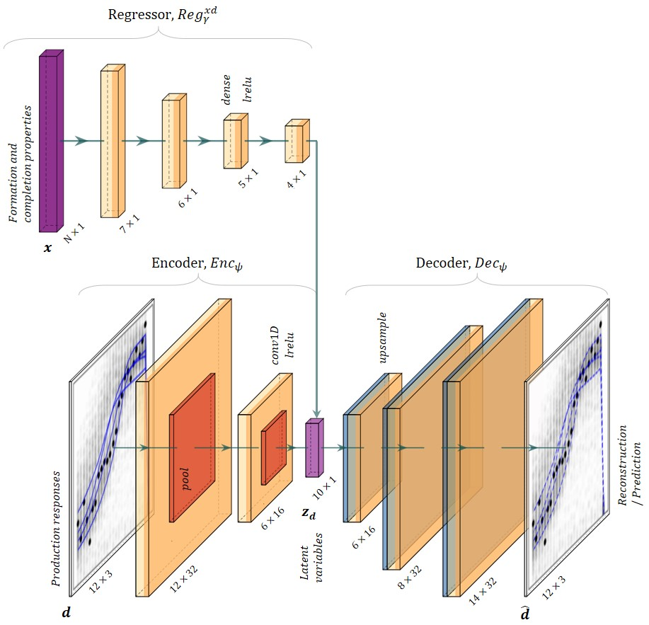
The Proposed Idea
Natural extension to existing methods (published in URTeC and MEOS) for interpretability
Perceptual problems
Non-perceptual problems

Slide 16
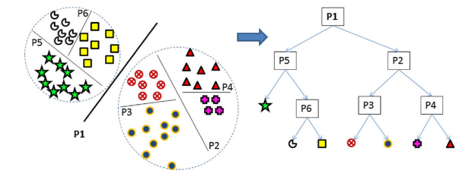
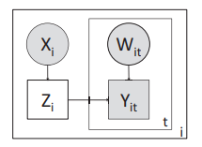
Literature Search: Trees for High-dim. Output
Do et al (2010) Classifying very-high dimensional data with random forests of oblique decision trees. In: Advances in Knowledge Discovery and Management. Studies in Computational Intelligence, vol. 292, pp. 39–55. Springer-Verlag, Berlin.
Handling high-dimensional (i.e., hundreds) output classes for classification problems using oblique splitting
Hutchinson et al (2011) Incorporating Boosted Regression Trees into Ecological Latent Variable Models. AAAI.
Decision trees from features to latent variable z, for modeling distribution of species indirectly using imperfect detection (observable features described by the latent variables)
Notes:
High dimensional input (not output):
Caruana et al (2008) An empirical evaluation of supervised learning in high dimensions. In: Proceedings of the 25th International Conference on Machine Learning, pp. 96–103.
Combine trees and CNN
Zhang et al (2019) Interpreting CNNs via Decision Trees. arXiv. Decision trees built on features in images - disentangled activations from fully-connected layers to learn feature importance/attribution.
Hutchinson et al (2011)
https://www.aaai.org/ocs/index.php/AAAI/AAAI11/paper/viewFile/3711/4086

Slide 17
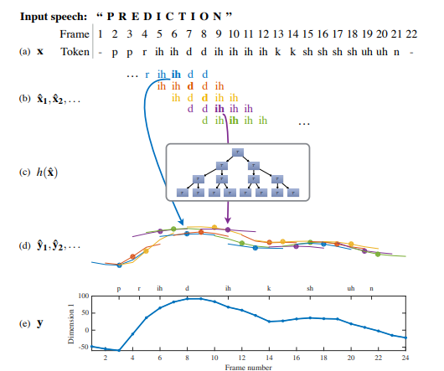

Literature Search: Trees for High-dim. Output
Kim et al (2015) A Decision Tree Framework for Spatiotemporal Sequence Prediction. ACM KDD.
Decompose spatiotemporal sequence prediction into a series of overlapping fixed-length latent variables multivariate regression problems
Local (independent) or cascading effects to capture interdependency in the output
Si et al (2017) Gradient Boosted Decision Trees for High Dimensional Sparse Output. ICML.
GBDT for high-dim. and sparse output using sparsity inducing regularization for classification problem (1/0 encoding).
Crucial observation that each data point has very few labels; and solve a L0 regularized optimization problem to enforce the prediction of each leaf node in each tree to have only a small number (k) of nonzero elements or labels.
Yu et al (2014) Large-scale Multi-label Learning with Missing Labels. PMLR.
Bhatia et al (2015) Sparse Local Embeddings for Extreme Multi-label Classification. NIPS.
Dimension reduction of high-dimensional labels

Slide 18
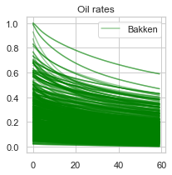
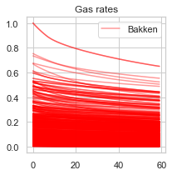
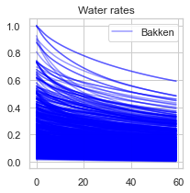
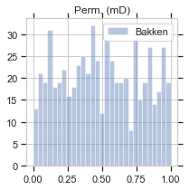
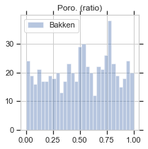
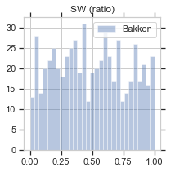
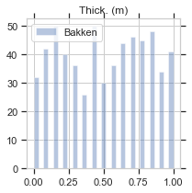
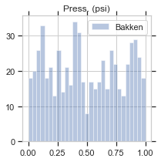
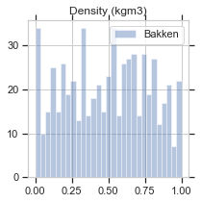
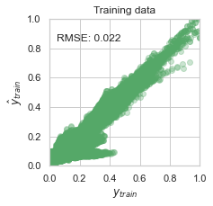
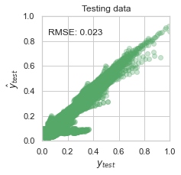
Experiment I
Output (Production profiles)
Input (Well properties)
Dimension reduction
Latent variables

Slide 19
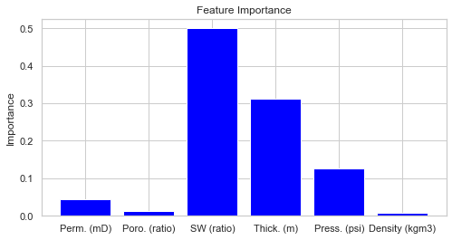
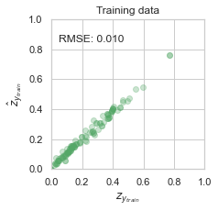
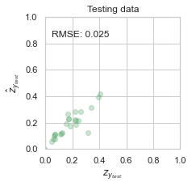
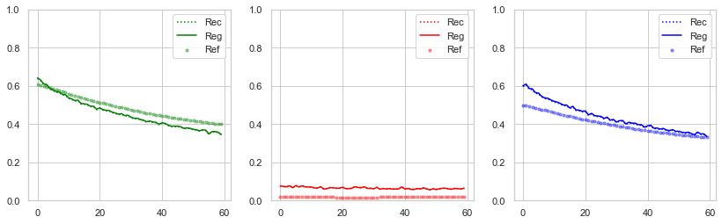
Experiment I
Feature importance
Latent var. prediction performance
Sample test predicted profiles

Slide 20
Experiment II
Notes:
https://stackoverflow.com/questions/39540123/muti-output-regression-in-xgboost

Slide 21
Experiment II
Notes:
https://stackoverflow.com/questions/39540123/muti-output-regression-in-xgboost

Slide 22
Experiment II
Notes:
https://stackoverflow.com/questions/39540123/muti-output-regression-in-xgboost

Slide 23
What’s Next?
Detailed implementation and formulation:
Input feature selection
Handling unbalanced dataset
Field implementation:
Missing data
Extension for Federated Learning:
Li et al (2020) Privacy-Preserving Gradient Boosting Decision Trees. AAAI 2020.
Li et al (2020) Practical Federated Gradient Boosting Decision Trees. AAAI 2020.
Extension for Transfer Learning:
Pruning irrelevant trees for target adaptation
Notes:
https://stackoverflow.com/questions/39540123/muti-output-regression-in-xgboost

Slide 24
Thanks!

