Slide 1
Assignment-2
Anish Khanal
Ujjwal Khatri
Prashant Bhattarai
Syed roman

Slide 2


AGENDA
INTRODUCTION
DATA PREPROCESSING
TECHNOLOGY USED
EDA
MODELLING
EVALUATION
CONCLUSION

Slide 3

Heart Disease Prediction

Slide 4

INTRODUCTION
What is heart disease ?
The term “heart disease” refers to several types of heart conditions.
The most common type of heart disease in the United States is coronary artery disease (CAD), which affects the blood flow to the heart.
Decreased blood flow can cause a heart attack.

Slide 5
SYMPTOMS
Heart attack: Chest pain or discomfort, upper back or neck pain, indigestion, heartburn, nausea or vomiting, extreme fatigue, upper body discomfort, dizziness, and shortness of breath.
Arrhythmia: Fluttering feelings in the chest (palpitations).
Heart failure: Shortness of breath, fatigue, or swelling of the feet, ankles, legs, abdomen, or neck veins.

Slide 6
RISK FACTORS
High blood pressure
High blood cholesterol
Smoking

Slide 7
Objective
We are performing EDA and predict if a person is prone to those symptoms provided above:
Heart attack
Arrhythmia
Heart failure
apply machine learning techniques resulting in improving the accuracy in the prediction of heart disease.

Slide 8

TECHNOLOGY USED
PANDAS
SCIKIT-LEARN
MATPLOTLIB
SEABORN
NUMPY

Slide 9
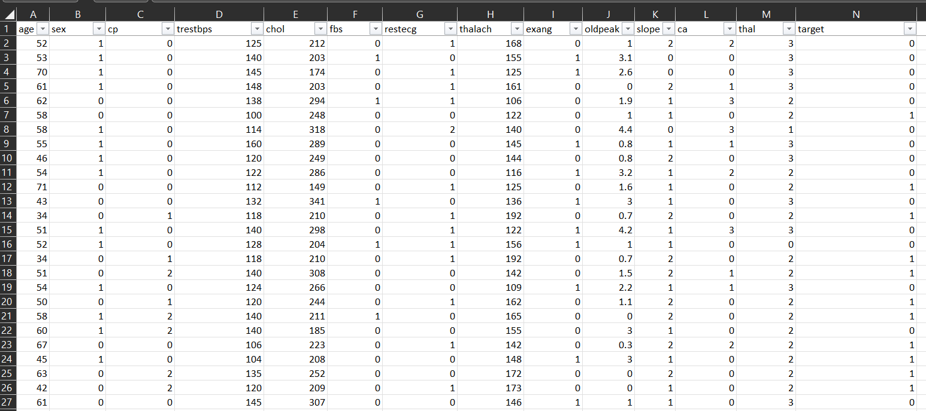
DATASET

Slide 10
Dataset Understanding
The "target" field refers to the presence of heart disease in the patient. It is integer-valued where 0 means having heart disease and 1 means no heart disease.
Each row represents the information and health conditions of the patient.
There are 1025 rows and 14 cols in the dataset.

Slide 11
Columns in the Dataset
age
sex
chest pain type (4 values)
resting blood pressure
serum cholestoral in mg/dl
fasting blood sugar > 120 mg/dl
resting electrocardiographic results (values 0,1,2)
maximum heart rate achieved
exercise induced angina
oldpeak = ST depression induced by exercise relative to rest
the slope of the peak exercise ST segment
number of major vessels (0-3) colored by flourosopy
thal: 0 = normal; 1 = fixed defect; 2 = reversable defect

Slide 12
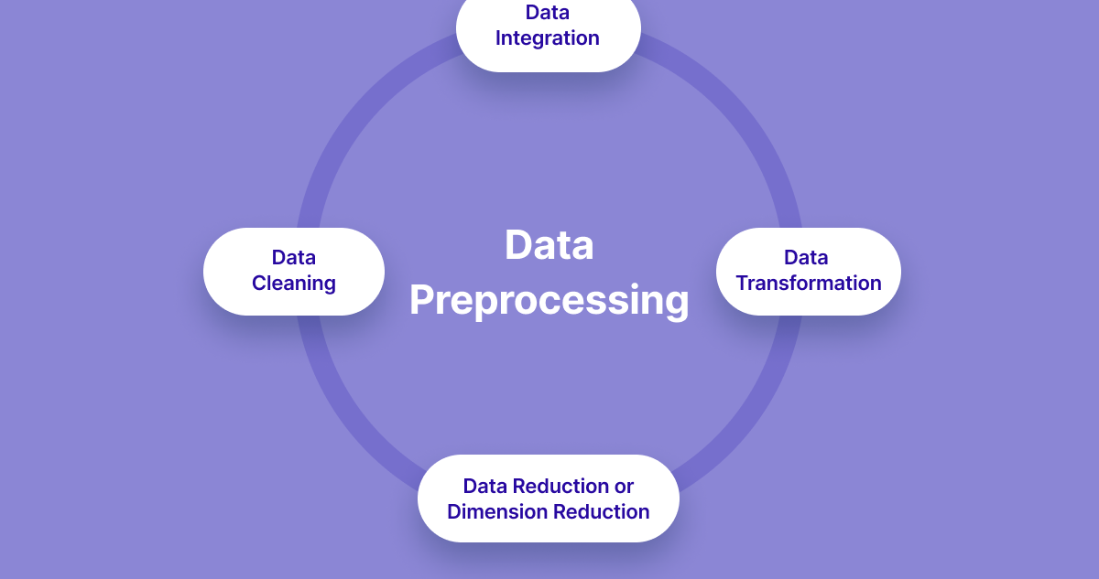
Data Preprocessing
Data preprocessing is a critical step in data analysis that involves preparing and cleaning the raw data before it can be used for further analysis. It plays a crucial role in ensuring the accuracy, reliability, and effectiveness of the subsequent analysis

Slide 13
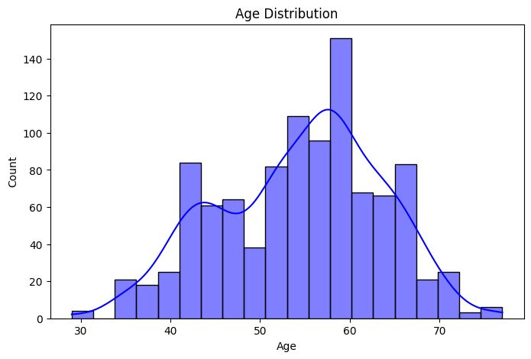
Histogram for Age Distribution

Slide 14
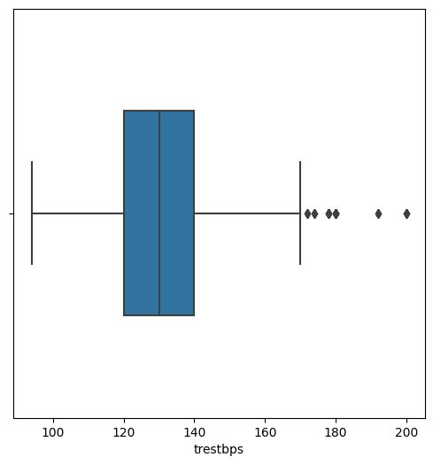
Boxplot for resting blood pressure

Slide 15
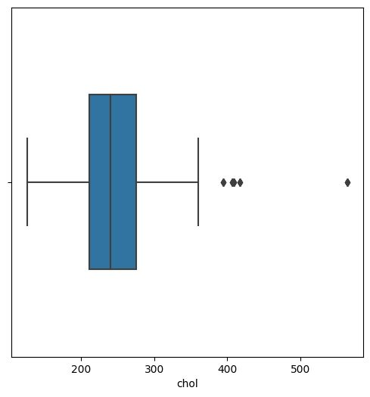
Boxplot for Cholestrol

Slide 16

Exploratory Data Analysis

Slide 17
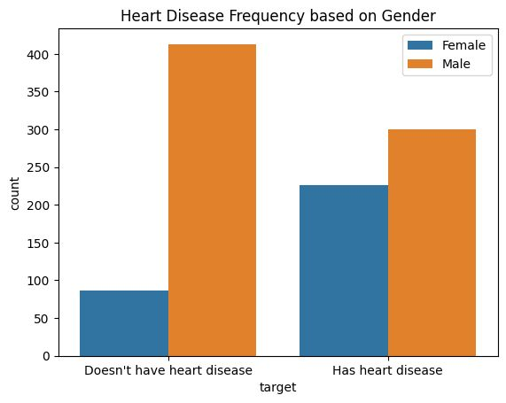

Slide 18
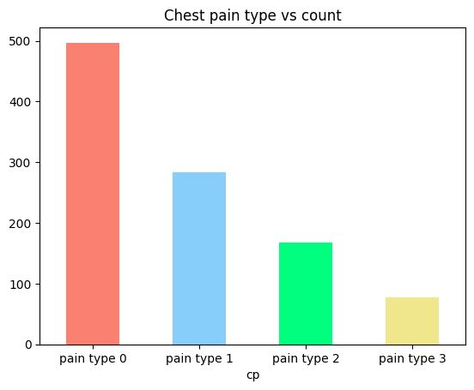
Chest pain type
Type 0: Typical angina
Typical angina refers to chest pain that is usually described as discomfort, pressure, or pain in the chest
Type 1:Atypical angina
Atypical angina is chest pain that does not have the typical characteristics of angina but is still related to the heart. It may manifest as different types of pain, such as burning, stabbing, or sharp discomfort.
Type 2:Non-anginal pain
Non-anginal pain refers to chest pain that is not caused by heart-related issues. It might be related to other conditions, such as musculoskeletal problems, acid reflux, or anxiety.
Type 3:Asymptomatic
Asymptomatic means the absence of any chest pain or discomfort. Patients with a value of 3 for cp do not experience any chest pain.

Slide 19
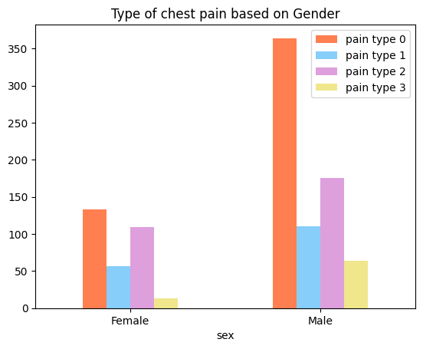

Slide 20
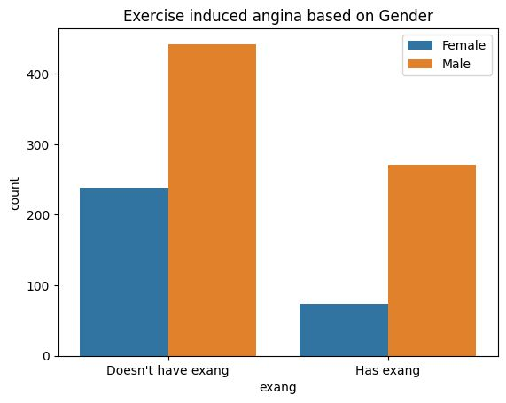
Exercise induced angina
a type of chest pain or discomfort that occurs during physical activity or exercise Exercise-induced
It is characterized by squeezing, pressure, heaviness, or tightness sensation in the chest.

Slide 21
Modelling
The Modelling process involves Model selection, prediction, and Model Evaluation of the Dataset.
Type of model used in the dataset: Semi-Supervised Algorithm
Logistic regression

Slide 22
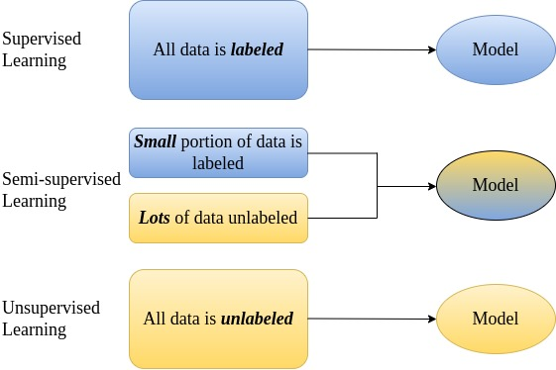
Semi Supervised Learning
Semi-supervised learning is a machine learning paradigm where a model is trained using both labeled and unlabeled data.
a model is trained using a combination of labeled data (data with known target values) and unlabeled data (data without target values).
The goal is to leverage the unlabeled data to improve the model's performance and generalization on the task at hand.

Slide 23
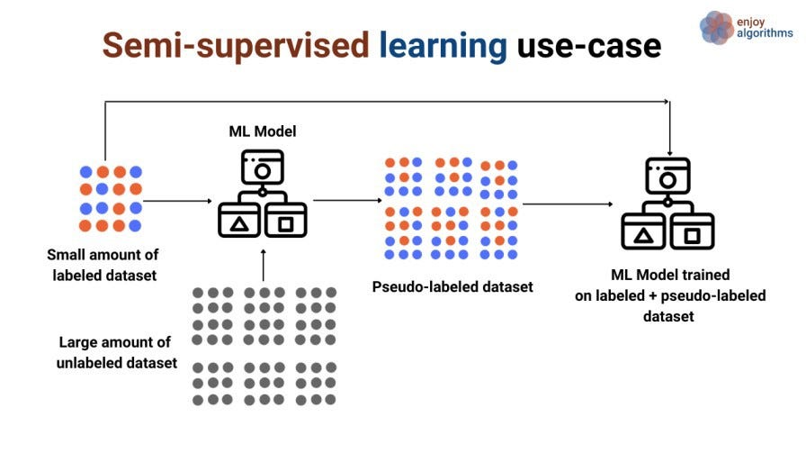

Slide 24
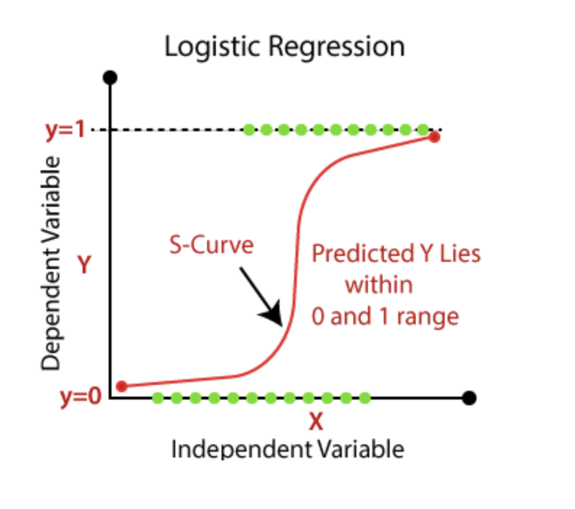
Logistic Regression
Logistic Regression is a statistical and machine learning algorithm used for binary classification tasks.
It is used to model the relationship between a dependent variable (target) and one or more independent variables (predictors) by estimating the probability of the dependent variable belonging to a particular class.
The goal of logistic regression is to find the best-fitting model that can predict the probability of the positive class (class 1) given the input features.

Slide 25
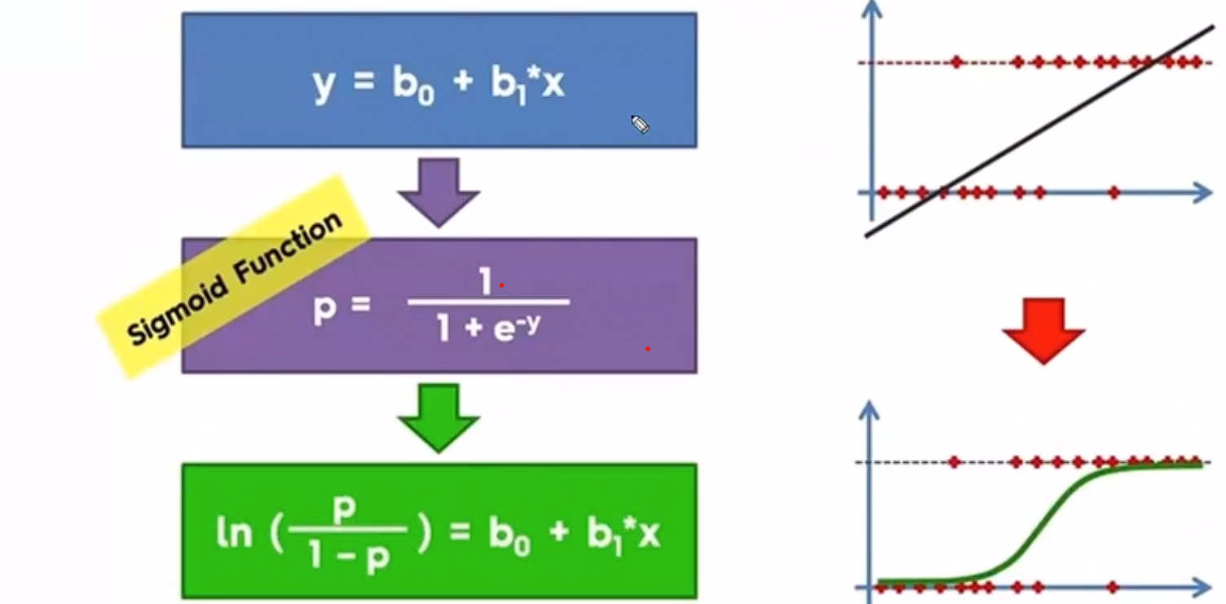

Slide 26
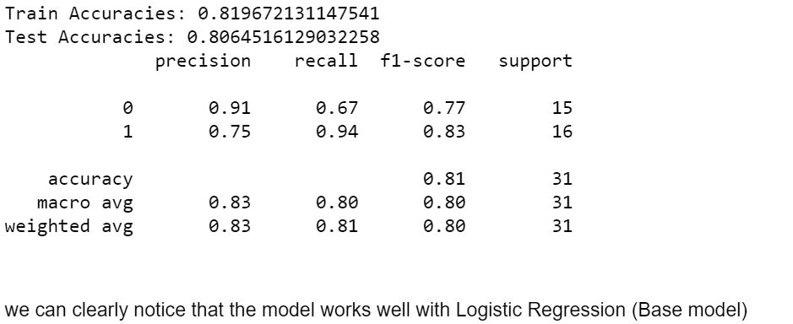
Logistic Regression

Slide 27
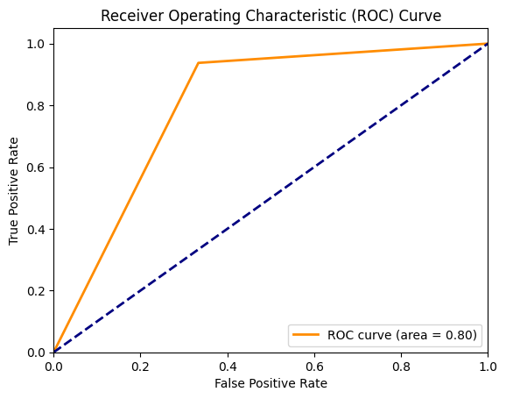
Roc curve for Base model

Slide 28
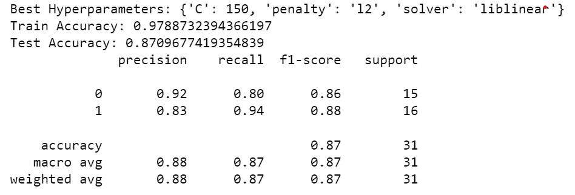
Hyper Tuning
By performing hyperparameter tuning in logistic regression, you can find the best combination of hyperparameters for your specific dataset and problem, leading to a more accurate and well-performing model.

Slide 29
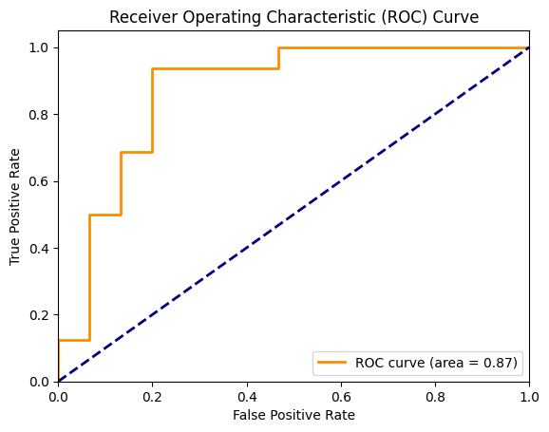
ROC curve After hypertunig

Slide 30
Conclusion:
In this project machine learning algorithm Logistic Regression Model was applied to the dataset.
It utilizes data such as blood pressure,cholesterol, age and then tries to predict the possible coronary heart disease patient in next years.
This may help in taking preventive measure and hence try to avoid the possibility of heart disease for patient.
When a patient is predicted as positive for heart disease, then the medical data for the patient can be closely analyzed by doctors.

