Slide 1
Hidden & Width in Excel 2010
Hiding columns, and then unhiding them on demand, works fine against Excel200x.
Against Excel2010, this only works if column width is also defined when unhiding
  AND width is different from 8.43!

Slide 2
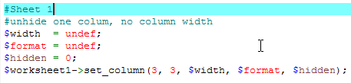
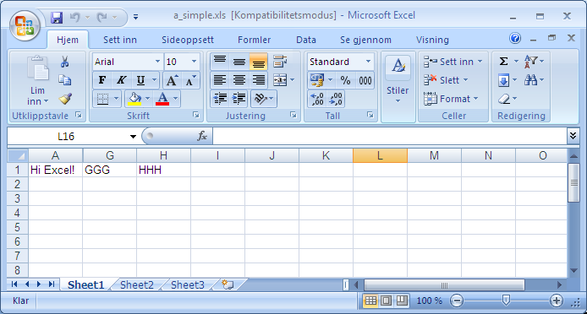
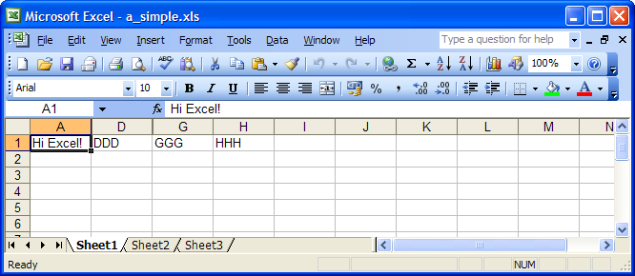
Unhide in Exl07
with width undef,
does not work
Unhide in Exl03
with width undef,
does work

Slide 3
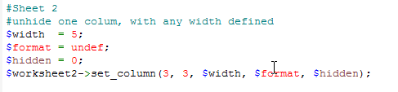
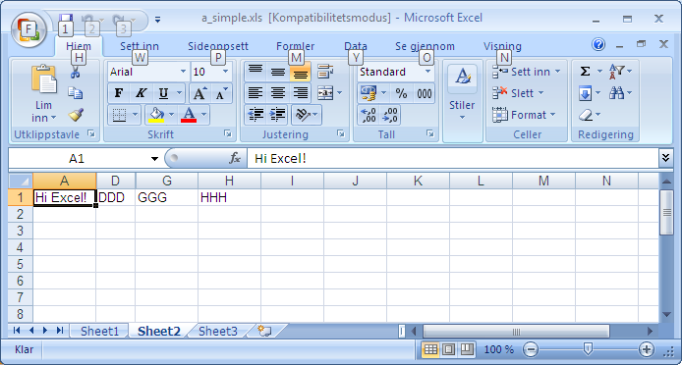

Unhide in Exl07
with width 5,
does work
Unhide in Exl03
with width 5,
does work

Slide 4
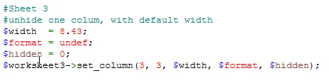
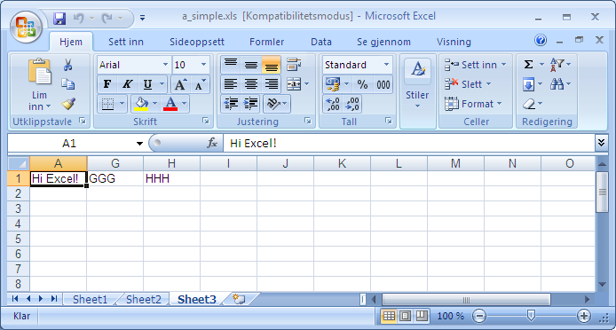
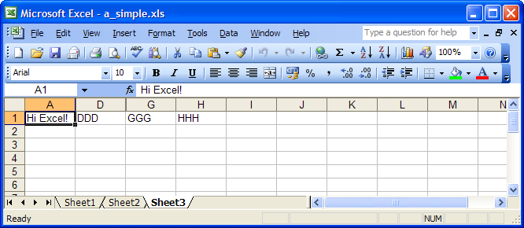
Unhide in Exl07
with width 8.43,
does not work
Unhide in Exl03
with width 8.43,
does work

Slide 5
Version
File generating platform
Perl version : 5.010000
OS name : MSWin32
Module versions: (not all are required)
Spreadsheet::WriteExcel 2.35
Parse::RecDescent 1.962.2
File::Temp 0.22
OLE::Storage_Lite 0.19
IO::Stringy 2.110
Spreadsheet::ParseExcel 0.56
Scalar::Util 1.19
Unicode::Map (not installed)
Also tested on 2.37
Office 2010 Norwegian,
  MSO 12.0.4518.1014,
  Also tested on similar US version

Slide 6
Code
use strict;
use Spreadsheet::WriteExcel;
# Create a new workbook called simple.xls and add a worksheet
my $workbook = Spreadsheet::WriteExcel->new('a_simple.xls');
my $worksheet1 = $workbook->add_worksheet();
my $worksheet2 = $workbook->add_worksheet();
my $worksheet3 = $workbook->add_worksheet();
populate_worksheet($worksheet1);
populate_worksheet($worksheet2);
populate_worksheet($worksheet3);
#Sheet 1,2,3
#hide most columns
my $width = undef;
my $format = undef;
my $hidden = 1;
$worksheet1->set_column(1, 5, $width, $format, $hidden);
$worksheet2->set_column(1, 5, $width, $format, $hidden);
$worksheet3->set_column(1, 5, $width, $format, $hidden);
#Sheet 1
#unhide one column, no column width
$width = undef;
$hidden = 0;
$worksheet1->set_column(3, 3, $width, $format, $hidden);
#Sheet 2
#unhide one column, with any width defined
$width = 5;
$hidden = 0;
$worksheet2->set_column(3, 3, $width, $format, $hidden);
#Sheet 3
#unhide one column, with default width
$width = 8.43;
$hidden = 0;
$worksheet3->set_column(3, 3, $width, $format, $hidden);
sub populate_worksheet {
my ($ws) = @_;
$ws->write(0, 0, "Hi Excel!");
$ws->write(0, 1, 'BBB');
$ws->write(0, 2, 'CCC');
$ws->write(0, 3, 'DDD');
$ws->write(0, 4, 'EEE');
$ws->write(0, 5, 'FFF');
$ws->write(0, 6, 'GGG');
$ws->write(0, 7, 'HHH');
}

