Slide 1
Having the Conversation Practical Tips for Effective Advance Care Planning
Revathi A-Davidson
Jean Anderson
March 28th, 2015

Slide 2
Session Objectives
Participants will be familiar with current advance care planning tools
such as the Values History Form, Advance Directive form, Out of Hospital DNR
form and the New Mexico MOST form.
Participants will be knowledgeable about the recommendations
from the 2014 Institute of Medicine Report called Dying in America.
Participants will understand what it means for a healthcare system
to be "Conversation Ready" and be familiar with The Conversation Project.

Slide 3
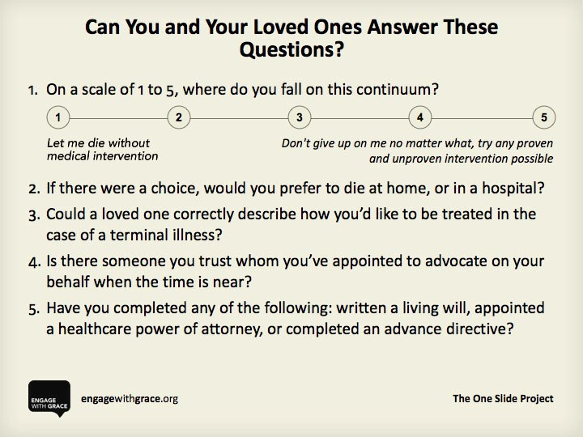

Slide 4
Healthcare Milestones in New Mexico
1977:
New Mexico Right to Die Act
1980s:
Values History Form
Present:
Medical Orders for Scope of Treatment
(MOST) Form
Recent Developments:
Physician aid in dying
January 2014 court ruling
about aid in dying in New Mexico
Why is this case important?

Slide 5
Useful Documents
Advance directives
5 Wishes
Values History http://som.unm.edu/ethics/_docs/values-history.pdf
Medical Orders for Scope of Treatment (MOST)
Do Not Resuscitate orders
Emergency Medical Services: Out of Hospital DNR

Slide 6
5 Wishes: A Summary
Which person you want to make health care decisions for you when you can’t make them.
The kind of medical treatment you want and don’t want.
How comfortable you want to be.
How you want people to treat you.
What you want your loved ones to know.

Slide 7
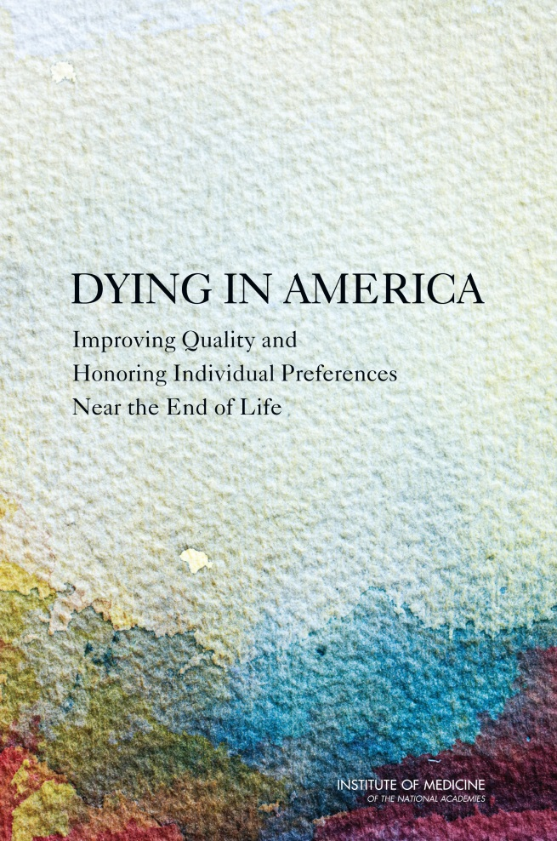

Dying in America: Improving Quality and Honoring Individual Preferences Near the End of Life
www/iom.edu/endoflife
Suggested citation: IOM (Institute of Medicine). 2014. Dying in America: Improving quality and honoring individual preferences near the end of life. Washington, DC: The National Academies Press.

Slide 8
Dying in America: Key Findings and Recommendations
Delivery of Care
Clinician-Patient Communication & Advance Care Planning
Professional Education and development
Policies and Payment Systems
Public Education and Engagement: we will be focusing on this finding and specific steps we can all take.

Slide 9
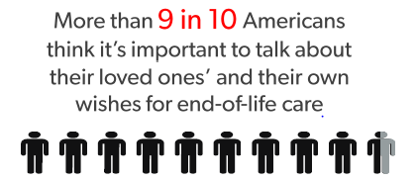
The Talking Gap
90% of people think it is important to talk about their loved ones’ and their own wishes for end-of-life care.
27% of people have discussed what they or their family wants when it comes to end-of-life care.
Source: The Conversation Project National Survey (2013)
Source: The Conversation Project and Institute for Healthcare Improvement

Slide 10
The Conversation Project:
“It is always too early, until it is too late.”
Ellen Goodman
A national public engagement campaign dedicated to assure that everyone’s wishes for end-of-life care are:
Expressed and Respected by:
Individual and Healthcare System
Source: The Conversation Project and Institute for Healthcare Improvement

Slide 11
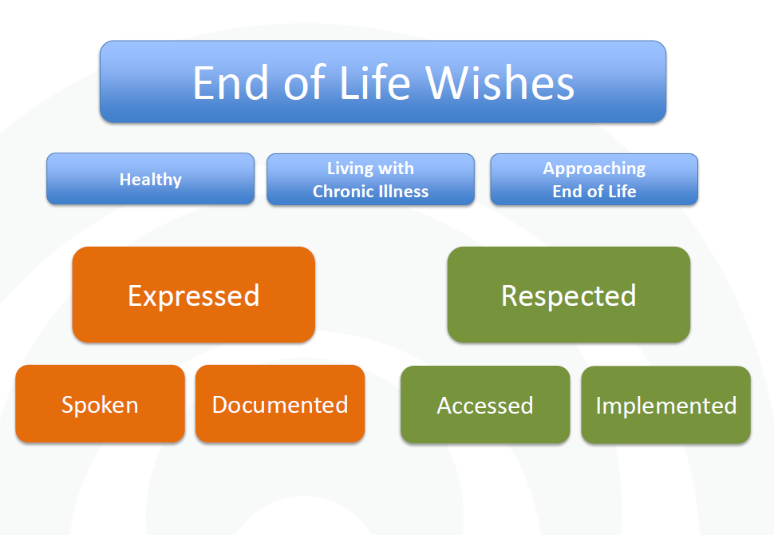
The Conversation Continuum
Source: The Cambia Health Foundation

Slide 12

TCP’s Strategy for Creating Cultural Change
Awareness: National media campaign and community engagement events
Accessible: Tools to help people get started
Available: Bringing TCP to people where they work, where they live, and where they pray

Slide 13
Having the Conversation….
Who?
It starts with each us!
How?
When?

Slide 14
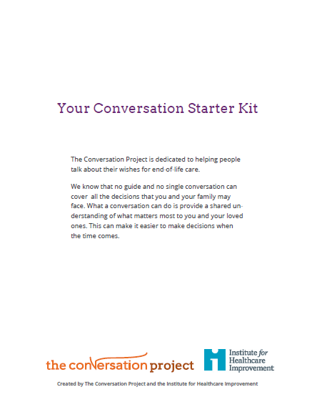
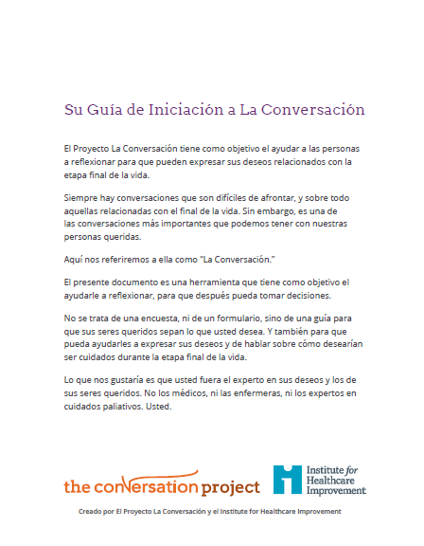
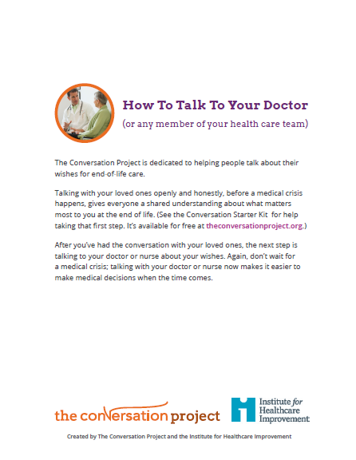
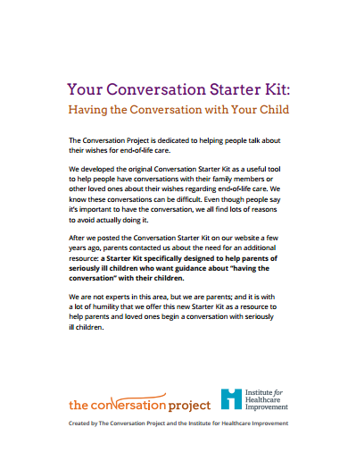
Accessible: Our Tools
Conversation Starter Kit
How to Talk to Your Doctor Starter Kit
Translations
Pediatric Starter Kit

Slide 15
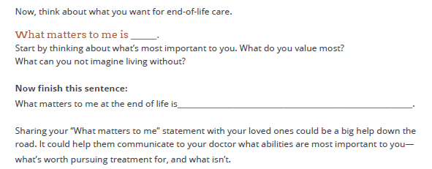
The Starter Kit: Get Ready

Slide 16
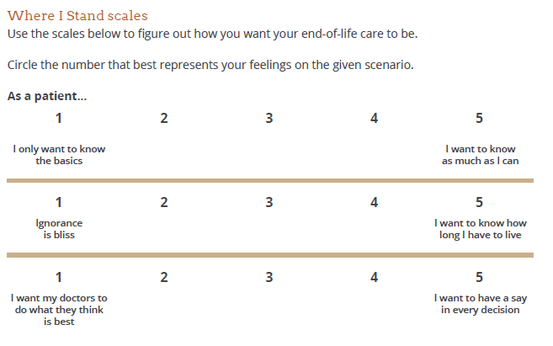
The Starter Kit: Get Set….

Slide 17
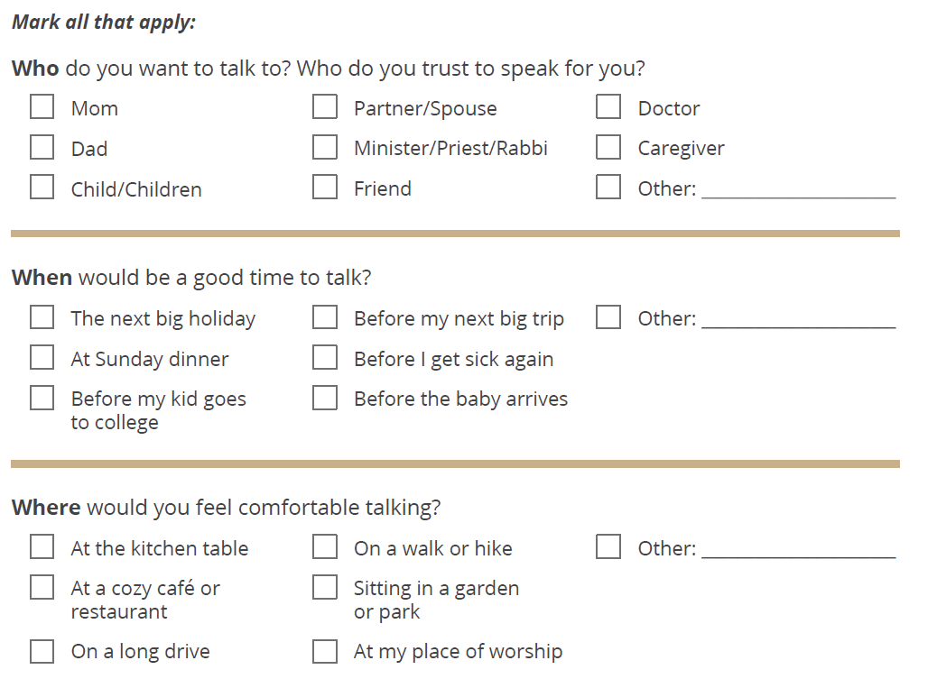
The Starter Kit: Go

Slide 18
It’s time to have the conversation when...
At key milestones, such as
When you get your driver’s license
When you form a long-term relationship
When you have a child
When you plan to retire
When you sign up for Medicare
In certain situations, such as
When you hold a high-risk job
When you engage in high-risk activities
When you start military training or are deployed
If you have a major genetic or congenital health condition
With your care provider, such as
During well visits with your primary care provider
When you’re diagnosed with a chronic, life-limiting illness
As your health worsens
When you enter your final year of expected life
Talk about your end-of-life values, goals, and preferences with your loved ones and care providers regularly. The conversation may be difficult, but wouldn’t you rather have it now, before a crisis?
Source: Institute of Medicine of The National Academies

Slide 19
Making Healthcare Systems Conversation Ready
IHI collaboration with TCP to establish a:
“Conversation Ready Healthcare Community”
The four R’s practiced by such a community:
Reach out
Record
Retrieve
Respect

Slide 20
In Conclusion
“It’s also clear that families need to talk, at the kitchen table, not in the intensive care unit, about how they want to live at the end of life. And they need to talk before there is a crisis.” Ellen Goodman, Founder of The Conversation Project

