Slide 1


Strategic Infrastructure Planning
SECURITY BENCHMARKS & FRAMEWORKS
Prepared for the Management Team | Riyadh Health Clinic
Presented by: Chief Information Technology Officer

Slide 2


EXECUTIVE OVERVIEW
As we scale our Riyadh facility, our digital dependence increases. This presentation aims to define our path toward operational excellence through:
Establishing clear security baselines.
Evaluating ISO 27001 vs. NIST CSF.
Selecting a strategic roadmap for adoption.

Slide 3


WHAT ARE SECURITY BENCHMARKS?
Standardized Baselines
Operational Purpose
Security benchmarks are documented, community-vetted best practices and configurations used to measure the security maturity of an organization. They serve as the "Measuring Stick" for our clinic's IT infrastructure.
By adopting benchmarks, we move from reactive "fire-fighting" to proactive governance. This ensures compliance with local Riyadh health regulations while aligning with global security expectations.

Slide 4


ISO/IEC 27001: THE GOLD STANDARD
Information Security Management
ISO 27001 focuses on establishing a robust **Information Security Management System (ISMS)**. It is less about specific tools and more about management processes, governance, and continuous improvement.
•
Globally recognized certification.
•
Requires mandatory third-party audits.
•
High-level control clauses (4-10) and Annex A (93 controls).
Ref: ISO/IEC. (2022). ISO/IEC 27001 Information security management systems.

Slide 5

NIST CSF: THE ADAPTIVE MODEL
Risk-Based & Outcome-Focused
The **NIST Cybersecurity Framework (CSF)** provides a common language for managing risk. It is highly flexible, allowing us to pick the controls that matter most to our clinical operations.
•
Core Functions: Identify, Protect, Detect, Respond, Recover, Govern.
•
Implementation Tiers for maturity measurement.
•
Voluntary and outcome-oriented.
Ref: NIST. (2024). The NIST Cybersecurity Framework (CSF) 2.0.

Slide 6
FRAMEWORK COMPARISON MATRIX
Feature | ISO/IEC 27001 | NIST CSF 2.0
Primary Focus | Compliance & Management System | Risk Management & Maturity
Certification | Certifiable by Third-Party | Self-Assessment (Non-Certifiable)
Flexibility | Prescriptive Requirements | Highly Scalable & Flexible
Audience | Auditors & Supply Chain | Executives & Technical Practitioners
Cost to Implement | High (Audit fees + Certification) | Moderate (Internal Resources)

Slide 7






HOW THEY WORK TOGETHER
Control Overlap
Common Language
Maturity Path
There is approximately **83% overlap** between the two. Implementing NIST CSF builds a massive foundation for later ISO certification.
Use NIST to find "where we are" and ISO to prove "how well we manage it" to our healthcare regulators.
NIST CSF speaks to business risk, while ISO provides the audit-ready documentation structure required for global partners.

Slide 8
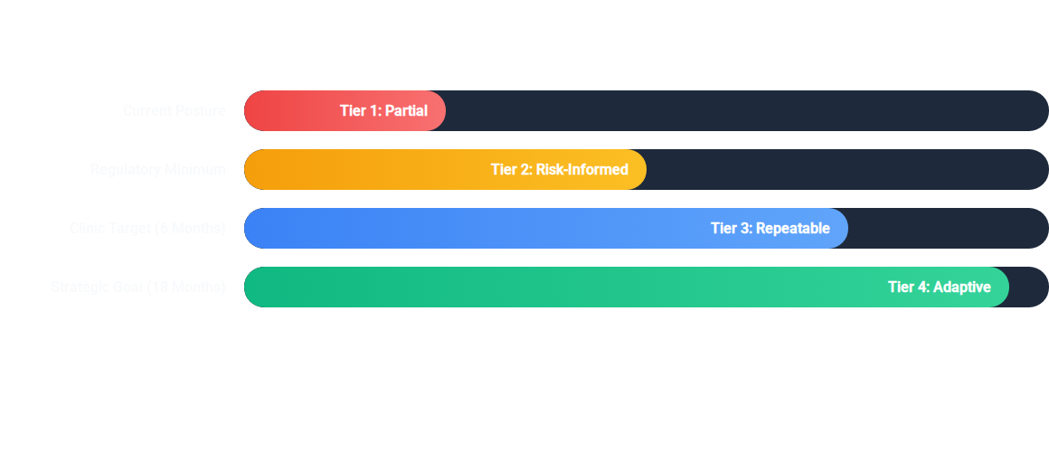
TARGET MATURITY BENCHMARKING
Adopting a benchmark will allow us to objectively track these improvements for the Riyadh Health Ministry.

Slide 9
RECOMMENDATION: NIST CSF FIRST
Why NIST CSF is the Correct First Step:
#1
For a facility of our size, flexibility and speed are critical. NIST CSF allows us to:
**Low Cost:** Free framework with no expensive audit fees.
**Immediate Value:** Identify gaps in weeks, not months.
Strategic Choice
**Clinical Focus:** Tailor security directly to our physician workflows.

Slide 10
BENCHMARK ADOPTION ROADMAP
Q3 2024: Assess
Q4 2024: Implement
Q2 2025: Formalize
Q4 2025: Certify
Conduct NIST CSF self-assessment to find existing gaps.
Deploy missing controls (Identify & Protect phases).
Align NIST outputs with ISO 27001 ISMS requirements.
Final external audit for ISO 27001 Certification.

Slide 11

STRATEGIC CONCLUSION
"
Cybersecurity is not just an IT metric; it is the foundation of patient trust in Riyadh's digital healthcare future.
— Chief Information Technology Officer
Key Takeaways:
• Benchmarks provide the baseline for maturity. • NIST CSF offers the flexibility we need today. • ISO 27001 provides the global credibility we want tomorrow.

Slide 12
Q&A
Strategic Security Decision-Making
Does the management team have any questions regarding the proposed roadmap or framework selection?
Chief IT Officer | Riyadh Medical Facility
cito@riyadhclinic.gov.sa

Slide 13




IMAGE SOURCES
https://static.vecteezy.com/system/resources/previews/008/137/037/non_2x/blurred-background-blur-office-with-bokeh-light-background-banner-business-concept-photo.jpeg
Source: www.vecteezy.com
https://cdn.vectorstock.com/i/500p/42/50/iso-27001-certified-seal-grunge-style-vector-33284250.jpg
Source: www.vectorstock.com
https://www.nist.gov/sites/default/files/images/2019/11/12/frameworkiconswithtext.png
Source: www.nist.gov
https://static.vecteezy.com/system/resources/previews/075/546/779/non_2x/futuristic-technology-blue-abstract-background-with-connected-lines-and-glowing-particles-for-digital-big-data-network-cyber-security-concept-and-futuristic-infrastructure-design-vector.jpg
Source: www.vecteezy.com

