Slide 1
Drones
Ethical Issues

Slide 2
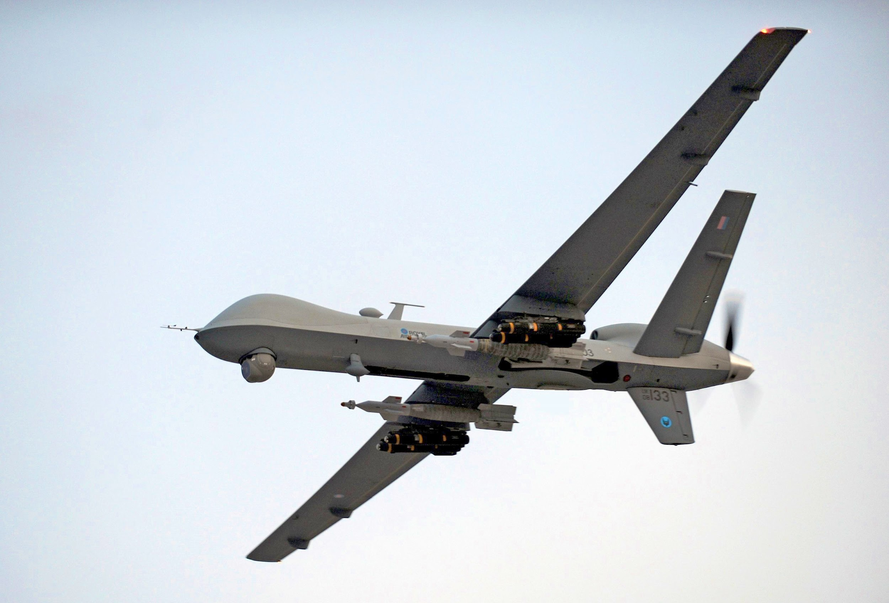
Military Use
Is it ethical to use drones in warfare?
Using unmanned drones can save lives by keeping people out of danger. Further AI development has further possibilities with saving our service members’ lives.

Slide 3
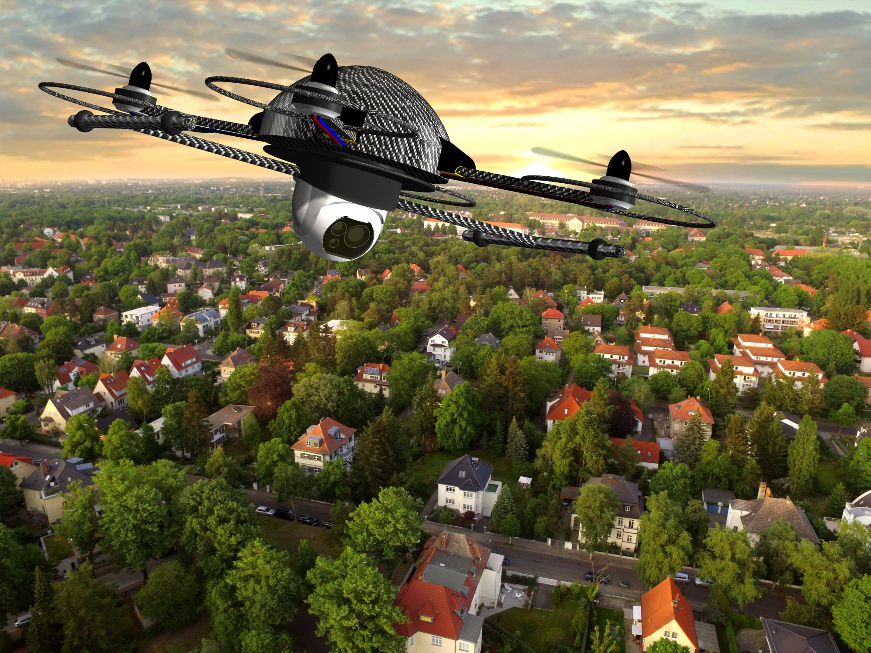
Privacy
High resolution cameras can capture private pictures of people while flying to and from its destination. This could happen with a seemingly innocent delivery drone. This leads to unwanted data gathering.

Slide 4
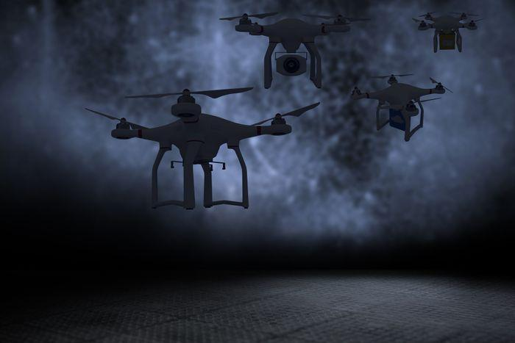
Data Mining
While potential privacy issues arise with drones, so does data mining. Simply put, drones enable another way for companies and governments to gather data on customers and citizens.

Slide 5
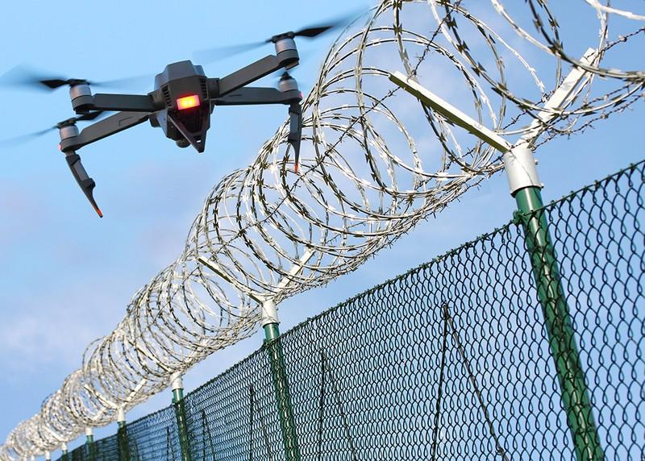
Cybersecurity
Drones are prone to cyber attacks and could be used unethically. Once drones are in malicious hands, who knows what criminals would do with the technology.

Slide 6
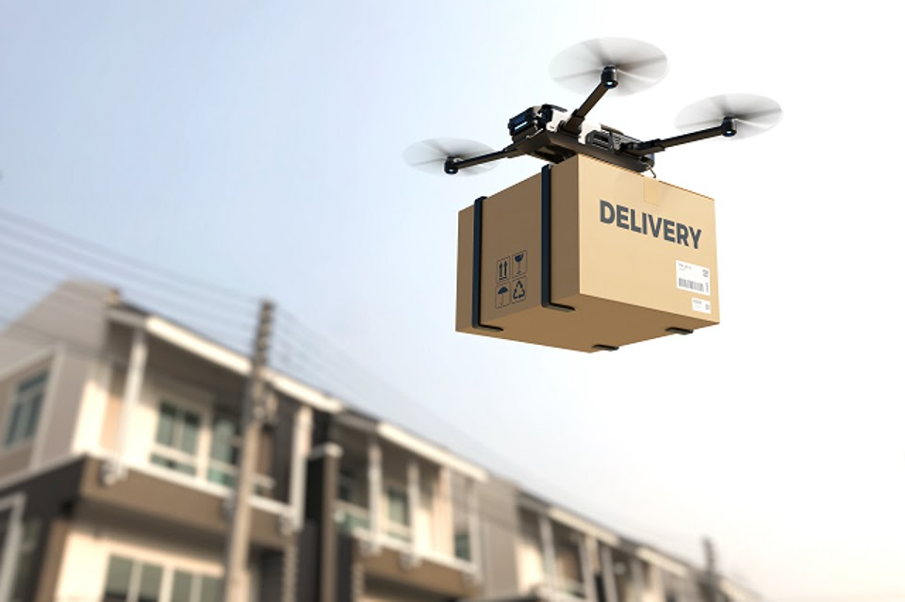
Environmental
Drones can save on fuel usage and CO2 pollution by replacing delivery trucks. The more deliveries dones by drones, the less traffic and less air pollution.

Slide 7
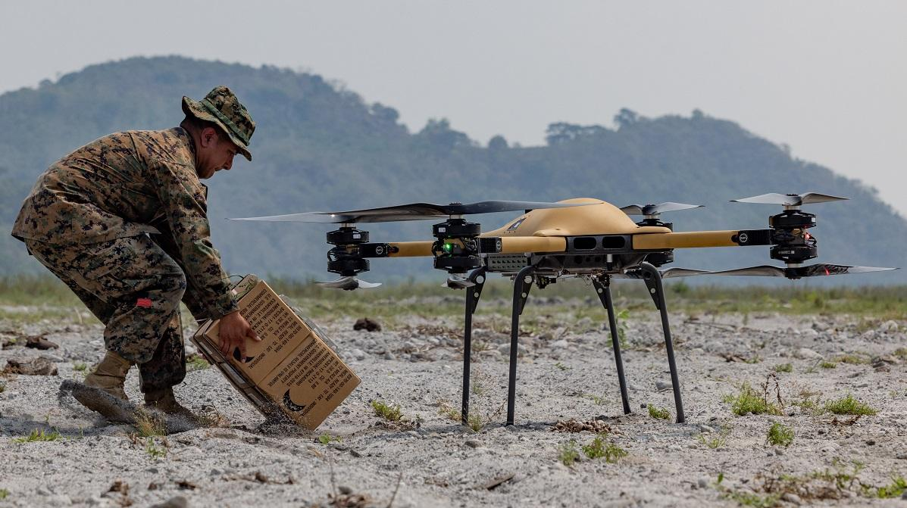
Conclusion
Drones maintain the possibility of providing benefits. However, that does not come without some risk. When used ethically, drones can make the world a safer and better place.

Slide 8
References
Kisters, S. (n.d.). The ethical concerns in drone technology. OriginStamp. https://originstamp.com/blog/the-ethical-concerns-in-drone-technology/#:~:text=Privacy%20is%20a%20primary%20concern,collected%20information%20are%20additional%20concerns.
Canada, D. D. (2023, November 3). Ethical considerations in the use of drones for cargo delivery. LinkedIn. https://www.linkedin.com/pulse/ethical-considerations-use-drones-cargo-delivery-xbeec
Defense Technical Information Center. (n.d.). https://apps.dtic.mil/sti/citations/ADA621793
Enemark, C. (2023, November 18). Enhanced ethics for military users of armed drones. E. https://www.e-ir.info/2023/11/18/enhanced-ethics-for-military-users-of-armed-drones/

