Slide 1


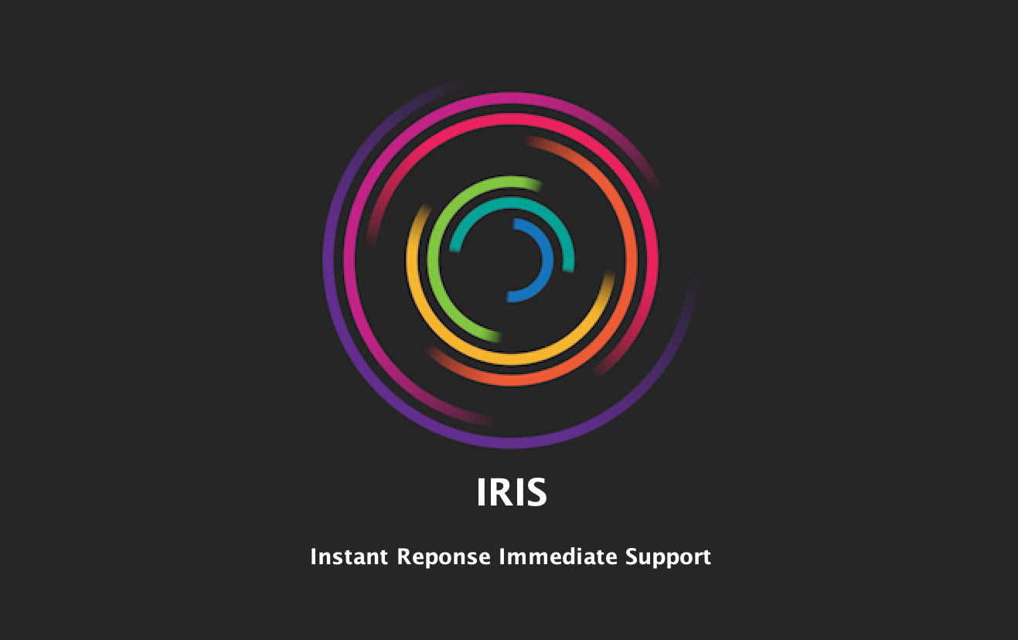




Instant Response Immediate Support
INFO 5100: Application Engineering and Design
AARTI GUPTA
AKSHATA JADHAV
YASWANTH DIGUMARTHI
002193082
001521710
002954545

Slide 2


PROBLEM STATEMENT
Not every 911 call is a true emergency.
Emergency Response Systems become unnecessarily burdened with non-emergent cases.
First Responders and critical equipment get diverted from real emergencies.
Potential delay in care for emergent, life-threatening cases.

Slide 3

BUSINESS IDEA
IRIS attempts at connecting low-acuity 911 callers with primary care resources within the community.
A digital solution to triage non-emergency complaints through immediate telehealth support with instantly available and qualified emergency physicians.
IRIS eligible patients to be schedule either for primary care physician along with arranged transport other than ambulance, local voluntary clinicians, or home care prescribed by physician.

Slide 4





DATA MODEL
USE-CASE DIAGRAM
SEQUENCE DIAGRAM
SYSTEM DESIGN

Slide 5
DEMO

Slide 6

PROJECT RESOURCES & REFERENCES
Real-time Geocoding - https://positionstack.com/
ETHAN. (2020, October 1). ETHAN Telehealth Program supported by the 1115 Waiver. Retrieved from https://www.houstontx.gov/govtrelations/2020interim/10.1.2020-ETHAN.pdf
Jackson, Adria. (2015). Houston EMS Advances Mobile Integrated Healthcare Through the ETHAN Program. Retrieved from https://www.jems.com/mobile-integrated-healthcare/houston-ems-advances-mobile-integrated-healthcare-through-the-ethan-program/
Video/Audio Recording - https://github.com/opencv-java/getting-started
IRIS Project URL - https://github.com/rtGupta/IRIS

Slide 7
THANK YOU!

