Slide 1
Linear Algebra review
2019. 6
References:
Steven Skiena, The Data Science Design Manual, Springer, 2017
Zico Kolter, CMU-388/688 Practical Data Science: Matrices, vectors, and linear algebra (review summary), 2018

Slide 2
Matrices and Linear Algebra
The most critical part of your data science project is reducing all the information you can find into one or more data matrices, ideally as large as possible.
  Rows: examples, samples, or indices
  Columns: distinct features or attributes
Linear algebra: mathematics of matrices
  Many machine learning algorithms are best understood through linear algebra

Slide 3
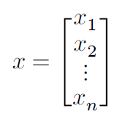
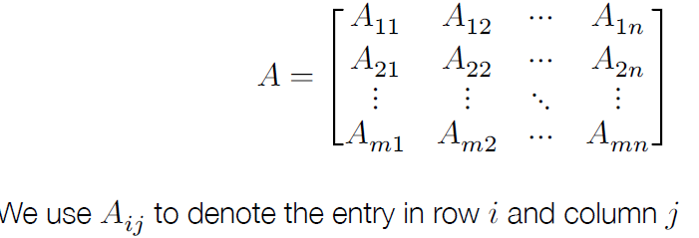
Matrices and Vectors
A vector is a 1D array of values
  By default, we use column vectors.
A matrix is a 2D array of values
  “Higher dimensional matrices” are called tensors.

Slide 4
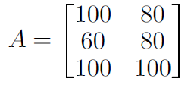
Row and column ordering
Matrices can be laid out in memory by row or by column
  Row major ordering: 100, 80, 60, 80, 100, 100
  Column major ordering: 100, 60, 100, 80, 80, 100
Row major ordering is default for C 2D arrays (and default for Numpy), column major is default for FORTRAN (since a lot of numerical methods are written in FORTRAN, also the standard for most numerical code)

Slide 5
What Can n*m Matrices Represent?
Data: rows are objects, columns features.
Geometric point sets: rows are points, columns are dimensions
Systems of Equations: rows are equations, columns are coefficients for each variable.
Graphs/Networks: M[i,j] denotes the number of edges from vertex i to vertex j.
Vectors: any row, column or d*1 matrix
Images: pixel (x,y)

Slide 6

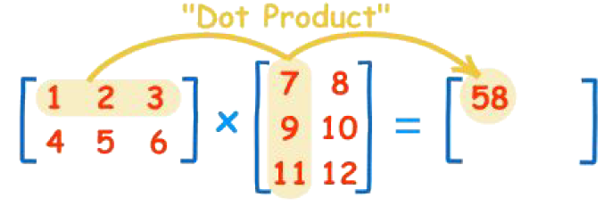
Matrix multiplication/ Dot products
The product A*B is defined by:
A*B must share inner dimensions to multiply.
Each element of the product matrix is a dot product of row/column vectors.
It is associative, but not commutative.
Multiplication by the identity commutes: I A = AI = A

Slide 7
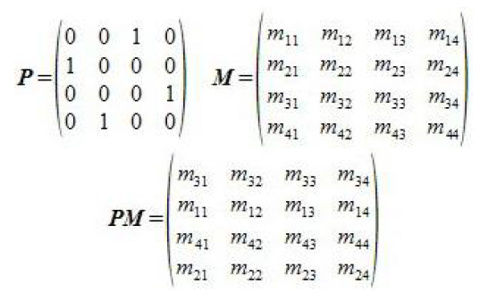
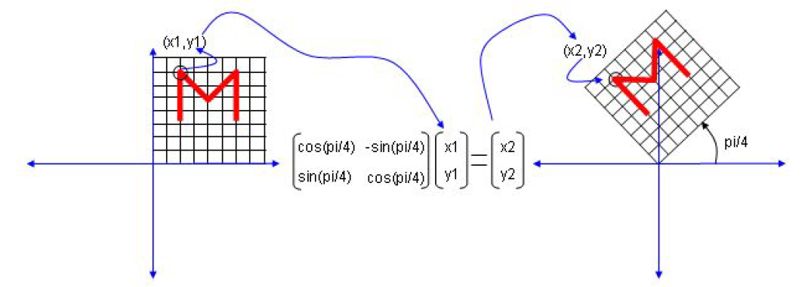
Interpreting Matrix Multiplication
Multiplication by permutation matrices rearrange rows/columns:
Rotating point in space:

Slide 8
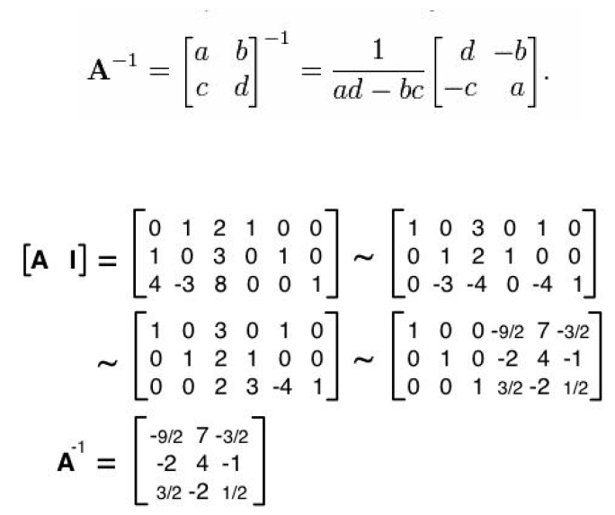
Matrix Inversion
A⁻¹ is the multiplicative inverse of A, if A * A⁻¹ = I, where I is the identity matrix.
If matrix A has an inverse, it can be computed by solving a linear system using Gaussian elimination.

Slide 9
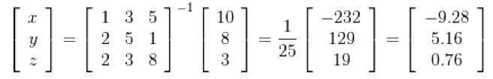
Matrix Inversion and Linear Systems
Multiplying both sides of Ax = b by the inverse of A yields: (A⁻¹ A)x = A⁻¹ b , or x = A⁻¹ b
Thus solving linear equations is equivalent to matrix inversion.
The inverse makes it cheap to evaluate many b vectors. However, Gaussian elimination is more numerically stable than inversion.

Slide 10
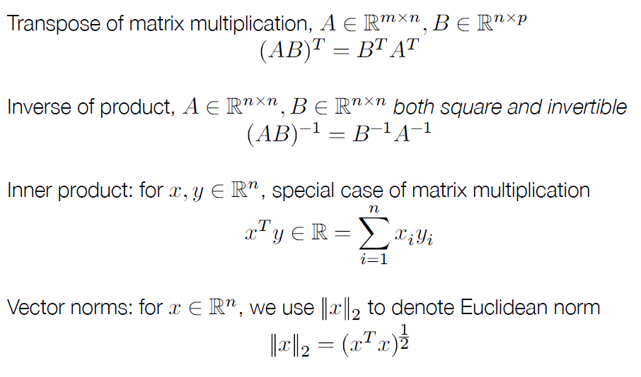
Some definitions/properties

Slide 11
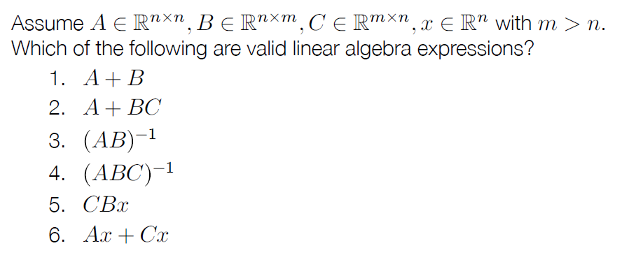
Valid linear algebra expressions

Slide 12
Matrix Rank
Systems are underdetermined if rows can be expressed as linear combinations of other rows.
The rank of a matrix is a measure of the number of linearly independent rows.
An n*n matrix should be rank n for all operations to be properly defined on it.
Some rows of the image may not be linearly independent, so it is not full rank. Adding small amounts of random noise increases rank without serious image distortion.

Slide 13
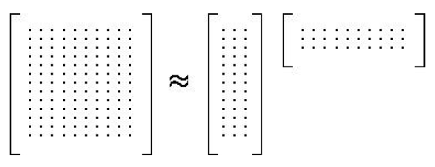
Factoring Matrices
Many important machine learning algorithms can be viewed as factoring a matrix. Suppose n*m matrix A can be expressed as the product B*C, i.e an n*k matrix times a k*m matrix.
(ex) factoring Word-Document Matrices
  If A is a document/word co-occurrence matrix, and A=BC, where B is d*k and C is k*w:
  B,C are compressed feature vectors for docs and words

Slide 14
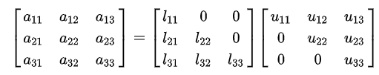
LU Decomposition
A = LU
  Factoring a matrix M representing lower and upper triangular matrices L and U prove useful in solving linear systems.
  The determinant of M is the product of the main diagonal elements of U.

Slide 15
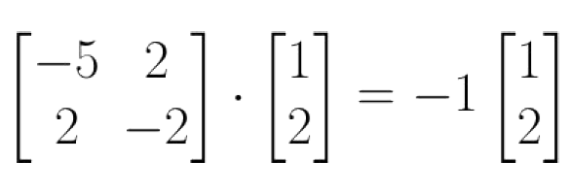
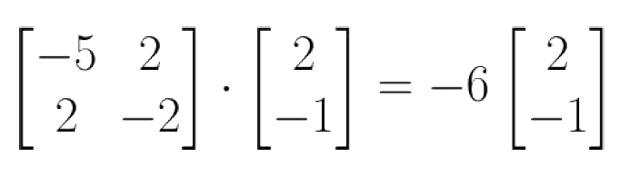
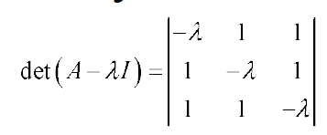
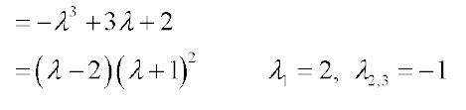
Eigenvalues and Eigenvectors
Multiplying a vector x by a matrix A can have the same effect as multiplying it by a scalar λ.
  Av = λv (x: eigenvector, λ: eigenvalue)
  Thus the eigenvalue-eigenvector pair (λ, v) must encode a lot of information about matrix A!
The n distinct eigenvalues of a rank n matrix can be found by factoring its characteristic equation.

Slide 16
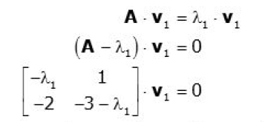
Computing Eigenvectors
The vector associated with a given eigenvalue can be computed by solving a linear system:
  (ex)
  -λ1 *v1,1 + v1,2 = 0
  -2 * v1,1 + (-3- λ1)*v1,2 = 0
Another approach uses v’ = (A * v)/ λ to compute approximations to v until it converges.

Slide 17
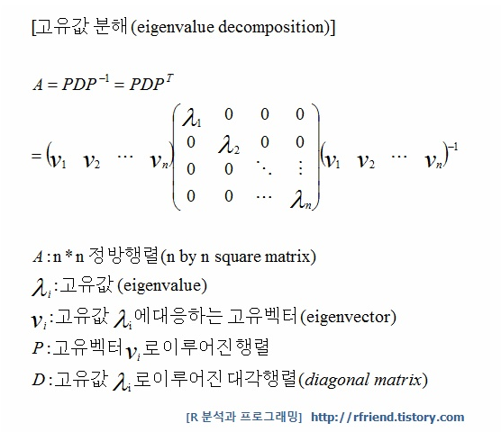
Eigenvalue Decomposition
Larger eigenvalues correspond to more important vector products.

Slide 18
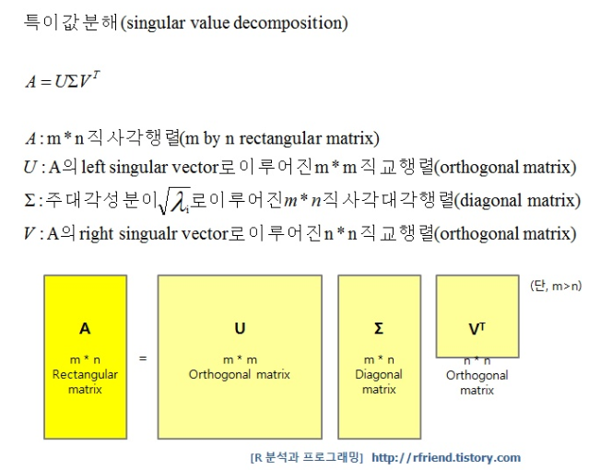

Singular Value Decomposition
Retaining only the rows/column with large weights permits us to compress m features with relatively little loss.

Slide 19




Reconstructing image from SVD
Lincoln’s face from 5 and 50 singular values, a substantial compression of the original matrix.
  (a) original (b) k=5 © k=50 (d) error for k=50

Slide 20
Sparse matrices
Many matrices are sparse (contain mostly zero entries, with only a few non-zero entries)
Examples: matrices formed by real-world graphs, document-word count matrices (more on both of these later)
Storing all these zeros in a standard matrix format can be a huge waste of computation and memory
Sparse matrix libraries provide an efficient means for handling these sparse matrices, storing and operating only on non-zero entries
  Note: this is important from the first (storage-based) perspective of matrices, the linear algebra is the same (mostly)

Slide 21
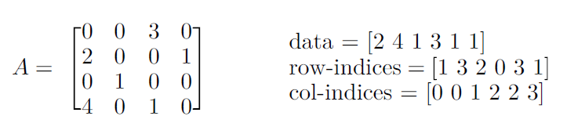
Coordinate format
There are several different ways of storing sparse matrices, each optimized for different operations
Coordinate (COO) format: store each entry as a tuple (row-index, col-index, value)
A good format for constructing sparse matrices

Slide 22
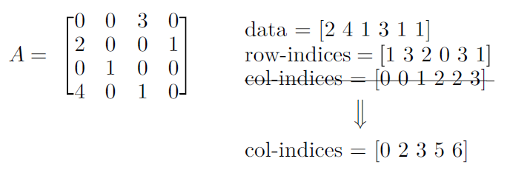
Compressed sparse column format
Compressed sparse column (CSC) format
Ordering is important (always column-major ordering)
Faster for matrix multiplication, easier to access individual columns
Very bad for modifying a matrix, to add one entry need to shift all data

