Slide 1
Probability and Statistics Review
2019. 6
Reference:
Steven Skiena, The Data Science Design Manual, Springer, 2017
https://www.cs.cmu.edu/~epxing/Class…/Probability_Review.ppt

Slide 2
Probability and Statistics
Probability
  deals with predicting the likelihood of future events
  theoretical branch of mathematics on the consequences of definitions
  For dice game, “each face will come up with probability 1/6.”
Statistics
  analyzes the frequency of past events
  applied mathematics trying to make sense of real-world observations
  For dice game, “I will watch a while, and keep track of how often each number comes up.”

Slide 3

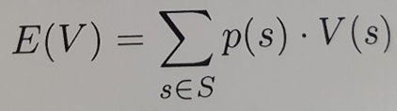
Probability
Experiment: a procedure which yields one of a set of possible outcomes
Sample space S: set of possible outcomes s of an experiment
Event: specified subset of the outcomes of an experiment
Probability p(s) of an outcome s: a number with:
  0 <= p(s) <= 1
Random variable V: numerical function(assignment) on the outcomes of a probability space
Expected value E of a random variable V on sample space S:

Slide 4
Probability (example)
Experiment: tossing two six-sided dice
Sample space S: 36 possible outcomes, namely
  S = {(1,1),(1,2),(1,3),(1,4),(1,5),(1,6), {(2,1),(2,2),(2,3),(2,4),(2,5),(2,6),
  (3,1),(3,2),(3,3),(3,4),(3,5),(3,6), {(4,1),(4,2),(4,3),(4,4),(4,5),(4,6),
  (5,1),(5,2),(5,3),(5,4),(5,5),(5,6), {(6,1),(6,2),(6,3),(6,4),(6,5),(6,6)}
Event: the event that the sum of the dice equals 7 or 11
  E = {(1,6),(2,5),(3,4),(4,3),(5,2),(6,1), (5,6),(6,5)}
Probability of the event: p(E) = 8/36
Random variable V: V(s) = 1 , 2 , 3 , 4 , 5 , 6 for each sample s
  P(V=7) = 1/6, p(V=12) = 1/36
Expected value E:
  E(V) = 1/6(1) +1/6(2) + 1/6(3) + 1/6(4) + 1/6(5) + 1/6(6) = 21/6

Slide 5

Compound Events and Independence
Suppose half my students are female (event A), and Half my students are above median (event B). What is the probability a student is both A & B?
Events A and B are independent iff
Independence (zero correlation) is good to simplify calculations but bad for prediction (no information shared between events A and B)

Slide 6
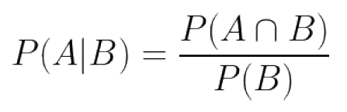
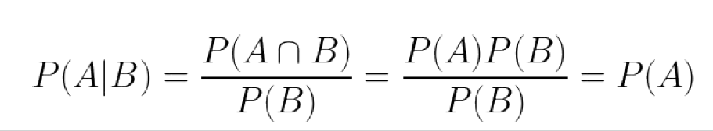
Conditional Probability
The conditional probability P(A|B) is defined:
Conditional probability get interesting only when events are not independent, otherwise:

Slide 7
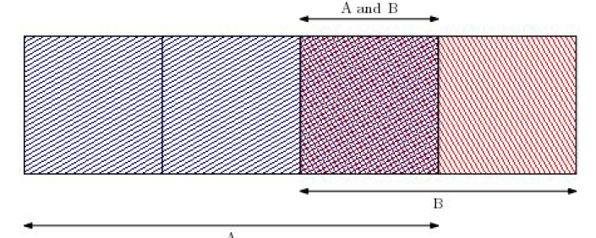
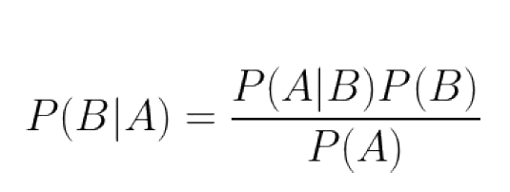
Bayes Theorem
Bayes theorem is an important tool which reverses the direction of the dependences:

Slide 8

Probability Distribution
확률분포
  확률변수 x 가 특정한 값을 가질 확률 정보
Probability Density Function, PDF (확률밀도함수)
  연속 확률변수에서 확률변수의 분포
  (ex) 키, 나이
Probability Mass Function, PMF (확률질량함수)
  이산확률변수에서 특정값에 대한 확률
  (ex) 주사위, 동전
Cumulative Distribution Function, CDF (누적분포함수)

Slide 9
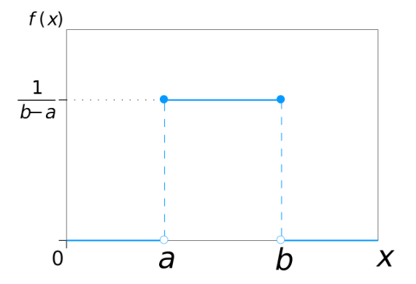
Probability Distribution
Uniform Distribution(균일분포)

Slide 10
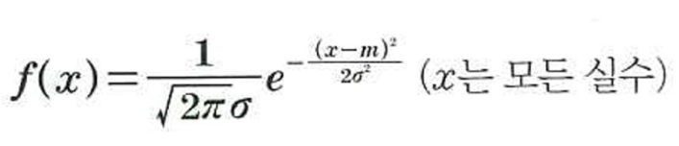
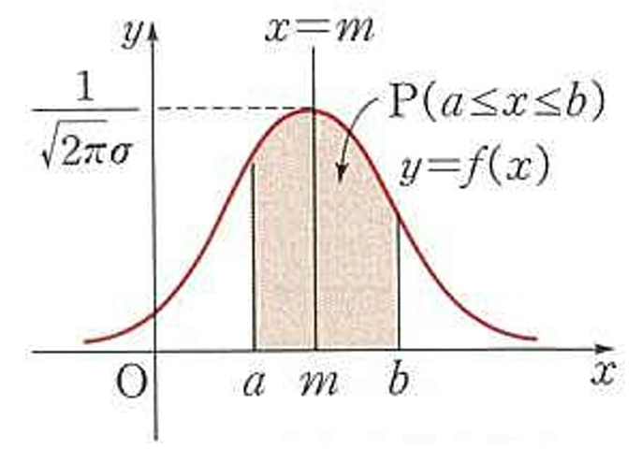
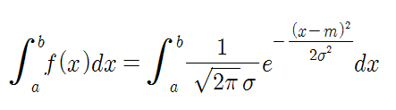
Probability Distribution
Normal Distribution (정규분포)
  확률 P(a ≤ X ≤ b) =

Slide 11
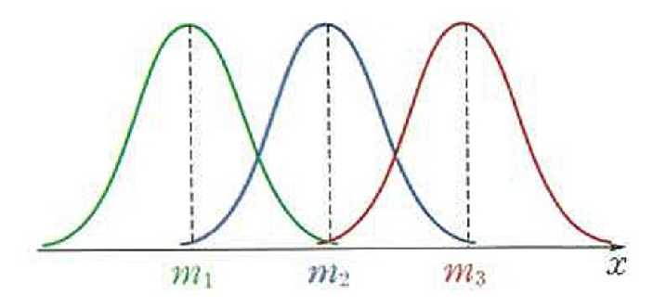
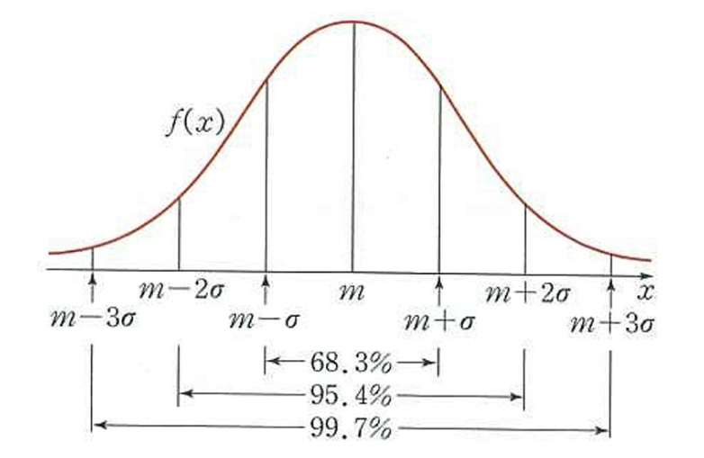
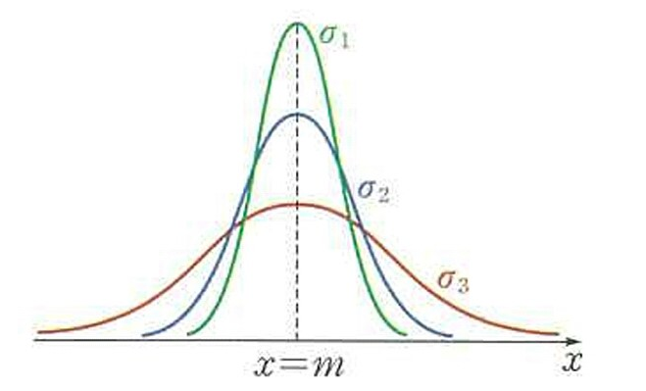
Probability Distribution
Normal Distribution (continued)

Slide 12
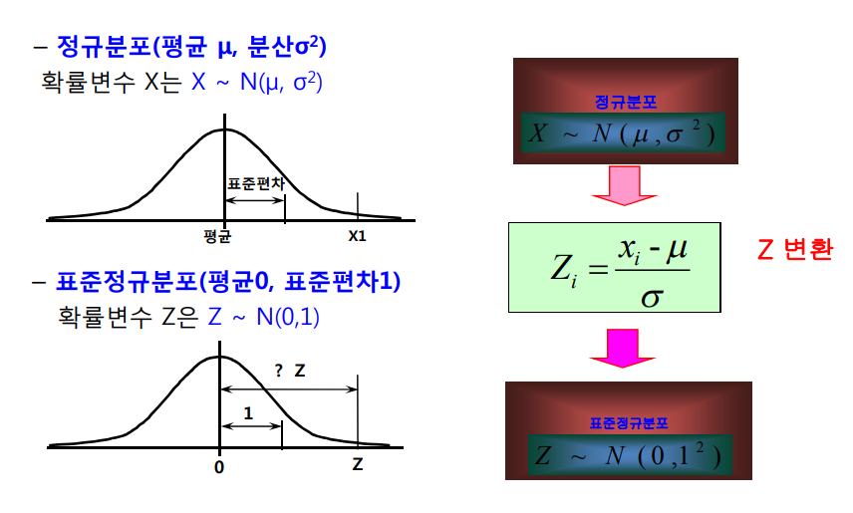
Probability Distribution
표준정규분포(Standard Normal Distribution)

Slide 13
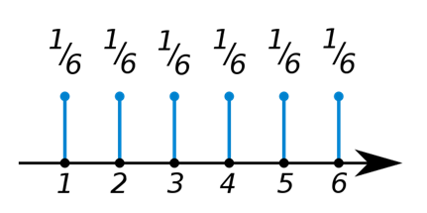

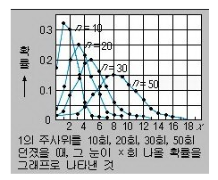
Probability Distribution
Discrete random variable
  (ex) 주사위를 한 번 던져 나올 값의 확률변수: X
  이항분포(Binomial Distribution): 여러 번의 연속 실험의 확률 (ex: 축구선수의 패널티킥 성공 확률이 0.8 일 때 10번 차서 7번 성공할 확률)
(*) p가 0이나 1에 가깝지 않고 n이 충분히 크면 이항분포는 정규분포(가우스분포)에
가까워지며, p가 1/2에 가까워짐에 따라 그래프는 좌우대칭인 산 모양 곡선이 된다.

Slide 14
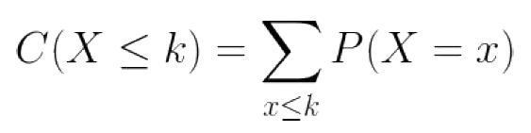
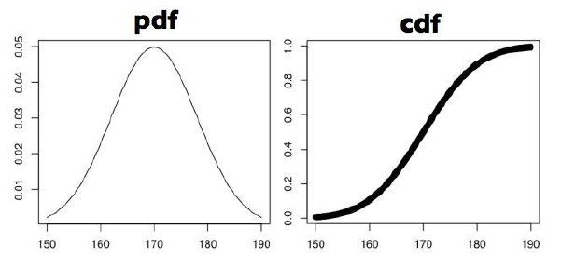
Probability/cumulative distribution
The cdf is the running sum of the pdf:
The pdf and cdf contain exactly the same information, one being the integral / derivative of the other.

Slide 15
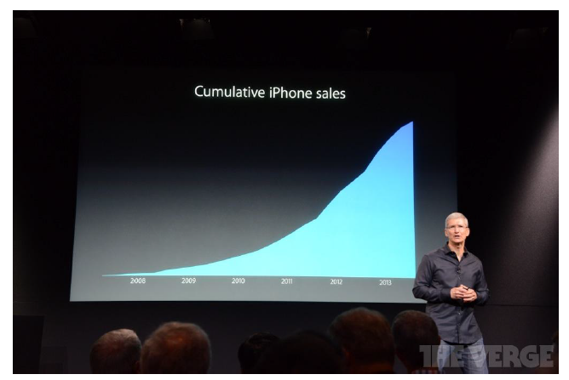
Visualizing Cumulative Distributions
Apple iPhone sales have been exploding, right?

Slide 16
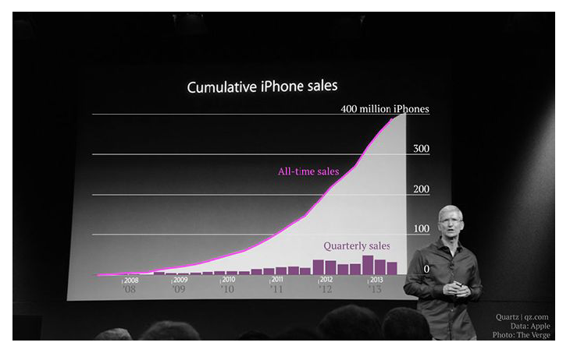
How explosive is that growth, really?
Cumulative distributions present a misleading view of growth rate.
  The incremental change is the derivative of this function, which is hard to visualize

Slide 17
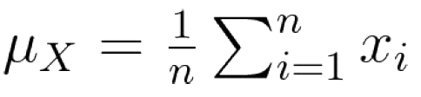

Descriptive Statistics
Descriptive statistics provides ways to capture the properties of a given data set / sample.
  Central tendency measures describe the center around the data is distributed.
  Variation or variability measures describe data spread
Centrality measure
  Mean: arithmetic, geometric, harmonic
  Median
  Mode

Slide 18
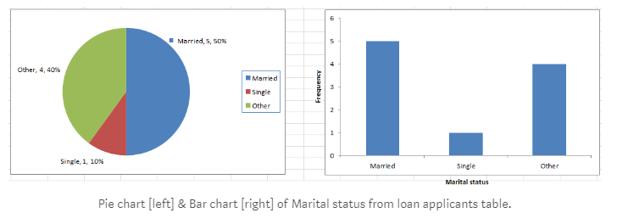
Uni-variate Descriptive Statistics
Different ways you can describe patterns found in uni-variate data include central tendency : mean, mode and median and dispersion: range, variance, maximum, minimum, quartiles , and standard deviation.

Slide 19
Bi-variate Descriptive Statistics
Bi-variate analysis involves the analysis of two variables for the purpose of determining the empirical relationship between them. The various plots used to visualize bi-variate data typically are scatter-plot, box-plot.
Scatter Plots
  The simplest way to visualize the relationship between two quantitative variables , x and y. For two continuous variables, a scatter-plot is a common graph. Each (x, y) point is graphed on a Cartesian plane, with the x axis on the horizontal and the y axis on the vertical. Scatter plots are sometimes called correlation plots because they show how two variables are correlated.
Correlation
  The correlation coefficient r quantifies the strength and direction of the linear relationship between two quantitative variables. The correlation coefficient is defined as:

Slide 20
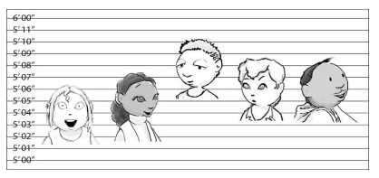
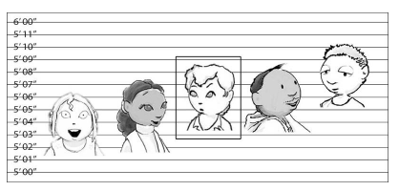

The Three Ms
Mean(평균): the average result
Median(중간값): the score that divides the result in half – the middle value
Mode(최빈치): the most common result

Slide 21
Which measure is best?
Mean is meaningful for symmetric distributions without outliers: e.g. height and weight.
Median is better for skewed distributions or data with outliers: e.g. wealth and income.
Bill Gates adds $250 to the mean per capita wealth but nothing to the median.

Slide 22
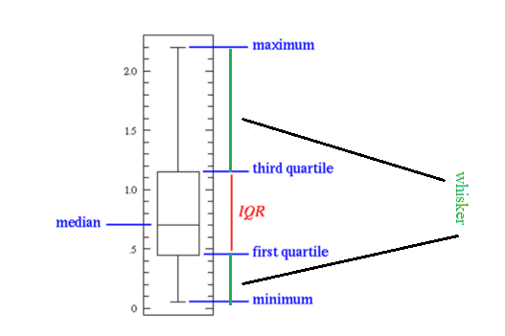
Boxplots
Box plots are especially useful for indicating whether a distribution is skewed and whether there are potential unusual observations (outliers) in the data set.

Slide 23
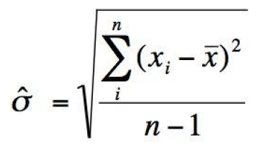
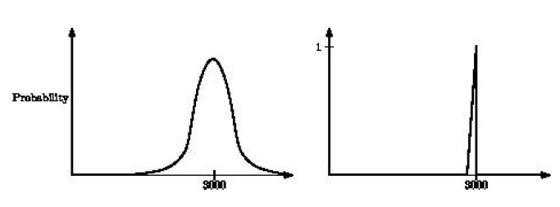
Variance Metric: Standard Deviation
The variance is the square of the standard deviation sigma.
Distributions with the same mean can look very different. But together, the mean and standard deviation fairly well characterize any distribution.

Slide 24
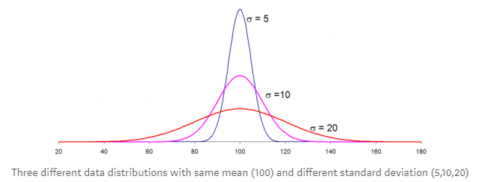
Standard Deviation

Slide 25
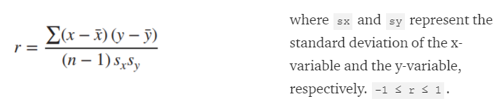
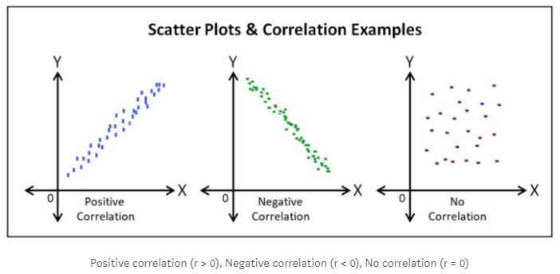
Correlation

Slide 26

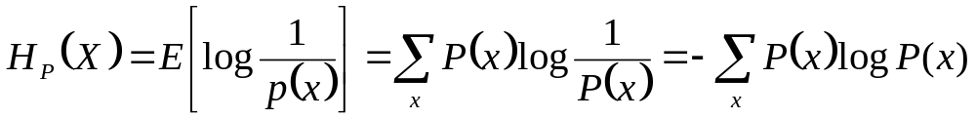
Information Theory
P(X) encodes our uncertainty about X
  Some variables are more uncertain that others
  How can we quantify this intuition?
    Information:
    Entropy: average number of bits required to encode X
P(X)
X

