Slide 1
Customer Churn in Banking - Exploratory Data Analysis
Data Exploration and Analysis (DSC530)
Ramesh Talapaneni
Prof. Amirfarrokh Iranitalab
2024-03-01

Slide 2
Introduction
Project Context
Understanding the factors influencing customer churn at a retail bank and developing strategies to improve retention.
Dataset Overview
Examine a comprehensive dataset, including demographics, account details, and customer behavior indicators.
To identify key predictors of churn.
To quantify the strength of relationships between customer attributes and churn likelihood.
To explore patterns and trends within customer behavior.
Analytical Goals
Data Exploration: Visualizations and summary statistics to understand the data distribution and initial patterns.
Statistical Analysis: Hypothesis testing to validate assumptions and inferential statistics to gauge variable significance.
Predictive Modeling: Logistic regression to predict churn based on customer attributes.
Methodology

Slide 3
About Dataset
RowNumber
NumOfProducts
CustomerId
HasCrCard
Surname
IsActiveMember
CreditScore
EstimatedSalary
Fields
Geography
Exited
1
Gender
Complain
2
Age
Satisfaction Score
Tenure
Card Type
3
Balance
Points Earned
Source
Bank Customer Churn (Kaggle)

Slide 4
Variables of choice
CreditScore
A numerical indicator of a customer's creditworthiness.
Balance
The customer's age could influence their decision to stay with or leave the bank.
Agenda
Balance
The current balance in the customer's account.
NumOfProducts
The number of products the customer has purchased from the bank.
IsActiveMember
Whether the customer is an active member.

Slide 5
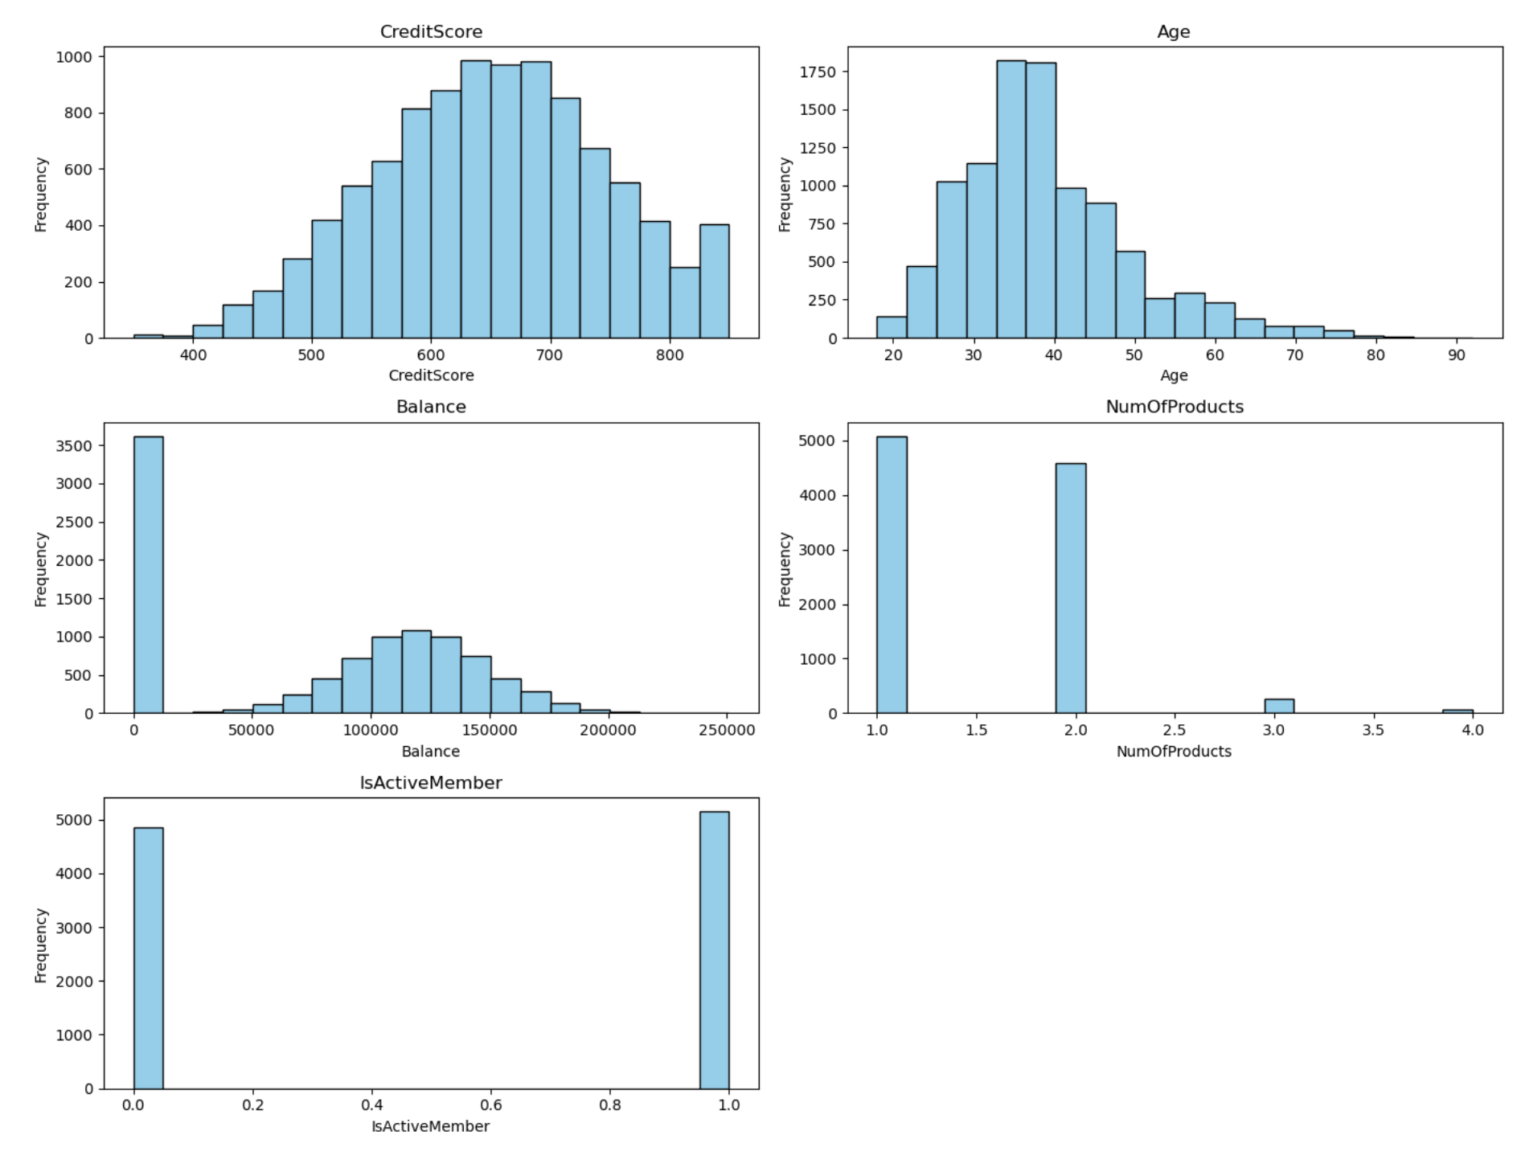
Histograms

Slide 6
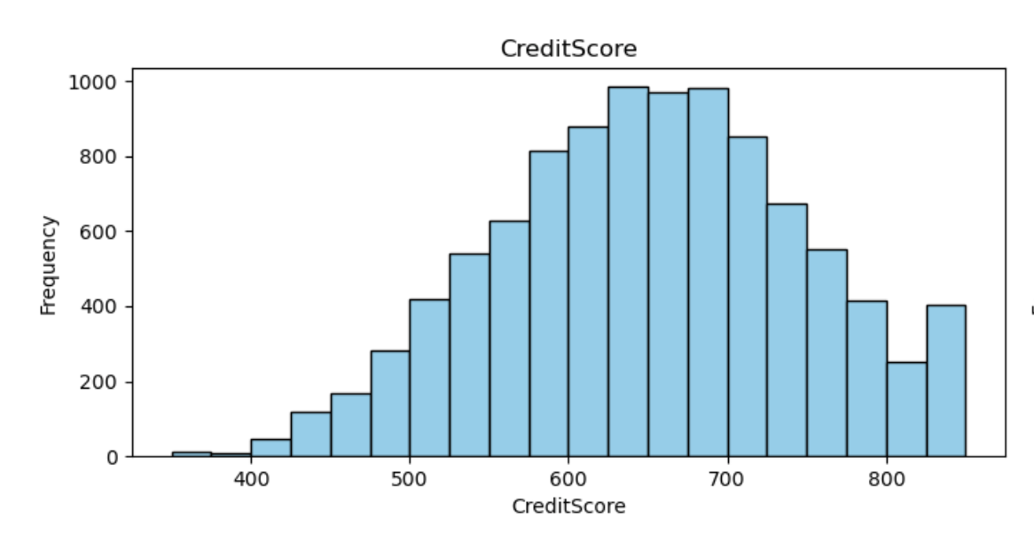
Histogram – Credit Score
The distribution exhibits a near-normal shape, suggesting balanced data distribution without significant skewness
No conspicuous outliers are evident, minimizing the potential for distortion in the analysis.
The symmetrical spread of data points around the central tendency enhances dataset reliability.
The absence of outliers reinforces the credibility of statistical measures, supporting confident interpretations and rigorous analysis.

Slide 7
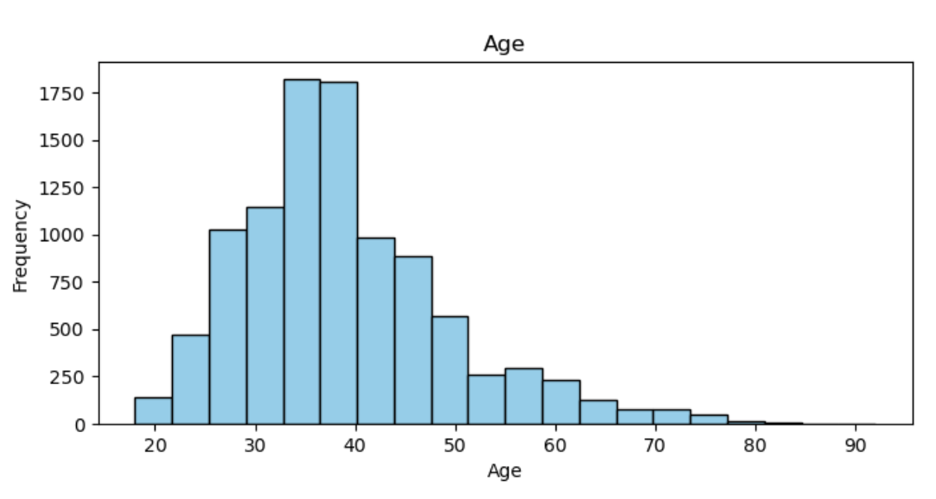
Histogram – Age
The age histogram illustrates a slightly right-skewed distribution of age.
Older customers are present, although the majority are younger.
The shape suggests that more individuals tend to be clustered toward the younger age range.
Overall, the distribution highlights varying age demographics among customers.

Slide 8
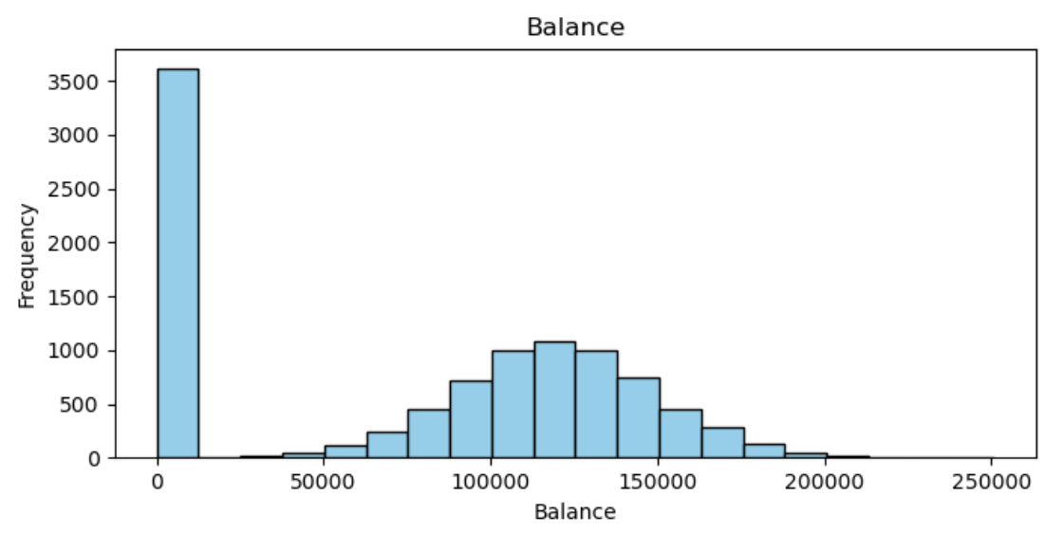
Histogram – Balance
A peak at zero suggests that a significant portion of customers have no balance.
The distribution reveals a fairly uniform spread of balances among the remaining customers.
Many customers exhibit zero balance, contributing to the large peak observed.
Beyond zero balance, the distribution displays relatively consistent balances among customers.

Slide 9
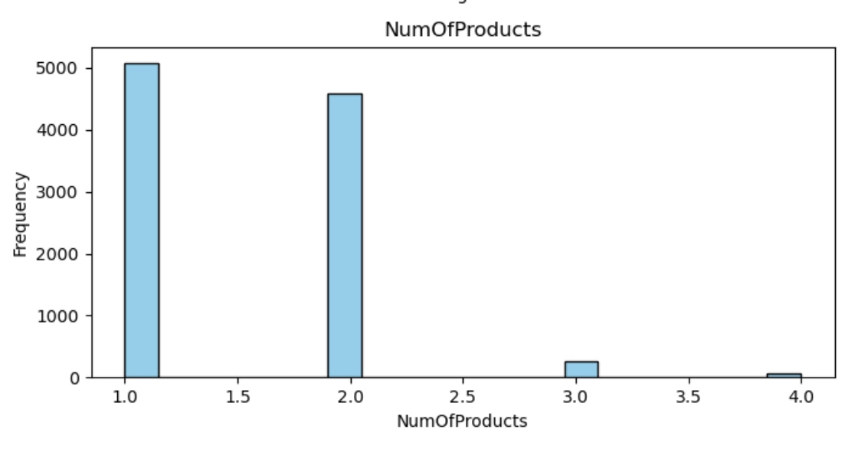
Histogram – Number of Products
The majority of customers possess one or two products offered by the bank.
A smaller proportion of customers hold three or four products, potentially representing outliers.
Most customers are concentrated within the range of one to two products.
The presence of fewer customers with three or four products suggests a deviation from the norm in the dataset.

Slide 10
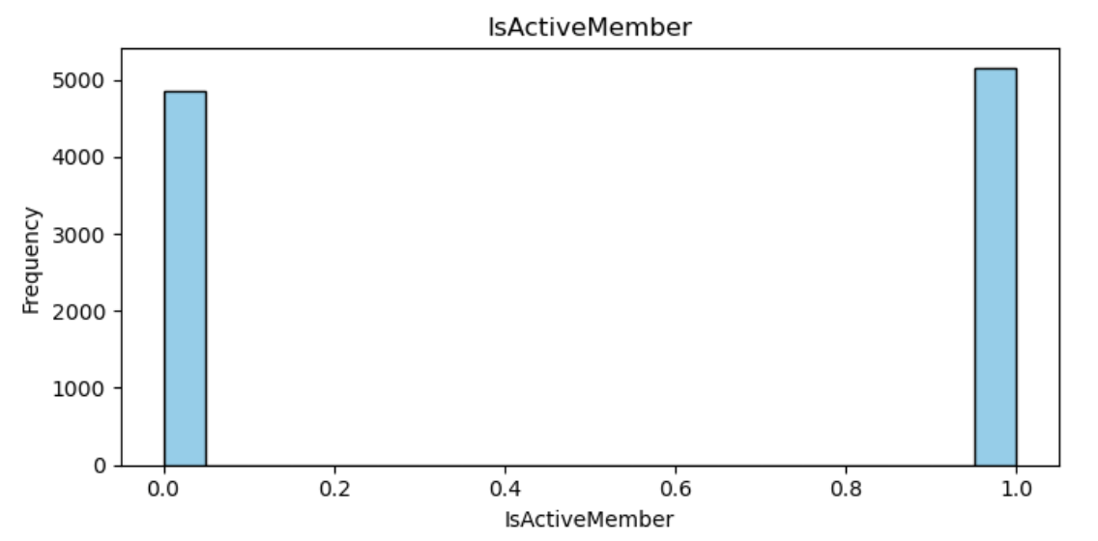
Histogram – Is Active Member?
Two distinct bars suggest a binary nature for this variable, distinguishing between active and non-active members.
Clear differentiation is observed between active and non-active members, reflected in the distinct bars.

Slide 11
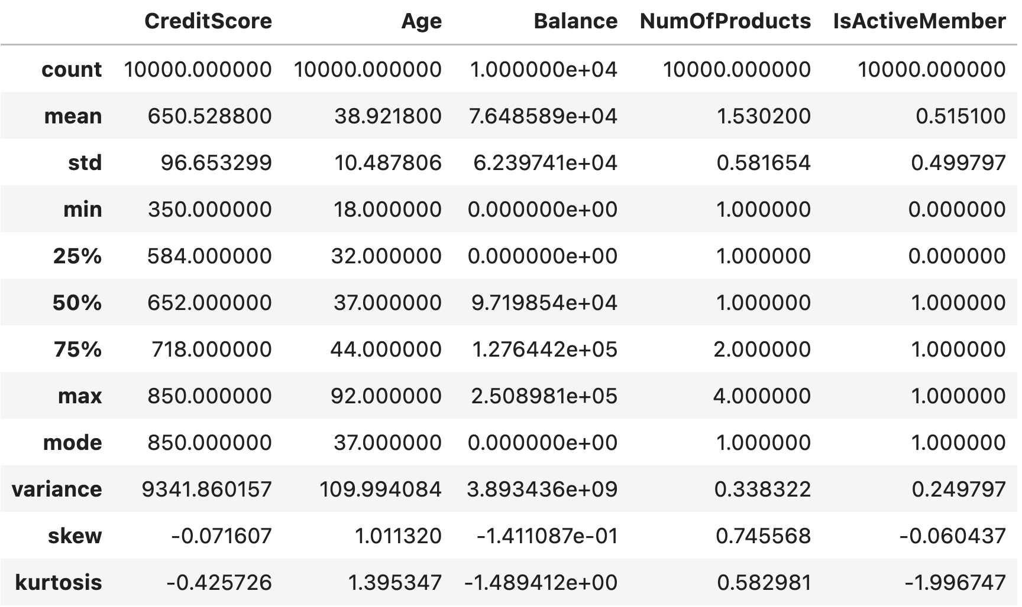
Descriptive Statistics

Slide 12
Descriptive Statistics – Credit Score
Mean | 650.53 | The mean credit score of 650.53 provides insight into the typical creditworthiness level among customers who churn, assessing their creditworthiness relative to non-churning customers and identifying potential risk factors associated with lower scores.
Mode | 850 | The mode of 850 reveals the most common credit score among churning customers, indicating a significant proportion possess the maximum possible credit score. This suggests that many churning customers exhibit excellent creditworthiness, prompting inquiry into the factors influencing churn despite high scores.
Variance | 9341.86 | Variance (credit score variation: 9341.86) quantifies the spread of credit scores among churning customers, with higher values indicating increased variability and a wider range of creditworthiness.
Skewness | -0.071 | Skewness (-0.071) and Kurtosis (-0.426) describe the shape and tail behavior of the credit score distribution among churning customers, indicating a slight left-skew and a light-tailed distribution, respectively.
Kurtosis | -0.426

Slide 13
Descriptive Statistics – Age
Mean | 38.92 | The mean age of 38.92 signifies the typical age among churned customers, suggesting that, on average, they tend to be around this age.
Mode | 37 | The mode age of 37 indicates the predominant age among churned customers, implying that a considerable portion belong to this age category.
Variance | 109.99 | The variance of 109.99 measures the spread of ages among churned customers, with a higher value indicating increased variability and a wider range of ages.
Skewness | 1.011 | A positive skewness of 1.011 reveals a right-skewed age distribution among churned customers, indicating that more customers have ages higher than the mean, skewing towards older ages. A positive kurtosis of 1.395 suggests a leptokurtic age distribution, with heavy tails and a higher likelihood of extreme age values, potentially reflecting distinct age segments within the churned population.
Kurtosis | 1.395

Slide 14
Descriptive Statistics – Balance
Mean | 76,485.89 | The mean balance of $76,485.89 signifies the typical account balance among churned customers, indicating that, on average, they tend to have balances around this amount.
Mode | 0.00 | The mode balance of $0.00 indicates the predominant balance among churned customers, suggesting that a significant portion have zero account balance.
Variance | 3,893,436,000.00 | The variance of $3,893,436,000.00 measures the dispersion of account balances among churned customers, with higher values indicating increased variability and a wider range of balances.
Skewness | -0.141 | A negative skewness of -0.141 indicates a slightly left-skewed distribution of balances among churned customers, suggesting that more customers have balances lower than the mean, skewing towards lower balances. Additionally, a negative kurtosis of -1.489 suggests a platykurtic distribution of balances, indicating lighter tails and a lower likelihood of extreme balance values, potentially reflecting a more concentrated distribution within the churned population.
Kurtosis | -1.489

Slide 15
Descriptive Statistics – Number of Products
Mean | 1.53 | The mean of 1.53 signifies the typical number of products used among churned customers, indicating that they tend to use around this amount on average.
Mode | 1 | Mode 1 indicates the predominant number of products used among churned customers, suggesting that a significant portion utilizes only one product.
Variance | 0.338 | The variance of 0.338 measures the dispersion of product usage among churned customers, with higher values indicating increased variability and a wider range of product usage among them.
Skewness | 0.746 | A positive skewness of 0.746 indicates a right-skewed distribution of product usage among churned customers, implying that more customers use fewer products than the mean, skewing towards lower product usage. Additionally, a positive kurtosis of 0.583 suggests a mesokurtic distribution of product usage, indicating moderate tails and a relatively balanced distribution within the churned population.
Kurtosis | 0.583

Slide 16
Descriptive Statistics – Active Member
Mean | 0.515 | The mean of 0.515 signifies the typical level of active usage among churned customers, suggesting that they tend to have an average active usage level around this value.
Mode | 1 | The mode of 1 indicates the predominant active usage level among churned customers, implying that a significant portion consistently maintains an active usage level of 1.
Variance | 0.25 | The variance of 0.25 measures the spread of active usage levels among churned customers, with higher values indicating increased variability and a wider range of active usage among them.
Skewness | -0.060 | A negative skewness of -0.060 indicates a slightly left-skewed distribution of active usage among churned customers. This suggests that more customers have lower active usage than the mean, skewing towards lower active usage. A negative kurtosis of -1.997 suggests a platykurtic distribution of active usage, indicating lighter tails and a lower likelihood of extreme values, potentially reflecting a more concentrated distribution within the churned population.
Kurtosis | -1.997

Slide 17
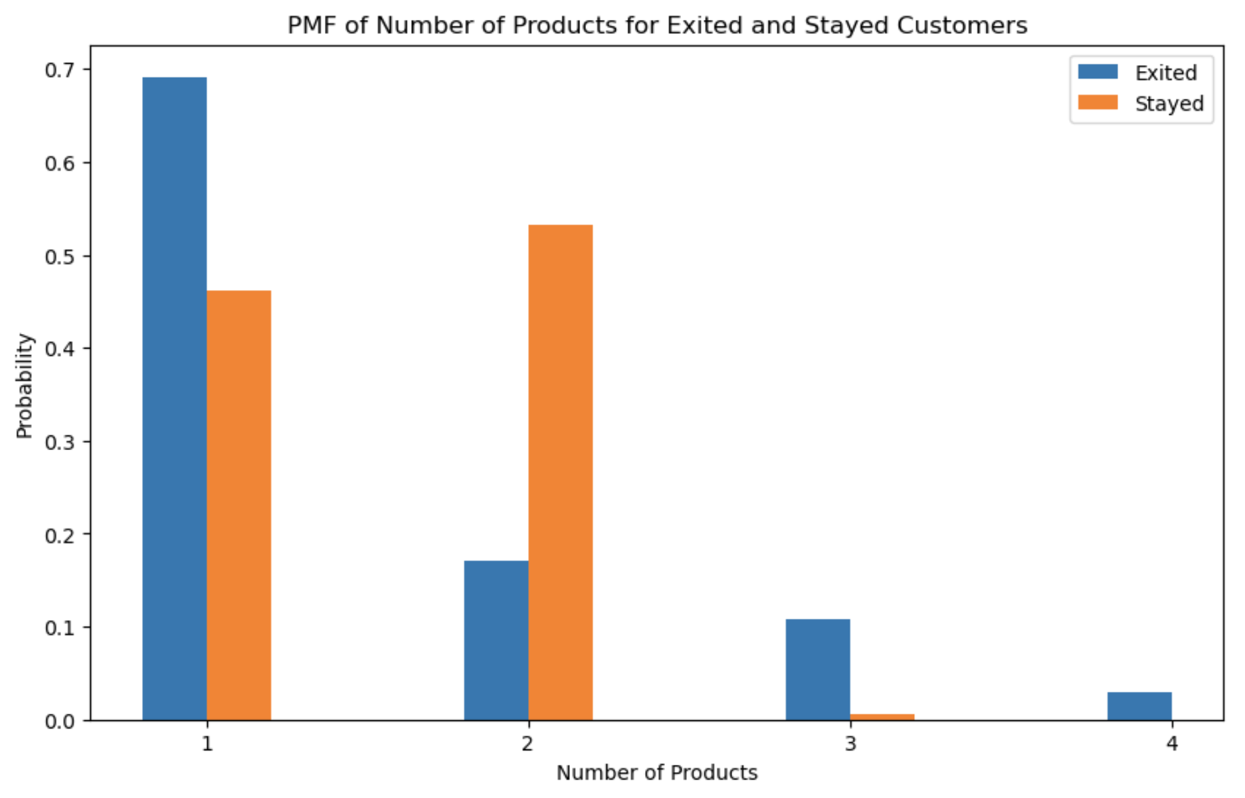
Probability Mass Function (PMF)

Slide 18
PMF – Number of Products
Customers who use more bank products are more likely to leave compared to those who use fewer products. This is because the graph for customers who left is higher than the graph for those who stayed, no matter how many products they used.
The chance of a customer leaving is highest when they use two products, as shown by the highest point on the graph for customers who left.
On the other hand, the chance of a customer staying is highest when they use only one product, as shown by the highest point on the graph for customers who stayed.
There's a clear pattern where the likelihood of leaving or staying changes depending on how many products customers use, with two products being the most common for leaving and one product for staying.

Slide 19
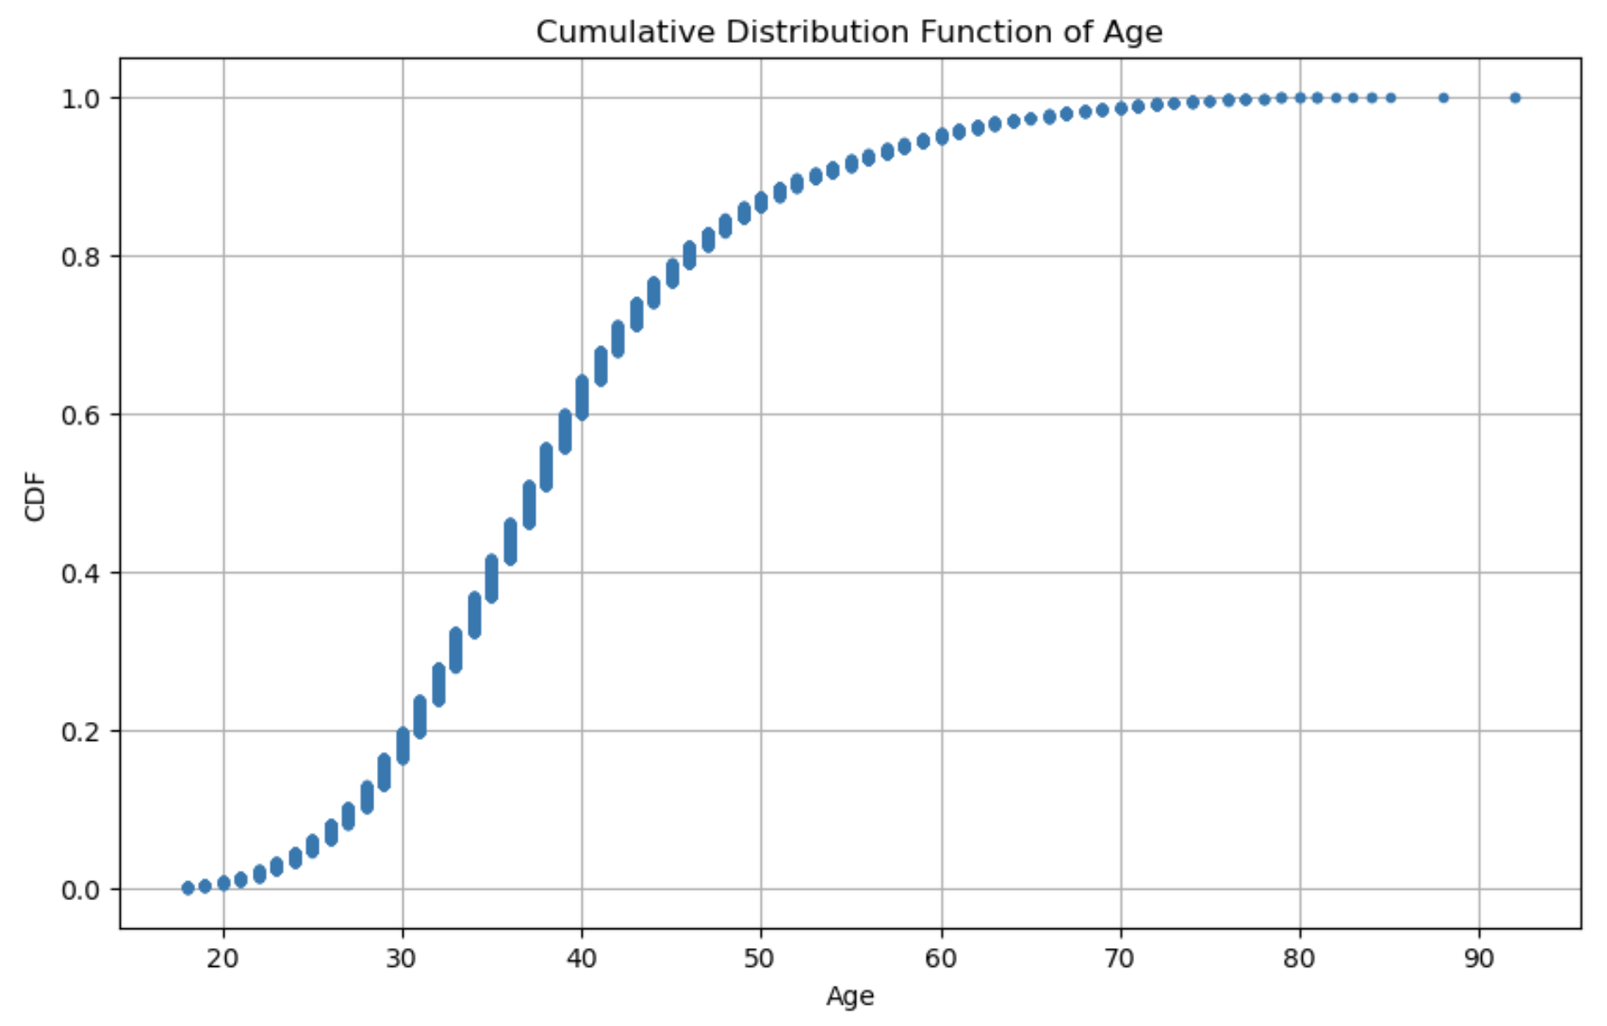
Cumulative Distribution Function (CDF)

Slide 20
Cumulative Distribution Function (DMF) – Age
The probability of a customer churning increases with age. This is because the CDF curve is increasing steadily.
By the age of 50, there is a 50% chance that a customer will have churned. This is because the CDF curve reaches 0.5 at the age of 50.
By the age of 90, there is almost a 100% chance that a customer will have churned. This is because the CDF curve approaches 1 as the age approaches 90.

Slide 21
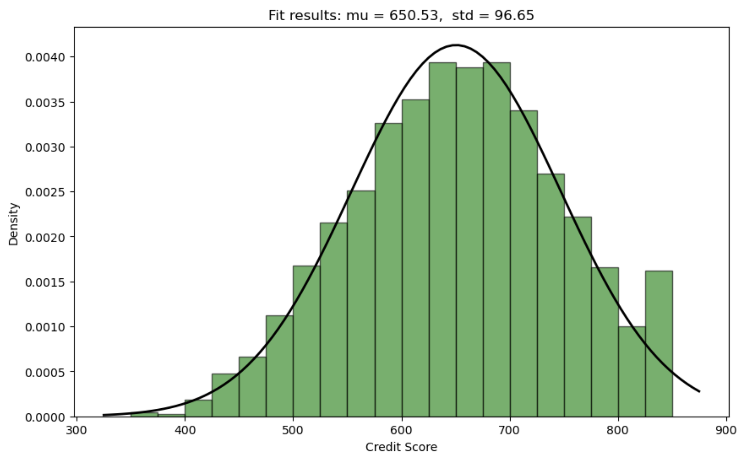
Analytical Distribution

Slide 22
Analytical Distribution – Credit Score
Mean (μ)
650.53
Standard Deviation (σ)
96.65
The credit score distribution shows a nearly normal, bell-shaped curve, typical for many naturally occurring phenomena, including credit scores. However, there's a slight left skew, indicating a slightly higher number of customers with lower credit scores.
The average credit score in the dataset is around 650.53, with a standard deviation of 96.65. This standard deviation suggests how individual credit scores deviate from the average, with a larger standard deviation indicating a wider spread of credit scores.

Slide 23
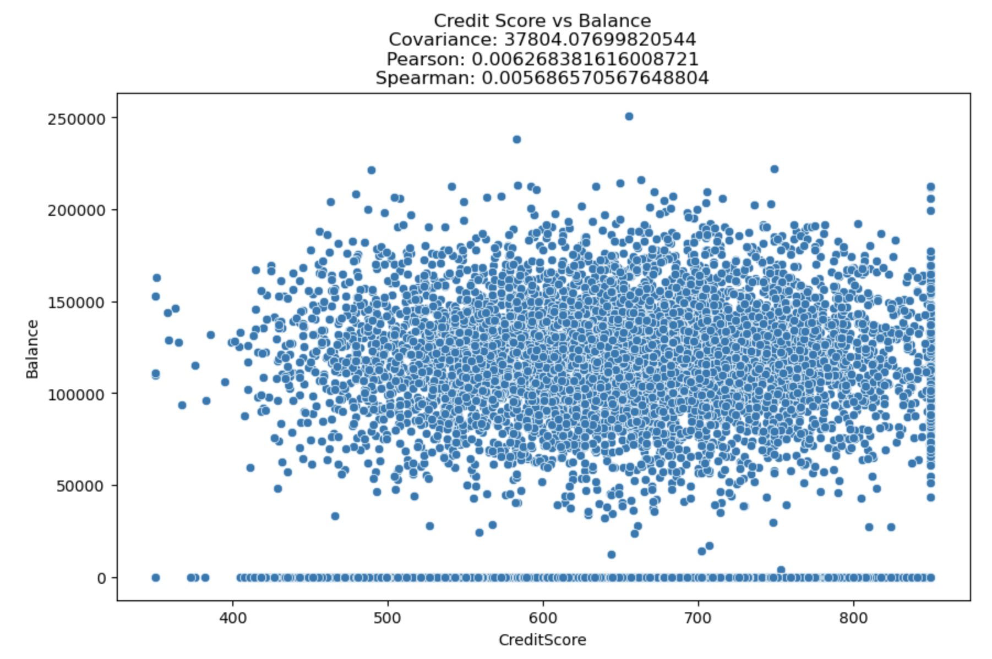
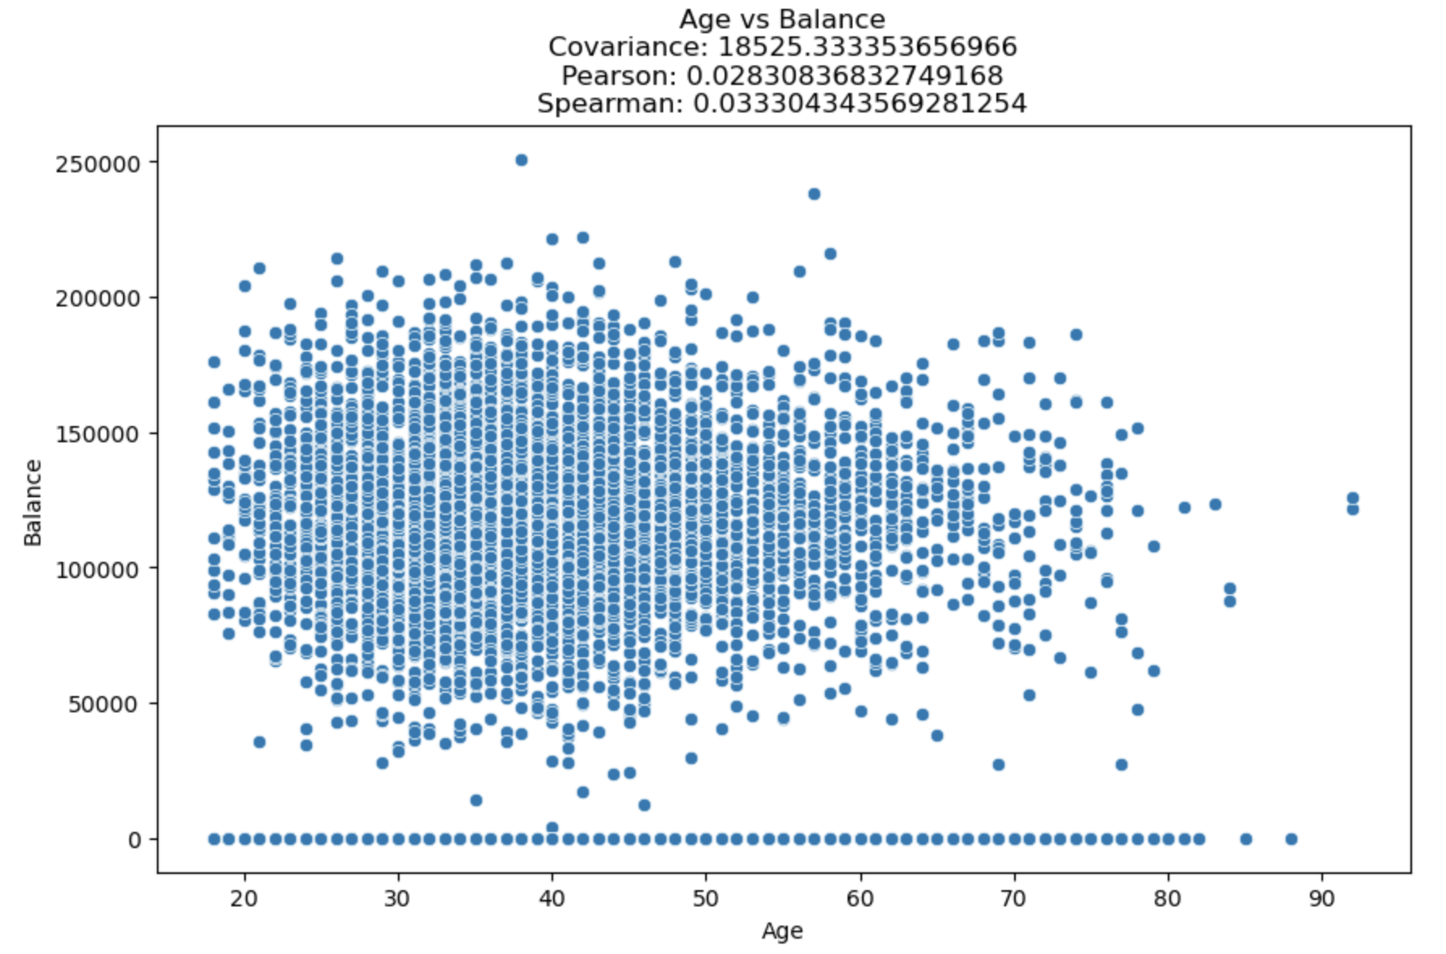
Scatter Plots

Slide 24
Scatter Plot – Credit Score vs Balance
Correlation Analysis: There exists a weak positive correlation between credit score and balance, indicating that as credit scores increase, there's a slight tendency for balances to increase as well. However, the data points are scattered, many deviating from this trend.
Pearson's Correlation Coefficient: The Pearson's correlation coefficient is calculated to be 0.0063, very close to 0, confirming a very weak positive correlation statistically.
Causation Consideration: It's essential to note that correlation does not imply causation. The correlation observed between credit score and balance does not necessarily indicate a causal relationship. Other factors like income or spending habits might influence both variables.
Non-Linear Relationships: Although the scatter plot doesn't reveal clear evidence of a non-linear relationship, further exploration of the data is recommended to uncover any hidden patterns.

Slide 25
Scatter Plot – Age vs Balance
Correlation Analysis: There is no clear linear correlation between age and balance, as indicated by the scattered distribution of data points throughout the plot without a consistent upward or downward trend.
Pearson's Correlation Coefficient: The Pearson's correlation coefficient, approximately 0.028, is very close to 0, confirming a very weak positive correlation statistically. However, due to the weakness of the correlation, drawing significant conclusions from this data is not advisable.
Causation Consideration: Correlation does not imply causation, and other factors such as income, spending habits, or profession could influence both age and bank balance. Thus, caution is needed in attributing causality based on correlation alone.
Non-Linear Relationships: Although no clear evidence of a non-linear relationship is observed in the scatter plot, further data exploration is recommended to uncover any hidden patterns.

Slide 26
Hypothesis Testing

Slide 27
Hypothesis Testing
Hypothesis Testing Results
T-statistic: 11.941
P-value: Approximately 1.21 × 10^(-32)
With such a small p-value, we reject the null hypothesis that there is no difference in mean balance between customers who exited and those who stayed.
The test result indicates a statistically significant difference in the mean balance between the two groups.
Interpretation
Conclusion
Given this result, it can be concluded that balance is likely an important factor in predicting customer churn.

Slide 28
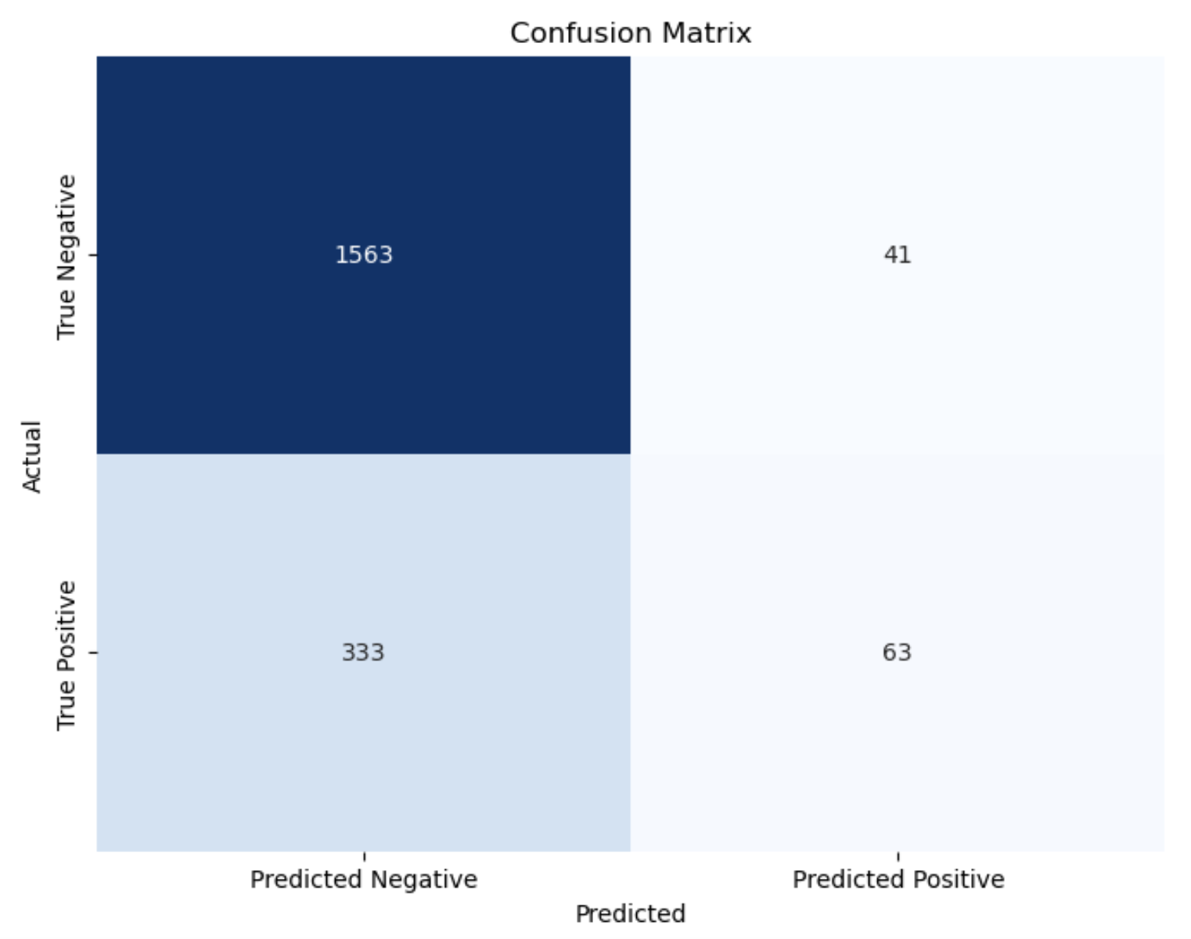
Regression Analysis

Slide 29
Regression Analysis
 | Precision | Recall | F1-Score | Support
0 | 0.82 | 0.97 | 0.89 | 1604
1 | 0.61 | 0.16 | 0.25 | 396
Accuracy |  |  | 0.81 | 2000
Macro Avg | 0.72 | 0.57 | 0.57 | 2000
Weighted Avg | 0.78 | 0.81 | 0.77 | 2000

Slide 30
Conclusion

Slide 31
Conclusion
Age and account balance are significant predictors of churn.
Credit score and number of products have a weaker relationship with churn likelihood.
Active membership status is inversely correlated with churn, indicating engaged customers are less likely to leave.
Summary of Findings
Challenges Overcome
Addressed data quality issues to ensure robust analysis.
Managed imbalanced classes in churn prediction using appropriate modeling techniques.
Implement targeted retention campaigns focused on customers identified as high-risk for churn.
Increase engagement through personalized offers, especially for customers with fewer products and lower account balances.
Consider loyalty programs to incentivize continued active membership.
Strategic Recommendation
Further analysis with additional behavioral data could provide deeper insights.
Explore advanced predictive models such as ensemble and machine learning for improved churn prediction.
Investigate the impact of external factors, such as economic changes, on customer churn rates.
Future Directions

Slide 32
Thank You

