Slide 1
Clear Skies Ahead: The Reliability of Modern Air Travel
Ramesh Talapaneni
August 08, 2024
Bellevue University – DSC 640
Instructor: Catherine Williams

Slide 2
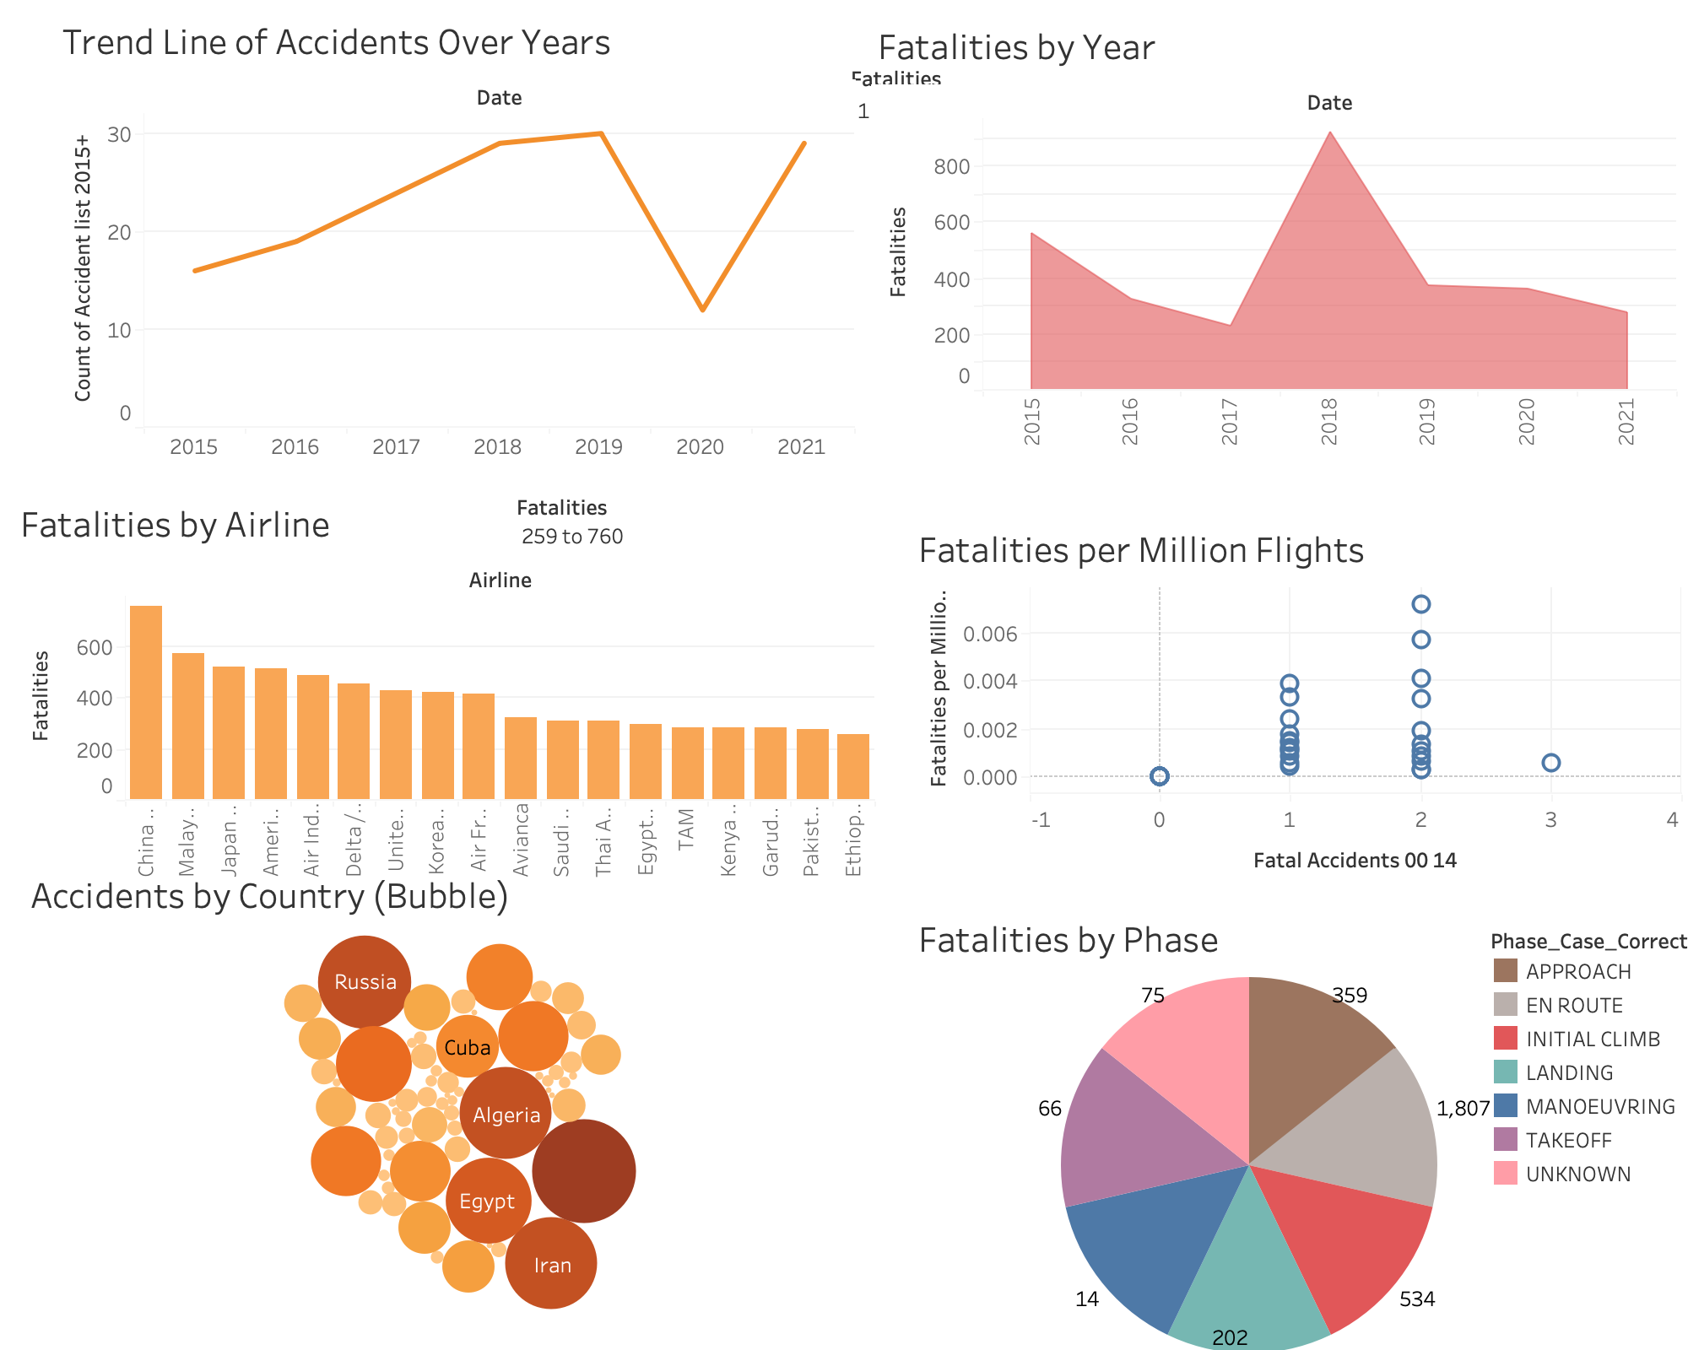
Introduction
Airline travel has long been scrutinized for its safety, with public perceptions often shaped by rare but high-profile accidents.
However, data tells a compelling story of continuous improvement and rigorous safety measures that make air travel the safest mode of transport today.

Slide 3
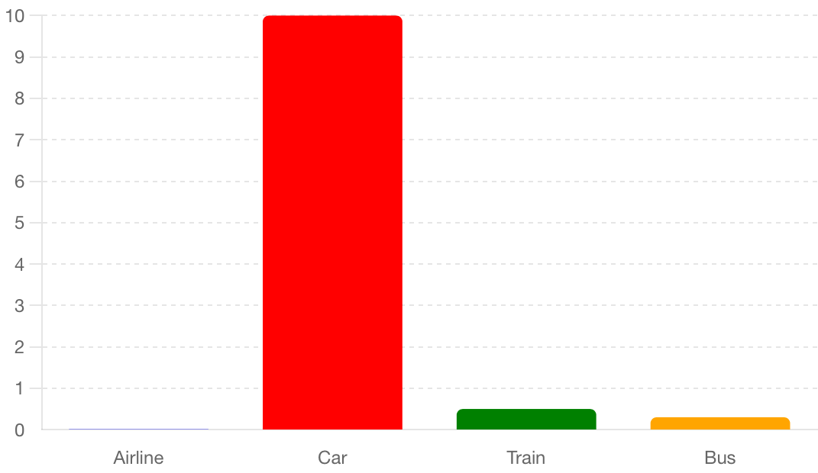
Comparative Safety
Comparing different modes of transport, air travel stands out as the safest.
The fatality rates for airlines are significantly lower than those for cars, trains, and buses, reinforcing the reliability and safety of flying.
This comparison is crucial for public perception, helping to alleviate undue fears about air travel.

Slide 4
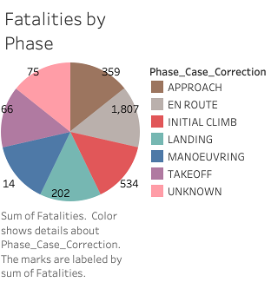
Focus on Critical Flight Phases
A closer look at the phases of flight reveals that most fatalities occur enroute and initial-climb.
These critical phases have been the focus of intensified safety efforts, resulting in notable safety enhancements.
The data emphasizes the importance of targeted safety measures to further mitigate risks during these times.

Slide 5
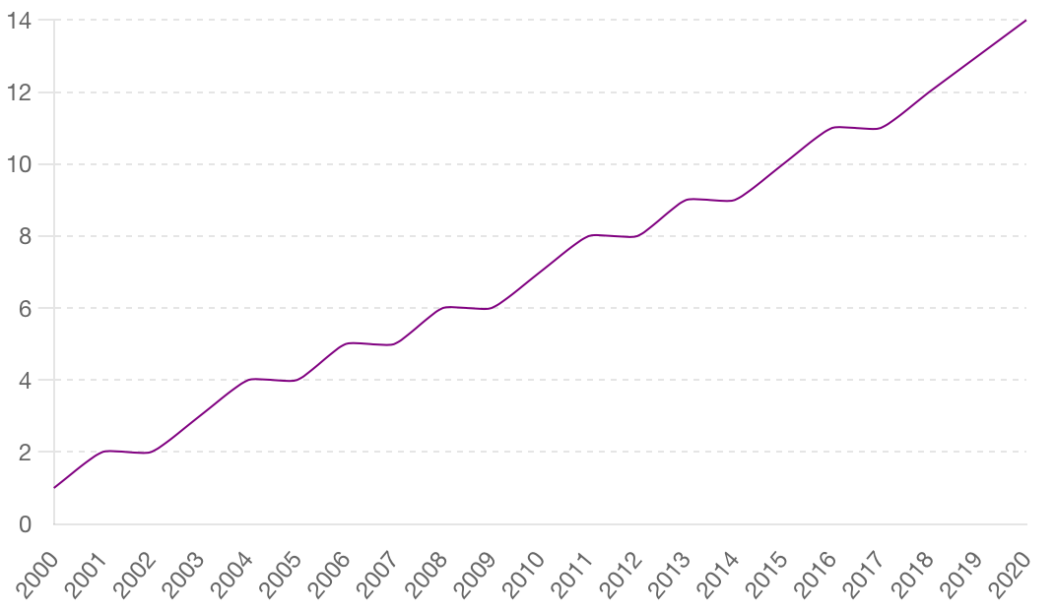
Historical Safety Improvement Trends
From 2000 to 2020, airline safety has shown a consistent upward trend.
This period saw a significant reduction in fatalities, attributed to enhanced safety protocols and technological advancements.
Despite occasional fluctuations, the overall trend highlights the aviation industry's dedication to passenger safety.

Slide 6
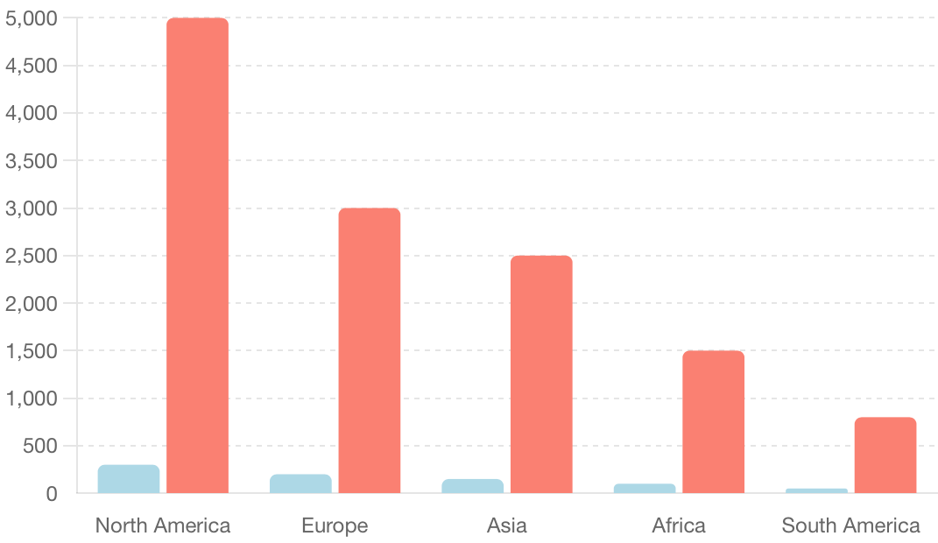
Global Safety Standards
Geographically, airline accidents occur worldwide, but most countries report low fatality numbers, indicating the effectiveness of global safety standards.
This global perspective showcases the widespread commitment to aviation safety.

Slide 7
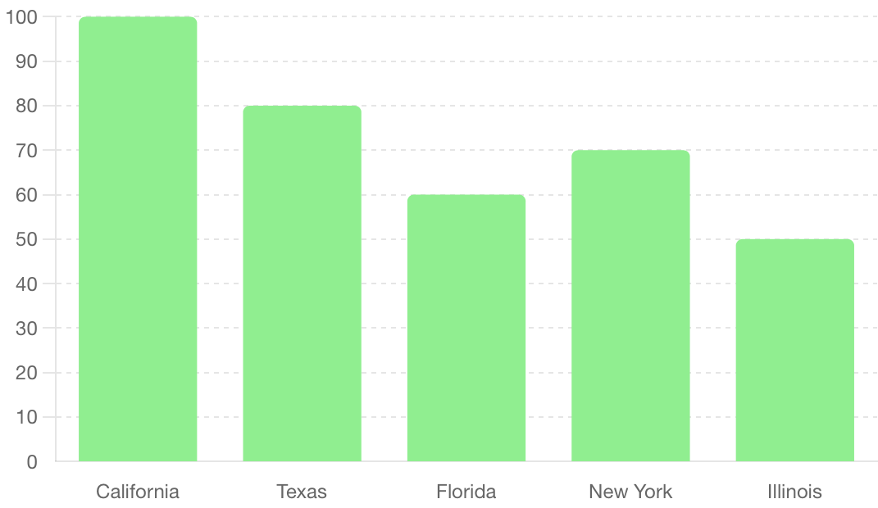
Economic Impact of Aviation
The economic impact of commercial aviation cannot be understated.
It underscores the importance of maintaining rigorous safety standards, not just for the sake of passenger safety but also for the economic health of the industry.
Ensuring safety is paramount to sustaining the vital contributions of aviation to the global economy.

Slide 8

Conclusion
In summary, the data on airline safety presents a reassuring narrative.
Continuous improvements, focused safety measures during critical flight phases, and the industry's global commitment highlight that air travel remains the safest and most reliable mode of transport.

