Slide 1
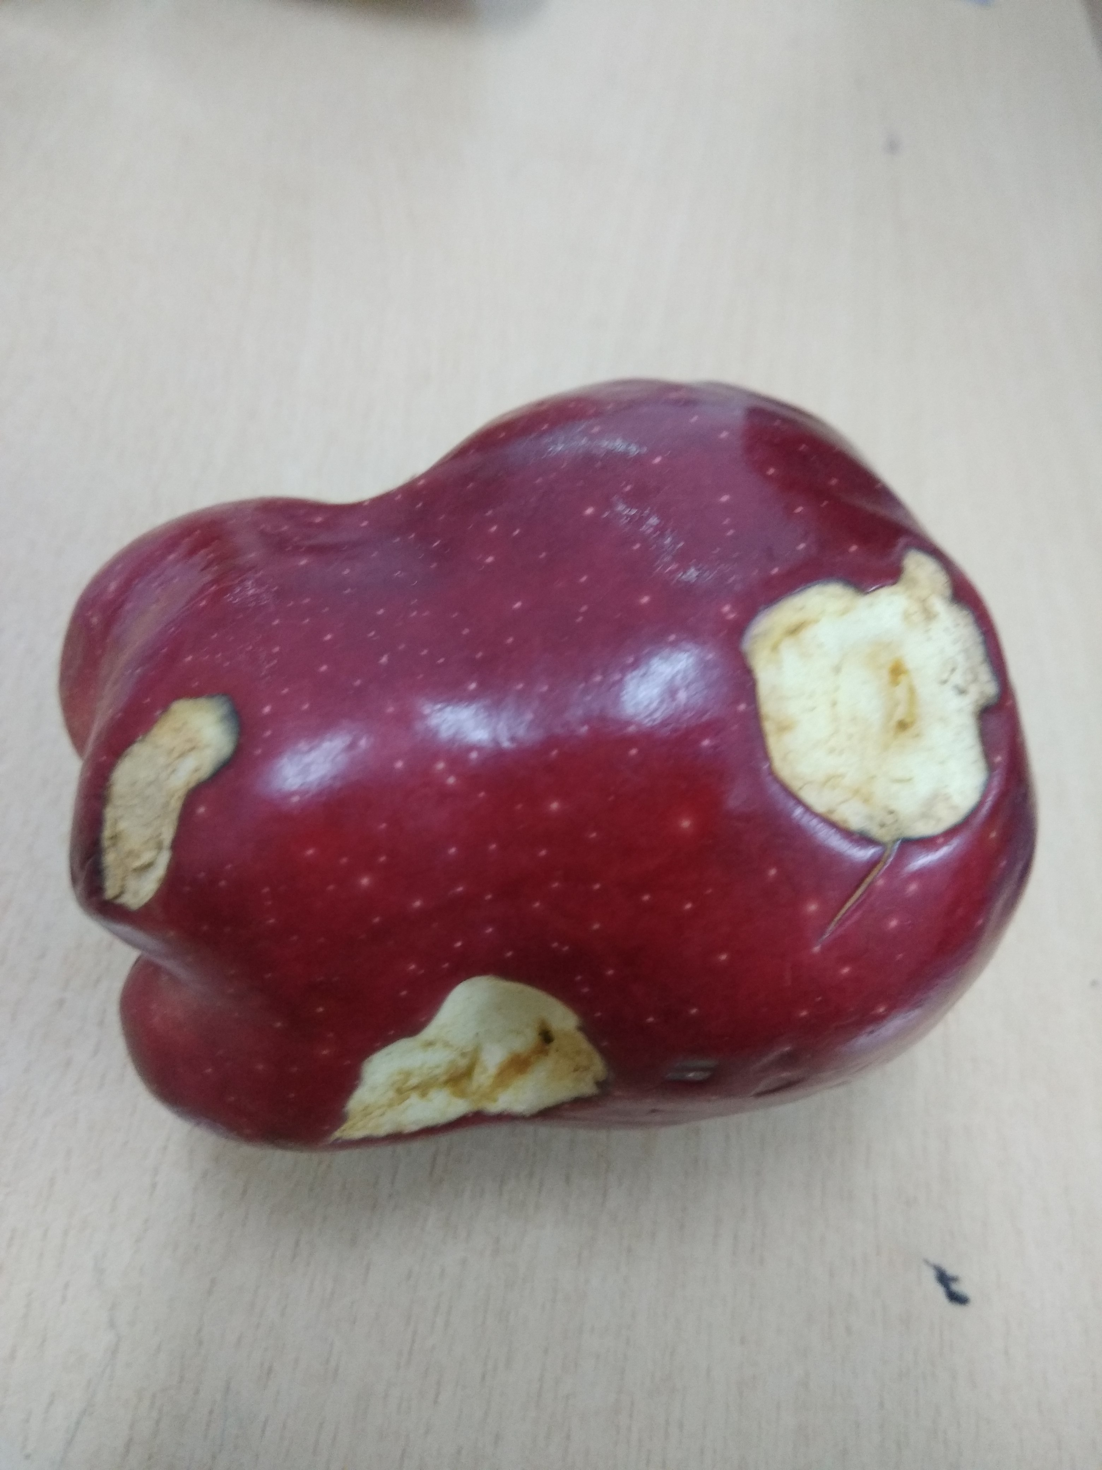
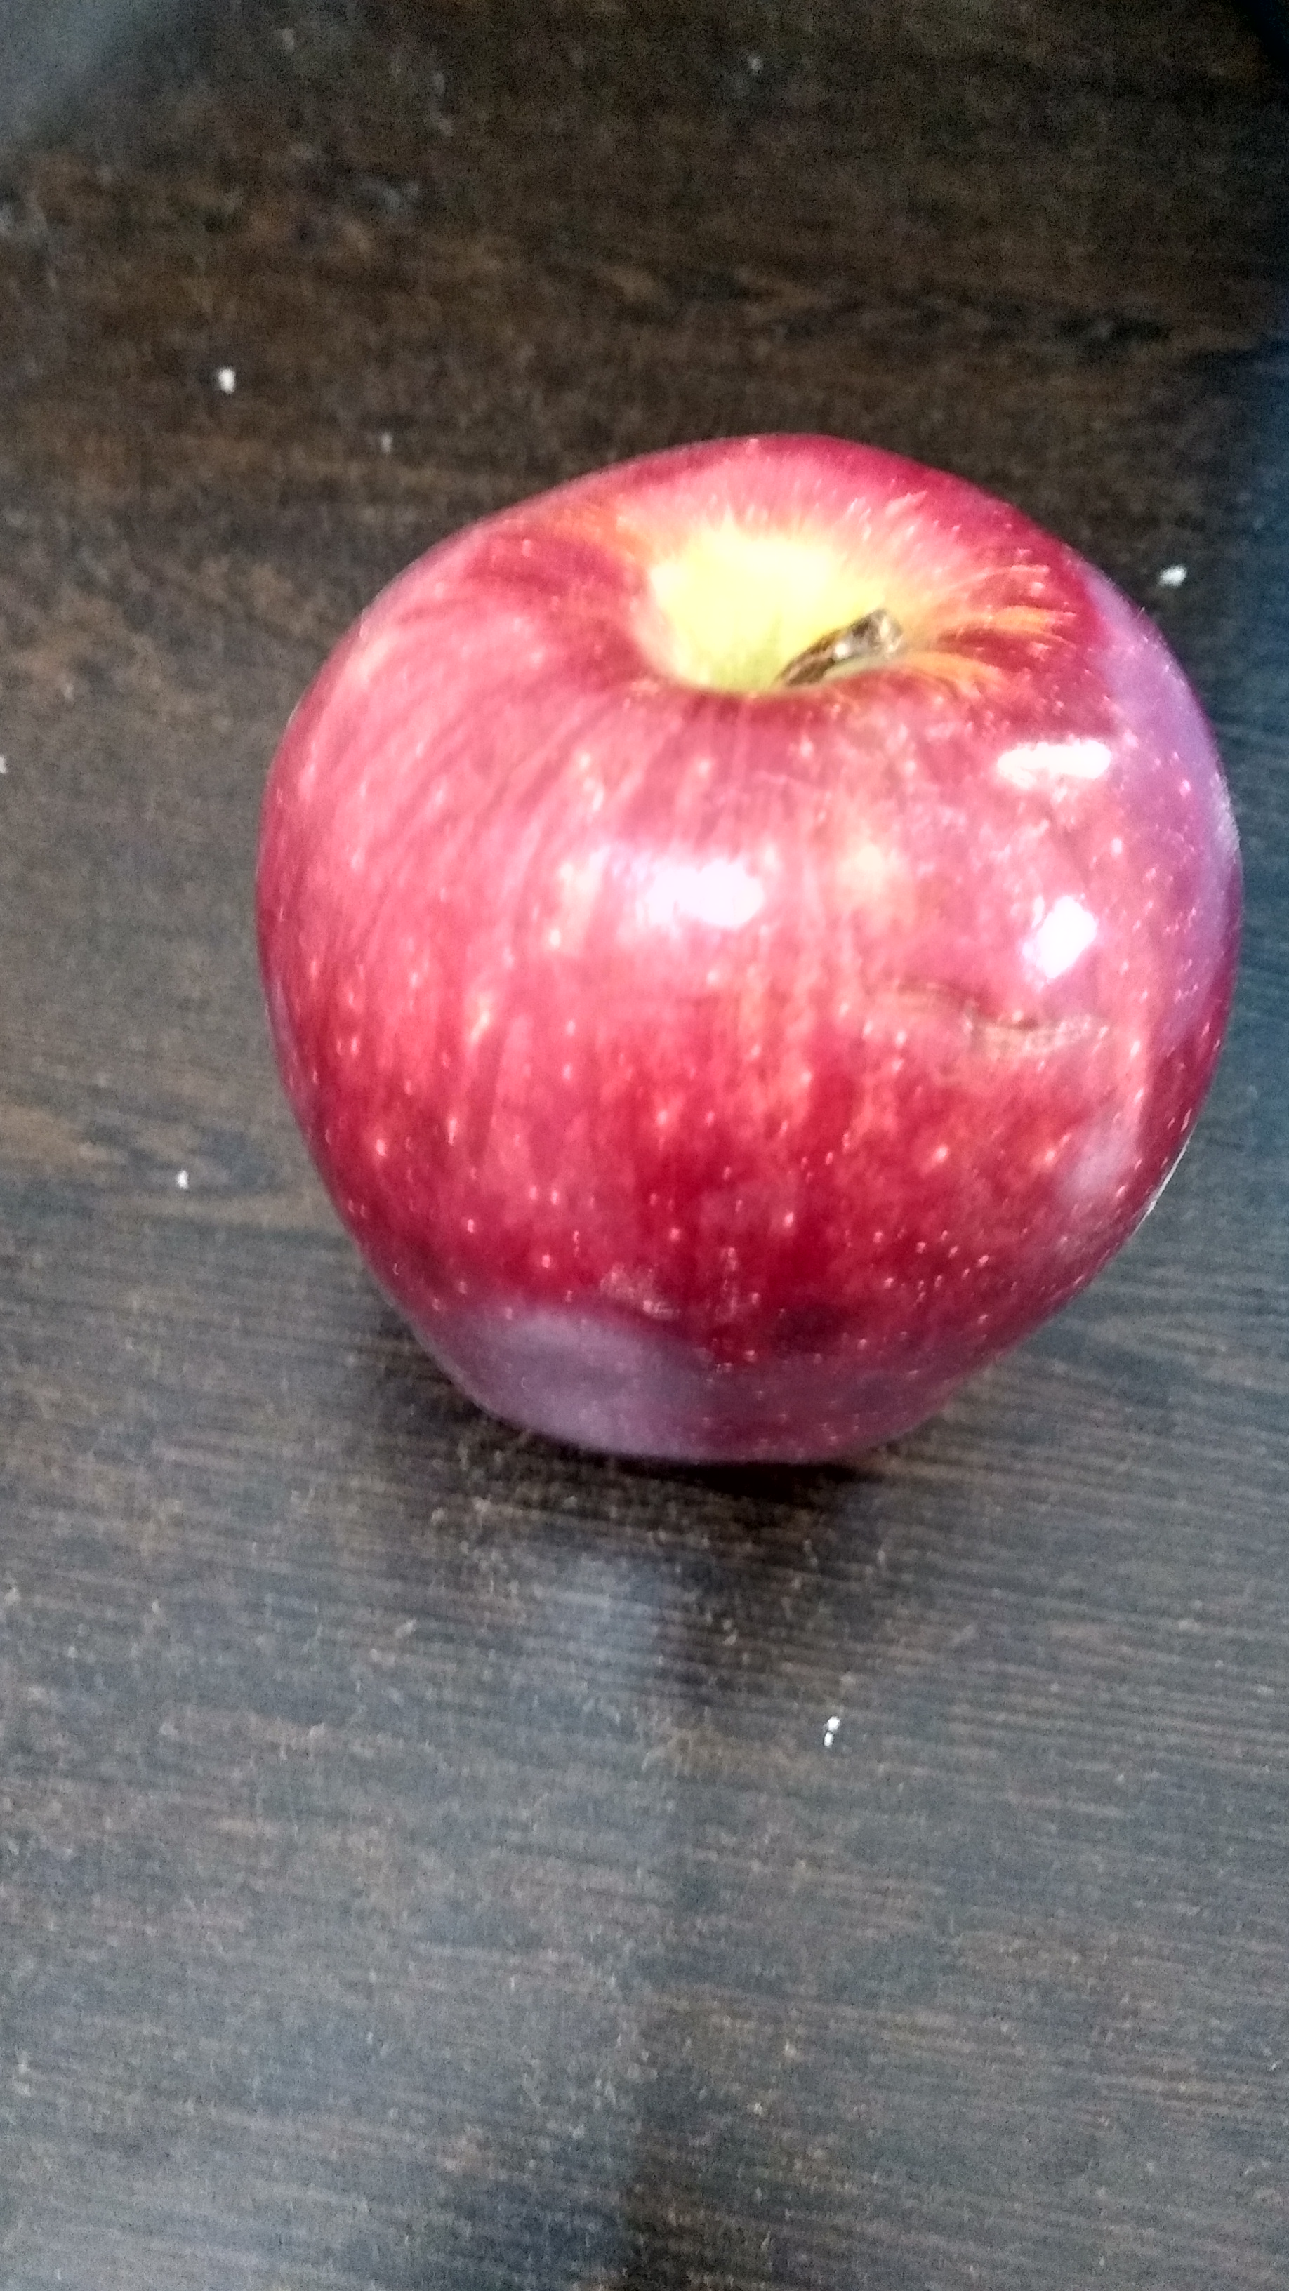
Convolution Neural Network Model
BAD
GOOD
Softmax
Convolution and MaxPooling
(Feature Learning)
Input Apples
Flatten, Fully Connected and Dense layer.

