Slide 1

Salary Prediction using Regression
A Machine Learning Approach
Name :- Tanya Rawat
Hindustan college of science &technology Farah Mathura

Slide 2

Introduction
Salary prediction helps companies estimate fair salaries.
Regression algorithms help predict continuous values such as salary based on features like experience, education, and skills.
Machine learning analyzes historical data to predict salaries.

Slide 3
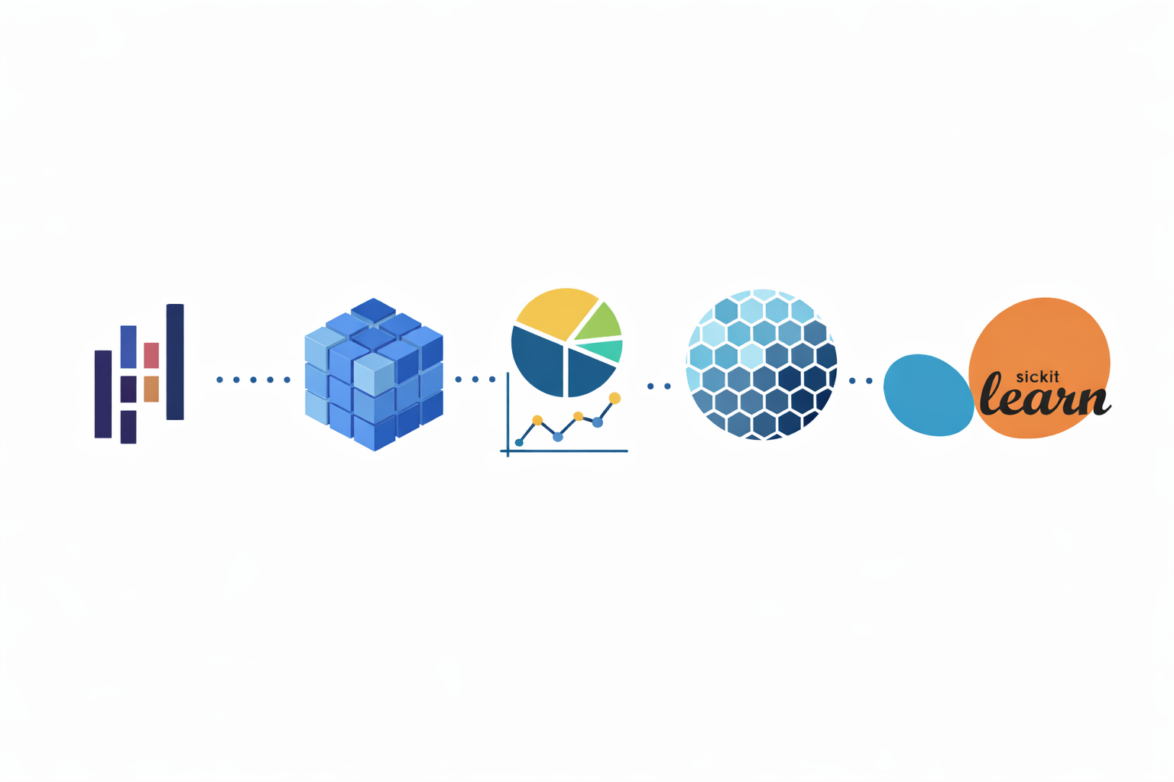
Libraries Used
Pandas – Data handling
NumPy – Numerical operations
Matplotlib & Seaborn – Visualization
Scikit-learn – Machine learning

Slide 4

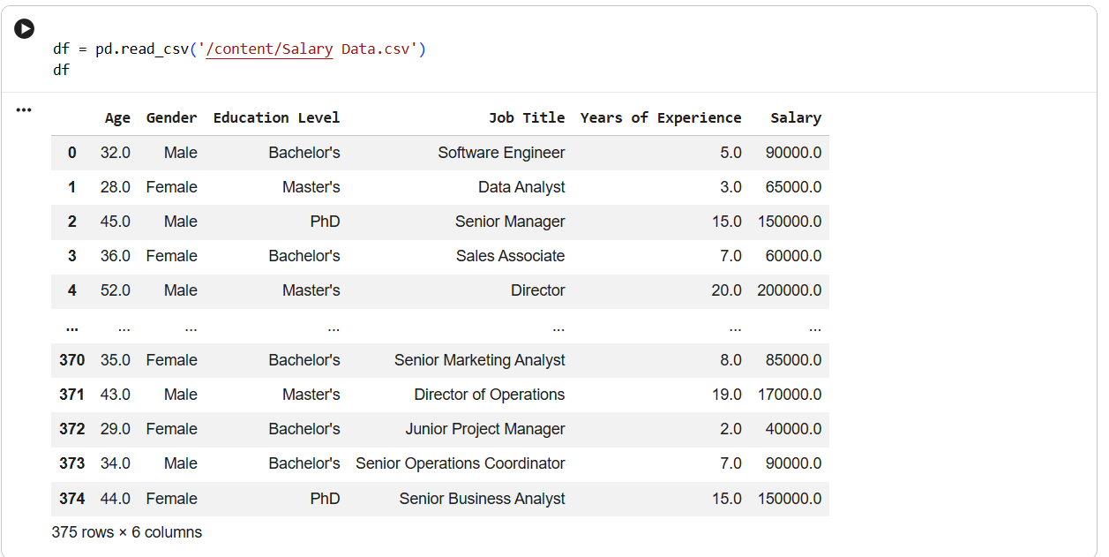
Dataset
Dataset includes:
Age
Gender
Years of Experience
Education Level
Job Title
Salary

Slide 5

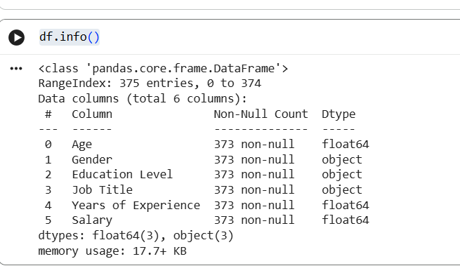
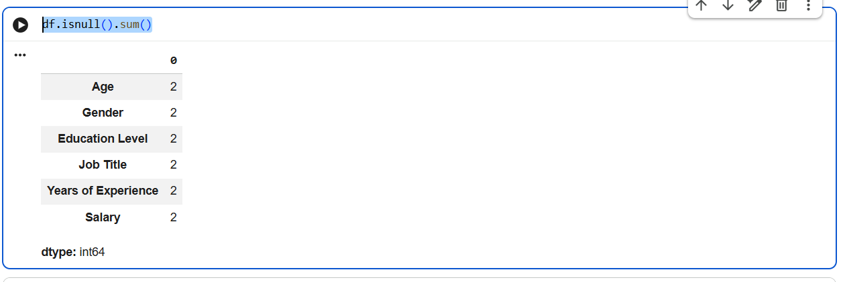
Simple Linear Regression
Handling missing values
Removing unnecessary columns
Converting categorical data to numeric

Slide 6
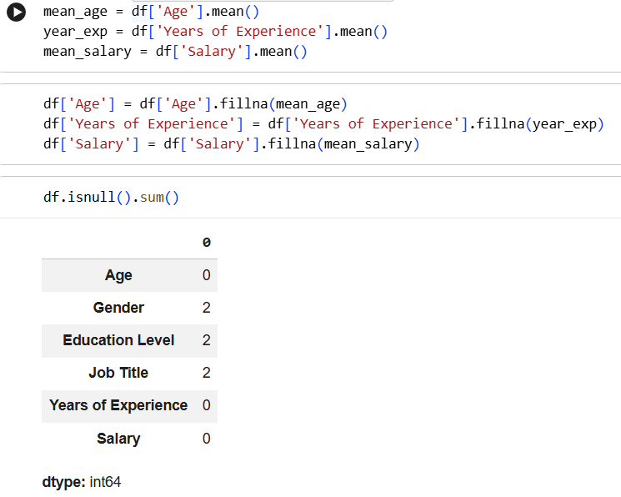
Handling Missing Values
Missing values replaced using mean values to keep dataset complete.
“Missing values in the dataset are replaced with the average (mean) of the column so that the dataset becomes complete and can be used for machine learning.”
This code calculates the average age, average experience, and average salary from the dataset. These values are stored in variables and can be used to fill missing values or analyze the data.

Slide 7

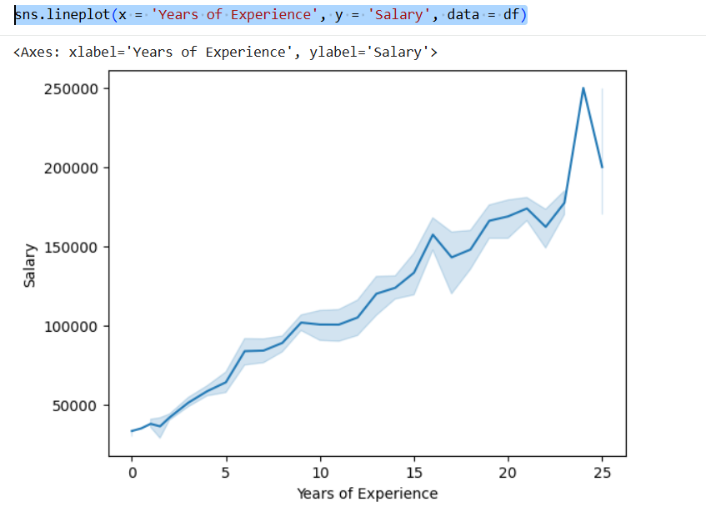
Data Visualization
Graphs help understand relationships between variables.
“This code creates a line graph using Seaborn to show the relationship between years of experience and salary in the dataset.”

Slide 8
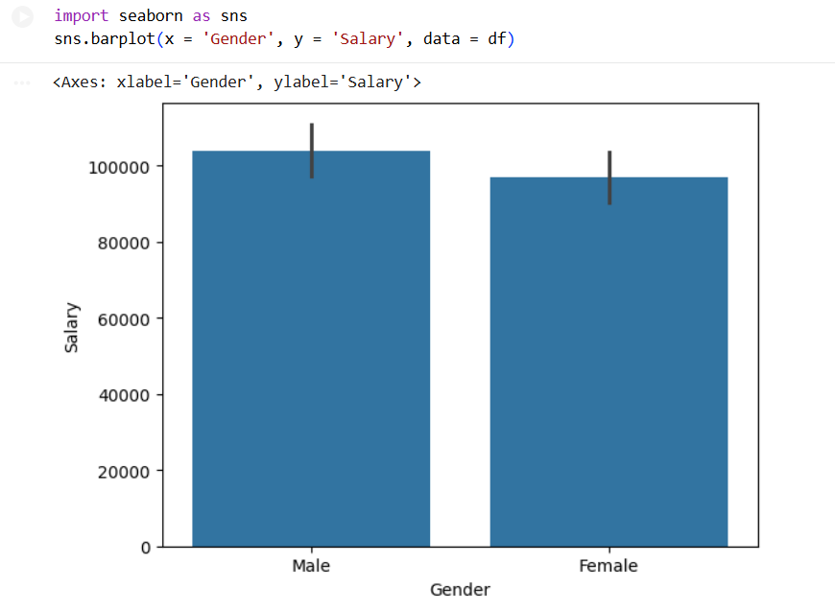
Model Training
“This code uses the Seaborn library to create a bar chart that shows the relationship between Gender and Salary using the dataset stored in the DataFrame.
Random Forest Regressor
XGBoost Regressor
Training and testing data split

Slide 9
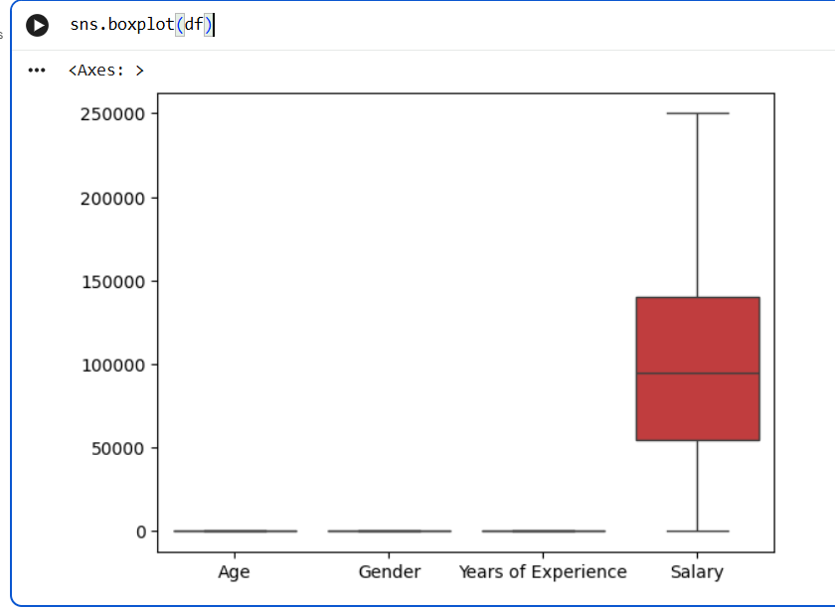
Model Evaluation
“sns.boxplot(df) creates box plots for the numerical columns of the dataset to visualize the distribution of data and detect outliers.”
Mean Absolute Error
Mean Squared Error
R² Score

Slide 10

Test data
Test data is a portion of the dataset used to evaluate the performance of a trained machine learning model on unseen data.
1️⃣ Training Data
Used to teach the model.
The model learns patterns from this data.
Example: The model learns that more experience → higher salary.
2️⃣ Test Data
Used to check the model's performance.
The model predicts values for data it has not seen before.

Slide 11

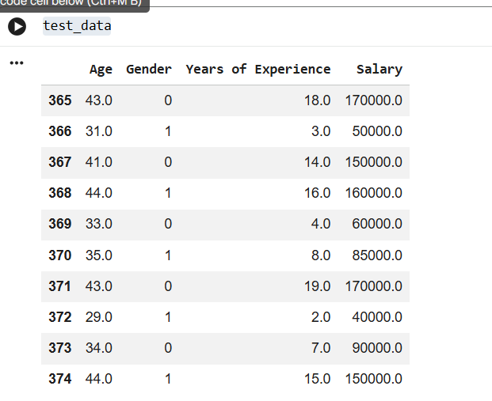
Test data helps to:
Evaluate model accuracy
Check if the model works on new data
Avoid overfitting (model memorizing training data)
Usually datasets are split like this:
80% Training Data
20% Test Data

Slide 12
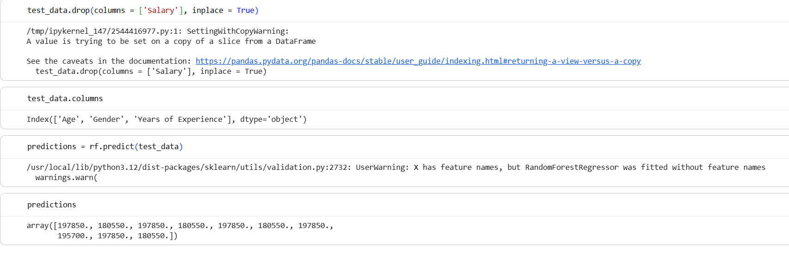
predictions

Slide 13
“This code removes the Salary column from the test dataset so that only input features remain for making salary predictions.”
test_data.columns displays the names of all columns present in the test dataset.
“This code uses the trained Random Forest model to predict salary values for the test dataset and stores the predicted results in the variable predictions.”
predictions is a variable that stores the values predicted by the machine learning model for the test dataset.

Slide 14
Applications
• HR salary analysis
• Job market prediction
• Compensation planning

Slide 15
Conclusion
Regression models help estimate salaries effectively.
They support better HR decisions and workforce planning.

Slide 16
THANK YOU

