Slide 1
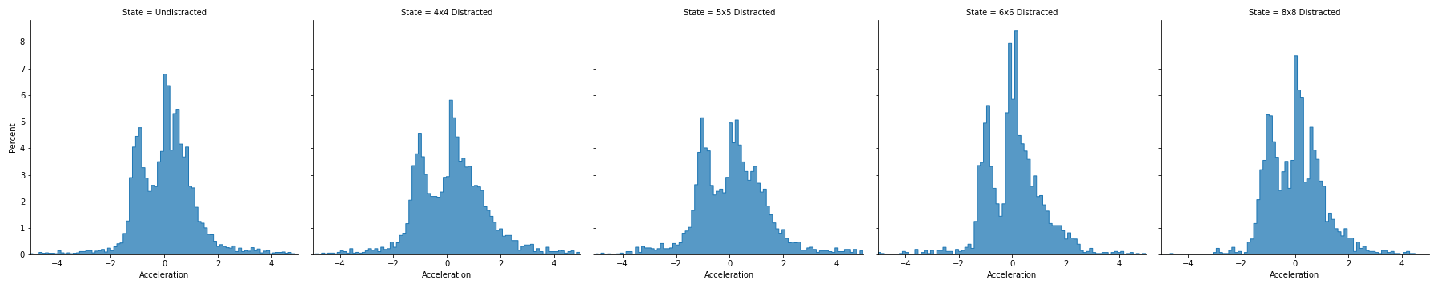
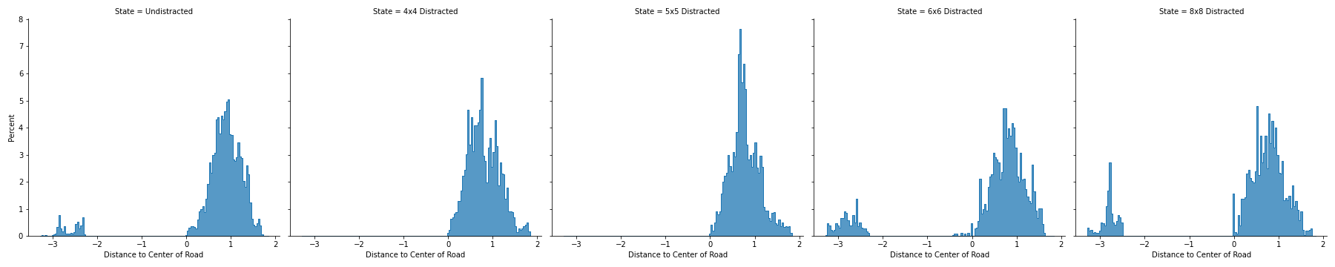

Slide 2
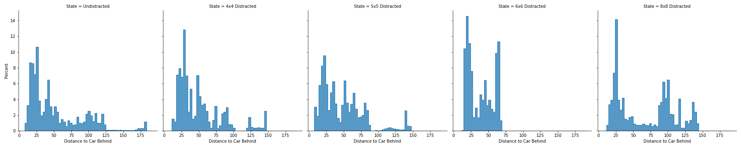
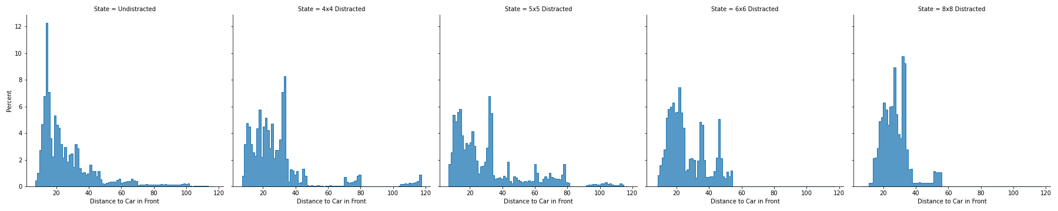

Slide 3
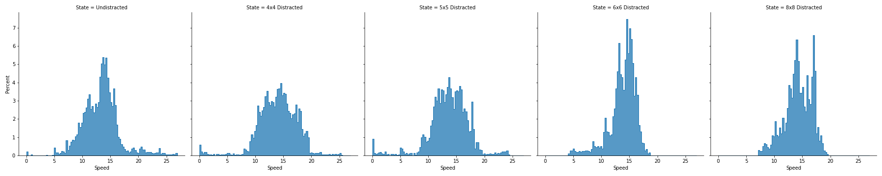
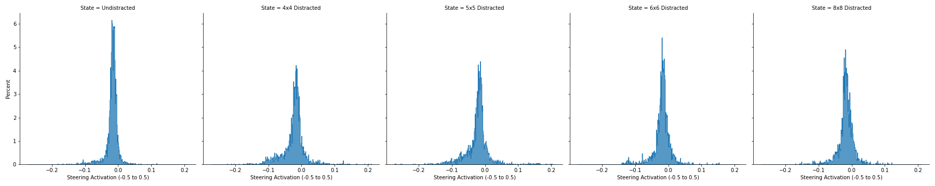

Slide 4
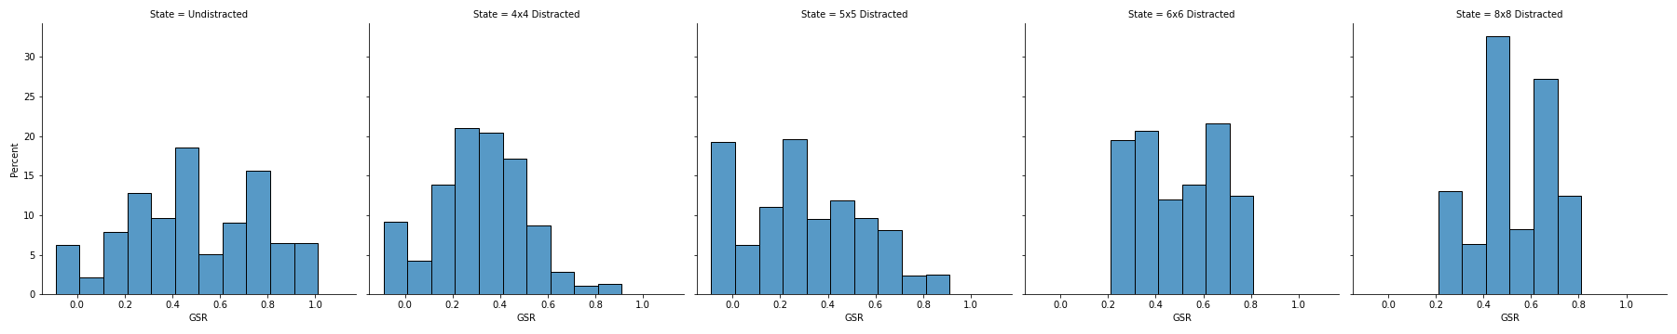

Slide 5
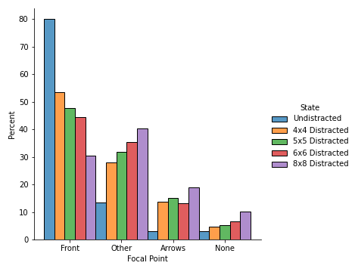

Slide 6
4x4 & 5x5 | Accel | Brake | Openness | PupilL | PupilR | Speed | Steering | Throttle | Center | Front | Back | gsr_phasic
count | 10845 | 10845 | 10845 | 10845 | 10845 | 10845 | 10845 | 10845 | 10643 | 10391 | 9996 | 10845
mean | -0.00144 | -0.00745 | 0.786756 | 0.037632 | -0.07942 | 13.46623 | -0.02243 | 0.086509 | 0.809528 | 28.46665 | 50.2381 | 0.361413
std | 2.507456 | 0.045828 | 0.34266 | 0.142954 | 0.249362 | 3.403946 | 0.032245 | 0.083335 | 0.335235 | 20.16196 | 34.30777 | 0.275526
min | -48.9215 | -1.10706 | 0 | -0.38551 | -0.89823 | 0.000218 | -0.27225 | 0 | 0 | 7.02341 | 7.846097 | -0.08946
25% | -0.84359 | 0 | 0.719344 | -0.00859 | -0.21274 | 11.53596 | -0.02917 | 0 | 0.585274 | 14.70163 | 23.96813 | 0.113234
50% | 0.137134 | 0 | 1 | 0.016009 | 0 | 13.63439 | -0.01807 | 0.083252 | 0.772738 | 22.22642 | 39.6705 | 0.332483
75% | 0.827917 | 0 | 1 | 0.11758 | 0.083621 | 15.50795 | -0.01019 | 0.134277 | 1.035459 | 32.93099 | 68.51158 | 0.554912
max | 17.08776 | 0 | 1 | 0.650031 | 0.388047 | 25.29107 | 0.210175 | 0.956482 | 1.835393 | 117.2723 | 189.8094 | 1.013131
6x6 & 8x8 | Accel | Brake | Openness | PupilL | PupilR | Speed | Steering | Throttle | Center | Front | Back | gsr_phasic
count | 4239 | 4239 | 4239 | 4239 | 4239 | 4239 | 4239 | 4239 | 4218 | 3916 | 4122 | 4239
mean | 0.048774 | -0.00114 | 0.863792 | 0.095272 | -0.25114 | 14.24057 | -0.01912 | 0.081973 | 0.072252 | 26.74211 | 55.6893 | 0.594506
std | 0.994227 | 0.018471 | 0.241372 | 0.122298 | 0.343652 | 2.008725 | 0.024083 | 0.071593 | 1.543624 | 10.9316 | 26.91254 | 0.173009
min | -8.22512 | -0.71094 | 0 | -0.26762 | -0.89548 | 7.93308 | -0.15512 | 0 | -3.29324 | 8.565921 | 16.21117 | 0.222222
25% | -0.73456 | 0 | 0.819156 | 0 | -0.51702 | 13.0247 | -0.02502 | 0.002441 | 0.239785 | 18.51691 | 33.37944 | 0.444444
50% | 0.077136 | 0 | 1 | 0.051683 | -0.34601 | 14.28479 | -0.01715 | 0.083252 | 0.762401 | 25.19029 | 52.65918 | 0.666667
75% | 0.564551 | 0 | 1 | 0.173462 | 0 | 15.66106 | -0.00928 | 0.119385 | 1.037007 | 32.90016 | 65.78897 | 0.777778
max | 5.511084 | 0 | 1 | 0.505462 | 0.695018 | 19.34057 | 0.119904 | 0.408203 | 1.739281 | 54.89931 | 118.2951 | 0.777778
Center, Front, Back are reporting fewer samples. Unsure why. Doesn’t seem to effect anything as far I can tell

