Slide 1
Creating a Simple Spring Boot App
Creating a Spring Boot app in IntelliJ
Understanding the application

Slide 2
1. Creating a Spring Boot App in IntelliJ
Overview of IntelliJ
Creating a Spring Boot project
Specifying project dependencies

Slide 3
Overview of IntelliJ
IntelliJ IDEA Ultimate has excellent support for Spring
Spring Boot and Spring Framework
IntelliJ Java dependencies:
JDK (e.g. JDK 21)
Set JAVA_HOME to the JDK folder
Set PATH to include the JDK binary folder

Slide 4
Creating a Spring Boot Project
Start IntelliJ, click New Project, and select Spring Initializr
Specify project info as follows:
Enter a suitable project name and location
Language - Java
Type - Maven
Enter a suitable group ID, artifact ID, and package name
Project SDK - Java 21
Java version - 21
Packaging - Jar
Then click Next

Slide 5
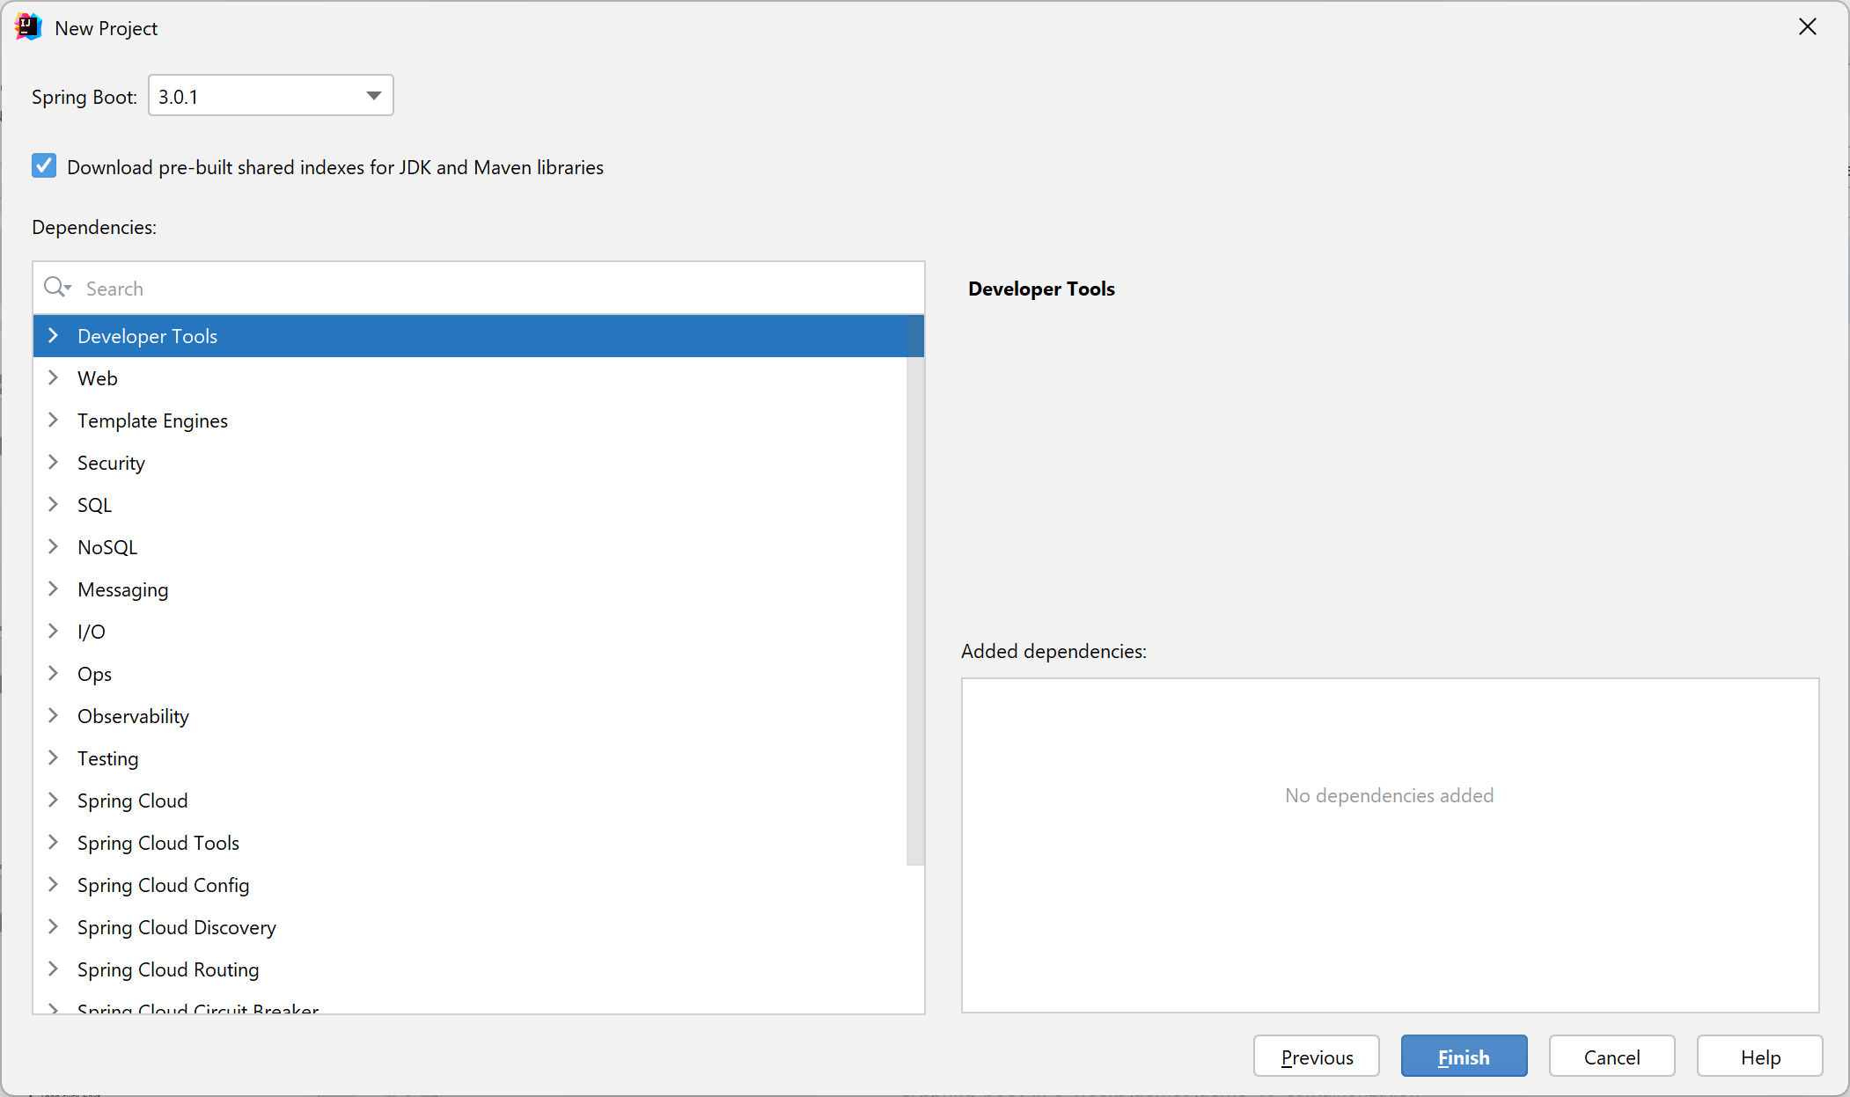
Specifying Project Dependencies
In the next window you can add dependencies to your project
We don't need any dependencies yet, so just click Finish

Slide 6
2. Understanding the Application
Understanding the application structure
Understanding the Maven POM file
Understanding the application code
Running the application
Viewing the application output

Slide 7
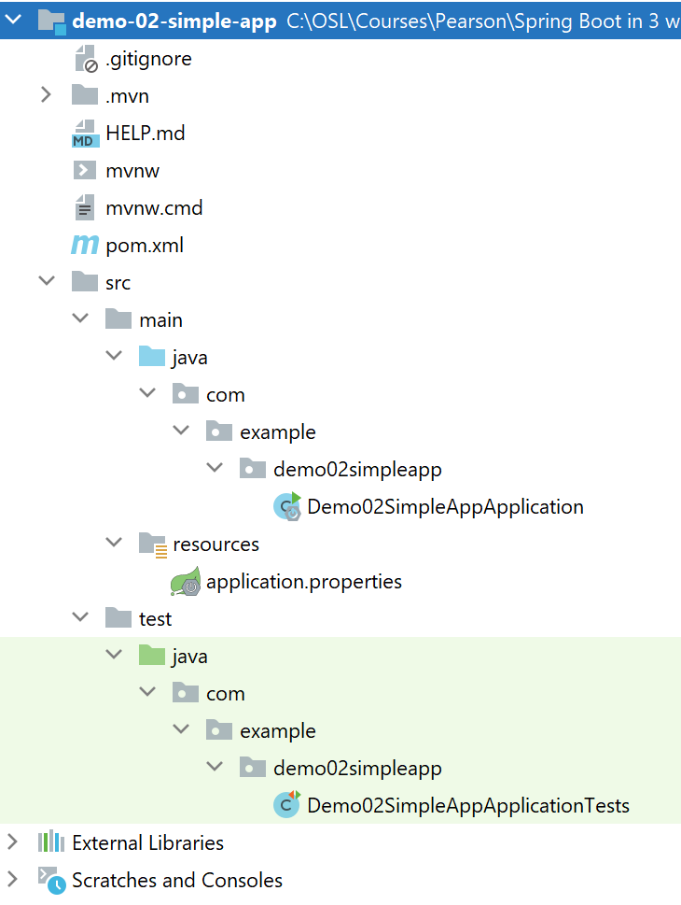
Understanding the Application Structure
The generated application is a regular Maven project

Slide 8
Understanding the Maven POM File
Here are the relevant sections in the Maven pom file:
<project … >
…
<parent>
<groupId>org.springframework.boot</groupId>
<artifactId>spring-boot-starter-parent</artifactId>
<version>3.2.2</version>
<relativePath/>
</parent>
<dependencies>
<dependency>
<groupId>org.springframework.boot</groupId>
<artifactId>spring-boot-starter</artifactId>
</dependency>
<dependency>
<groupId>org.springframework.boot</groupId>
<artifactId>spring-boot-starter-test</artifactId>
<scope>test</scope>
</dependency>
</dependencies>
…
Parent POM
Spring Boot dependency
Spring Boot test dependency
pom.xml

Slide 9
Understanding the Application Code
Here's the generated application code:
@SpringBootApplication is equivalent to:
@Configuration
@EnableAutoConfiguration
@ComponentScan
import org.springframework.boot.SpringApplication;
import org.springframework.boot.autoconfigure.SpringBootApplication;
@SpringBootApplication
public class Demo02SimpleAppApplication {
public static void main(String[] args) {
SpringApplication.run(Demo02SimpleAppApplication.class, args);
}
}
Demo02SimpleAppApplication.java

Slide 10
Running the Application
You can build/run the app via the mvn command in the project root directory as follows:
If you don't have Maven installed separately on your machine, you can run the following command instead:
It's also possible to run the application directly in IntelliJ
Right-click in the main class, and click Run
mvn spring-boot:run
mvnw spring-boot:run

Slide 11
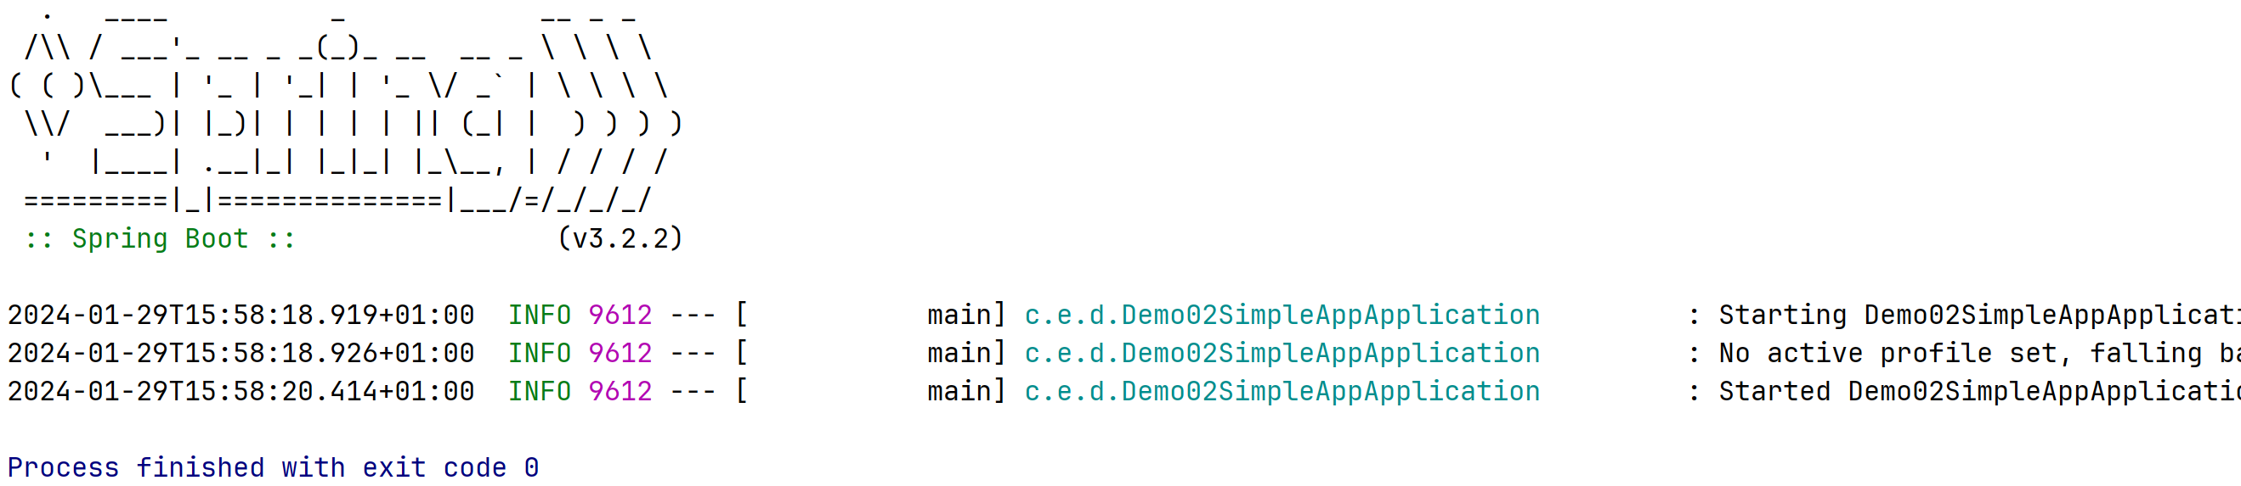
Viewing the Application Output
This is the application output
Displays a "Spring Boot" banner
The app terminates immediately, because it's so simple 😊

Slide 12
Summary
Creating a Spring Boot app in IntelliJ
Understanding the application

