Slide 1
Consuming REST Services
Overview
How to use RestClient
Example
Other ways to consume a REST service
Consuming a REST service from HTML

Slide 2
Overview
Spring Web provides 2 ways to consume REST services:
RestClient - fluent coding style, recommended
RestTemplate - traditional approach, not recommended
In either case, you must include the following dependency:
We'll concentrate on using RestClient
See following slides…
<dependency>
<groupId>org.springframework.boot</groupId>
<artifactId>spring-boot-starter-web</artifactId>
</dependency>
pom.xml

Slide 3
How to Use RestClient
Here's an example of how to use RestClient for a GET API:
There are similar methods for other types of requests
post()
put()
delete()
RestClient client = RestClient.create();
String someUri = "http://localhost:8080/full/products/1";
ResponseEntity<Product> response = client
.get()
.uri(someUri))
.retrieve()
.toEntity(Product.class);
System.out.printf("\nGot product 1, response details:");
System.out.printf(" Status code: %d\n", response.getStatusCodeValue());
System.out.printf(" Response body: %s\n", response.getBody());

Slide 4
Example
Let's see a complete example of using RestClient:
See the code here:
Project: demo-13-rest-clients
Class: ConsumerViaRestClient.java
REST request
REST client
ConsumerViaRestClient
REST service
/full/products
REST response
demo-13-rest-clients
http://localhost:8181
demo-13-rest-services
http://localhost:8080

Slide 5
Other Ways to Consume a REST Service
Via RestTemplate
This is the original way to consume a REST service
Not as elegant as RestClient, but widely used in the past
See ConsumerViaRestTemplate.java
Via WebClient
Can be synchronous or asynchronous
Well suited to calling reactive REST services (WebFlux)
See ConsumerViaWebClient.java and pom.xml

Slide 6
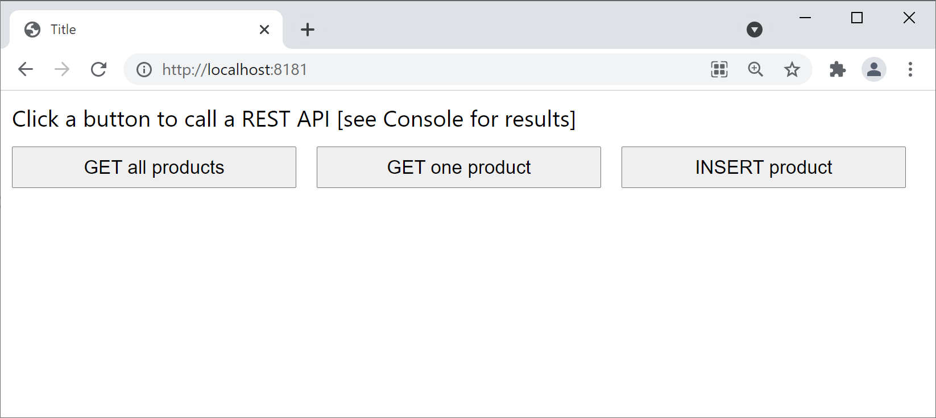
Consuming a REST Service from HTML
We've also implemented a simple HTML page to show how to consume a REST service from a web UI
Project: demo-13-rest-clients
Folder: src/main/resources/static
Open a browser and browse to http://localhost:8181

Slide 7
Summary
Overview
How to use RestClient
Example
Other ways to consume a REST service
Consuming a REST service from HTML

