Slide 1
Containerizing a Spring Boot App
Introduction to containerization and Docker
Understanding Docker images
A closer look at images and containers
How to containerize a Spring Boot app

Slide 2
1. Introduction to Containerization and Docker
What is containerization?
Containers vs. virtual machines
Installing Docker
Starting Docker

Slide 3
What is Containerization?
Containerization is a way of wrapping an application, plus its environment, into a shrink-wrapped container
Makes it easy to deploy and run the application, because it runs in a virtualized environment
Docker is a very popular containerization tool
You build an image that contains your app, properties, etc.
You then run the image - a running image is called a container

Slide 4
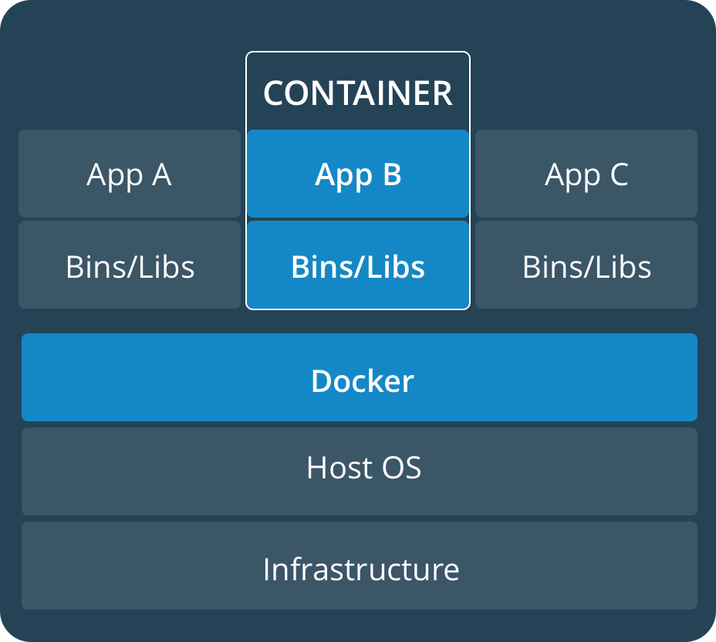
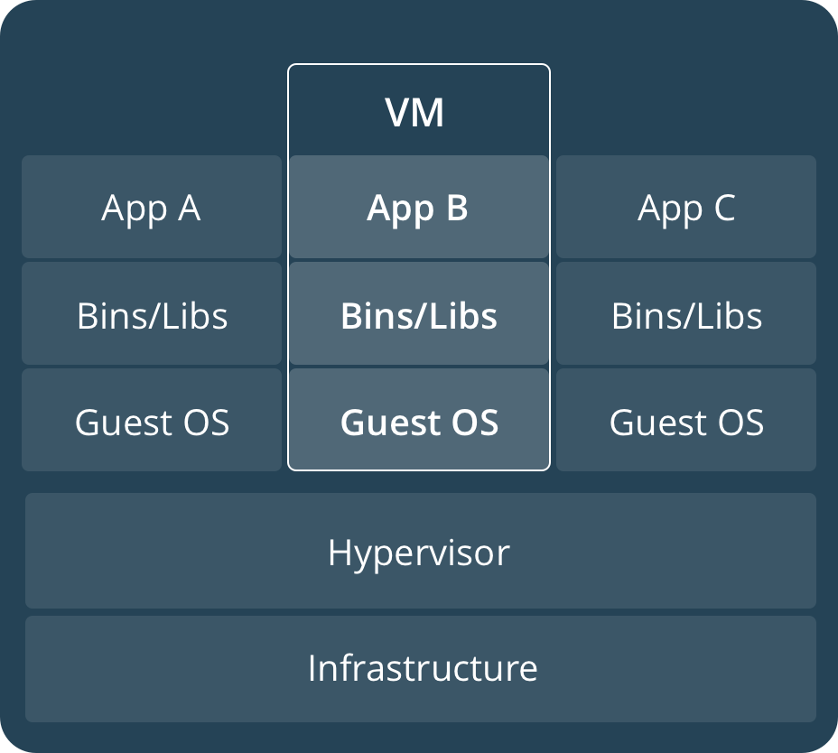
Containers vs. Virtual Machines
Containers are much more lightweight that VMs
Containers run on top of the host OS, e.g. Linux
VMs are much bulkier because they actually contain a guest OS
Docker containers
Virtual machines

Slide 5
Installing Docker
Docker is a Linux technology…
If you're using Linux, you can install the Docker Engine directly on your machine
See https://docs.docker.com/engine/install/
More generally you can install Docker Desktop
One-click-install application for Linux, Windows, or Mac
See https://docs.docker.com/desktop/
Note:
On Windows, Docker runs on WSL (specifically WSL 2)

Slide 6
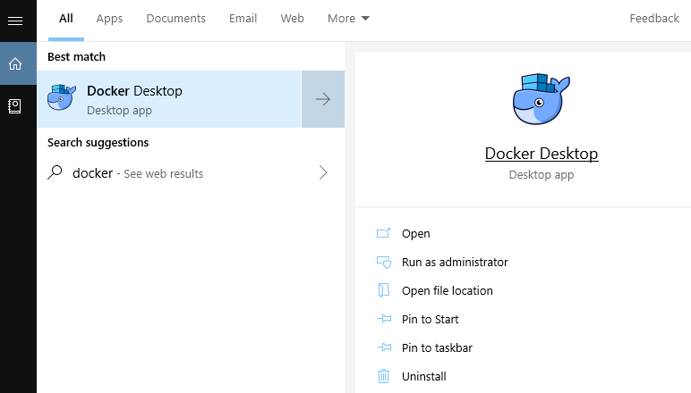
Starting Docker
Docker does not start automatically after installation, so you must run it manually
For example, on Windows:

Slide 7
2. Understanding Docker Images
Overview
Images vs. containers
Running a sample image
Listing images in the local Docker registry

Slide 8
Overview
A Docker image is a black box executable package
It includes everything needed to run an application
E.g. a Docker image for a Java microservice might have:
A JVM
A web server (e.g. Tomcat)
Any additional JARs necessary, e.g. database drivers
A JAR containing your REST service
In this section we’re going to see how to download (“pull”) and run a pre-built image from Docker Hub

Slide 9
Images vs. Containers
When you run a Docker image…
Docker creates an in-memory instance of the image
This in-memory instance is called a container
You can run many container instances for an image, if you like

Slide 10
Running a Sample Image (1 of 3)
Docker has a sample pre-built image called hello-world
You can run it as follows:
Docker looks for the image in the local registry
The default location for images is /var/lib/docker
If the image isn’t in the local registry…
Docker pulls it from a global registry (e.g. Docker Hub)
Docker stores the downloaded image in the local registry
Docker then runs the image
i.e. it creates a container, a running instance of the image
docker run hello-world

Slide 11
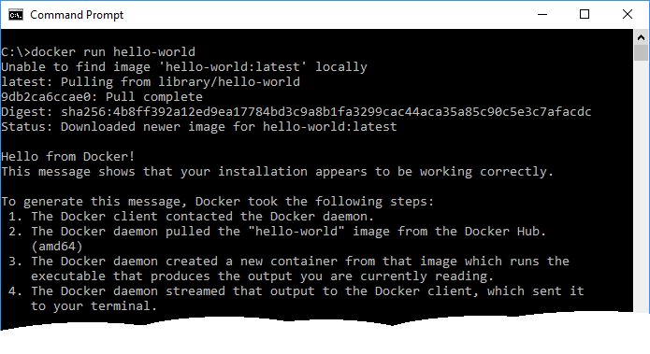
Running a Sample Image (2 of 3)
Here’s a screenshot of what happens
Note in particular, the “pull” request near the top
docker run hello-world

Slide 12
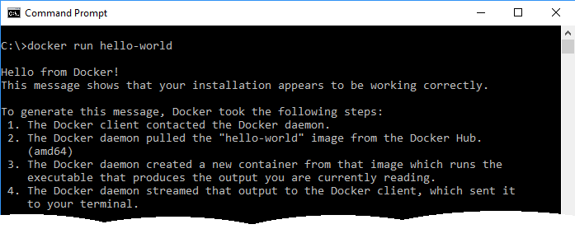
Running a Sample Image (3 of 3)
Do another Docker run, and see what happens
Note there’s no “pull” request this time – why not…?
docker run hello-world

Slide 13
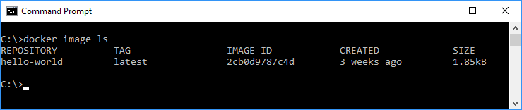
Listing Images in the Local Docker Registry
You can get a list of all the Docker images in your local Docker registry, as follows:
docker image ls

Slide 14
3. A Closer Look at Images and Containers
The power of containerization
Running multiple containers from an image
Running containers in detached mode
Listing containers
Stopping a container
Pruning containers and images

Slide 15
The Power of Containerization (1 of 2)
Docker Hub contains thousands of useful images, providing containerized shrink-wrapped functionality
E.g. Tomcat, MySQL, MongoDB, etc.
E.g. run this command to download and run Tomcat
This downloads the Tomcat image into your local registry, and creates an instance of the image (i.e. a container)
Tomcat runs inside the container
Within the container, Tomcat listens on port 8080 by default
You can map it to any port on our computer, e.g. 8123 here
docker run -p 8123:8080 tomcat

Slide 16
The Power of Containerization (2 of 2)
You can ping Tomcat from your host computer
Specify port 8123
Docker maps the request to port 8080 within the container, which means Tomcat handles the request
curl http://localhost:8123

Slide 17
Running Multiple Containers from an Image
You can easily spin up another Tomcat container
Tomcat will run on port 8080 within that container
You must map it to a different port in your host O/S
You can ping this instance of Tomcat from your host computer
Specify port 8246
docker run -p 8246:8080 tomcat
curl http://localhost:8246

Slide 18
Running Containers in Detached Mode
You can run a container in “detached mode”
Specify the –d option
The container runs in the background
You can ping this instance of Tomcat from your host computer
Specify port 8369
docker run -d -p 8369:8080 tomcat
curl http://localhost:8369

Slide 19
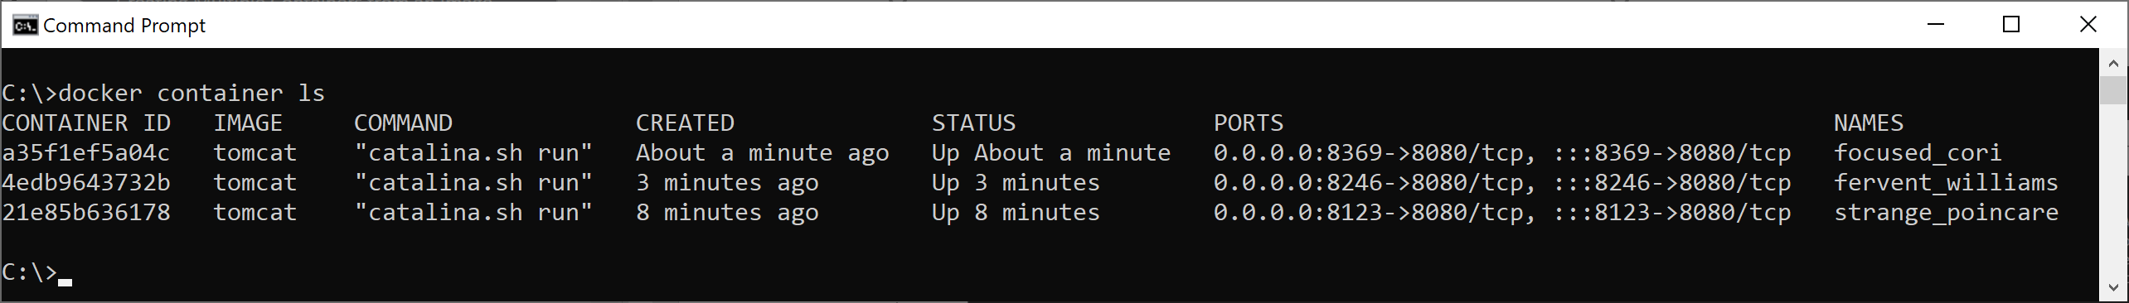
Listing Containers
You can get a list of all the containers currently running
Each container has:
A unique container id (abbreviated)
The name of the image (of which this container is an instance)
The command that is executed within the container
Created timestamp and status
Port mappings
A name for the container (random name by default)
docker container ls

Slide 20
Stopping a Container
To stop a container, run the following command with the container ID or name you want to stop
Even after you stop a container, Docker maintains information about that container (e.g. so you can view its logs)
You can list all containers (including stopped ones) as follows:
docker container stop focused_cori
docker container ls -a

Slide 21
Pruning Containers and Images
To completely remove all stopped containers:
To completely remove all dangling images:
docker container prune
docker image prune

Slide 22
4. How to Containerize a Spring Boot App
Overview
Running the application as normal
Bundling the application in a JAR
Defining a Dockerfile
Understanding the Dockerfile
Building the image
Viewing images in the local Docker registry
Running a container
Demo package: demo.containerization

Slide 23
Overview
In this section we'll see how to containerize a Spring Boot app
We'll build a Docker image that contains a Spring app
Then we'll run a container (i.e. an instance of the Docker image)
Our Spring Boot app will run on a JVM inside the container
See demo project, demo-15-containerization
Take a look at Application.java
It's a simple Spring Boot app with a REST service

Slide 24
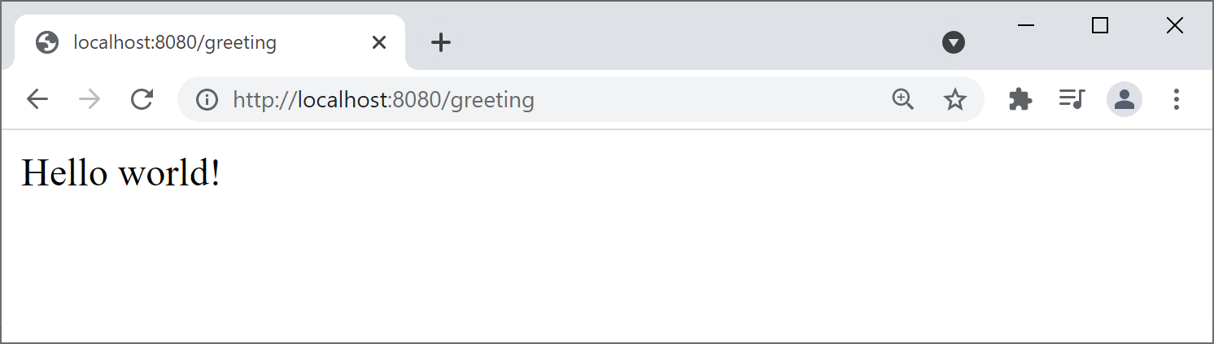
Running the Application as Normal
You can run the application as normal
Right-click Application.java, then Run Application
This runs the application directly on your host computer
The application contains an embedded web server (Tomcat)
Tomcat listens on port 8080 on your host computer
You can ping it via http://localhost:8080/greeting

Slide 25
Bundling the Application in a JAR
If you want to run a Java app in a Docker container…
The first step is to bundle the app into a JAR file
To bundle the app into a JAR:
Open a Terminal window in the project root folder
Run the following Maven command
This creates the JAR file:
target/demo-15-containerization-0.0.1.jar
.\mvnw package -DskipTests

Slide 26
Defining a Dockerfile (1 of 2)
Now we're ready to see how to create a Docker image
Remember, a Docker image is a “black box” executable package
It includes everything needed to run an application
In our case, we'll create a Docker image containing:
A JVM
Our Spring Boot JAR file
A command to execute the Spring Boot JAR file on the JVM

Slide 27
Defining a Dockerfile (2 of 2)
In order to define a Docker image, define a special file named Dockerfile (by default)
Specifies build instructions, so Docker can build an image
See this Dockerfile in the demo project (root folder)
See following slides for an explanation
Also see https://docs.docker.com/engine/reference/builder/
FROM openjdk:21
ARG JAR_FILE
COPY ${JAR_FILE} myapp.jar
EXPOSE 8080
ENTRYPOINT ["java","-jar","/myapp.jar"]

Slide 28
Understanding the Dockerfile (1 of 3)
FROM openjdk:21
ARG JAR_FILE
COPY ${JAR_FILE} myapp.jar
EXPOSE 8080
ENTRYPOINT ["java","-jar","/myapp.jar"]
A Dockerfile starts with a FROM instruction
Specifies the "base image" from which we are building
Our image will be based on OpenJDK version 21
OpenJDK is an open-source implementation of Java SE
When we run this Dockerfile to build our image…
Docker will see if we've already downloaded openjdk:21
If we haven't, Docker will pull it from the Docker Hub

Slide 29
Understanding the Dockerfile (2 of 3)
FROM openjdk:21
ARG JAR_FILE
COPY ${JAR_FILE} myapp.jar
EXPOSE 8080
ENTRYPOINT ["java","-jar","/myapp.jar"]
When you build a Docker image, you can pass arguments into the Docker build command
In the Dockerfile, use ARG statements to capture these arguments
In our example, the JAR_FILE arg specifies the name of our JAR
A Dockerfile specifies files to copy into the Docker image
Use COPY instructions to copy files into the Docker image
In our example, we copy our JAR file into the image
Inside the image, the JAR file will be named myapp.jar

Slide 30
Understanding the Dockerfile (3 of 3)
FROM openjdk:21
ARG JAR_FILE
COPY ${JAR_FILE} myapp.jar
EXPOSE 8080
ENTRYPOINT ["java","-jar","/myapp.jar"]
The EXPOSE instruction:
Acts as documentation about port(s) inside the container
Indicate this port must be mapped to a port on the host
The ENTRYPOINT instruction:
Specifies what to actually execute inside the Docker image
In our example, we run our JAR on the JVM in the image

Slide 31
Building the Image
Use the docker build command to build a Docker image
Type the following all on one line
It reads and executes the instructions in the Dockerfile
-t
Specifies the tag name for the image
Tells Docker to create an image with this name in the local registry
--build-arg
Specifies a value for a build argument
Followed by a name=value pair
docker build -t my-spring-boot-app
--build-arg JAR_FILE=target/demo-15-containerization-0.0.1.jar
.

Slide 32
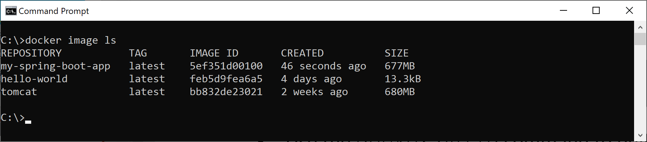
Viewing Images in the Local Docker Registry
You can view images in the Docker registry
docker image ls

Slide 33
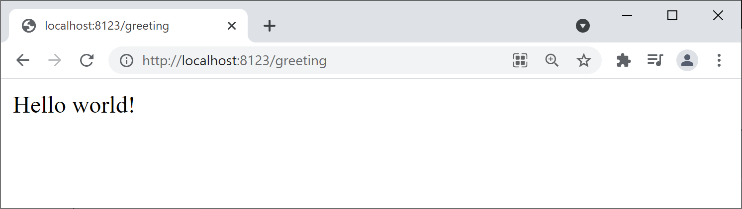
Running a Container
You can run a container as normal
You can then ping as normal, via the mapped port
docker run --name app -d -p 8123:8080 my-spring-boot-app

Slide 34
Summary
Introduction to containerization and Docker
Understanding Docker images
A closer look at images and containers
How to containerize a Spring Boot app

Slide 35

Exercise
Modify your Spring Boot app (e.g. add an index.html file) and then rebuild the JAR file:
Forcibly remove the old container and image:
Rebuild the image and run another container:
.\mvnw package -DskipTests
docker container rm -f app
docker image rm -f my-spring-boot-app
docker build -t my-spring-boot-app
--build-arg JAR_FILE=target/demo-15-containerization-0.0.1.jar
.
docker run --name app -d -p 8123:8080 my-spring-boot-app

