Slide 1
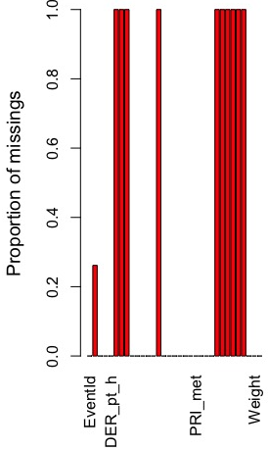
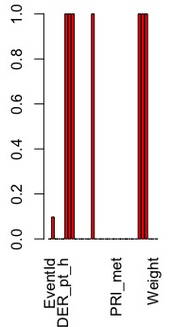
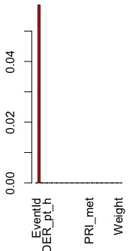
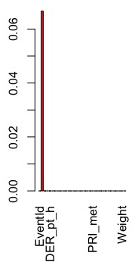
Missingness and jet number
0
1
2
3
Jet number can be treated as accounting for missingness

Slide 2
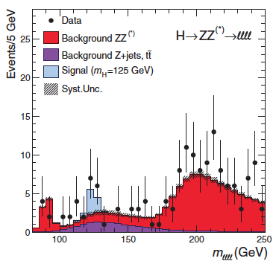
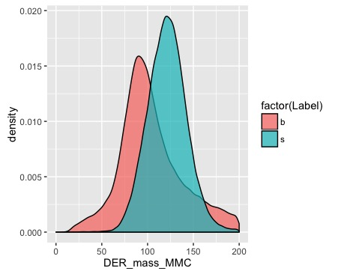
Mass as a predictor of Higgs Boson

Slide 3
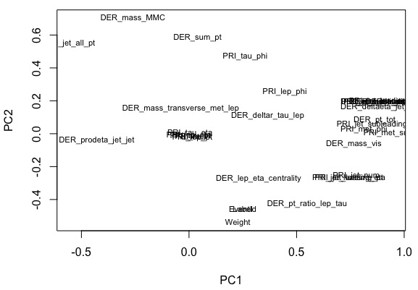
PCA
PCA shows that derived mass and label have a very strong relationship.

Slide 4
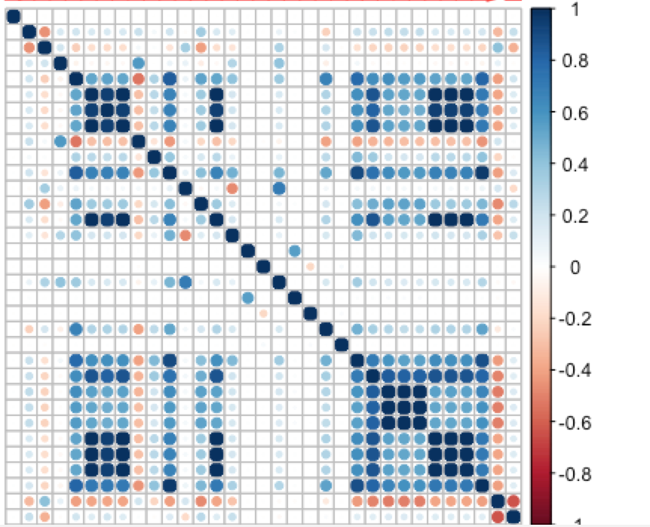
Correlation matrix
There are several variables with strong covariance among the 33 variables.

Slide 5
ROC AUC slide
Justification why we choose it over AMS

