Slide 1

Case Study 2
A study in Employee Attrition for DDSAnalytics.
Research performed in R Studio
By
Roger Tchegui

Slide 2

Introduction
The purpose of this presentation is to used the case study02 dataset that was provide to us to first identified the top 3 factors that lead to attrition and then build a model that will predict employee attrition in organizations .
We will first analyze our data and do a preliminary EDA process, in other to eliminated the unnecessary columns and the transform columns that need to be transform before fitting it into to the model that we will decide to used.
We will then remember that the business is also interesting in learning about any job role specific trends that may exist in the data.

Slide 3
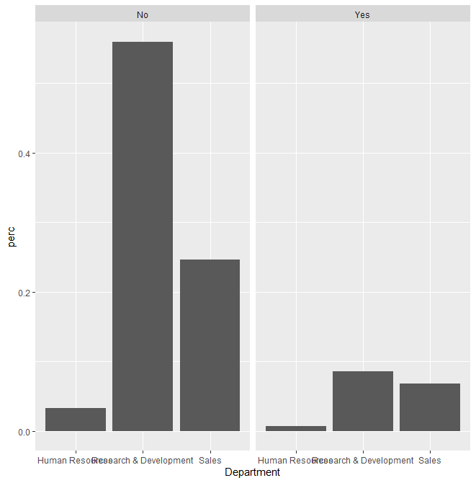
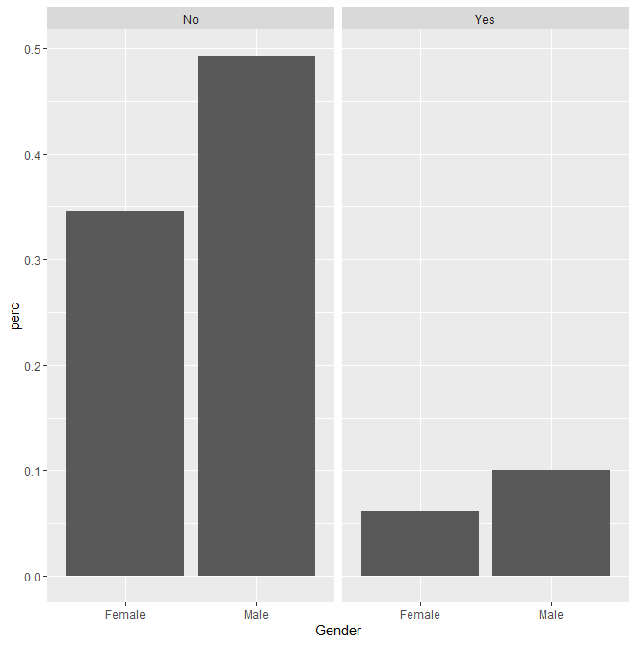
A little bit about DDSAnalytics employees
Predominantly Male Workforce Attrition rate across different departments
with Similar Attrition across Gender

Slide 4
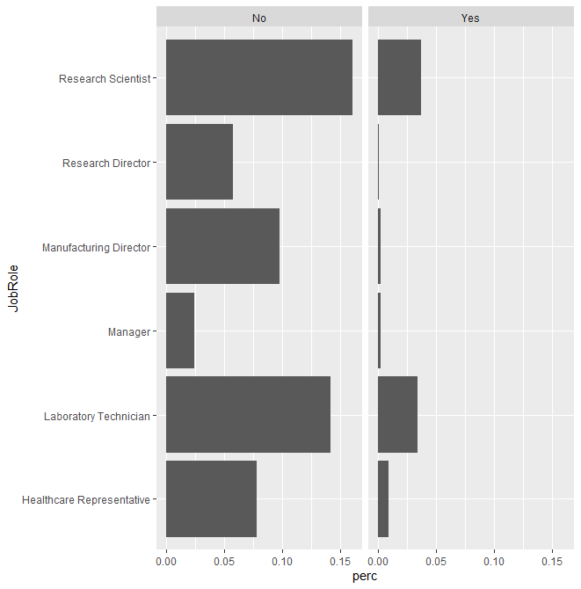
Counts by Role
Research Scientist and
Laboratory Technician have the most human capital with the higher Attrition rate

Slide 5
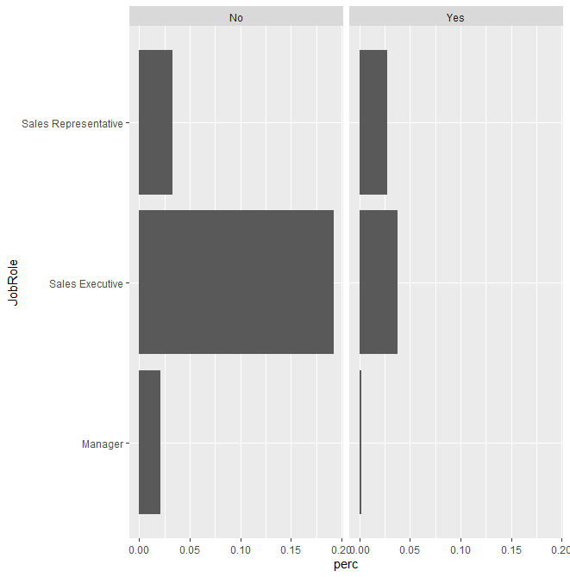
Management Roles from Job Roles
Executive ranks are Sales Heavy

Slide 6

Top three factors associated with turnover
MonthlyIncome
JobLevel
Age
Factor | Estimated Effect | Std. Error | Significance
Monthly Income | .94 | .33 | .00089
Joblevel | .063 | .018 | .00035
Age | 1.31 | .74 | .00019

Slide 7
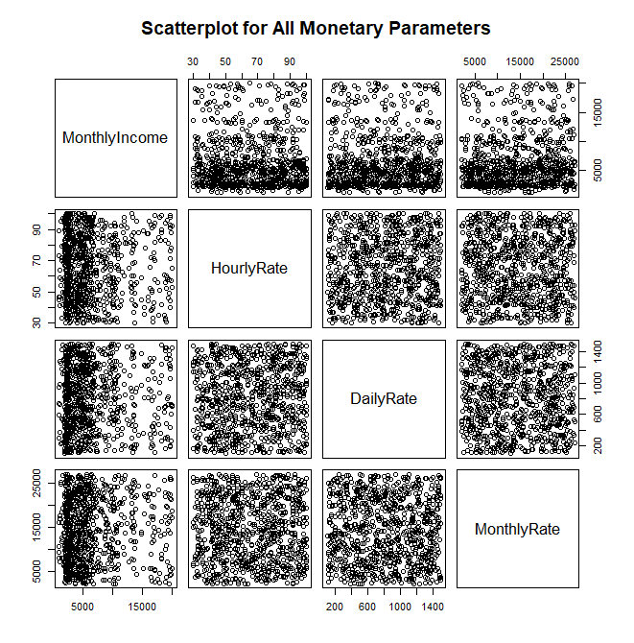
Pairwise SCATTERPLOT
The Pairwise scatterplot show correlation between all monetary parameters in our data

Slide 8
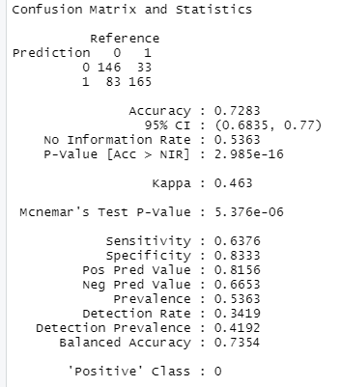
Let’s build our model to predict Attrition
KNN Model :

Slide 9
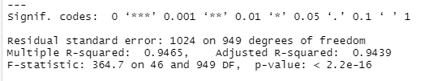
Let’s build our linear model
We have an RMSE of 1039.964
Well below the required RMSE of < 3000

Slide 10
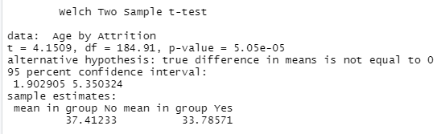
Sample t-test
With a p-value of 5.05*10^-05 it’s statiscal signifiant

Slide 11
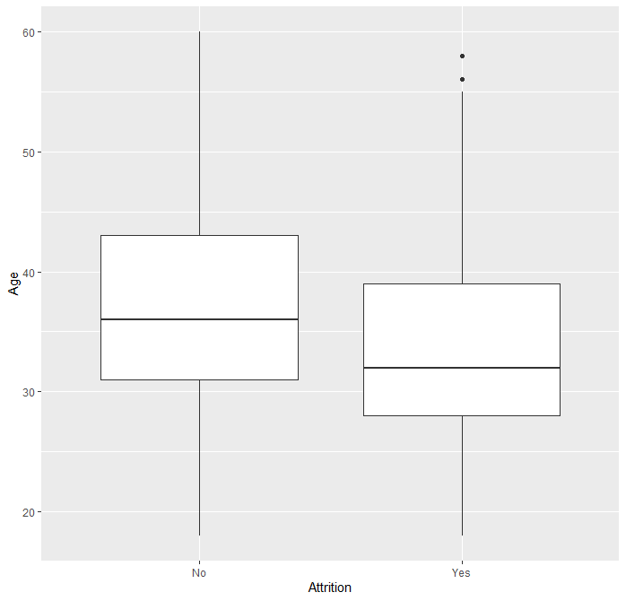
Additional finding

