Slide 1
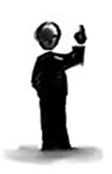
Entire corpus of publications
Training
documents
Test
documents
1
Word embedding model
Candidates
2
Save classifier
for uncertainty sampling
poly(x)
poly(x)
poly(x)
Expert/Untrained
Labeling
poly(x)
target
6
3
Classifier (Round X)
4
Test on “non-English” nouns
from test papers
Retrain classifier
Updated word embedding model
poly(x)
poly(x)
poly(x)
poly(x)
5
Updated classifier (Round X)
target
Test updated classifier

Slide 2
Corpus of publications
1
Other
documents
Word embedding model
Test
documents
2
Expert/untrained
crowd labeling
NLP-filtered
candidates
Test
4
poly(x)
poly(x)
poly(x)
poly(x)
target
NLP-filtered
candidates
3
poly(x)
Classifier used
for uncertainty sampling
poly(x)
poly(x)
Classifier
poly(x)
target

Slide 3
Corpus of publications
1
Other
documents
Word embedding model
Test
documents
Test against
NLP-filtered
candidates from
test documents
2
NLP-Filter
Expert & untrained
crowd labeling
of NLP-filtered
candidates
Unlabeled
poly(x)
poly(x)
4
poly(x)
poly(x)
poly(x)
poly(x)
poly(x)
poly(x)
Target
Labeled
3
poly(x)
poly(x)
poly(x)
poly(x)
Target
Classifier used
for uncertainty sampling for next round
Classifier

Slide 4
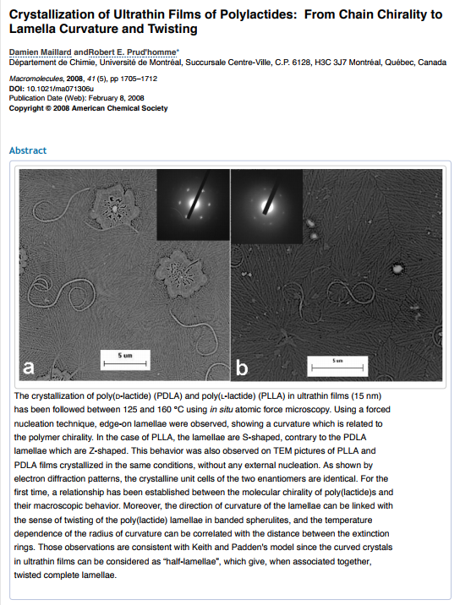
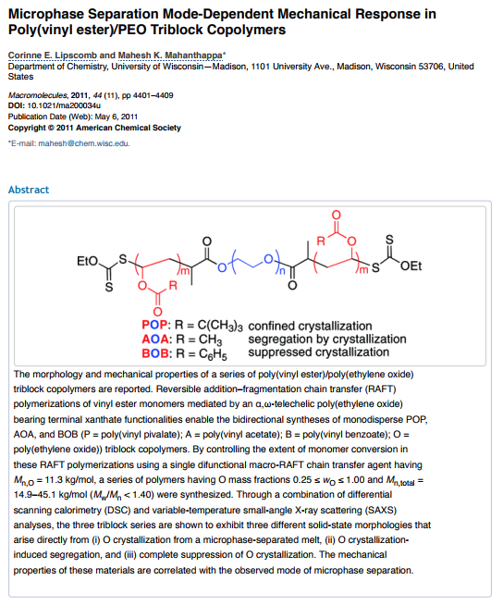
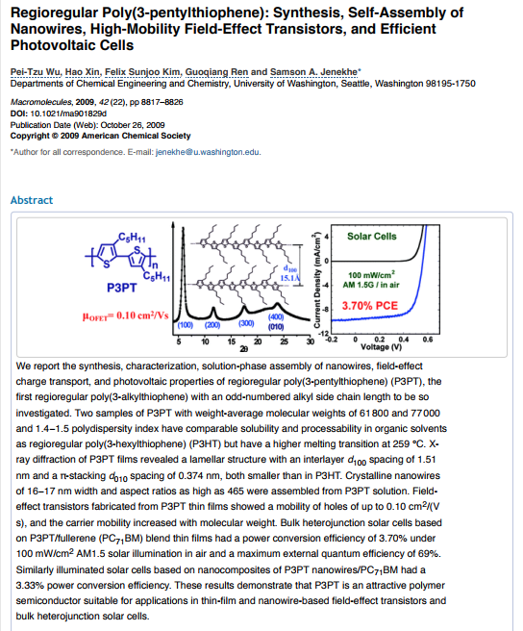

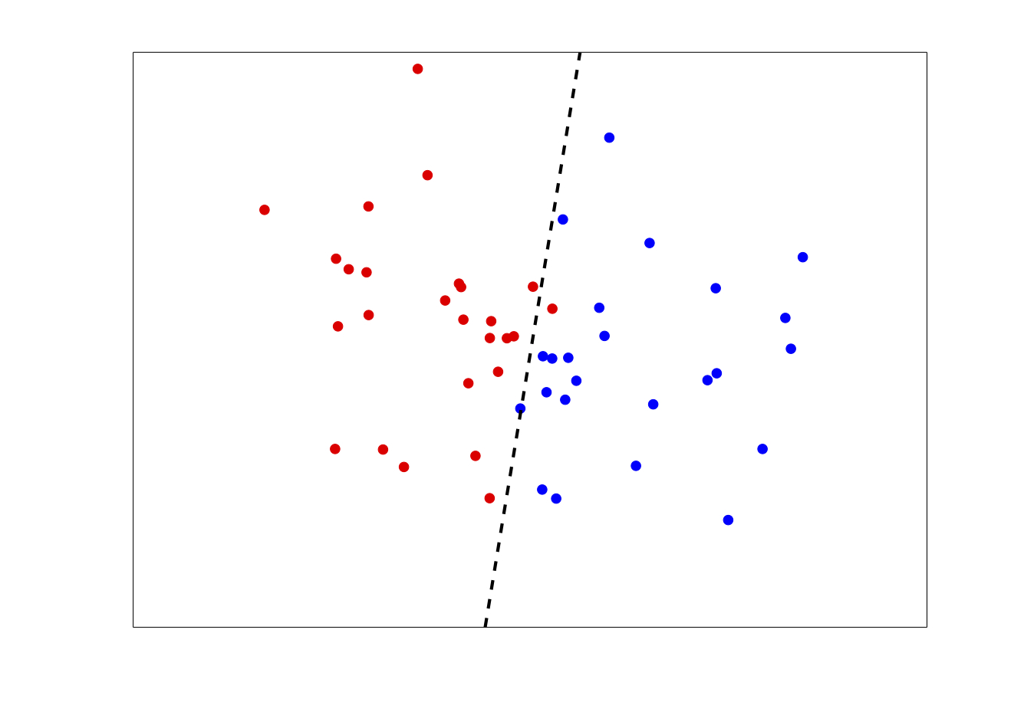
Active learning (Figure 2)
Word embedding
model generated
from publications
(1)
NLP filtering
(2)
Initial bootstrapping
and labeling
(3)
Sampling
strategies
(4) Expert and untrained crowd labeling
(5) Candidate
classification
Digital
dictionary
Random
Distance UBS
UBS
Cut numbers,
cut adjectives, trim :.,:- etc.
PS
Labeled
entity referents
Distance UBS
Dictionary

