Slide 1
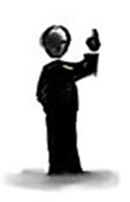
Entire corpus of publications
Training
documents
Test
documents
1
Word embedding model
Candidates
2
Save classifier
for uncertainty sampling
poly(x)
poly(x)
poly(x)
Expert/Untrained
Labeling
poly(x)
target
6
3
Classifier (Round X)
4
Test on “non-English” nouns
from test papers
Retrain classifier
Updated word embedding model
poly(x)
poly(x)
poly(x)
poly(x)
5
Updated classifier (Round X)
target
Test updated classifier

Slide 2
Corpus of publications
1
Other
documents
Word embedding model
Test
documents
2
Expert/Untrained
Labeling
NLP-filtered
candidates
4
poly(x)
poly(x)
poly(x)
poly(x)
target
NLP-filtered
candidates
3
poly(x)
Save classifier
for uncertainty sampling
poly(x)
poly(x)
Classifier
poly(x)
target
Test

Slide 3
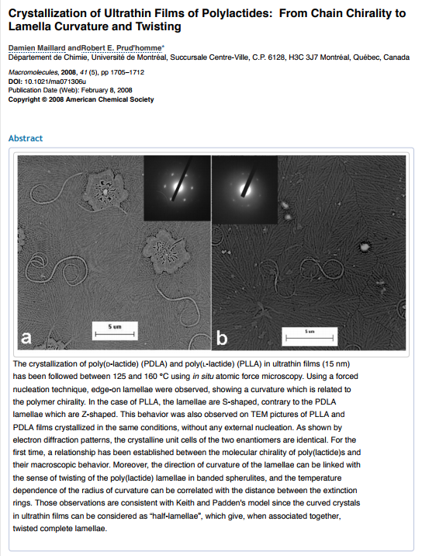
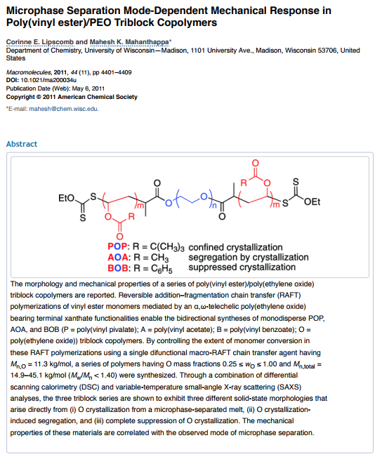
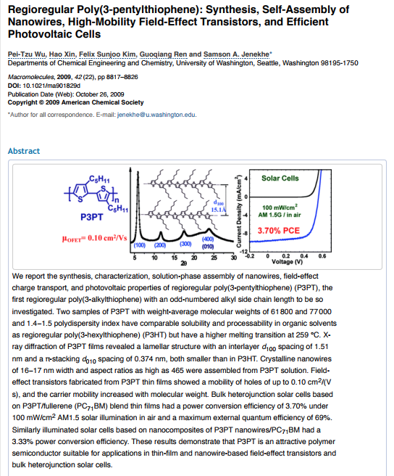

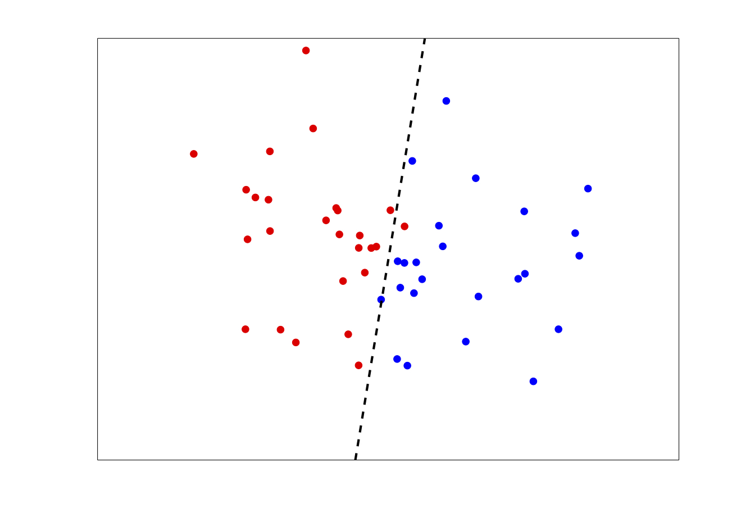
Active learning
Word embedding
model generated
from publications
(1)
NLP filtering
(2)
Bootstrapping &
Initial labeling
(3)
Sampling
strategies
(4) Expert/Untrained labeling
(5) Candidate
discrimination
Digital
dictionary
Random
Distance UBS
UBS
Cut numbers,
cut adjectives, trim :.,:- etc.
PS
Labeled
entity referents
Distance UBS
Dictionary

