Slide 1
Designing a Battery Management System From a Real-Time System Perspective
Jinkyu Lee
Dept. of Computer Science and Engineering,
Sungkyunkwan University (SKKU)
2022.9.21-22 Samsung SDI

Slide 2
Overall Schedule
1차시 (신동화 교수님)
9/19(월) 13~16시
실시간 시스템의 개념
2차시
9/21(수) 9~12시
실시간 태스크 스케줄링 기법
3차시
9/22(목) 13~16시
실시간 태스크 스케줄링 가능성 (Schedulability) 분석 기법
추후
배터리 관리 시스템의 태스크 구성과 스펙에 따른 실시간 시스템 성능 요구 분석 (현재 BMS 스펙 등을 검토 및 토의)
Designing a Battery Management System From a Real-Time System Perspective

Slide 3
Schedule for each day
(9/21)
09:00 – 10:15
Lecture
10:15 – 10:30
Break
10:30 – 11:45
Lecture
11:45 –
Q&A
(9/22)
13:00 – 14:15
Lecture
14:15 – 14:30
Break
14:30 – 15:45
Lecture
15:45 –
Q&A

Slide 4
REVIEW OF THE PREVIOUS LECTURE

Slide 5
Real-Time Scheduling
Real-time task model
Concept of scheduling algorithm and schedulability analysis
Priority-driven scheduling algorithm
Fixed-priority scheduling (e.g., Rate Monotonic)
EDF
Schedulability analysis
Utilization-based analysis
Response time analysis

Slide 6
Real-Time Scheduling
Uniprocessor: at each time slot, only one job can be executed.
T₁=4, D₁=4, C₁=1
τ₁
(4,1)
τ₂
(5,2)
5
10
15
τ₃
(7,2)
5
10
15
τ₁ > τ₂ > τ₃, non-preemptive
τ₁ > τ₂ > τ₃, preemptive
Deadline miss

Slide 7
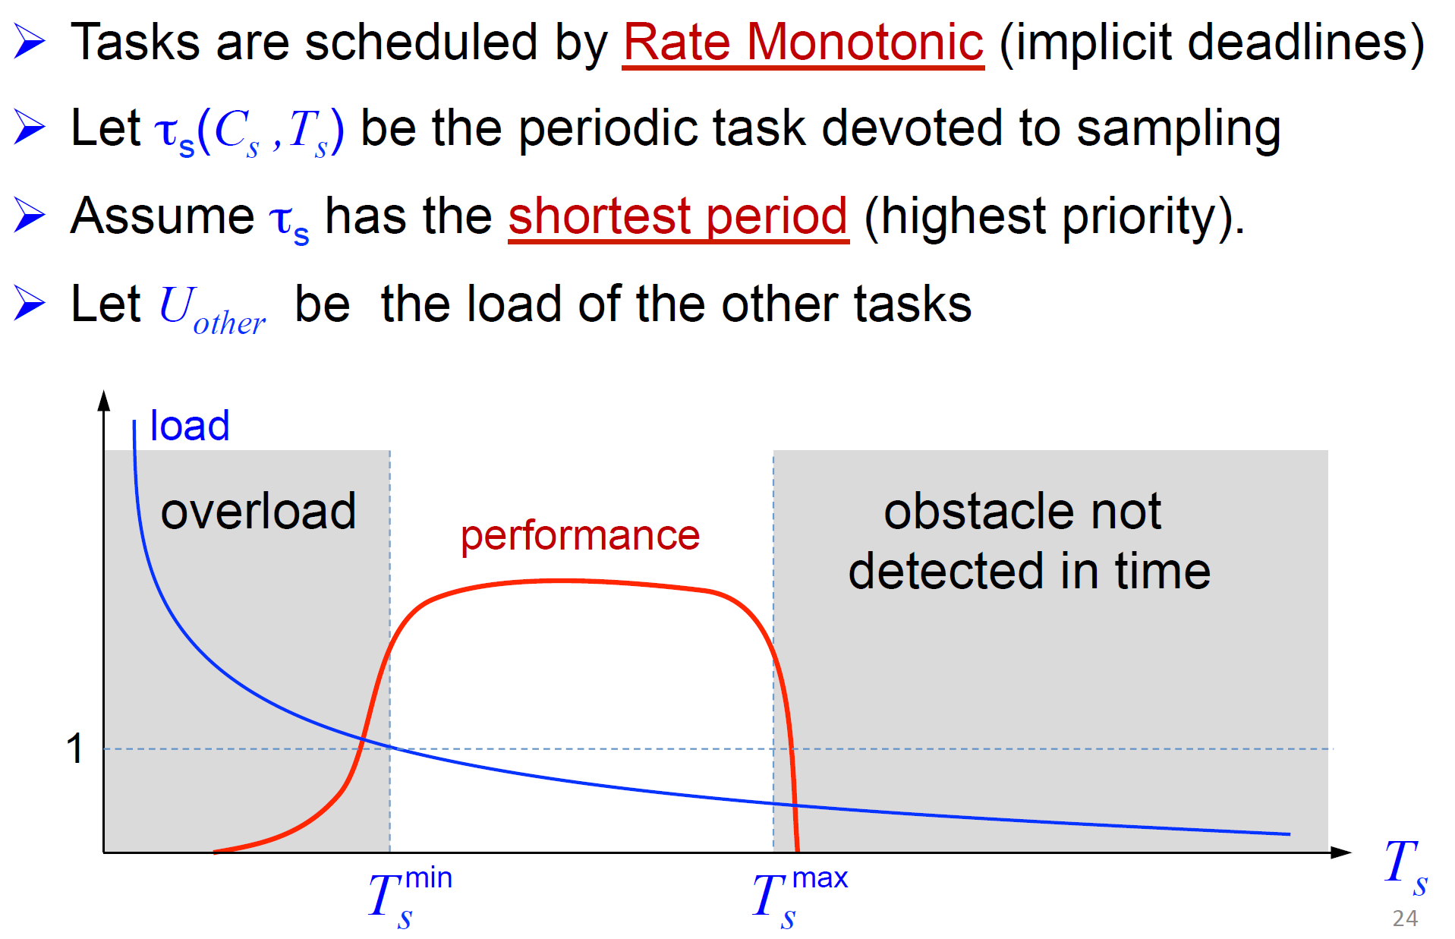
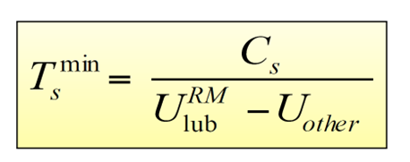
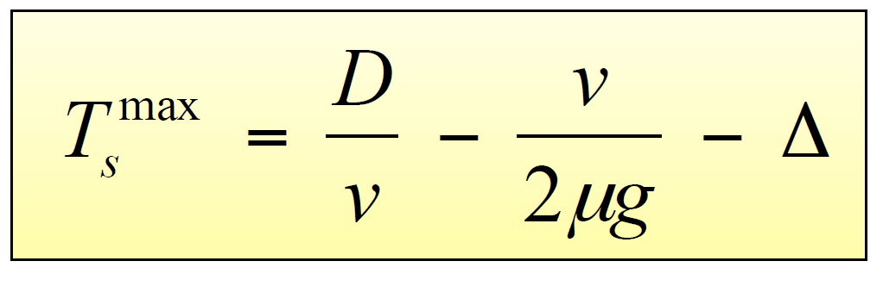
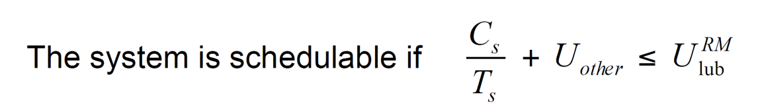
Real-Time Scheduling
A practical example of real-time scheduling
Why this is possible?
Scheduling algorithm + Schedulability analysis
From “Real-Time Systems: Achievements and Perspectives” by Giorgio Buttazzo

Slide 8
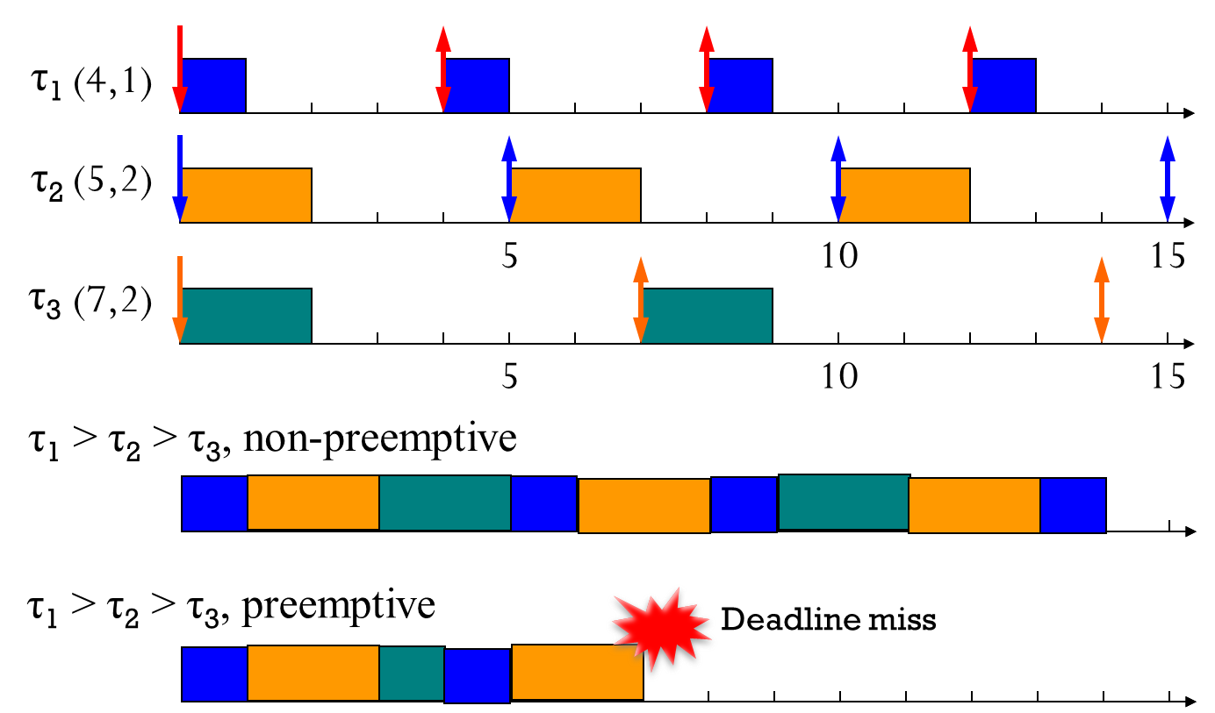
Real-Time Scheduling
Two main components for real-time scheduling
Scheduling algorithm
Determine when each job executes (which job to be executed)
Schedulability analysis
Guarantee no deadline miss of a given task set under the target scheduling algorithm
Can we guarantee no deadline miss in the future?
Scheduling
Algorithm
Schedulability Analysis

Slide 9
Real-Time Scheduling
Why do we need schedulability analysis? Isn’t it possible to guarantee schedulability simply by simulating a target set of tasks?
Is it possible to simulate all different combinations of offsets?
Can each simulation guarantee the schedulability even with actual execution times less than their corresponding WCETs?
Is it feasible to simulate a target set of tasks if their LCM is very large?
Can we guarantee no deadline miss in the future?
Scheduling
Algorithm
Schedulability Analysis

Slide 10
Real-Time Scheduling
Which scheduling algorithm with which condition (i.e., schedulability analysis) guarantees that there is no single job deadline miss forever?
With any offset,
With any actual execution time,
With any arbitrary long period,
Example
Can we guarantee no deadline miss in the future?
Scheduling
Algorithm
Schedulability Analysis

Slide 11
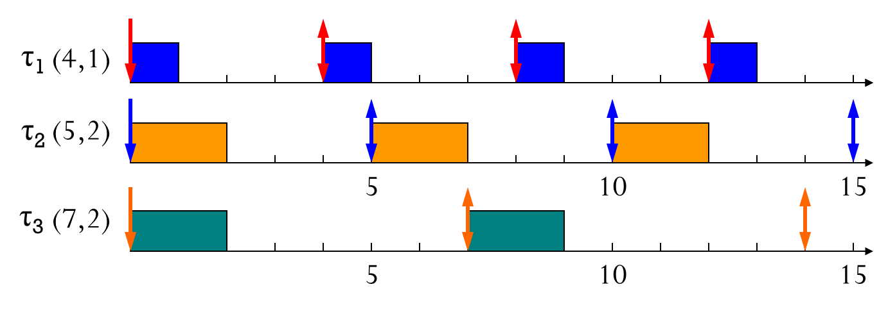
Classification of Priority-Driven Scheduling
Can we guarantee no deadline miss of all jobs of a given task set under each scheduling algorithm?
TFP: RM
JFP: EDF
JDP: LLF
What is the maximum utilization?
U = ∑ C_{i}/T_{i} ≤ 1.0
Example: 1/4 + 2/5 + 2/7
Can each scheduling algorithm achieve the maximum utilization?

Slide 12
RM: Overview
Critical instant under RM
Utilization-based analysis
U ≤ n(2^{1/n} – 1.0)
n → ∞, n(2^{1/n} – 1.0) → 0.69
Only sufficient
Response-time analysis
Exact
Some applications
Schedulability with transient overhead, interrupts and blocking
Without loss of generality
T₁ ≤ T₂ ≤… ≤ T_{n}

Slide 13
RM: Critical Instant
Critical instant of τ_{i}
A job of τ_{i} arriving at that instant has the largest response time
Which τ₂ has the maximum response time?
In-phase instant is critical under RM
All higher priority tasks are released at the same instant of J_{i,c} (assume all jobs are completed before the next job is released)
Task₁ Task₂
Task_{1,} Task₂
Task₂ Task₁
Why?

Slide 14
RM: Utilization-Based Analysis
Example
Total utilization is
.200 + .267 + .286 = .753 < U(3)=3(2^{1/3} – 1.0)=.779
The periodic tasks in the example are schedulable according to the UB test.
 | C_{i} | T_{i} | U_{i}
Task₁ | 20 | 100 | 0.200
Task₂ | 40 | 150 | 0.267
Task₃ | 100 | 350 | 0.286
U ≤ n(2^{1/n} – 1.0)

Slide 15
SYNCHORNIZATION

Slide 16
Priority inversion
Priority-based preemptive scheduling
Priority represents importance or urgency.
However, a higher-priority task can be blocked by a lower-priority task, i.e., priority inversion
Execution with critical section
Mutex for shared resource access
Non-preemptive sub-systems access, e.g., system bus, secondary storage, network, etc.

Slide 17
No priority inversion
τ_{H}
Released at t=2
τ_{M}
…
Released at t=4
τ_{L}
Released at t=0
τ_{H}
τ_{M}
…
τ_{L}

Slide 18
Priority inversion
normal execution
execution with critical section
τ_{H}
Released at t=2
τ_{M}
…
Released at t=4
τ_{L}
Released at t=0
τ_{H}
request_lock(R)
lock(R)
…
unlock(R)
τ_{M}
lock(R)
τ_{L}
unlock(R)

Slide 19
Priority inversion
It is not harmful, most of time.
Some additional delays for higher-priority tasks
However, it can be very critical at some point
Example: Mars Pathfinder

Slide 20

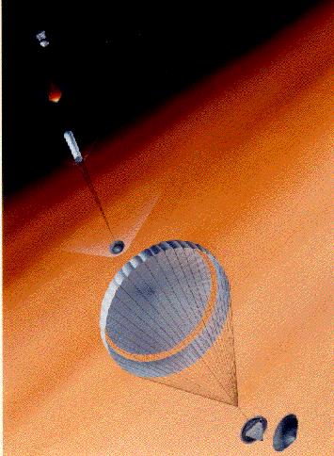

Mars Pathfinder
Landed on the Mars on July 4th, 1997.
Surface operations
Daily images of Mars
Daily weather reports from the surface of Mars
Out-of-control, due to a software problem
http://nssdc.gsfc.nasa.gov/planetary/mesur.html
Successful
operations
Communication errors
Problem solved
Landed
What happened?
July 4th
July 12th
July 19th

Slide 21
Mars Pathfinder
τ_{H}: information bus task (short, frequent)
Should have quick responses
τ_{M}: communication task
τ_{L}: meteorological task
Total system reset!
τ_{H}
request_lock(R)
lock(R)
…
unlock(R)
τ_{M}
lock(R)
τ_{L}
unlock(R)

Slide 22
Synchronization protocols
Priority inheritance protocol (PIP)
Priority ceiling protocol (PCP)
Lui Sha, Raj Rajkumar, John Lehoczky, “Priority Inheritance Protocols: An Approach to Real-Time Synchronization,” IEEE Transactions on Computers, vol. 39, no. 9, page 1175-1185, 1990.

Slide 23
Priority inheritance protocol (PIP)
A higher-priority task inherits its priority to a lower-priority task
When the higher-priority task waits for the resource locked by the lower-priority task
τ_{H}
unlock(R)
request_lock(R)
lock(R)
τ_{M}
…
lock(R)
τ_{L}
τ_{L} inherits τ_{H}’s priority
unlock(R), the inheritance ends

Slide 24
Priority inheritance protocol (PIP)
τ_{H}
request_lock(R)
lock(R)
…
unlock(R)
τ_{M}
lock(R)
τ_{L}
unlock(R)
τ_{H}
unlock(R)
request_lock(R)
lock(R)
τ_{M}
…
lock(R)
τ_{L}
τ_{L} inherits τ_{H}’s priority
unlock(R), the inheritance ends

Slide 25
Priority inheritance protocol (PIP): Deadlock
What if there are two types of critical sections?
normal execution
R1
R2
execution with critical section
τ_{H}
Released at t=2
τ_{L}
Released at t=0
lock(R1)
request_lock(R2)
τ_{H}
lock(R2)
request_lock(R1)
τ_{L}
Deadlock!

Slide 26
Priority ceiling protocol (PCP)
PIP + the following mechanism
A task can lock a resource only if its priority is strictly higher than all the ceilings of the resources currently locked by other tasks.
Ceiling(R1)= τ_{H}
Ceiling(R2)= τ_{H}
request_lock(R1)
Ceiling(R2)= τ_{H}
No lock(R1)
lock(R1)
lock(R2)
unlock(R1)
τ_{H}
lock(R2)
lock(R1)
unlock(R2)
τ_{L}
unlock(R1)
unlock(R2)

Slide 27
Priority ceiling protocol (PCP)
lock(R1)
request_lock(R2)
τ_{H}
lock(R2)
request_lock(R1)
τ_{L}
Deadlock!
request_lock(R1)
Ceiling(R1)= τ_{H}
No lock(R1)
lock(R1)
lock(R2)
unlock(R1)
τ_{H}
lock(R2)
lock(R1)
unlock(R2)
τ_{L}
unlock(R1)
unlock(R2)

Slide 28
Priority ceiling protocol (PCP)
Proved that
PCP prevents chained blocking and deadlocks; and
A task can be blocked for at most the duration of one critical section.

Slide 29
Synchronization protocols: Where are we?
Synchronization Protocols
Schedulability Analyses
Periodic resources
Some studies
Uniprocessor
Fully mature
Fully mature
Identical multicore
Some studies
Heterogeneousmulticore
Few studies

Slide 30
CASE STUDY: BMS SYSTEM

Slide 31
Case Study
BMS system
Task model
Periodic tasks except for initialization tasks (start-up & shutdown)
Initialization tasks perform only for start-up and shutdown
The source of WCET
Measuring the max execution time
Task dependency
No control flow dependency
No shared resource

Slide 32
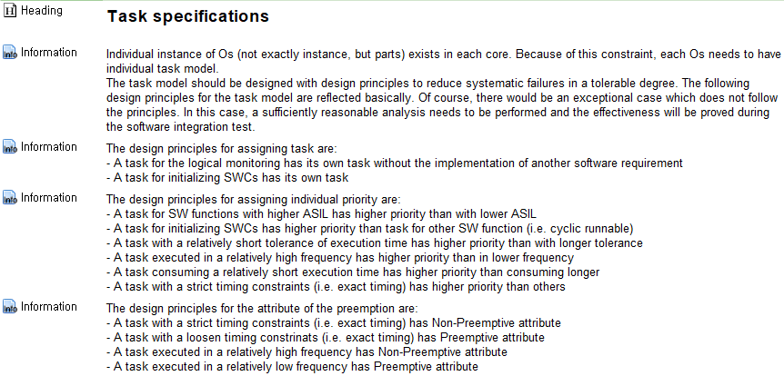
Case Study
BMS system
Prioritization
Priority-driven,
TFP
Rate Monotonic
Mixture of
Non-preemptive & Preemptive

Slide 33
Case Study

Slide 35
Case Study
(T, C) task model
Preemptive, no preemption cost
No offset
Fixed-priority scheduling (e.g., Rate Monotonic scheduling)
Focus on a single processor (i.e., no interference between cores)
ms
regulated
 | Period | WCET
τ₁ | 100 | 6
τ₂ | 10 | 4
τ₃ | 20 | 1
τ₄ | 50 | 20
Runnable | Runnable Priority | Offset | max execution time [ns] | Period[ms]
SbcM_MainFunction | 0 | 0 | 515520 | 100
SbcM_MainFunction_10ms | 2 | 0 | 28000 | 10
R_DIS | 10 | 0 | 2080 | 20
R_MCI | 12 | 85 | 633280 | 50
=> 0
Priority: τ₁ > τ₂ > τ₃ > τ₄

Slide 36
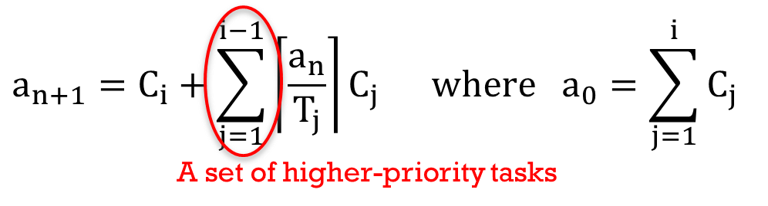
Case Study
Applying response-time analysis
R₁
R₁ = 6 (≤ 100, schedulable)
R₂
a=6+4=10 => 10
R₂ =10 (≤ 10, schedulable)
R₃
a=6+4+1=11 => 15
a=15 => 15
R3 =15 (≤ 20, schedulable)
R₄
a=6+4+1+20=31 => 44
a=44 => 49
a=49 => 49
R₄ =49 (≤ 50, schedulable)
 | Period | WCET
τ₁ | 100 | 6
τ₂ | 10 | 4
τ₃ | 20 | 1
τ₄ | 50 | 20

Slide 37
Case Study
(T, C) task model
Preemptive, no preemption cost
No offset Non-trivial offset
Fixed-priority scheduling (e.g., Rate Monotonic scheduling)
Focus on a single processor (i.e., no interference between cores)
ms
regulated
 | Period | WCET
τ₁ | 100 | 6
τ₂ | 10 | 4
τ₃ | 20 | 1
τ₄ | 50 | 20
Runnable | Runnable Priority | Offset | max execution time [ns] | Period[ms]
SbcM_MainFunction | 0 | 0 | 515520 | 100
SbcM_MainFunction_10ms | 2 | 0 | 28000 | 10
R_DIS | 10 | 0 | 2080 | 20
R_MCI | 12 | 85 | 633280 | 50
Priority: τ₁ > τ₂ > τ₃ > τ₄

Slide 38
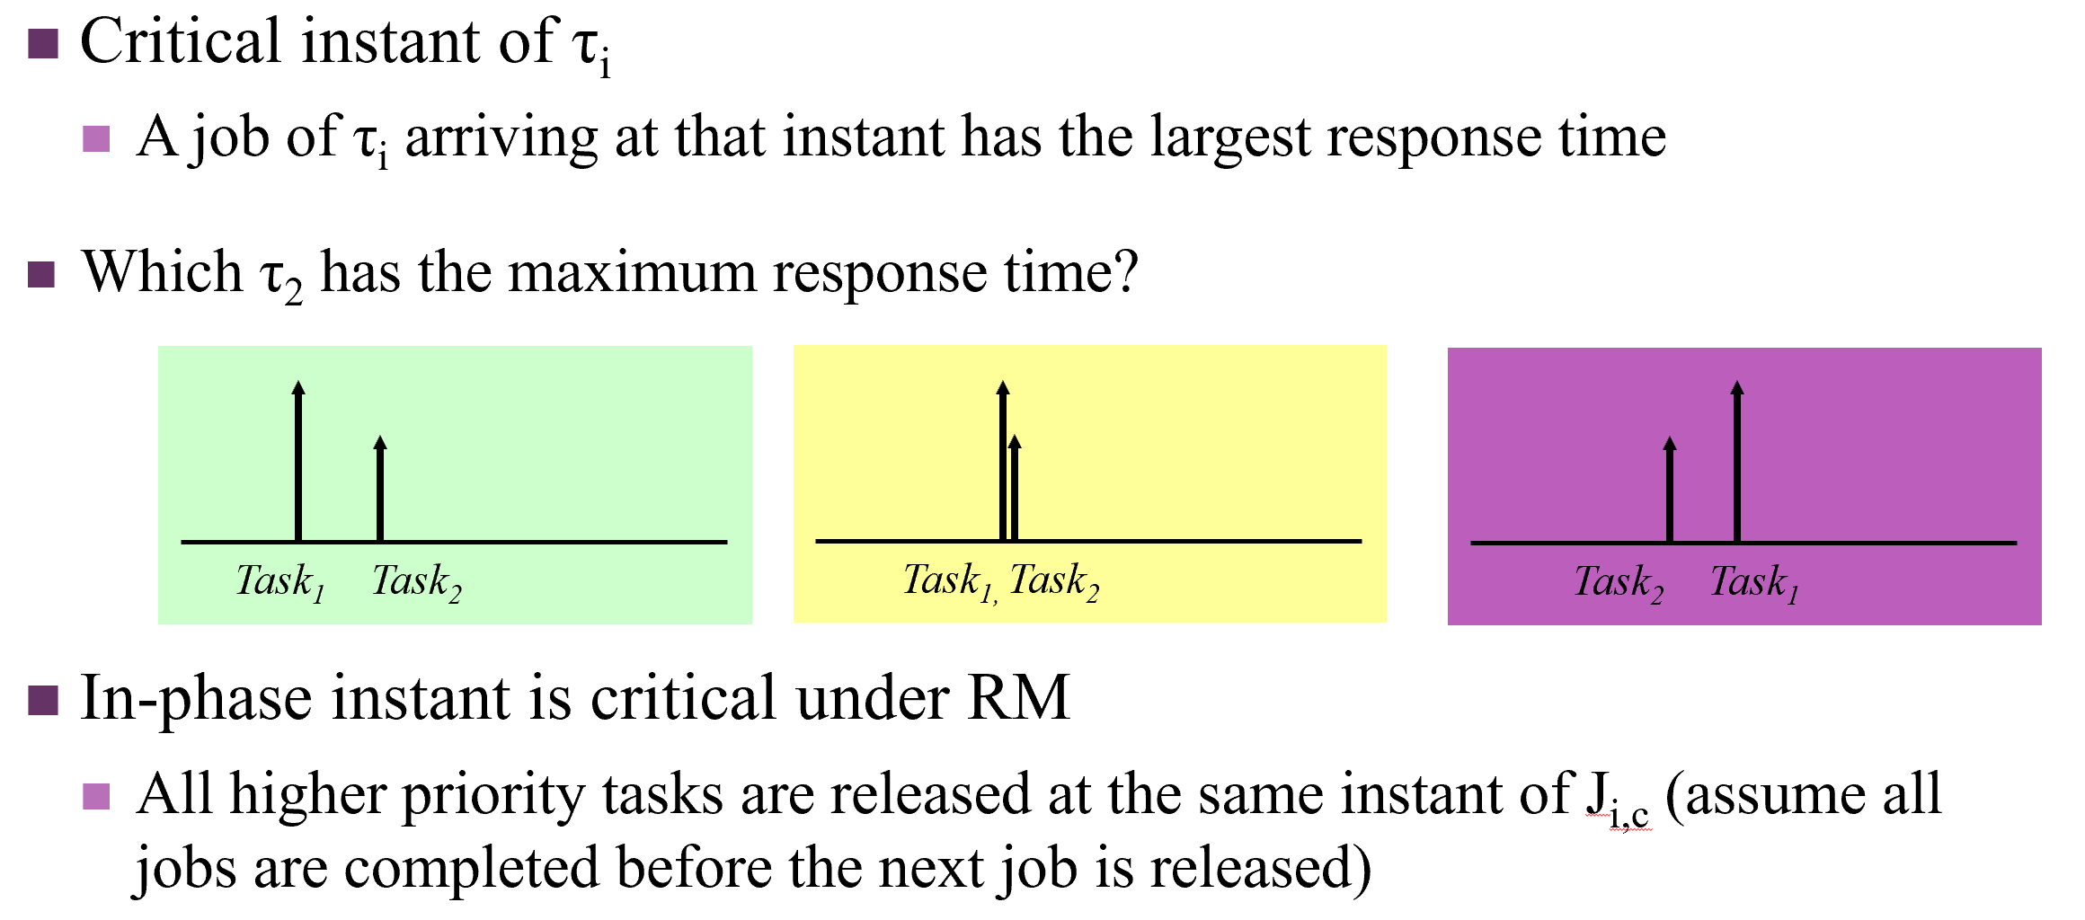
Case Study
Applying response-time analysis AS IT IS
Why?
Critical instances
τ₂
(10,4)
τ₄
(50,20)
τ₂
(10,4)
τ₄
(50,20)

Slide 39
Case Study
(T, C) task model
Preemptive, no preemption cost Non-preemptive
No offset Non-trivial offset
Fixed-priority scheduling (e.g., Rate Monotonic scheduling)
Focus on a single processor (i.e., no interference between cores)
ms
regulated
 | Period | WCET
τ₁ | 100 | 6
τ₂ | 10 | 4
τ₃ | 20 | 1
τ₄ | 50 | 20
Runnable | Runnable Priority | Offset | max execution time [ns] | Period[ms]
SbcM_MainFunction | 0 | 0 | 515520 | 100
SbcM_MainFunction_10ms | 2 | 0 | 28000 | 10
R_DIS | 10 | 0 | 2080 | 20
R_MCI | 12 | 85 | 633280 | 50
NP
NP
NP
NP
Priority: τ₁ > τ₂ > τ₃ > τ₄

Slide 40
Case Study
Can we apply response-time analysis as it is?
NO!
Can a lower-priority block a higher-priority task?
When?
What are the differences?
In terms of interfering
In terms of being interfered
What is the critical instance?
For the lowest-priority task
For the highest-priority task
For other tasks?
τ₂
(10,4)
τ₄
(50,20)

Slide 41

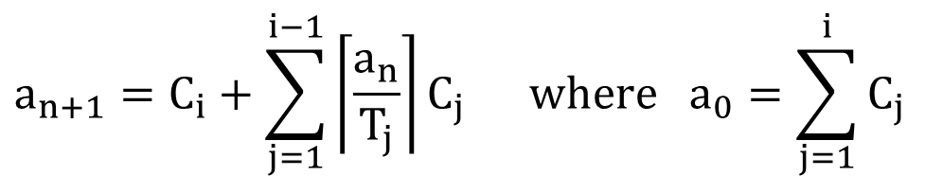
Case Study
Modifying the response-time analysis
A job of the lower-priority task τ_{i} can block a job of the higher-priority task τ_{k} only when τ_{i} starts its execution before is τ_{k} released.
A job of the higher-priority task can be blocked by only one job of any lower-priority tasks.
A set of higher-priority tasks
$$a_{n+1}=C_{i}+\sum_{j=1}^{i−1}{\left\lceil \frac{a_{n}}{T_{j}}\right\rceil }C_{j} \text{where} {\text{a}}_{0}=\sum_{j=1}^{i}{C_{j}}$$
+ max ${(C}_{i}−1)$
A set of lower-priority tasks
Can we apply critical instant for the preemptive model to that for the non-preemptive model?

Slide 42
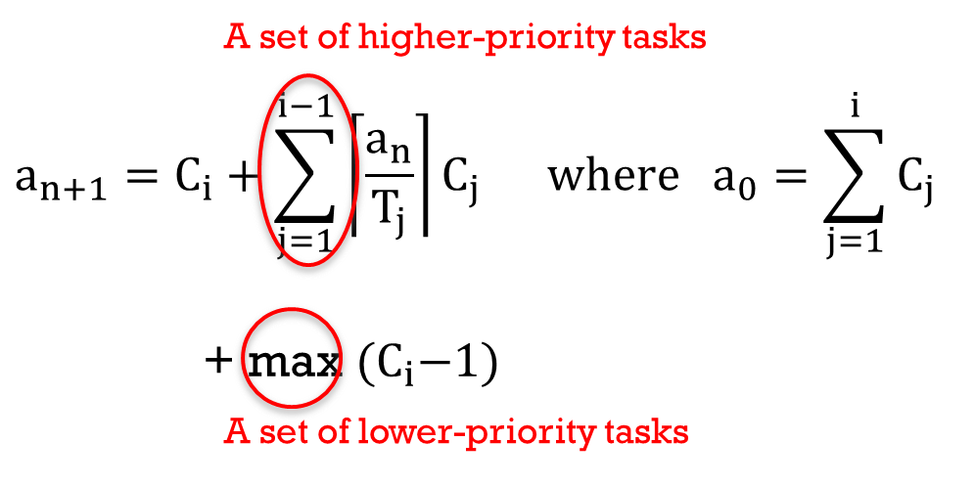
Case Study
Applying response-time analysis
R₁
R₁ = 6+19 (≤ 100, schedulable)
R₂
a=6+4+19=29
R₂ ≥ 29 (>10, unschedulable)
R₃
a=6+4+1+19 =30
R₃ ≥ 30 (>20, unschedulable)
R₄
a=6+4+1+20=31 => 44
a=44 => 49
a=49 => 49
R₄ =49 (≤ 50, schedulable)
 | Period | WCET
τ₁ | 100 | 6
τ₂ | 10 | 4
τ₃ | 20 | 1
τ₄ | 50 | 20

Slide 43

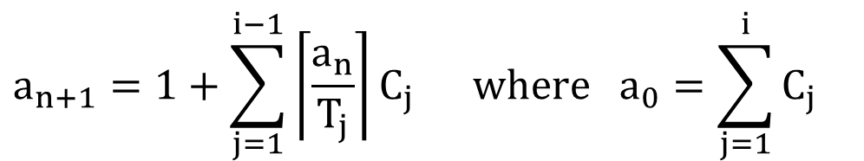
Case Study
Check whether a task starts its execution at t,
Instead of whether a task finishes its execution at t.
What is the difference?
A set of higher-priority tasks
$$a_{n+1}=1+\sum_{j=1}^{i−1}{\left\lceil \frac{a_{n}}{T_{j}}\right\rceil }C_{j} \text{where} {\text{a}}_{0}=\sum_{j=1}^{i}{C_{j}}$$
+ max $(C_{i}−1)$
A set of lower-priority tasks

Slide 44
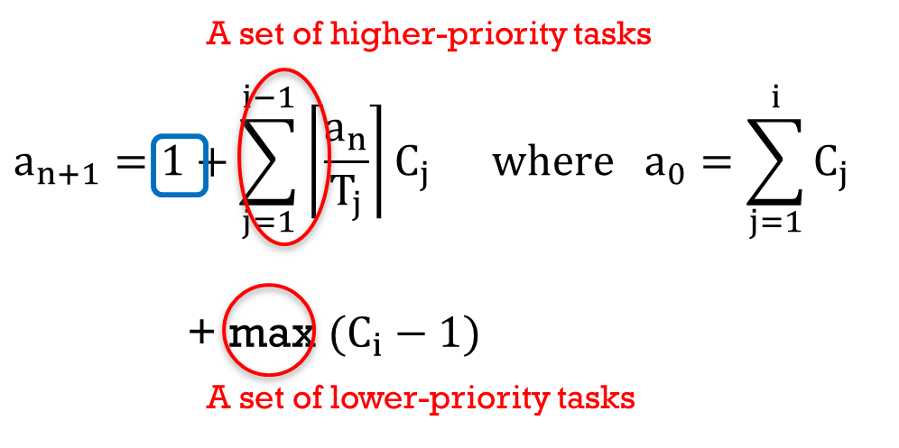
Case Study
R₃
a=6+3+5=14 => 17
a=17 => 17
R₃ =17 (≤ 20, schedulable)
F₃
a=6+3+1=10 => 10
F₃ =10
⬄ R₃ = F₃ +(C₃-1) = 10+4=14
(≤ 20, schedulable)
 | Period | WCET
τ₁ | 100 | 6
τ₂ | 10 | 3
τ₃ | 20 | 5

Slide 45
Case Study
(T, C) task model
A mixture of preemptive and non-preemptive
No offset Non-trivial offset
Fixed-priority scheduling (e.g., Rate Monotonic scheduling)
Focus on a single processor (i.e., no interference between cores)
ms
regulated
 | Period | WCET
τ₁ | 100 | 6
τ₂ | 10 | 4
τ₃ | 20 | 1
τ₄ | 50 | 20
Runnable | Runnable Priority | Offset | max execution time [ns] | Period[ms]
SbcM_MainFunction | 0 | 0 | 515520 | 100
SbcM_MainFunction_10ms | 2 | 0 | 28000 | 10
R_DIS | 10 | 0 | 2080 | 20
R_MCI | 12 | 85 | 633280 | 50
P
NP
NP
P
Priority: τ₁ > τ₂ > τ₃ > τ₄

Slide 46
Case Study
Can we apply response-time analysis as it is?
NO!
What are the differences?
4 cases (interfered, interfering)
P: preemptive, NP: non-preemptive
(P ← P), (P ← NP), (NP ← P), (NP ← NP)
What is the critical instance?
For the lowest-priority task
For the highest-priority task
For other tasks?

Slide 47
Case Study
(P ← P)
(P ← NP)
(NP ← P)
(NP ← NP)
→ A set of non-preemptive lower-priority tasks
→ A set of non-preemptive lower-priority tasks
Can we apply critical instant for the preemptive model to that for the mixture model?

Slide 48
Case Study
(T, C) task model + initialization task
A mixture of preemptive and non-preemptive
No offset Non-trivial offset
Fixed-priority scheduling (e.g., Rate Monotonic scheduling)
Focus on a single processor (i.e., no interference between cores)
ms
regulated
 | Period | WCET
τ₁ | 100 | 6
τ₂ | 10 | 4
τ₃ | 20 | 1
τ₄ | 50 | 20
Runnable | Runnable Priority | Offset | max execution time [ns] | Period[ms]
SbcM_MainFunction | 0 | 0 | 515520 | 100
SbcM_MainFunction_10ms | 2 | 0 | 28000 | 10
R_DIS | 10 | 0 | 2080 | 20
R_MCI | 12 | 85 | 633280 | 50
P
NP
NP
P

Slide 49
Case Study
Add the execution time of the initialization task only once.
What about the shut-down task?
ms
regulated
 | Period | WCET
τ₁ | 100 | 6
τ₂ | 10 | 4
τ₃ | 20 | 1
τ₄ | 50 | 20
P
NP
NP
P

Slide 50
Case Study
More general, complex case
Interference between cores
Dependency between tasks
Example: shared resources, precedency relationship
Limited preemption
Multiple computing cores
Global scheduling
Partitioned scheduling
More general, complex task model
E.g., DAG-structured tasks
Each issue is a research topic, yielding a number of academic papers.

Slide 51
Case Study: Conclusion
As the task model, constraints and platforms get more complex, it also becomes more complex to derive the schedulability analysis.
However, it is usually possible to derive schedulability analysis.
At least in the settings we discussed so far.
Also, the result of the schedulability analysis is less complex than the derivation of the schedulability analysis.

Slide 52
THE END
Thank you for attending this class!

Slide 54
MULTIPROCESSOR SCHEDULING

Slide 55
What have we done so far for task scheduling?
Scheduling a set of tasks with various constraints on a single processor.
What should we do if schedulability condition for the given task set cannot be met?
Question: which tasks should be assigned to which processors and why?
Ideally, combined task assignment and scheduling is desirable, but this is very hard.
Common approach: assign tasks and then schedule them on each processor.

Slide 56
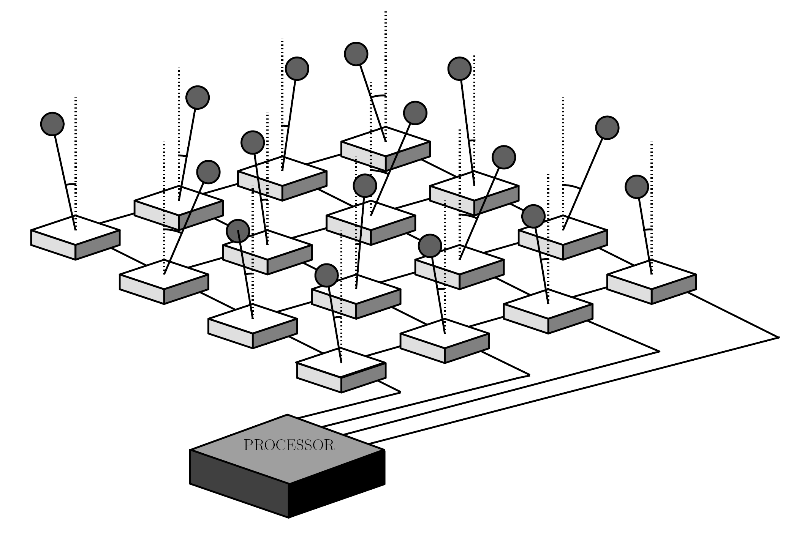
Summary: periodic tasks
reference input
A/D
control law
computation
D/A
sensor
actuator
Source: http://aar.faculty.asu.edu/research/mosart/mosart.html
A job of Task 1
Source: “Task Scheduling for Control Oriented Requirements for Cyber-Physical Systems,” RTSS 2008.
C₁=2
τ₁
D₁=4
D₁
D₁
T₁=5
T₁
T₁

Slide 57
Summary: uniprocessor scheduling
VxWorks, Xen, RT Linux
Practice
Theory
Preemption cost
analysis
D_{i} ≤ T_{i}
Dependent task model, e.g., resource sharing
A single processor
Hard deadline
Independent periodic tasks
D_{i} = T_{i}
Preemptable without any limit and overhead for context switch
Non-preemptive scheduling
Hierarchical model (virtualization)
Soft deadline

Slide 58
Summary: uniprocessor scheduling
Task-level fixed-priority (TFP)
RM (Rate-monotonic): optimal TFP
Utilization-based analysis: U ≤ n(2^{1/n} – 1.0) (only sufficient)
Response-time analysis (exact)
Job-level fixed-priority (JFP)
EDF (Earliest Deadline First): optimal
U ≤ 1.0 (exact)
Job-level dynamic-priority (JDP)
Least Laxity First (LLF): optimal
U ≤ 1.0 (exact)

Slide 59
Multiprocessor scheduling
Assumptions
m identical processors (homogeneous)
Hard deadlines
Independent periodic tasks
Relative deadline = period (D_{i} = T_{i})
Preemptable without any limit
No overhead for context switch

Slide 60
Multiprocessor scheduling
How are tasks assigned to processors?
Static assignment (static binding)
The processor(s) used for executing a task are determined before system is put in mission (“off-line”)
Approach: partitioned scheduling
Dynamic assignment
The processor(s) used for executing a task/job are determined during system operation ( “on-line”)
Approach: global scheduling

Slide 61
Multiprocessor scheduling
Are tasks allowed to migrate?
Partitioned scheduling – No migration
Each instance of a task must execute on the same processor
Equivalent to multiple uniprocessor systems
Global scheduling
Full migration
A task is allowed to execute on any processor
Migration can occur even during execution of an instance of a task (for example, after being preempted)
Semi-partitioned scheduling
No migration for some tasks, and full migration for other tasks

Slide 62
Partitioned vs. global static-priority scheduling
Incomparable [Leung and Whitehead’82] for TFP
(A) There are task systems that are feasible on m processors under partitioned approach but for which no priority assignment exists which would cause all jobs of tasks to meet their deadlines under global scheduling on m processors; and
(B) There are task systems that are feasible on m processors under global approach, but which cannot be partitioned into m distinct subsets such that each partition is uniprocessor static-priority feasible.
Leung and Whitehead, “On the complexity of fixed priority scheduling of periodic, real-time tasks,” Performance Evaluation, 2(4), Dec. 1982

Slide 63
Partitioned vs. global static-priority scheduling
Incomparable [Leung and Whitehead’82] for TFP
(A) There are task systems that are feasible on m processors under partitioned approach but for which no priority assignment exists which would cause all jobs of tasks to meet their deadlines under global scheduling on m processors.
Example: m=2, Task 1(2,1), Task 2(4,2), Task 3(3,2), Task 4(6,2)
Easily schedulable by partitioned scheduling
But, there exists no task-level assignment that makes the task set schedulable

Slide 64
Partitioned vs. global static-priority scheduling
Incomparable [Leung and Whitehead’82] for TFP
(B) There are task systems that are feasible on m processors under global approach, but which cannot be partitioned into m distinct subsets such that each partition is uniprocessor static-priority feasible.
Example: m=2, Task 1(3,2), Task 2(6,4), Task 3(12,5)
Never be schedulable by any partitioned scheduling
But, schedulable by TFP with priority (Task 1 > 2 > 3)

Slide 65
Multiprocessor scheduling
A fundamental limit ^{[ABJ01]}
For any scheduling (partitioned or global) with TFP and JFP, the utilization bound cannot be higher than 50% (=m/2)
Example
m processors
m+1 tasks: T_{i}=2L-1, C_{i}=L, released at 0
Utilization: L/(2L-1)*(m+1) → ½*m, if L → ∞
What happens with partitioned scheduling in [0, 2L-1]?
What happens with global scheduling in [0, 2L-1]?
BTW, what is the utilization bound?
[ABJ01] Bjorn Andersson, Sanjoy Baruah, Jan Jonsson, “Static-priority scheduling on multiprocessor”, RTSS 2001, pp. 193-202.
Notes:
U(tau) <=m^2/(3m-2) on m identical processors

Slide 66
Multiprocessor scheduling
What happens with partitioned scheduling in [0, 2L-1]?
With any TFP, JFP and JDP
Not feasible!
L
P₁
τ₁
2L-1
P₂
τ₂
P₃
τ₃
…
…
P_{m}
τ_{m}
τ_{m+1}

Slide 67
Multiprocessor scheduling
What happens with global scheduling in [0, 2L-1]?
With any TFP and JFP
Not feasible!
L
P₁
τ₁
2L-1
P₂
τ₂
P₃
τ₃
…
…
P_{m}
τ_{m}
τ_{m+1}

Slide 68
Multiprocessor scheduling
What happens with global scheduling in [0, 2L-1]?
With JDP (e.g., LLF)
Feasible!
L
P₁
τ₁
2L-1
P₂
τ₂
P₃
τ₃
…
…
P_{m}
τ_{m}
τ_{m+1}

Slide 69
Multiprocessor scheduling
A fundamental limit – more accurate statement
For any partitioned scheduling (with TFP, JFP and JDP), the utilization bound cannot be higher than 50% (=m/2)
For any global scheduling with TFP and JFP, the utilization bound cannot be higher than 50% (=(m+1)/2)
What about global scheduling with JDP?
Dhall’s effect: It is possible to find a task set that is unschedulable although it consumes any arbitrarily small fraction of the multiprocessor platform
Notes:
U(tau) <=m^2/(3m-2) on m identical processors
Dhall’s effect:
U->1 no matter how many processors are used
for T1=T2=…=Tm=(2e,1), T_(m+1)=(1,1+e) on m identical unit-speed processors where Ti=(Ci, Pi)
I.e., it is possible to find a task set that is unschedulable although it consumes only an arbitrarily small fraction of the multiprocessor platform.

Slide 70
Partitioned scheduling
Each processor has its own queue for ready tasks
Tasks are organized in groups, and each task group is assigned to a specific processor
For example, using a bin-packing algorithm
When selected for execution, a task can only be dispatched to its assigned processor, i.e., static-binding

Slide 71
Partitioned scheduling
Advantages:
Mature scheduling framework
Most uniprocessor scheduling theory is also applicable
Uniprocessor resource-management protocols can be used
Supported by automotive industry
AUTOSAR adopts partitioned scheduling
Disadvantages:
Cannot exploit all unused execution time
Surplus capacity cannot be shared among processors
Will suffer from overly-pessimistic WCET derivation

Slide 72
Partitioned scheduling
Bin-packing algorithms:
Basic idea:
Packs the objects of varying sizes in boxes (“bins”) with the objective of minimizing # of boxes to use.
Application to multiprocessor systems:
Bins are represented by processors and objects by tasks.
Whether a processor is “full” or not is determined by a utilization-based feasibility test.
Assumptions:
Independent, periodic tasks
Preemptive, uniprocessor scheduling (e,g., RM)

Slide 73
Global scheduling
All ready tasks/jobs are kept in a common (global) queue that is shared among the processors
Whenever a processor becomes idle, a task/job from the global queue is selected for execution on that processor.
After being preempted, a task/job may be dispatched to a processor other than the one that started executing it.

Slide 74
Global scheduling
Advantages:
Supported by most multiprocessor operating systems
Windows 7, Mac OS X, Linux, ...
Effective utilization of processing resources
Unused processor time can easily be reclaimed, e.g., when a task does not execute its full WCET.
Disadvantages:
Weak theoretical framework:
“Few of the results obtained for a single processor generalize directly to the multiple processor case; bringing in additional processors adds a new dimension to the scheduling problem. The simple fact that a task can use only one processor even when several processors are free at the same time adds a surprising amount of difficulty to the scheduling of multiple processors” ^{[Liu69]}.
[Liu69] C.L.Liu, “Scheduling algorithms for multiprocessors in a hard real-time environment,” JPL Space Programs Summary, vol. 37-60, pp. 28-31, 1969.

Slide 75
Reasons for weak theoretical results
Dhall’s effect^{[DhLi78]}
With RM and EDF, some low-utilization task sets can be unschedulable regardless of how many processors are used. Thus, any utilization guarantee bound would become so low that it would be useless in practice.
This is in contrast to the uniprocessor case where we have utilization guarantee bounds of 69.3% (RM) and 100% (EDF).
Hard-to-find critical instant
A critical instant does not always occur when a task arrives at the same time as all its higher-priority tasks.
This is in stark contrast to the uniprocessor case!
[DhLi78] S.K. Dhall and C. L. Liu, “On a real-time scheduling problem,” Operations Research 26(1), 1978, pp.127-140.

Slide 76
Reasons for weak theoretical results
Dhall’s effect
Example (EDF or RM)
m processors
m+1 tasks: m tasks (1, 2*∆), 1 task (1+ ∆, 1)
Utilization= m*2*∆/1 + 1*1/(1+ ∆)
if ∆→0, U→1 << m
∆
τ₁
τ₂
P₁
∆
1
∆
Deadline Miss at 1+ ∆
τ₃
P₂
…
P₃
τ_{m}
…
*10
τ_{m+1}
P_{m}

Slide 77
Reasons for weak theoretical results
Hard-to-find critical instant
RM on uniprocessor
Synchronous release is the critical instant
RM on multiprocessor
Synchronous release is NOT the critical instant
Example
2 processors, 4 tasks: (4,2), (4+∆,2), (4+2*∆,2) (4+3*∆,2)

Slide 78
Reasons for weak theoretical results
Hard-to-find critical instant (RM)
2 processors, 4 tasks: (4,2), (4+∆,2), (4+2*∆,2) (4+3*∆,2)
Sync-release (released at t=0)
Task 2 released at t=1, and others released at t=0
1
1
τ₁
P₁
1
1
3
3
Response time of Task 4 = 4
2
2
τ₂
2
2
4
4
P₂
3
3
τ₃
4
4
τ₄
P₁
1
1
3
Response time of Task 4 > 4
3
2
2
4
P₂
Deadline Miss at 4+3*∆

Slide 79
Research trend: how to beat the weak theoretical results
Scheduling algorithm
Design better algorithms than EDF and RM
Make the algorithms ease the development of schedulability analyses
Schedulability analysis
Develop schedulability analyses of EDF and RM, and then extend the developed techniques to more complex algorithms
Consider the worst-case release pattern (since we don’t know the critical instant)
The critical instant
Find some conditions for the critical instant, and incorporate the conditions to existing schedulability analyses

Slide 80
Global scheduling: utilization-based analysis
TFP
RM-US: U ≤ m²/(3m-1) ≈ 0.33*m, and more studies
JFP
EDF-US: U ≤ m²/(2m-1) ≈ 0.5*m, and more studies
JDP
Fluid scheduling: U ≤ m (optimal)
Notes:
US

Slide 81
Global scheduling: utilization-based analysis
RM-US^{[ABJ01]}
The algorithm gives the highest priority to tasks with utilization greater than m/(3m-2), and otherwise assigns priorities in RM order.
Then, RM-US can schedule any task set with utilization less than m²/(3m-1) ≈ 0.33*m
Example
2 processors with Task 1(8,1), Task 2(10,6), Task 3(20,1)
Priorities by RM: Task 1 > Task 2 > Task 3
Priorities by RM-US: Task 2 > Task 1 > Task 3
Schedulable by RM-US?
[ABJ01] Bjorn Andersson, Sanjoy Baruah, Jan Jonsson, “Static-priority scheduling on multiprocessor”, RTSS 2001, pp. 193-202.

Slide 82
Global scheduling: utilization-based analysis
EDF-US^{[SrBa02]}
The algorithm gives the highest priority to tasks with utilization greater than m/(2m-1), and otherwise assigns priorities in EDF order.
Then, EDF-US can schedule any task set with utilization less than m²/(2m-1) ≈ 0.5*m
Example
2 processors with Task 1(5,1), Task 2(5,1), Task 3(11,10)
Any job of Task 3 always has the highest priority.
Schedulable by EDF-US?
[SrBa02] A. Srinivansan and S.K. Baruah, “Deadline-based scheduling of periodic task systems on
Multiprocessors,” Information Processing Letters, 84:93–98, 2002.

Slide 83
Global scheduling: optimal scheduling
Fluid scheduling
In any interval of length L, jobs of Task x execute exactly L*C_{x}/T_{x}
Example,
2 processors with Task 1(3,2), Task 2(4,3), Task 3(12,7)
U=2/3 + 3/4 + 7/12 = 2
9
8
7
Amount of execution
12
Time

Slide 84
Global scheduling: optimal scheduling
Fluid scheduling
Fluid scheduling cannot work in reality.
Needs infinitesimal quantum length
What if the quantum length is a clock tick, e.g., 1?
In [0,1), the amount of execution for the two tasks is 1, while that of the unexecuted task is 0.
How to simulate fluid scheduling without any deadline miss?
7
Amount of execution
12
Time

Slide 85
Global scheduling: optimal scheduling
Fluid scheduling
Pfair^{[BCP96]}, ERfair^{[AnSr01]}, DP-fair^{[LFS10]}, RUN^{[RLM11]}, and more
These algorithms incur many preemptions/migrations
It is a very critical issue to reduce the number of preemptions/migrations
Exact analysis
U ≤ m (optimal)
[BCP96] S. Baruah, N. K. Cohen, C. G. Plaxton, and D. A. Varvel, “Proportionate progress: a notion of fairness in resource allocation,” Algorithmica, vol. 15, no. 6, pp. 600–625, 1996.
[AnSr01] J.H.Anderson and A.Srinivasan, “Mixed Pfair/ERfair scheduling of asynchronous periodic tasks,” in ECRTS, 2001.
[LFS10] G. Levin, S. Funk, C. Sadowski, I. Pye, and S. A. Brandt, “Dp-fair: A simple model for understanding optimal multiprocessor scheduling,” in ECRTS, 2010.
[RLM11] P. Regnier, G. Lima, E. Massa, G. Levin, and S. A. Brandt, “Run: Optimal multiprocessor real-time scheduling via reduction to uniprocessor,” in RTSS, 2011.

Slide 86
Global scheduling: optimal scheduling
Pfair
Idea: split a task into multiple tasks with execution time 1, and then schedule split tasks by EDF
EDF can schedule a task set with U ≤ m if every task in the task set has execution time 1.
Example
2 processors with Task 1(8,4), Task 2 (11,8), Task 3 (3,2)
How to split Task 2 and Task 3? (11/8,1) doesn’t make sense.
T₁
T₁’

Slide 87
Global scheduling: optimal scheduling
Pfair
Example
Task 2 (11,8)
Release: Floor(11/8*(i-1))
Deadline: Ceil(11/8*i)
i=1
Release: Floor (11/8*0)=0
Deadline: Ceil(11/8)=2
T₁
i=3
Release: Floor(11/8*2)=2
Deadline: Ceil(11/8*3)=5
T₁’
Actual release time = max(virtual release time of i, finishing time of (i-1))

Slide 88
Global scheduling: response time analysis
Response-time analysis framework^{[BeCi07]}
RM on a uniprocessor
The critical instant: synchronous release
The maximum amount of execution of Task j in an interval of length L
Ceil(L/T_{j})*C_{j}
C_{j}
C_{j}
L
a_{n+1} = C_{i}+∑Ceil(a_{n}/T_{j})*C_{j}
e.g., (3,1), (5,2), (20,3)
A set of higher-priority tasks
[BeCi07] M. Bertogna, M. Cirinei, Response-time analysis for globally scheduled symmetric multiprocessor platforms, in: Proceedings of IEEE Real-Time Systems Symposium, 2007, pp. 149-160.

Slide 89
Global scheduling: response time analysis
Response-time analysis framework^{[BeCi07]}
Ceil(L/ T_{j})*C_{j}
RM on a multiprocessor
We don’t know the critical instant
The maximum amount of execution of Task j in an interval of length 1
Ceil((L+ T_{j} -C_{j}) / T_{j})*C_{j}
C_{j}
C_{j}
L
a_{n+1} = C_{i}+∑Ceil(a_{n}/ T_{j})*C_{j}
C_{j}
C_{j}
C_{j}
L
a_{n+1} = C_{i}+Floor(∑Ceil((a_{n}+T_{j}-C_{j})/T_{j})*C_{j}/m)

Slide 90
Global scheduling: response time analysis
Response-time analysis framework^{[BeCi07]}
RM on a multiprocessor
Ceil((L+T_{j}-C_{j}) / T_{j})*C_{j}
Why is this working? Why Floor?
C_{j}
C_{j}
C_{j}
L
a_{n+1} = C_{i}+Floor(∑Ceil((a_{n}+ T_{j} -C_{j})/ T_{j})*C_{j}/m)

Slide 91
Global scheduling: response time analysis
Response-time analysis framework^{[BeCi07]}
There are some more techniques that can decrease the upper-bound of the amount of higher-priority jobs’ execution.
This framework can be applied to other scheduling algorithms
e.g., EDF, LLF, and potentially more
Need to calculate the amount of higher-priority jobs’ execution.

Slide 92
Global scheduling: response time analysis
Some finding of RM’s critical instant
At most m-1 higher-priority carry-in jobs ^{[GSY09]}
Carry-in job in an interval: released before the interval and having remaining execution at the beginning of the interval
What happens if there are more than m-1 carry-in jobs?
We can shift the interval of interest, which can increase the response time.
How to incorporate this finding to RTA framework?
[GSY09] N. Guan, M. Stigge, W. Yi, G. Yu, New response time bounds for fixed priority multiprocessor scheduling, in: Proceedings of IEEE Real-Time Systems Symposium, 2009, pp. 387-397.

Slide 93
Global scheduling: response time analysis
How to incorporate this finding to RTA framework?
The amount of execution of Task j in an interval of length L
Ceil(L/T_{j})*C_{j}
Ceil((L+T_{j}-C_{j}) /T_{j})*C_{j}
Non-carry-in job
C_{j}
C_{j}
L
Carry-in job
C_{j}
C_{j}
C_{j}
L
a_{n+1} = C_{i}+Floor(∑Ceil((a_{n}+T_{j}-C_{j})/T_{j})*C_{j}/m)
Summation of Ceil(a_{n}/T_{j})*C_{j} for all tasks +
Summation of Ceil((a_{n}+T_{j}-C_{j})/T_{j})*C_{j} - Ceil(a_{n}/T_{j})*C_{j} for (m-1) largest task j

Slide 94
Summary: D_{i} = T_{i}
TFP
RM-US: U ≤ 0.33*m
RM: response-time analysis
Some conditions for the critical instant
JFP
EDF-US: U ≤ 0.5*m
EDF: response-time analysis
JDP
Fluid scheduling (optimal)
U ≤ m (the only exact analysis in multiprocessor scheduling)

Slide 95
Extension: D_{i} = T_{i} → D_{i} ≤ T_{i}
TFP
RM-US: ∑ C_{i}/D_{i} ≤ 0.33*m
RM: response-time analysis
JFP
EDF-US: ∑ C_{i}/D_{i} ≤ 0.5*m
EDF: response-time analysis
JDP
Fluid scheduling (not optimal any more)
∑ C_{i}/D_{i} ≤ m (not exact any more)
Schedulability analysis for EDZL, FPZL and LLF

Slide 96
Schedulability analysis driven optimal scheduling
TFP
Why RM (DM)?
JFP
Why EDF?

Slide 97
TFP for multicore: beyond RM
A schedulability analysis exists for any arbitrary task-priority assignment for TFP.
Answer how to find optimal task-level priority
[DaBu11] R. I. Davis and A.Burn, Improved Priority Assignment for Global Fixed Priority Preemptive Scheduling in Multiprocessor Real-Time Systems, Real-Time Systems, 2011, pp. 1-40.

Slide 98
TFP for multicore: beyond RM
Task-level optimal priority assignment
Select iteratively a task for the lowest possible priority
B
A
C
F
E
D
Lowest Priority
Highest Priority
Lowest Priority

Slide 99
JFP for multicore: beyond EDF
A schedulability analysis does not exist for any arbitrary job-priority assignment for JFP.
How to assign job-priority?
Pseudo-deadlines: SPDF (Smallest Pseudo Deadline First)
Develop a schedulability analysis for any given job-priority assignment
Answer how to find optimal pseudo deadlines (job-level priority)
[CBC12] H. S. Chwa, H. Back, S. Chen, J. Lee, A. Easwaran, I. Shin, and I. Lee, Extending Task-level to Job-level Fixed Priority Assignment and Schedulability Analysis Using Pseudo-Deadlines, IEEE Real-Time Systems Symposium (RTSS), 2012, pp 51-62.

Slide 100
JFP for multicore: beyond EDF
Job-level optimal priority assignment
Optimal pseudo-deadline assignment
A
B
C
D
E
F
D
A
B
C
F
E

Slide 101
More general task model
DAG or fork-join task model
Mixed-criticality task model

Slide 102
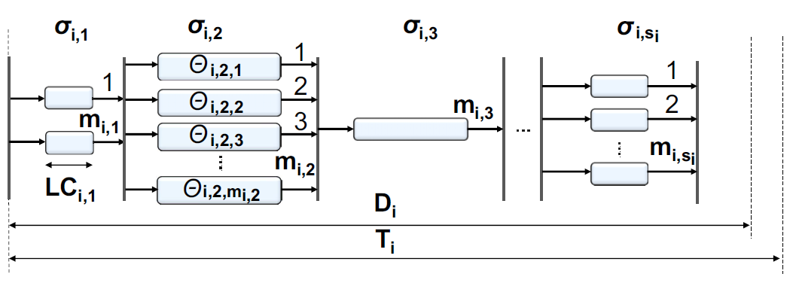
Task model for parallel programming
DAG or fork-join task model
For OpenMP, MapReduce
More room for improvement
[CLP13] H. S. Chwa, J. Lee, K. Phan, A. Easwaran, and I. Shin, Global EDF Schedulability Analysis for Synchronous Parallel Tasks on Multicore Platforms, Euromicro Conference on Real-Time Systems (ECRTS), 2013, pp 25-34.

Slide 103
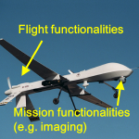
Mixed-criticality task model
Tasks have different criticality.
Priority according to criticality yields low utilization.
Can we improve utilization without compromising time constraints of both low- and high-criticality tasks?
Exploit varying degrees of execution time assurance!
[LPG14] J. Lee, K. Phan, X. Gu, J. Lee, A. Easwaran, I. Shin, and I. Lee, MC-Fluid: Fluid Model-Based Mixed-Criticality Scheduling on Multiprocessors, IEEE Real-Time Systems (RTSS), 2014, pp. 41-52

Slide 104
Scheduling theory towards practice
VxWorks, Xen, RT Linux
Practice
Theory
Preemption cost
analysis
D_{i} ≤ T_{i}
Dependent task model, e.g., resource sharing
m identical cores
Hard deadline
Independent periodic tasks
D_{i} = T_{i}
Preemptable without any limit and overhead for context switch
Non-preemptive scheduling
Hierarchical model (virtualization)
Soft deadline

Slide 105
Scheduling theory towards practice
A lot of movement towards practice
For example,
[CBH14] Linux’s Processor Affinity API, Refined: Shifting Real-Time Tasks towards Higher Schedulability, RTSS 2014.
[CGB14] F. Cerqueira, A. Gujarati, B. B. Brandenburg, Linux’s Processor Affinity API, Refined: Shifting Real-Time Tasks towards Higher Schedulability, IEEE Real-Time Systems Symposium (RTSS), 2014, pp 249-259.

Slide 106
Scheduling for Linux’s processor affinity
Task migration under current RTOSs
Arbitrary Processor Affinities
Why processor affinities?
Security: isolate tasks to prevent cache side-channel attacks
Cache locality: avoid migration-related cache misses
Energy efficiency: restrict non-critical tasks to small, power-efficient cores

Slide 107
Scheduling for Linux’s processor affinity
Affinity (O) Priority (X)
τ₁
P₁
τ₁
P₁
τ₂
P₂
τ₂
P₂
τ₃
P₃
P₃
τ₄
τ₄

Slide 108
Scheduling for Linux’s processor affinity
Affinity (O) Priority (O)
τ₁
P₁
τ₁
P₁
τ₂
P₂
τ₂
P₂
τ₃
τ₃
P₃
P₃
τ₄
τ₄

Slide 109
Scheduling for Linux’s processor affinity
Scheduling algorithm
How to find the best matching?
Schedulability analysis
How to incorporate the new matching into a schedulability analysis?

Slide 110
Notice
궁금한 것이 있으시면 중간에 질문 부탁드립니다.
쉬는 시간이나 Q&A 시간에 하셔도 좋습니다.
현업의 어플리케이션에 필요한 관련 내용 (작업 모델, 시스템)을 말씀해 주시면 답변을 드리거나 반영가능한 내용은 내일 강의 내용에 반영하겠습니다.

Slide 111
Real-Time Scheduling
아래 예제로 돌아와서, 무슨 algorithm을 쓰고, 어떤 조건을 만족하면 모든 (영원히) schedulable 한가?
τ₁
(4,1)
τ₂
(5,2)
5
10
15
τ₃
(7,2)
5
10
15
τ₁ > τ₂ > τ₃, non-preemptive
τ₁ > τ₂ > τ₃, preemptive
Deadline miss

Slide 112
Real-Time Scheduling
왜 schedulability analysis가 필요한가? Simulation 해 보면 schedulability를 알 수 있지 않나?
Offset이 바뀌어도 schedulable 한가? 모든 offset에 대해서 simulation?
Execution이 max 보다 작게 되어도 여전히 schedulable 한가?
주기의 최소 공배수가 매우 크면 simulation은 어떻게?
…
Can we guarantee no deadline miss in the future?
Scheduling
Algorithm
Schedulability Analysis

Slide 113
Real-Time Scheduling
무슨 scheduling algorithm을 쓰고, 어떤 조건을 만족하면 (즉, schedulability analysis) 모든 job이 영원히 deadline miss를 하지 않는가?
Offset 에 관계없이?
모든 실제 실행시간 ≤ WCET에 대해?
주기의 최소 공배수가 매우 커도 보장이 가능?
예시
Can we guarantee no deadline miss in the future?
Scheduling
Algorithm
Schedulability Analysis

Slide 114
Case Study
BMS system
Task model
초기화 작업을 제외하고는 periodic tasks
Initialization task가 존재하나 start-up, shutdown 시에만 수행
실행시간
max execution time을 측정
Task dependency
Control flow dependency 없음
Shared resource 경쟁 없음

Slide 115
Case Study
왜 analysis가 필요한가?
Q: (T,C)에서 최대 실행 시간대로 시간에 맞게 simulation 하면 schedulability를 알 수 있지 않는가?
A: task model에 따라 scheduling anomaly 때문에 schedulability를 guarantee 할 수 없다
Execution이 더 짧아지는게 deadline miss를 일으키는 예제 설명

