Slide 1

A High-Precision Approach to Transforming Clinical Narratives into Structured Data.

Slide 2
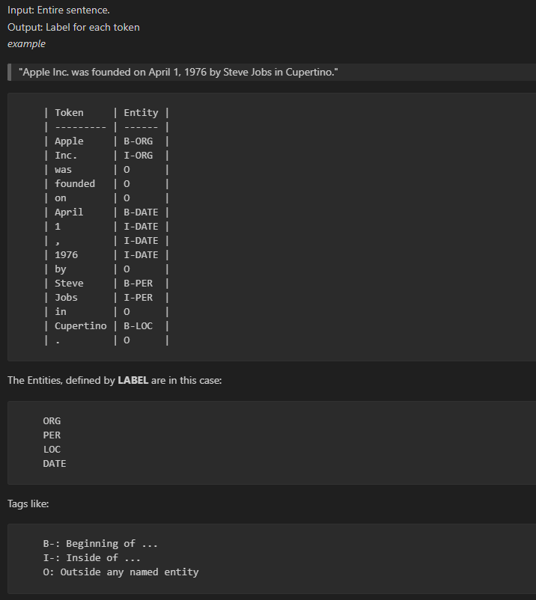
How does it work?
We use GBERT-base via the Hugging Face framework
Pretrained transformer model for German language processing
Fine-tuned for Named Entity Recognition (NER) on clinical text
Input: clinical narratives
Output: structured entities (e.g., diagnoses, symptoms, dates)

Slide 3
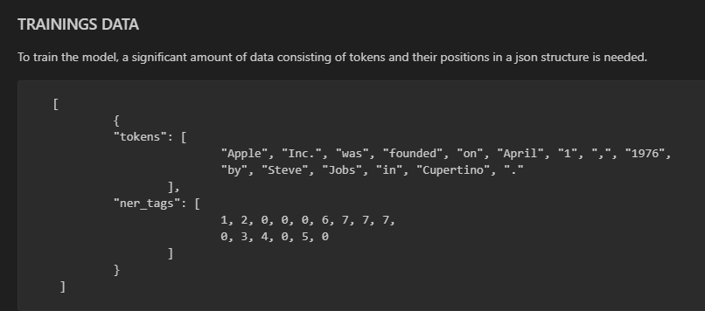
Trainings data
10000 synthetic samples
Template-based + paraphrased data
BIO-annotated for NER training

Slide 4
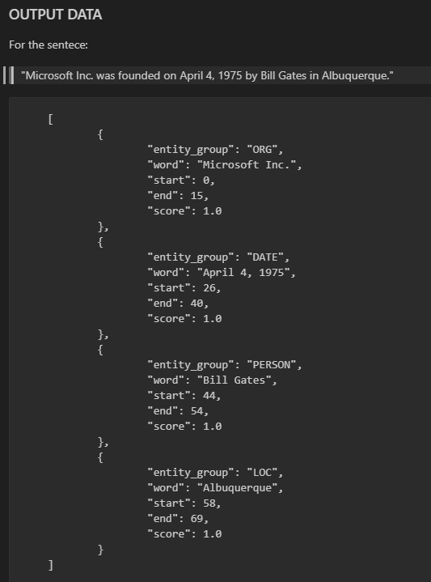
INFERENCE/PREDICTIONS
Input: clinical text
Output: structured entities

Slide 5
Future Work
Multilingual support via translation (MarianMT / Google)
Mapping to HL7 FHIR resources
Validation on a real clinical datasets

Slide 6
Let‘s start…
CONFIG.py:
There are defined the ENTITIES
DEFINITIONS.py
There are defined the possible random values
TEMPLATES.py
There are defined the Template for synthetic medical report
Trainings data:
1: from template
2: from paraphrase
we have used 50% random...

Slide 7



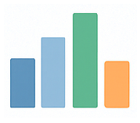

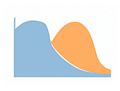
PURPOSE
METHOD & MODEL
EVALUATION
Entity-level-metrics
-Precision, Recall, F1
Confusion Analysis
Bar chart & Heatmap
Misclassifications highlighted
Extract structured data (e.g.
diagnoses, Medications, dates)
from unstructured german
clinical text
Input: Clinical text (PDF, DOCX, image, plain text)
OCR & preprocessing
GBERT model for NER token level
Post-processing into structured outputs(JSON)
Synthetic data used for training and validation
KEY RESULTS
High performance on
structured entities
DATE ≈ 0.90
ORG, DOCTOR ≈ 0.85
FUTURE WORKS
Lower performance on
complex terms
DIAGNOSIS,
MEDICATION ≈ 0.60
Map extracted entities to HL7 FHIR
Embed in DICOM Structured Report
Evaluation on complex clinical datasets
Frequent confusions
SYMPTOMS vs DIAGNOSIS
📌 Take-home message: Framework reliably evaluates NER models on synthetic clinical text.
Strong performance on structured data, challenges remain in clinical semantics.

Slide 8
Evaluation of Clinical NER Models with Synthetic Reports
Workflow
📄 Synthetic Clinical Reports
↓
🤖 NER Model Predictions
↓
📑 Reference Annotations
Evaluation
📊 Entity-level Metrics
- Precision, Recall, F1, Support
🔄 Confusion Analysis
- Bar chart & Heatmap
- Misclassifications highlighted
Key Results
✅ High performance on structured entities (DATE, ORG)
⚠️ Lower recall on clinical terms (DIAGNOSIS, MEDICATION)
🔄 Frequent confusions (SYMPTOM vs DIAGNOSIS)
Entities
Precision / Recall / F1
Confusion Matrix
(DATE vs ORG vs DIAGNOSIS)
📌 Take-home message: Framework reliably evaluates NER models on synthetic clinical text.
Strong performance on structured data, challenges remain in clinical semantics.

Slide 9

THE BIG PICTURE

