Slide 1
CSS 342
Data Structures, Algorithms, and Discrete Mathematics
Lecture 1
Carrano Ch 1, Appendix A.

Slide 2
Intro: Who am I?
Studied at University of Illinois: BS, MS, PhD (CS, CE, EE)
Worked at IBM and Microsoft on a bunch of stuff including:
Operating Systems: AIX, Linux, OS/2
Java Virtual Machines
Business Platforms: WebSphere, BizTalk
Dev Tools: Visual Studio
Frameworks: .Net, Windows Communication Foundation, Workflow
Azure Cloud Services: Workflow, ServiceBus, Web Platform
Commerce Platform: supporting XBOX, Office, Azure, all on-line transactions
Supply Chain: Moving monolithic arch to Cloud-based services arch
Worked in a bunch of roles: Dev, Dev Lead, Dev Manager, Director of Dev, General Manager
Currently consulting on Azure Security (MS)
Taught at UT and UWB: CSS332, CSS340, CSS342, CSS343, CSS430, CSS432, CSS436, CSS501, CSS502, CSS503, CSS490 (Cloud), CSS503, CSS566

Slide 3
Class Intro
Email: dimpsey@uw.edu
Will try to respond in 24 hours (likely not on same day)
However, may be as long as 48 hours (if this long, please re-email me)
No guarantees on weekend
We will use Canvas for
Announcements
Assignments
Grades
Discussions
Office Hours: MW 9:45 – 10:45am, UW1-271G

Slide 4
Small Group
INTRO

Slide 5
What IDE should I use?
Visual Studio? VS Code? IntelliJ? Eclipse?
IDE = Integrated Development Environment

Slide 6
What is the best IDE?
https://www.keycdn.com/blog/best-ide
https://websitesetup.org/best-ide-software/
https://medium.com/issuehunt/10-best-ide-in-the-world-c4875d1300c5
https://hackr.io/blog/web-development-ide
https://geekflare.com/ide-for-programmer/

Slide 7

Visual Studio Editions
Community Edition 2022 (FREE!!) ←
this has everything you need
But only supports C++ on Windows ☹
Visual Studio Professional (expensive)
Visual Studio Enterprise (expensive++)
https://visualstudio.microsoft.com/vs/compare/

Slide 8
Developing on MAC
XCODE
OR
2) Visual Studio Code & C++

Slide 9

Developing on Linux
Clion
OR
2) Visual Studio Code & C++
OR
3) GNU C++ tool chain
Excellent link by Prof. Pisan on using VS Code on Linux Lab:
https://csswiki.uwb.edu/c-toolchain/

Slide 10
Group Exercise
Discuss what C++ toolchain you have used or will use, if any. Discuss with each other

Slide 11
Demo One
ViSual Studio Community EDITION Install
Finding your Way Around VS
First C++ Application from Template
C++ From Empty File

Slide 12
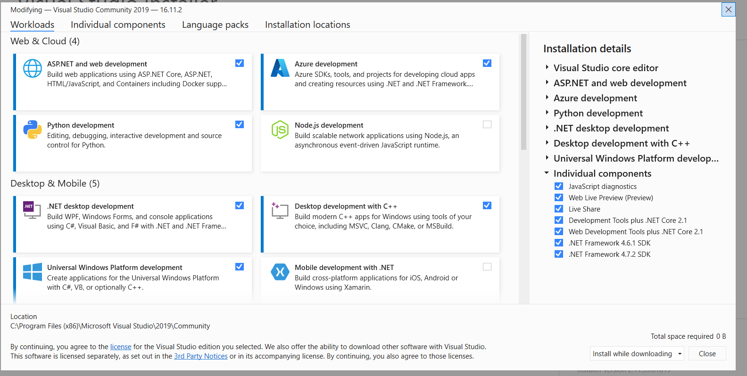
First Demo: Windows / Visual Studio Community
1) DOWNLOAD: https://visualstudio.microsoft.com/vs/community/
2) Make sure to install “Desktop development with C++”
video tutorial:
https://youtu.be/ZxJ5IEyZrU8

Slide 13
Let’s Code…. “Hello World”
#include <iostream>
int main()
{
std::cout << "Hello World" << std::endl;
}

Slide 14


Why Hello World?
Sample First introduced in A Tutorial Introduction to the Language B by Brian Kernighan
Kernighan worked with Dennis Ritchie to write first (and most popular) C book and included the sample

Slide 15
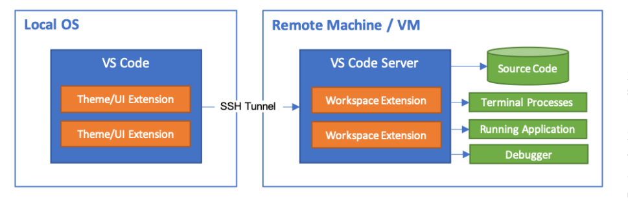
Second IDE Demo: Remote Dev on Linux Lab using VS Code
Install Visual Studio Code: https://code.visualstudio.com/Download
Have command/terminal window with ssh
For Windows I use “Git Bash”
Make sure you can ssh into Linux System
Install “Remote Development Extension Pack” into vs code
Install “C/C++ for Visual Studio Code” Extension
https://code.visualstudio.com/docs/remote/ssh

Slide 16
Second IDE Demo: Remote Dev on Linux Lab using VS Code
Start vs_code in terminal/command window with ssh support
"C:\Users\dimpsey\AppData\Local\Programs\Microsoft VS Code\Code.exe“
View->Command Palette->Remote ssh: connect to Host
Connect to Linux lab: uwnetid@csslabX.uwb.edu
Create folder using terminal
File->Open Folder
Log in again
Add file xyz.cpp and code!
Build Terminal
g++ xyz.cpp –o xyz
Execute xyz
File -> Close Remote Connection

Slide 17
What should I do before next class??
Be able to build and run a C++ application
(bonus: get something running on Linux Lab)
01
Read Carrano Readings
Find C++ beginning materials
02
Start Program One
03

Slide 18

Class Goals + Mechanics.
The dry stuff of CLASS ONE

Slide 19
Course Objectives: Why are you here?
Design, implement, debug, and test Objected-Oriented Programs (OOP)
Learn C++
Course uses C++ to reach goals
Course is not focused on teaching C++ but we will teach aspects of it
In particular: objects, allocation/deallocation, pointers, operator overloading, constructors, templates, STL
Understand key data structures utilized in programming
stack, list, array, queue, binary search tree
Introduce key algorithms and algorithmic techniques
Recursion, Sorting, Searching
Discrete math as the underpinnings of Computer Science
Formally analyze complexity of algorithms: Big O space and time
Propositional Logic
Maybe Induction?

Slide 20
Course Objectives
Problem Solving
Designing and coding industry quality applications

Slide 21
Assignments / Tests / Grades
Assignments
Programs: five
Tests
Test One
Test Two
Final
Grades
55% Tests
45% Programs

Slide 22
Programs
IDEs
Use any IDE you like to develop
In class I will use Microsoft 2022 Community edition
Canvas will be used to collect programs
Each program will have specific and detailed instructions on what to turn in
READ THESE CAREFULLY
Start programs early
Ask questions early

Slide 23
CSS342 FAQ
I know Java, do I need to know C++ to take this course?
I missed the C++ boot UP!, will this be a problem?
Can I use the 6th edition of the Carrano book?
Do I need a C++ intro book?
How much math is required for this class?
Should I take SKL342 as well?
Is this class a lot work?
Any advice on success?

Slide 24
Advice on Success
It takes more than one cold day for a river to freeze a meter deep.
All things are difficult at the start.
Failure is the mother of success.
It just needs hard work to grind an iron rod into a needle.
A thousand mile journey starts with a footfall.
It's better to walk thousands of miles than to read thousands of books.
Just Do It.

Slide 25
More (better?) advice on Success
Find a study group
Exchange Test Cases
Learn how to use the debugger
Start programs early
Code, Code, Code, Code
Redo examples in class w/o looking at them
C++ beginners book
Leet code
Take SKL 342

Slide 26
Programs
Program Grading
Design
Style
Correctness
Efficiency
Grading will be done on Linux Lab systems

Slide 27

Tour Canvas
Available Resources

Slide 28

Activity
READ SYLLABUS
Questions?

Slide 29
In-class program
Write a program which takes in two numbers from the console and outputs the largest

Slide 30

Class Bell
9.25.24

Slide 31
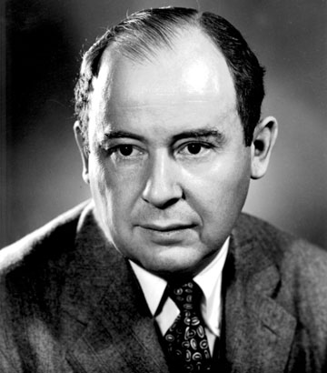
Computer Scientist of the week
John Von Neumann!
Innovations in Set theory, Geometry, Quantum Mechanics, Economics, Statistics
Founded Game Theory
Monte Carlo Method
EDVAC: data and program both in same address space
ENIAC: First computer to use a stored program
Von Neumann Architecture!
Manhattan Project
MAD: Mutually Assured Destruction
Merge Sort Algorithm

Slide 32
Program 1
Intro

Slide 33


Why Object Oriented Programming (OOP)? Some language theory…
Abstraction
Encapsulation
Hierarchy
Polymorphism
Abstraction, information hiding, and encapsulation are very different, but highly-related, concepts.
One could argue that abstraction is a technique that helps us identify which specific information should be visible,
and which information should be hidden. Encapsulation is then the technique for packaging the information in such a way as to hide what should be hidden,
and make visible what is intended to be visible.
Notes:
Distinct phenotypes (morphs) in a population of a species

Slide 34
Why C++?
Supports OOP fundamentals
Elegant
Efficient
Some nice features
Type Safety
Operator Overloading
Provides system understanding
Memory (stack/heap), OS, threads, etc..
Usage of pointers / memory allocation/deallocation
Low level functionality

Slide 35
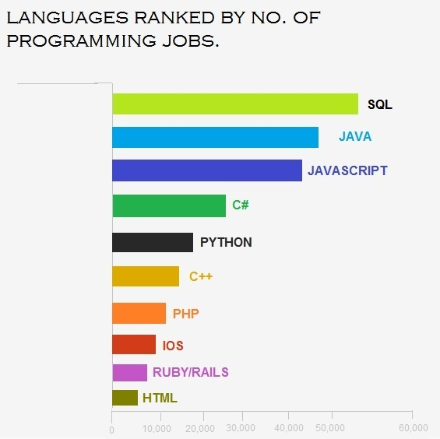
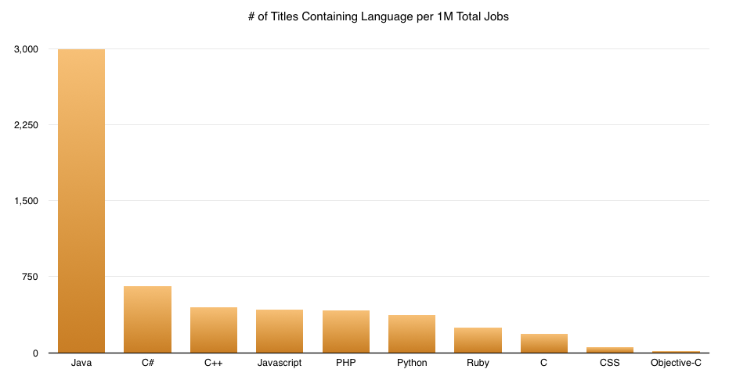
Why C++?

Slide 36
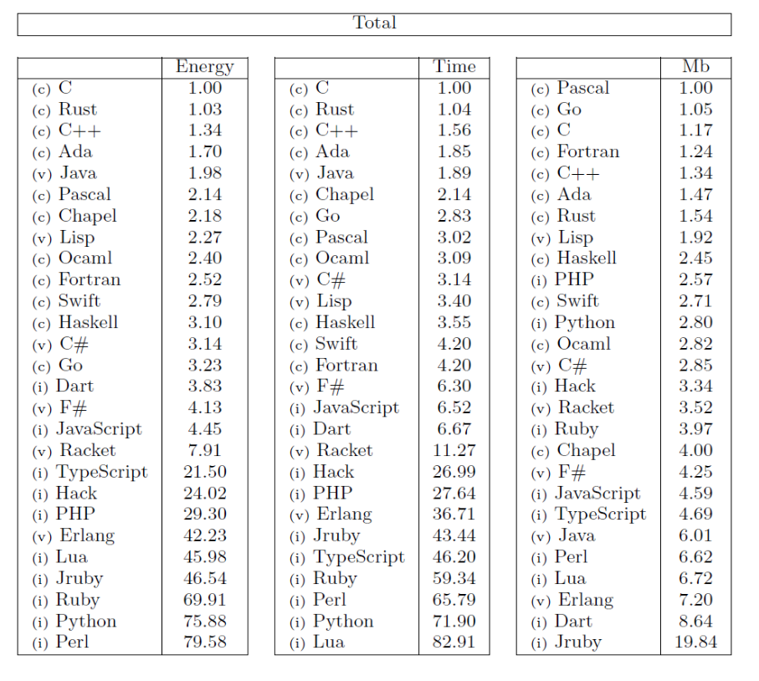
Why C++?
Efficiency: Computer Benchmark Game

Slide 37

Bonus: Fundamentals
SOME EXTRA TO GET STARTED

Slide 38
Console Input
#include <iostream>
using namespace std;
int main()
{
int age;
cout << "How old are you (in years)? ”;
cin >> age;
cout << "that is " << (365 * age) << " days." << endl;
}

Slide 39
An aside… string
#include <iostream>
#include <string>
using namespace std;
int main()
{
string first_name = "jimmy";
string last_name("hoffa");
string full_name;
full_name = first_name + " " + last_name;
cout << full_name << endl;
if (full_name == "jimmy hoffa")
{
cout << "Found him!" << endl;
}
else
{
cout << "My house was painted" << endl;
}
}
http://www.cprogramming.com/tutorial/string.html
mutable, copied not shared.

