Slide 1
CSS 342
Data Structures, Algorithms, and Discrete Mathematics I
Lecture 2.
Carrano CH1, C++ Interlude 1.1-1.2, C++ Interlude 6
C++ Book OR Tutorial (of your CHOICE)

Slide 2
Announcements
Quantative Skill Center (QSC). Tutors!
https://www.uwb.edu/academic-support-programs/qsc
https://www.uwb.edu/academic-support-programs/qsc/schedule/css
Video: https://youtu.be/kKwIxylCv5c
Canvas Resources
Lectures
Programs
Class Recordings
Coding Style Guide
CSS WIKI: https://csswiki.uwb.edu/wiki/
Technical Problems: Send email to uwbit@uw.edu
Discord Channel: gg/c2fUSDaj
Program 1: Due 10/9

Slide 3
Announcements
Some possible on-line support: https://learn.codesignal.com/course-paths

Slide 4
Agenda
Core Tenets of C++
C++ Classes
Design (using stack as an example)
Mechanics
Coding Guidelines
Assignment One
Testing 101: Unit Test Intro
C++ Fundamentals: Call by Ref, Value

Slide 5
Warm Up!!
Write a global function which determines if a string is a palindrome and returns a Boolean

Slide 6


Why Object-Oriented Programming (OOP)? Some language theory…
Abstraction
Encapsulation
Hierarchy
Polymorphism
Static: Templates, Function Overloads
Dynamic (through inheritance)
Abstraction, information hiding, and encapsulation are very different, but highly-related, concepts.
One could argue that abstraction is a technique that helps us identify which specific information should be visible,
and which information should be hidden. Encapsulation is then the technique for packaging the information in such a way as to hide what should be hidden,
and make visible what is intended to be visible.
Notes:
Distinct phenotypes (morphs) in a population of a species

Slide 7
Abstraction

Slide 8
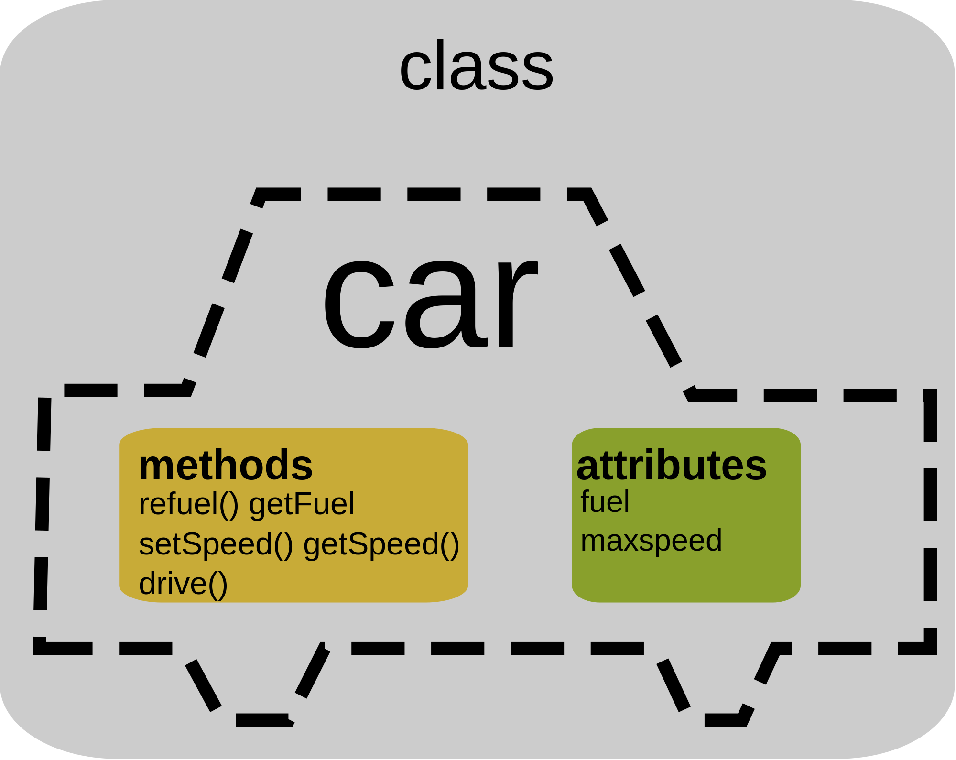
Abstraction
Separate the implementation from the expression the Class
Specify Contract / Interface for Class first
ADT
Abstract Data Type
Can be specified using Uniform Modeling Language (UML)
UML does not use language specific syntax

Slide 9
Abstraction
Data Abstraction
A collection of data and a set of well-defined operations
The data can be reused without knowing the internal data representation and structure
OOP: Class and Objects
Class
Definition of data
Definition of operations (methods) on the data
Objects
Instances of such abstracted data structure

Slide 10
UML Class Diagram
ClassName
data_field_name1_ : DataType
data_field_name2_ : DataType
ConstructorName(arg1: ArgType)
MethodName1(arg1: ArgType) : ReturnType
MethodName2(arg1: ArgType) : ReturnType
We will not need to use UML in this class as C++ header file does an excellent job defining class

Slide 11
Design
Design classes before coding
Contract specified
Data Members
Method Signatures
Relationship between classes
Understand which methods are idempotent and how others change internal state of object
Modular design
Re-use
Loosely Coupled
Test-Driven Design (TDD) is a technique to arrive at design through usage

Slide 12

Class Design Goals
Simple
Complete
Cohesive
Descriptive
Intuitive
Minimal
No Public Data
Amenable to loosely couple

Slide 13
Class Design Checklist
Constructors
Setters/Getters
Actions/Verbs (what the object does)
Operator Overloads
Data Members

Slide 14
Enforcing Abstraction in C++
C++ class
Data Members describing object
Methods which manipulate data
Objects are instances of Classes
MyClassName my_object;
Class is defined with two files
C++ Headers file contain method signatures and data definition (.h)
Code files contain implementation of methods (.cpp)

Slide 15
Group Problem
Design a class representing a push/pop stack

Slide 16
class IntStack
{
public:
bool Pop(int& value);
bool Peek(int& value) const;
bool Push(int value);
int size();
};

Slide 17
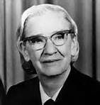

Computer Scientist of the week
Grace Hopper
Invented the first compiler
United States Navy Rear Admiral
Promoted the idea of machine independent languages
Key inventor of COBOL
Popularized the term debugging
Advocated for Navy to move from centralized computers to distributed computers in the 1970s

Slide 18
Programming Guidelines
https://google.github.io/styleguide/cppguide.html

Slide 19
Programming Style / Guidelines
Very important!
Code is read much more than written
80-90% of the life of code is spent maintaining it compared to initially writing it*
You are writing code for others not yourself
You often inherit others code
Consumer should not have to rely on comments to understand code
Will be an important component in grade for class
Good code follows prescribed style rules
*http://tynerblain.com/blog/2007/02/28/agile-development-roi-2/

Slide 20
Programming Guidelines
We’ll use Google C++ guidelines
https://google.github.io/styleguide/cppguide.html
We will keep to a few simple rules
This will impact grade of programs

Slide 21
Naming
https://google.github.io/styleguide/cppguide.html#General_Naming_Rules
Definitions
PascalCasing: RedTop, FirstInLine, BigScaryMonster
lower camelCasing: blueBallThingy, sock, theItem, lastInLine
Underscores: red_top, the_item
Do use PascalCasing for ClassNames, NameSpaces, Functions
Do use underscores for for parameters, variables: my_param
Data members: underscores with a trailing underscore. int my_data_member_
Do use lower-case k in front of all constants
const int kCardsInDeck = 52
Do choose readable identifier names
Do favor readability over brevity
Do not use hyphens, or other non-alphanumeric characters

Slide 22
Spacing/lines
Recommended (not required): Do keep opening and closing braces on their own lines
Do use a single space after a comma between parameters
Do not use spaces after or before brackets b[13] or before flow control statement
Do indent each block even if braces are not used
void foo(char a, int b)
{
while(x < y)
{
x = 13;
}
}

Slide 23
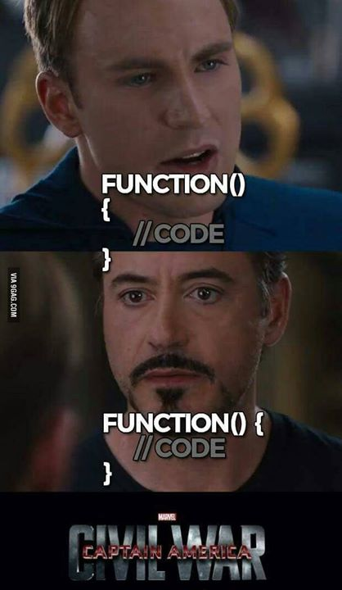

Slide 24
Class Bell.
9/30/2024

Slide 25
Spaces
Use a single space after a comma between parameters but not after/before closing parenthesis
Yes: f(x, y, z)
No: f( x, y, z )
No: f(x , y , z)
Do not use spaces after or before brackets or before flow control statement
Yes: arr[12]
No: arr[ 12 ]
No: arr [12]
One space around binary operators and assignments
Yes: x = y + z
No: x=y+z
No: x = y+z

Slide 26
Comments
Do comment functions appropriately using // before the function
Use in-line comments sparingly
Use comments to describe something not obvious to someone reading the code
Comments describing the use of the class should go in the interface definition (.h)
Comments about the class operation and implementation should accompany the implementation (.cpp)
https://blog.submain.com/field-guide-code-comments/
// This function is based on the zipterian algorithm.
int Zip(FileObj data_file)
{
}

Slide 27
Program 1
Introduction

Slide 28
Program 1 FAQ
VendingBank
Use Class Design Checklist
Should I worry about inventory?
TimeSpan
Can I get away with a single constructor?
Where should I place const definitions?
What do I need to turn in?
Why .h and .cpp; What about .hpp
How many test cases?

Slide 29

Testing 101
UNIT TEST

Slide 30
Unit Tests
Simple, automated tests which test fine-grained aspects of your code
Tests smallest components of application
Encourages modularity
Allows for
Maintainability
Incremental Development
Development scale
Test Code Coverage
Tests are created as development is going on
Unit-Tests are run whenever code is incrementally changed to make sure no regressions added
Continuous Integration which runs Unit Tests
Blocks check-ins when Unit Tests do not run
IDEs provide multiple frameworks for creating and utilizing Unit Tests
https://www.youtube.com/watch?v=3kzHmaeozDI

Slide 31

C++ Fundamentals
LET’S CODE

Slide 32
Call by Value, Reference, and Constant Reference
typedef struct
{
int width;
int length;
} Rectangle;
int Area(Rectangle &rect);
int main()
{
int result;
Rectangle my_yard = {5, 7};
result = Area(my_yard);
cout << "Area of Rectangle(" << my_yard.width << "," << my_yard.length << "): " << result << endl;
}
//int Area(Rectangle rect)
int Area(Rectangle &rect)
//int Area(const Rectangle &rect)
{
int area;
area = rect.width * rect.length;
rect.width = 0;
return area;
}

Slide 33
In class code
Write a function which takes two integers and “swaps” them

Slide 34
Call by Value, Reference, and Constant Reference
Arrays, Pointers, and Structures
Which of swap functions is appropriate?
void swap(string a, string b)
{
string tmp = a;
a = b;
b = tmp;
}
void swap(string &a, string &b)
{
string tmp = a;
a = b;
b = tmp;
}
void swap(const string &a, const string &b)
{
string tmp = a;
a = b;
b = tmp;
}
Which of findMax functions is appropriate?
int findMax(vector<int> a)
{
int max = a[0];
int i;
for (i=1; i < a.size(); i++)
if (a[i] > max)
max = a[i];
return max;
}
int findMax(vector<int> &a)
{
int max = a[0];
int i;
for (i=1; i < a.size(); i++)
if (a[i] > max)
max = a[i];
return max;
}
int findMax(const vector<int> &a)
{
int max = a[0];
int i;
for (i=1; i < a.size(); i++)
if (a[i] > max)
max = a[i];
return max;
}

