Slide 1

CSS 342
Data Structures, Algorithms, and Discrete Mathematics I
Lecture 10.
C++ Interlude 2.1-2.3, 6.1-6.2, 6.4-6.5

Slide 2
10.28.2024
Announcements
Program 2: Complete!
Program 3: Due 11/8
Test Two: 11/6
Agenda
Class Warm Up
Stack w/Linked List
Program 3: intro
Test One Review

Slide 3
Conversions
Convert 13426 to hexadecimal

Slide 4

Linked Lists
Dynamic Memory

Slide 5
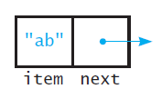
A node
struct Node
{
string item;
Node *next;
}

Slide 6
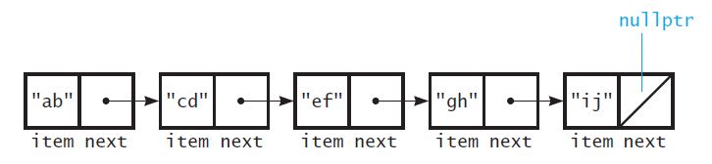
A linked list
FIGURE 4-2 Several nodes linked together

Slide 7
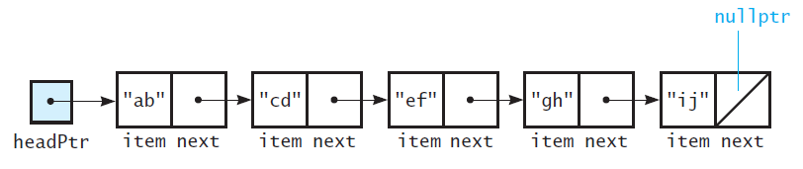
A linked list with headPtr
FIGURE 4-3 A head pointer to the first of several linked nodes

Slide 8
Let’s build an Integer Stack
Use a linked list as a data structure
Use the following “node” structure
struct Node
{
int value;
Node *next;
};
Implement Push/Pop
Overload the following operators:
<<
Assign = and Copy Constructor
+, +=

Slide 9
Integer Stack .h
struct Node
{
int value = 0;
Node* next = nullptr;
};
class IntStack
{
public:
IntStack();
~IntStack();
bool Push(int value);
bool Pop(int& value);
private:
Node* head_;
};

Slide 10
Push/Pop Implementation
bool IntStack::Push(int value)
{
Node* insert_node = new Node();
insert_node->value = value;
insert_node->next = head_;
head_ = insert_node;
return true;
}
bool IntStack::Pop(int& value)
{
if (head_ == nullptr)
{
return false;
}
Node* tmp = head_;
head_ = head_->next;
value = tmp->value;
delete tmp;
return true;
}
IntStack::IntStack() : head_(nullptr)
{
}
IntStack::~IntStack()
{
int a;
while (Pop(a));
}

Slide 11
An aside for the interested..
NULL v nullptr: https://dzone.com/articles/what-exactly-nullptr-is-in-c#:~:text=Nullptr%20vs%20NULL%20NULL%20is%200%20%28zero%29%20i.e.,the%20same%20i.e.%20%28void%2A%290%20in%20C%20and%20C%2B%2B.
Short answer: use nullptr

Slide 12

Computer Scientist of the Week
Margaret Hamilton
Developed on-board flight software for Apollo space program
Director of MIT Instruments Lab
2016: awarded Presidential Medal of Freedom
First Site Reliability Engineer (SRE)
Contributions to async software, priority scheduling and priority
Display
Foundations for ultra-reliable software design
Apollo 8:
P01 Key selection issue illustrates reliability thinking
Apollo 11 Landing: design helped to successfully land ship amidst
Overloading

Slide 13

Program 3
Introduction!!

Slide 14
Class Bell
10.28.24

Slide 15
Let’s build an Integer Stack
Use a linked list as a data structure
Use the following “node” structure
struct Node
{
int value;
Node *next;
};
Implement Push/Pop
Overload the following operators:
<<
Assign = and Copy Constructor
+, +=

Slide 16
Print Stack
ostream& operator<<(ostream& stream, const IntStack& st)
{
Node* p_node = st.head_;
while (p_node != nullptr)
{
stream << p_node->value << " ";
p_node = p_node->next;
}
return stream;
}

Slide 17
Let’s build an Integer Stack
Use a linked list as a data structure
Use the following “node” structure
struct Node
{
int value;
Node *next;
};
Implement Push/Pop
Overload the following operators:
<<
Assign =, copy constructor
+, +=

Slide 18

Copy Constructor Assignment Overload
When, How

Slide 19
Copy Constructor Example
class Bird
{
public:
//constructors-destructors
Bird();
Bird(string name, int id);
Bird(const Bird& bird);
~Bird();
//getters-setters
string name() const;
int wingspan() const;
int id() const;
void set_name(const string& name);
void set_wingspan(int wingspan);
void set_id(int id);
//overload operators
Bird& operator=(const Bird& bird);
friend ostream& operator<<(ostream& outStream, const Bird& b);
private:
string name_;
int wingspan_;
int id_;
};
1) Bird b1("eagle", 123);
2) Bird b2;
cout << "bird 1 " << b1;
cout << "bird 2 " << b2;
3) b2 = b1;
cout << "bird 2 " << b2;
4) Bird b3 = b1;
cout << "bird 3 " << b3;
Constructor(string, int)
Default Constructor
Assignment
Copy Constructor

Slide 20
Assignment/Copy Constructor
All objects have implicit assignment operator and Copy constructor
Chains to the assignment operators of the class data members
Built-in types do straight-forward copies
This often works. However, when memory is dynamically allocated in the class it has problems.
Need to override = and copy constructor in these cases
Assignment: MyClass& operator=(const MyClass &myobj)
Copy Constructor: MyClass(const MyClass &source)

Slide 21
Overriding copy constructor and assignment (=)
//Copy Constructor
Bird::Bird(const Bird& bird)
{
name_ = bird.name_;
wingspan_ = bird.wingspan_;
id_ = bird.id_;
cout << "Copy Constructor is running" << endl;
}
//Assignment Operator
Bird& Bird::operator=(const Bird& rhs_bird)
{
name_ = rhs_bird.name_;
wingspan_ = rhs_bird.wingspan_;
id_ = rhs_bird.id_;
cout << "Assignment" << endl;
return *this;
}

Slide 22
Assignment
If Assignment = is over-ridden then all copying / allocation must be done on the object
General steps
MyClass& MyClass::operator= (const MyClass &source)
{
1) If (this == &source) return;
2) //chain all data member’ assignments operators
3) // manage all dynamic memory that has been utilized
// de-allocate memory in destination
// allocate new memory for a deep copy or just copy ref for a shallow copy
4) return *this;
}

Slide 23
Copy Constructor
MyClass::MyClass(const MyClass &source)
{
// Initialize Members to defaults
*this = source;
}
//Copy Constructor
Bird::Bird(const Bird& rhs_bird)
{
*this = rhs_bird;
}

Slide 24
Copy Constructor Invocation
MyObj o1 = o2
MyObj o1(o2);
Pass by Value
Return by Value

