Slide 1

CSS 342
Data Structures, Algorithms, and Discrete Mathematics I
Lecture 13.
CARRANO CHAPT 11 and 12

Slide 2
11.6.2024
Announcements
Program 3: Due 11/8
Program 4 assigned over weekend
Agenda
Sorting
Insertion/Bubble:: BIG-O
Merge Sort
Class Feedback Summary
Intro to BIG-O
Veteran’s Day: 11/11
Test Two: 11/13
Finish Linked Lists
Program 3 Questions
Test Two Review

Slide 3

Program III
Final Questions.

Slide 4
List can also be implemented with an array
Easy implementation
Fixed list size
Necessity to shift data down to an extended space upon an insertion and to shift data up upon a deletion
list[0]
list[1]
list[2]
list[3]
list[4]
list[n]
list[n-1]

Slide 5
Circular Linked Lists
Linearly linked lists:
Circular linked lists:
Traverse in circular linked lists:
Node *first = head_;
Node *cur = head_->next;
while ( cur != first ) {
display(cur->item);
cur = cur->next;
};
head_
45
51
NULL
dummy
head_
45
51
dummy

Slide 6
Doubly Linked Lists
Single Linked Lists
head_
45
73
51
NULL
To be deleted
Doubly Linked Lists
45
73
51
NULL
NULL
head_
cur->prev->next = cur->next
cur->next->prev = cur->prev;
But pointer operations become more complicated.

Slide 7
Inserting a Node before the current pointer
20
73
(d)
(a)
(b)
45
(c)
cur
new_ptr->next = cur; // (a)
new_ptr->prev = cur->prev; // (b)
cur->prev = new_ptr; // (c)
new_ptr->prev->next = new_ptr; // (d)

Slide 8

Algorithm Efficiency
BIG O

Slide 9
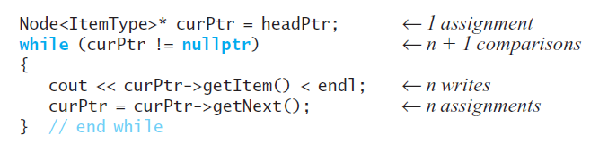
Execution Time: counting operations
Traversal of linked nodes – example:
Displaying data in linked chain of n nodes requires time proportional to n
g(n) = 3n + 2 → O(n)

Slide 10
Counting operations: How many times is Task() called?
for (i = 1; i <= n; i++)
{
for (j = 1; j <= i; j++)
{
for (k = 1; k <= 5; k++)
{
Task();
}
}
}

Slide 11
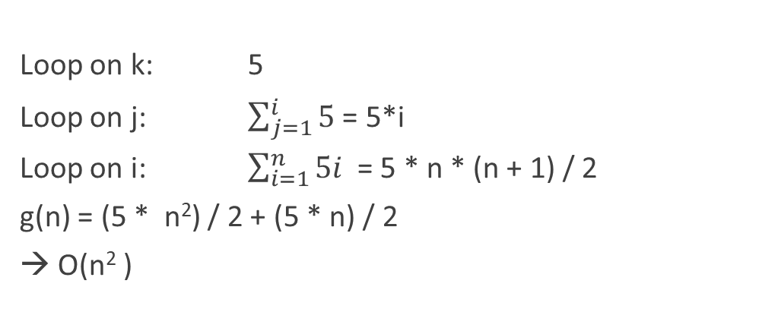
Counting operations
for (i = 1; i <= n; i++)
{
for (j = 1; j <= i; j++)
{
for (k = 1; k <= 5; k++)
{
Task();
}
}
}
Loop on k: 5
Loop on j: $\sum_{j=1}^{i}{5}$ = 5*i
Loop on i: $\sum_{i=1}^{n}{5i }$= 5 * n * (n + 1) / 2
g(n) = (5 * n²) / 2 + (5 * n) / 2
→ O(n² )

Slide 12
Analysis and Big O Notation
Algorithm A is order f ( n ): Denoted O( f ( n ))
If constants k and n₀ exist
Such that A requires no more than k × f ( n ) time units to solve a problem of all sizes n ≥ n₀
Big O is upper-bound, not tight upper bound
Algorithm A grows no faster than O(n)
Tight upper bound is Big Theta Θ
However, it is often abused in CS to mean the tight upper bound

Slide 13
An aside… with more detail
Computer scientists are lazy mathematicians…
From a pure mathematical sense
Big O is upper-bound, not tight upper bound: Algorithm A grows no faster than O( f(n) )
Ω(n) is lower-bound: Algorithm A grows faster than Ω ( f(n) )
Tight upper bound is Θ(f(n)). Algorithm A is Θ( f(n) ) when it is both O( f(n) ) and Ω( f(n) )
O(n) is often abused in CS to mean the tight upper bound as well

Slide 14


Slide 15

Sorts and Sorting

Slide 16
Sorting the Sorts
Selection Sort worst/average O(n²)
Bubble Sort worst/average O(n²)
Insertion Sort worst/average O(n²)
Shell Sort worst O(n²)/average O(n^{3/2})
Merge Sort worst/average O(n log n)
Quick Sort worst O(n²)/average O(n log n)
Radix Sort worst/average O(n)

Slide 17
Sorts previously covered
Bubble Sort: http://en.wikipedia.org/wiki/Bubble_sort#mediaviewer/File:Bubble-sort-example-300px.gif
→ let’s determine why it is O(n²)
Insertion Sort: http://en.wikipedia.org/wiki/Insertion_sort#mediaviewer/File:Insertion-sort-example-300px.gif
→ let’s determine why it is O(n²)

Slide 18
Efficiency of Bubble Sort: O(n²)
Pass 1
Pass 2
29
10
14
37
13
10
14
29
13
37
10
29
14
37
13
10
14
29
13
37
10
14
29
37
13
10
14
29
13
37
=2(n-1)n/2 = n^2 - n
O(n^2)
10
14
29
37
13
10
14
13
29
37
10
14
29
13
37
Comparison
Swapping
N-1
N-1
N-2
N-2
…
…
1
1

Slide 19
Efficiency of Insertion Sort: O(n²)
Sorted
Unsorted
Max Max
Comp. Shift Insert Operations
29
10
14
37
13
10
29
14
37
13
1 1 1 2+1
10
29
14
37
13
10
14
29
37
13
2 2 1 4+1
10
14
29
37
13
10
14
29
37
13
3 3 1 6+1
10
14
29
37
13
10
13
14
29
37
4 4 1 8+1

Slide 20

Merge Sort

Slide 21
Merge Sort
Key: THE MERGE!
Assuming that we have already had two sorted array,
How can we merge them into one sorted array?
1
4
8
13
14
20
25
2
3
5
7
11
23
1
2
3
4
5
7
8
11
13
14
20
23
25

Slide 22
sorted
sorted
first
mid
last
theArray
first1
last1
last2
first2
<
>=
tempArray
index
sorted
sorted
first
mid
theArray
first1
last1
last2
first2
tempArray
index

Slide 23
void Merge(vector<int>& vec, int first, int mid, int last)
{
int size = last - first + 1;
int* tmp_arr;
tmp_arr = new int[size];
int first1 = first;
int last1 = mid;
int first2 = mid + 1;
int last2 = last;
int index = 0;
while ((first1 <= last1) && (first2 <= last2))
{
if (vec[first1] < vec[first2])
{
tmp_arr[index] = vec[first1];
first1++;
}
else
{
tmp_arr[index] = vec[first2];
first2++;
}
index++;
}
while (first1 <= last1)
{
tmp_arr[index] = vec[first1];
first1++;
index++;
}
while (first2 <= last2)
{
tmp_arr[index] = vec[first2];
first2++;
index++;
}
for (index = 0; index < size; index++)
{
vec[first] = tmp_arr[index];
first++;
}
delete[] tmp_arr;
}

Slide 24
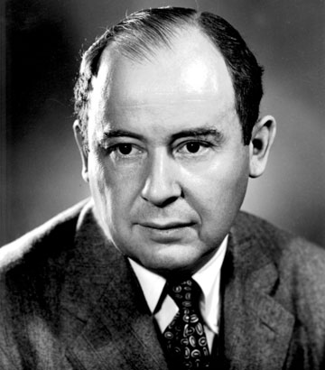
Computer Scientist of the week
John Von Neumann!
Innovations in Set theory, Geometry, Quantum Mechanics, Economics, Statistics
Founded Game Theory
Monte Carlo Method
EDVAC: data and program both in same address space
ENIAC: First computer to use a stored program
Von Neumann Architecture!
Von Neumann Probes!
Manhattan Project
MAD: Mutually Assured Destruction
Merge Sort Algorithm

Slide 25
Merge Sort: successive merges
38
16
27
39
12
17
24
5
16
38
27
39
12
17
5
24
16
27
38
39
5
12
17
24
5
12
16
17
24
27
38
39
Use recursion to get here

Slide 26
Merge Sort
mid=(fist + last)/2
first
last
theArray
38
16
27
39
12
17
24
5
mid=(fist + last)/2
mid=(fist + last)/2
first
last
first
last
first < last
38
16
27
39
12
17
24
5
first
last
38
16
27
39
12
17
24
5
first
last
38
16
27
39
12
17
24
5

Slide 27
MergeSort: Overview
mid=(fist + last)/2
first
last
theArray
38
16
27
39
12
17
24
5
void MergeSort(vector<int>& vec, int first, int last)
{
if (first < last)
{
int mid = (first + last) / 2;
MergeSort(vec, first, mid);
MergeSort(vec, mid + 1, last);
Merge(vec, first, mid, last);
}
}
38
16
27
39
12
17
24
5
first
last
38
16
27
39
12
17
24
5
38
16
27
39
12
17
24
5
16
38
27
39
12
17
5
24
16
27
38
39
5
12
17
24
http://en.wikipedia.org/wiki/Merge_sort#mediaviewer/File:Merge-sort-example-300px.gif
5
12
16
17
24
27
38
39

Slide 28
Class Bell.
11.06.24

Slide 29
Merge Sort: Efficiency Analysis
Level (n items in array) | # sub-arrays | #comparisons per sub-array # copies per sub-array
1 | 4 = 8/2 | 1 2 * 2
2 | 2 = 8/4 | 3 4 * 2
3 | 1 = 8/8 | 7 8 * 2
38
16
27
39
12
17
24
5
16
38
27
39
12
17
5
24
16
27
38
39
5
12
17
24
5
12
16
17
24
27
38
39
At level X, # major operations = (#sub-arrays) * (ops/sub-array)
n/2^{x} * (2 * 2^{x} + 2^{x} – 1) = n/2^{x} * (3 * 2^{x} - 1) = ~3n
O(3n)
#levels = log n, where n = # array elements ( if n is a power of 2 )
#levels = log n + 1 if n is not a power of 2
# operations = O(3n) * (log n + 1) = O(3 n log n) = O(n log n)
X | n/2^{x} | 2^{x}-1 2^{x} * 2

