Slide 1

CSS 342
Data Structures, Algorithms, and Discrete Mathematics I
Lecture 14.
CARRANO CHAPT 11 and 12

Slide 2
11.18.2024
Announcements
Agenda
Quick Sort
Exam 2 Review
Finish Merge Sort
Summation Videos https://www.youtube.com/watch?v=8i9-9zHbW6g https://www.youtube.com/watch?v=WVfiBnzM3vQ
Program 4 Tips
Shell Sort (if time)
Program 4: Due 11/21

Slide 3

Sorts and sorting

Slide 4

Merge Sort

Slide 5
Merge Sort
Key: THE MERGE!
Assuming that we have already had two sorted array,
How can we merge them into one sorted array?
1
4
8
13
14
20
25
2
3
5
7
11
23
1
2
3
4
5
7
8
11
13
14
20
23
25

Slide 6
sorted
sorted
first
mid
last
theArray
first1
last1
last2
first2
<
>=
tempArray
index
sorted
sorted
first
mid
theArray
first1
last1
last2
first2
tempArray
index

Slide 7
MergeSort: Overview
mid=(fist + last)/2
first
last
theArray
38
16
27
39
12
17
24
5
void MergeSort(vector<int>& vec, int first, int last)
{
if (first < last)
{
int mid = (first + last) / 2;
MergeSort(vec, first, mid);
MergeSort(vec, mid + 1, last);
Merge(vec, first, mid, last);
}
}
38
16
27
39
12
17
24
5
first
last
38
16
27
39
12
17
24
5
38
16
27
39
12
17
24
5
16
38
27
39
12
17
5
24
16
27
38
39
5
12
17
24
http://en.wikipedia.org/wiki/Merge_sort#mediaviewer/File:Merge-sort-example-300px.gif
5
12
16
17
24
27
38
39

Slide 8
Merge Sort: Efficiency Analysis
Level (n items in array) | # sub-arrays | #comparisons per sub-array # copies per sub-array
1 | 4 = 8/2 | 1 2 * 2
2 | 2 = 8/4 | 3 4 * 2
3 | 1 = 8/8 | 7 8 * 2
38
16
27
39
12
17
24
5
16
38
27
39
12
17
5
24
16
27
38
39
5
12
17
24
5
12
16
17
24
27
38
39
At level X, # major operations = (#sub-arrays) * (ops/sub-array)
n/2^{x} * (2 * 2^{x} + 2^{x} – 1) = n/2^{x} * (3 * 2^{x} - 1) = ~3n
O(3n)
#levels = log n, where n = # array elements ( if n is a power of 2 )
#levels = log n + 1 if n is not a power of 2
# operations = O(3n) * (log n + 1) = O(3 n log n) = O(n log n)
X | n/2^{x} | 2^{x}-1 2^{x} * 2

Slide 9
Sorting the Sorts
Selection Sort worst/average O(n²)
Bubble Sort worst/average O(n²)
Insertion Sort worst/average O(n²)
Shell Sort worst O(n²)/average O(n^{3/2})
Merge Sort worst/average O(n log n)
Quick Sort worst O(n²)/average O(n log n)
Radix Sort worst/average O(n)

Slide 10
QuickSort

Slide 11
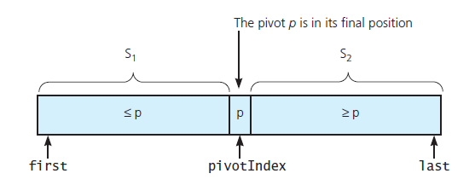
The Quick Sort

Slide 12
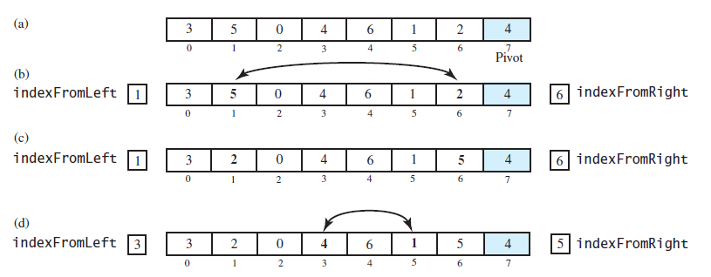
The Quick Sort (after the pivot chosen)

Slide 13
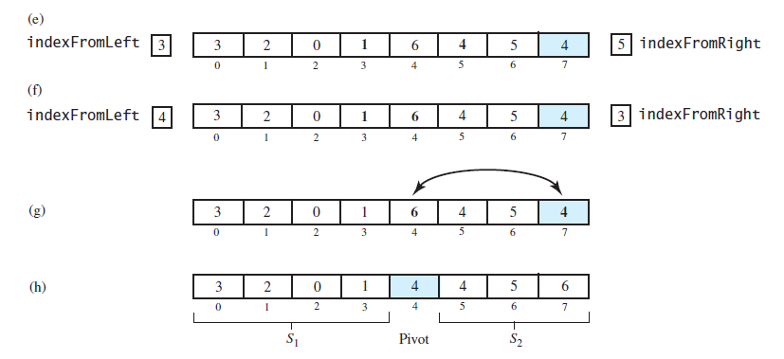
The Quick Sort: (after the pivot chosen)
FIGURE 11-10 Partitioning of array during quick sort

Slide 14
Choosing the pivot
Ideally it is the median as this will split array in half
Not feasible without sorting
Avoid bad pivots
At first, Pivot chosen was last in array. Generally bad behavior
Suggestion: Choose mid of first, middle, last (Sedgewick)
This turns out to be quite decent

Slide 15
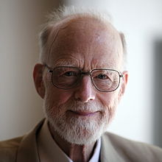
Computer Scientist of the week
Sir Charles Antony Richard Hoare
“Tony” Hoare
Developed QuickSort
Dining Philosopher’s problem
ALGOL 60
1980 Turing award
Invented the NULL Reference

Slide 16
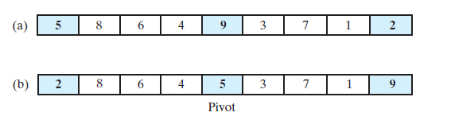
The Quick Sort
FIGURE 11-11 Median-of-three pivot selection: (a) The original array; (b) the array with its
first, middle, and last entries sorted

Slide 17
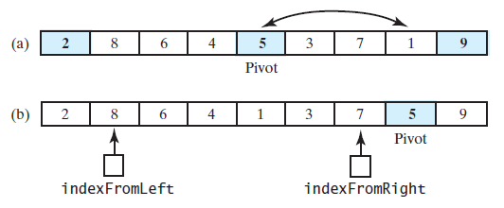
The Quick Sort
FIGURE 11-12 (a) The array with its first, middle, and last entries sorted; (b) the array after positioning the pivot and just before partitioning

Slide 18
Visual of Quicksort
http://en.wikipedia.org/wiki/Quicksort#mediaviewer/File:Sorting_quicksort_anim.gif

Slide 19
void QuickSort(vector<int> &itemVector, int first, int last)
{
if (last - first < 4)
{
InsertionSort(itemVector, first, last);
return;
}
int mid = (first + last) / 2;
if (itemVector[first] > itemVector[last])
{
swap(itemVector[first], itemVector[last]);
}
if (itemVector[first] > itemVector[mid])
{
swap(itemVector[first], itemVector[mid]);
}
else if (itemVector[mid] > itemVector[last])
{
swap(itemVector[mid], itemVector[last]);
}
int pivot = itemVector[mid];
swap(itemVector[mid], itemVector[last - 1]);

Slide 20
int left = first + 1;
int right = last - 2;
bool done = false;
while (! done)
{
while (itemVector[left] < pivot)
{
left++;
}
while (itemVector[right] > pivot)
{
right--;
}
if (right > left)
{
swap(itemVector[left], itemVector[right]);
right--;
left++;
}
else
{
done = true;
}
}
swap(itemVector[left], itemVector[last - 1]);
QuickSort(itemVector, first, left - 1);
QuickSort(itemVector, left + 1, last);
}

Slide 21
Quicksort: Efficiency Analysis
Worst case: If the pivot is the smallest item in the array segment, S1 will remain empty.
S2 decreases in size by only 1 at each recursive call.
Level 1 requires n-1 comparisons.
Level 2 requires n-2 comparisons.
Thus, (n-1) + (n-2) + …. + 2 + 1 = n(n-1)/2 = O(n²)
Average case: S1 and S2 contain the same number of items.
log n or log n + 1 levels of recursions occur.
Each level requires n-k comparisons
Thus, at most (n-1) * (log n + 1) = O(n log n )

Slide 22
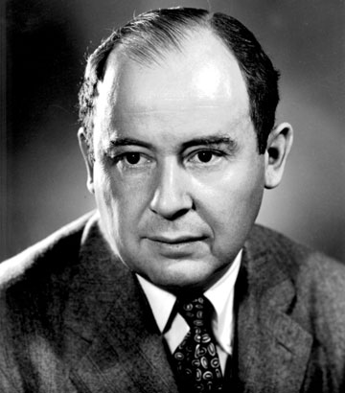
Mergesort versus Quicksort

Slide 23
Mergesort versus Quicksort
 | Worst case | Average case
Mergesort | n log n | n log n
Quicksort | n² | n log n
Why is Quicksort still around?
Reasons:
Mergesort requires item-copying operations from the array a to the temp
array and vice versa.
A worst-case situation is not typical.
Quicksort has very good memory characteristics
Then, why do we need Mergesort?
Reason:
If you sort a linked list, no item-copying operations are necessary.

Slide 24

Program 4: FAQ
Make sure your sorts work from for indices passed in: NOT WHOLE ARRAY
Sort functions are global functions, not methods on a class
iterative merge v. merge sort
Report
Make sure you call out O(n) per sort
Likely requires at least two charts
Iterative v. recursive merge sort
Questions???

Slide 25

Class Bell 11/18/24

Slide 26
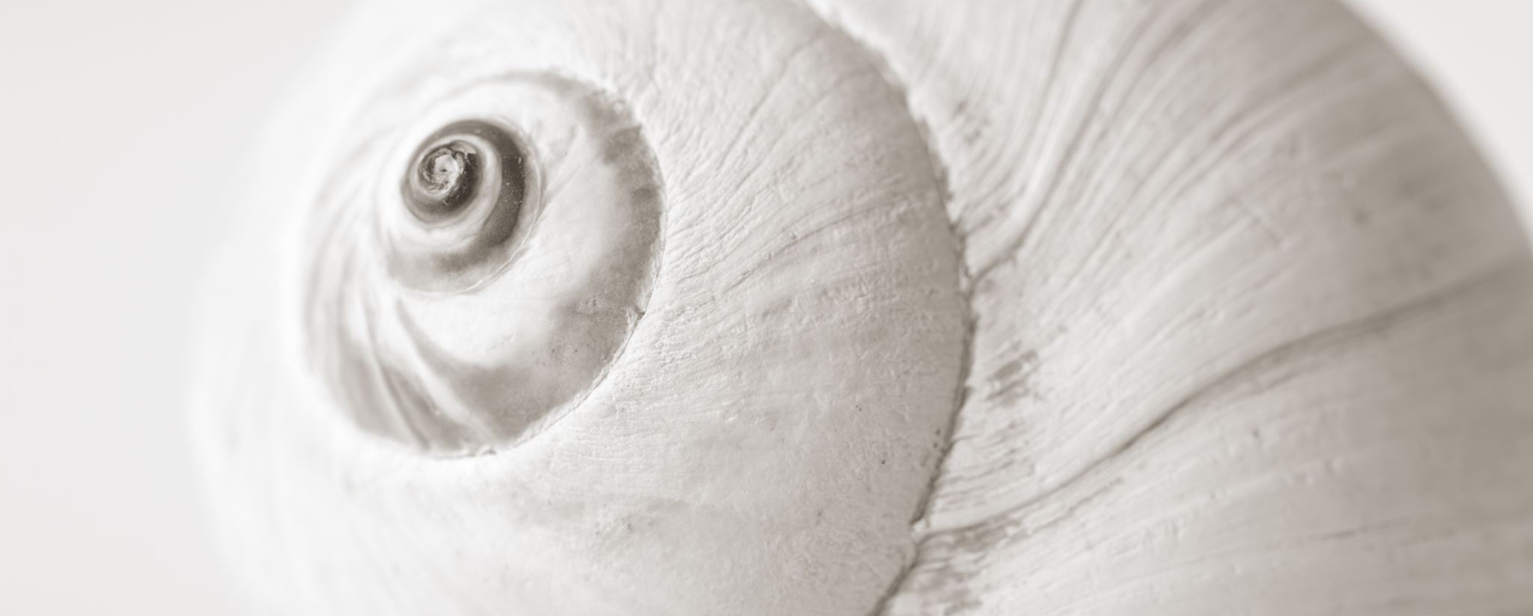
Shell Sort
Mr. Shell

Slide 27
ShellSort
Generalization of the Insertion Sort
Optimized to reduce data movement
Developed 1959 by Donald Shell
Choose an Interleave/gap size (n) and sort the arrays chosen by that size
This moves data large distances quickly
Complexity has not been fully determined
Depends on gap size (see appendix)
Works best on partially sorted data

Slide 28
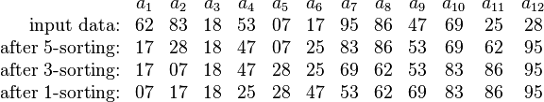
Shell Sort Example
Using gaps of size 5, 3, 1.

Slide 29
0
gap = 3/2.2 = 1
16
81
94
11
96
12
35
17
95
28
58
41
75
15
85
87
38
20
15
11
12
12
gap = 17/2 = 8
11
15
81
94
11
96
12
35
17
95
20
58
11
75
12
35
17
38
17
17
28
58
41
75
15
85
87
38
sort
28
94
41
96
15
85
87
95
38
20
20
81
28
28
gap = 8/2.2 = 3
20
sort
35
41
38
20
58
11
15
12
11
35
41
75
12
35
sort
17
38
28
75
58
17
38
28
20
41
35
58
75
94
41
96
75
58
87
87
81
15
85
87
94
81
96
94
85
95
81
95
85
81
87
96
94
95
95
85
96

Slide 30
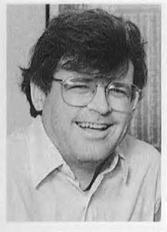
Computer Scientist of the Week
Robert Sedgewick
Studied under Donald Knuth, Professor at Princeton
Much work in sorting:
Thesis on Quick Sort
Determining ideal Gap for Shell Sort
Derived the red-black tree from the symmetric binary B-tree
Wrote the series entitled, Algorithms
You can take his courses on Coursera
Algorithms Part I and Part II,
Analysis of Algorithms
Analytic Combinatorics

Slide 31
for (int gap = size / 2; gap > 0; gap = (gap == 2) ? 1 : int(gap / 2.2))
{
for (int i = gap; i < size; i++)
{
int tmp = arr[i];
int j = i;
for ( ; (j >= gap) && (tmp < arr[j - gap]); j -= gap)
{
arr[j] = arr[j - gap];
}
arr[j] = tmp;
}
}
http://en.wikipedia.org/wiki/Shellsort#mediaviewer/File:Sorting_shellsort_anim.gif

Slide 32
Mind the Gap

Slide 33
Mind the Gap (more)

