Slide 1
CSS 342
Data Structures, Algorithms, and Discrete Mathematics I
Lecture 15.
CARRANO CHAPT 10

Slide 2

Announcements/Agenda 11/20/24 CANCELLED DUE TO STORM AND MASSIVE POWER OUTAGE
Announcements
Program 4: 11/22
Agenda
Program 4 Questions
Algorithm Efficiency / Big O
In Class Design Review: 12/2
Program Due: 12/9
Shell Sort
Comparisons of Sorting Efficiency
Finish Test Two Review
Final: 12/11
Program 5

Slide 3

Program 4
Questions???

Slide 4

Sorts and sorting

Slide 5
Sorting the Sorts
Selection Sort worst/average O(n²): Learn on your own
Bubble Sort worst/average O(n²)
Insertion Sort worst/average O(n²)
Shell Sort worst O(n²)/average O(n^{3/2})
Merge Sort worst/average O(n log n)
Quick Sort worst O(n²)/average O(n log n)
Radix Sort worst/average O(n)

Slide 6
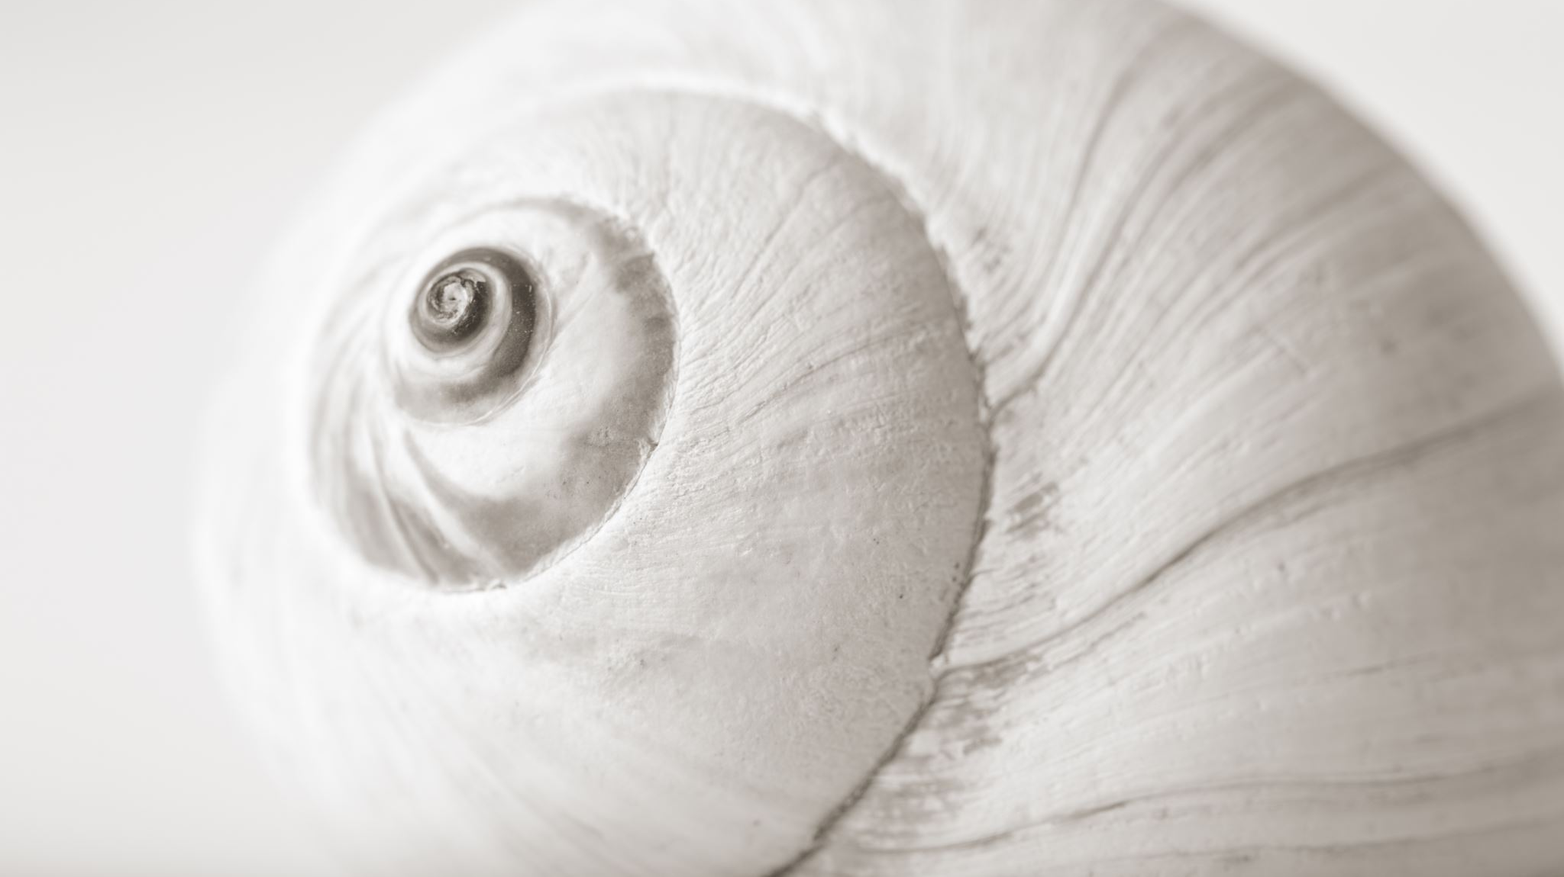
Shell Sort
Mr. Shell

Slide 7
ShellSort
Generalization of the Insertion Sort
Optimized to reduce data movement
Developed 1959 by Donald Shell
Choose an Interleave/gap size (n) and sort the arrays chosen by that size
This moves data large distances quickly
Complexity has not been fully determined
Depends on gap size (see appendix)
Works best on partially sorted data

Slide 8
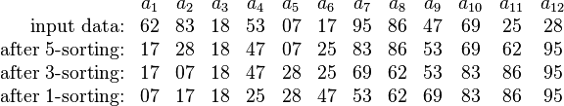
Shell Sort Example
Using gaps of size 5, 3, 1.

Slide 9
0
gap = 3/2.2 = 1
16
81
94
11
96
12
35
17
95
28
58
41
75
15
85
87
38
20
15
11
12
12
gap = 17/2 = 8
11
15
81
94
11
96
12
35
17
95
20
58
11
75
12
35
17
38
17
17
28
58
41
75
15
85
87
38
sort
28
94
41
96
15
85
87
95
38
20
20
81
28
28
gap = 8/2.2 = 3
20
sort
35
41
38
20
58
11
15
12
11
35
41
75
12
35
sort
17
38
28
75
58
17
38
28
20
41
35
58
75
94
41
96
75
58
87
87
81
15
85
87
94
81
96
94
85
95
81
95
85
81
87
96
94
95
95
85
96

Slide 10
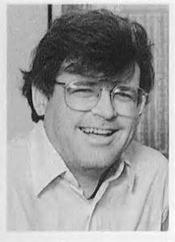
Computer Scientist of the Week
Robert Sedgewick
Studied under Donald Knuth, Professor at Princeton
Much work in sorting:
Thesis on Quick Sort
Determining ideal Gap for Shell Sort
Derived the red-black tree from the symmetric binary B-tree
Wrote the series entitled, Algorithms
You can take his courses on Coursera
Algorithms Part I and Part II,
Analysis of Algorithms
Analytic Combinatorics

Slide 11
for (int gap = size / 2; gap > 0; gap = (gap == 2) ? 1 : int(gap / 2.2))
{
for (int i = gap; i < size; i++)
{
int tmp = arr[i];
int j = i;
for ( ; (j >= gap) && (tmp < arr[j - gap]); j -= gap)
{
arr[j] = arr[j - gap];
}
arr[j] = tmp;
}
}
http://en.wikipedia.org/wiki/Shellsort#mediaviewer/File:Sorting_shellsort_anim.gif

Slide 12
Mind the Gap

Slide 13
Mind the Gap (more)

Slide 14
for (int gap = size / 2; gap > 0; gap = (gap == 2) ? 1 : int(gap / 2.2))
{
for (int i = gap; i < size; i++)
{
int tmp = arr[i];
int j = i;
for ( ; (j >= gap) && (tmp < arr[j - gap]); j -= gap)
{
arr[j] = arr[j - gap];
}
arr[j] = tmp;
}
}
http://en.wikipedia.org/wiki/Shellsort#mediaviewer/File:Sorting_shellsort_anim.gif

Slide 15
Radix Sort
NOT COVERD IN CLASS BONUS SLIDES!!
BONUS SLIDES

Slide 16
The Radix Sort
Uses the idea of forming groups, then combining them to sort a collection of data.
Consider collection of three letter groups
ABC, XYZ, BWZ, AAC, RLT, JBX, RDT, KLT, AEO, TLJ
Group strings by rightmost letter
(ABC, AAC) (TLJ) (AEO) (RLT, RDT, KLT) (JBX) (XYZ, BWZ)
Combine groups
ABC, AAC, TLJ, AEO, RLT, RDT, KLT, JBX, XYZ, BWZ
BONUS SLIDES

Slide 17
The Radix Sort
Group strings by middle letter
(AAC) (A B C, J B X) (R D T) (A E O) (T L J, R L T, K L T) (B W Z) (X Y Z)
Combine groups
AAC, ABC, JBX, RDT, AEO, TLJ, RLT, KLT, BWZ, XYZ
Group by first letter, combine again
( A AC, A BC, A EO) ( B WZ) ( J BX) ( K LT) ( R DT, R LT) ( T LJ) ( X YZ)
Sorted strings
AAC, ABC, AEO, BWZ, JBX, KLT, RDT, RLT, TLJ, XYZ
BONUS SLIDES

Slide 18
Radix Sort: Overview
0123 | 2154 | 0222 | 0004 | 0283 | 1560 | 1061 | 2150 | Original integers
1560 | 2150 | 1061 | 0222 | 0123 | 0283 | 2154 | 0004 | Grouped by 4th digit
1560 | 2150 | 1061 | 0222 | 0123 | 0283 | 2154 | 0004 | Combined
0004 | 0222 | 0123 | 2150 | 2154 | 1560 | 1061 | 0283 | Grouped by 3rd digit
0004 | 0222 | 0123 | 2150 | 2154 | 1560 | 1061 | 0283 | Combined
0004 | 1061 | 0123 | 2150 | 2154 | 0222 | 0283 | 1560 | Grouped by 2nd digit
0004 | 1061 | 0123 | 2150 | 2154 | 0222 | 0283 | 1560 | Combined
0004 | 0123 | 0222 | 0283 | 1061 | 1560 | 2150 | 2154 | Grouped by 1st digit
0004 | 0123 | 0222 | 0283 | 1061 | 1560 | 2150 | 2154 | Combined (sorted)
BONUS SLIDES

Slide 19
Radix Sort (Efficiency Analysis)
Each grouping work requires n shuffles.
# grouping and combining steps is # digits.
The previous case is 4.
Thus, for k digit number, the performance is:
K * n = O( n ) where k is irrelevant to n
Disadvantage:
Memory inefficient
K is not really a constant
Need to compare digits in the same order rather than items
Need to accommodate 10 groups for numbers
Need to accommodate 27 groups for strings (alphabet + blank)
BONUS SLIDES

Slide 20
Efficiency comparisons of Sorts
http://www.sorting-algorithms.com/
https://www.youtube.com/watch?v=kPRA0W1kECg

Slide 21

Algorithm Efficiency
BIG O

Slide 22
Big O Resources
Carrano Chapter 10
Problems published on Canvas
Summations:
https://www.youtube.com/watch?v=8i9-9zHbW6g
https://www.youtube.com/watch?v=WVfiBnzM3vQ

Slide 23
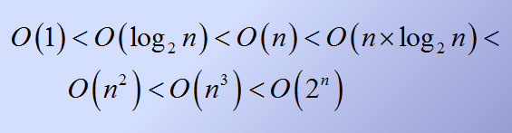
Order of growth of common functions

Slide 24
Empirical Overview of Efficiency*
All algorithms take approximately same time for N = 10
Any algorithm with N! running time is useless for N ≥ 20
2^{N} is intractable for n ≥ 40
O(N²) is usable for N = 10,000 but horrendous for N ≥ 1,000,000
O(N) and O(N log N) are practical for inputs of size 1,000,000,000
O(log N) was okay for any input size
*From “The Algorithm Design Manual”

Slide 25
Counting operations (redux) How many times is Task() called?
for (i = 1; i <= n; i++)
{
for (j = 1; j <= i; j++)
{
for (k = 1; k <= 5; k++)
{
Task();
}
}
}

Slide 26
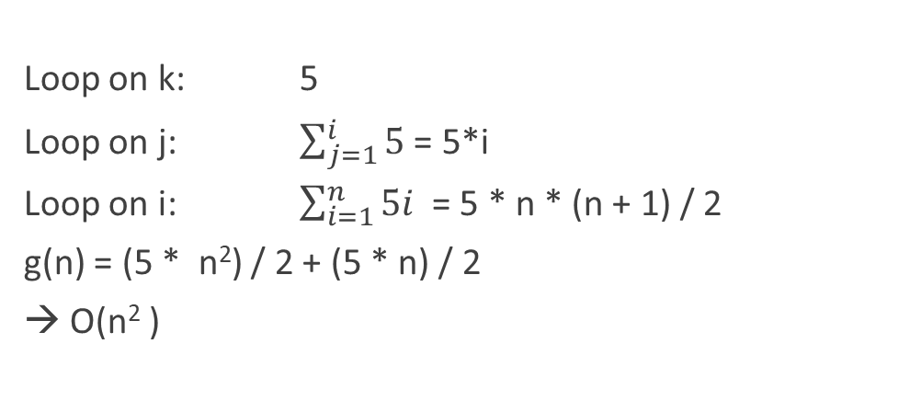
Counting operations
for (i = 1; i <= n; i++)
{
for (j = 1; j <= i; j++)
{
for (k = 1; k <= 5; k++)
{
Task();
}
}
}
Loop on k: 5
Loop on j: $\sum_{j=1}^{i}{5}$ = 5*i
Loop on i: $\sum_{i=1}^{n}{5i }$= 5 * n * (n + 1) / 2
g(n) = (5 * n²) / 2 + (5 * n) / 2
→ O(n² )

Slide 27
Complexity calculations
g(n) = (5 * t * n²) / 2 + (5 * t * n) / 2
Find k and n₀ such that k*n² > f(n) for all n>n₀
k = 3t, n₀=5
3tn² > 2.5tn² + 2.5tn
3 > 2.5 + 2.5/n, n>5
g(n) is O(n²)

Slide 28
Proving an algorithm / code snippet is O( f(n) )
Determine a formula for the number of important operations in algorithm or snippet as a function of n.
Express this as g(n).
Show there is a constant, k, such that k * f(n) > g(n) for all n greater than some number.
You have proven g(n) is O(f(n))
Rejoice!

Slide 29
What is Big-O complexity of this snippet
j = n;
while (j >= 1)
{
Call.Task();
j = j / 3;
}
g(n): number of calls to Call.Task()
g(n) = log₃n + 1
Snippet is O(log₃n)

Slide 30
In-Class Discussion Big-O complexity: Program Three
Determine the efficiency of your + operator on program three
Count operations assuming two lists of size n
How about one list of size n and one of size m
How about Merge operator?
BuildList Operator?

Slide 31

Computer Scientist of the week
Aaron Swartz
Born in Chicago!
Developed RSS as a teenager
Developed Markdown: markup standard derived from HTML
Early version of Reddit; joined Wired and quit
Wrote Guerilla Open Access Manifesto
Key activist in stopping SOPA (Stop Online Privacy Act)
Legally released millions of court documents from PACER
JSTOR controversy lead to overzealous prosecution
For more info watch: “The Internet’s own Boy”

Slide 32
What is Big-O complexity of this algorithm
j = n;
while (j >= 1)
{
for (i = 1; i <= j; i++)
{
Call.Task();
}
j = j / 2
}
g(n): number of calls to Call.Task()

Slide 33
In the 1st while-loop, j = n. for-loop executes Call.Task() n times.
In the 2nd while-loop, j <= n/2, n/2 times
In the 3rd while-loop, j <= n/4, n/4 times
In the z^{th} while-loop, j <= n/2^{z} n/2^{z} times = 1
g(n) = n + (n/2) + (n/4) + (n/8) + …. + (n/2^{z}) where z = log₂n
Geometric Sum:
a + ar + ar² + …. + ar^{m} = a(r^{m+1} – 1)/(r – 1), where r != 1.
g(n) = n + n/2 + n/4 + … + n/2^{z}
= n + n*(1/2) + n*(1/2)² + … + n * (1/2)^{z}
= n( (1/2) ^{z+1} -1)/(1/2 – 1) = n( (1/2) ^{z-1}-1)/(-1/2)
= 2n(1-1/2^{z+1}) = n(2 – 1/2^{z}) = n(2 – 1/n) = 2n - 1
let k = 2, n₀ = 1
g(n) is O( n )

