Slide 1
CSS 342
Data Structures, Algorithms, and Discrete Mathematics I
Lecture 15.
CARRANO CHAPT 10

Slide 2
Announcements/Agenda 11/25/24
Announcements
Program 5
Agenda
Finish Test Two Review
Algorithm Efficiency / Big O
In Class Design Review: 12/2
Program Due: 12/9
Shell Sort (Learn 2 Home): Likely on Final
Comparisons of Sorting Efficiency
Final: 12/11
Program 5 Intro

Slide 3
Linked List Coding

Slide 4

Shell Sort
Mr. Shell: Please Learn

Slide 5
ShellSort
Generalization of the Insertion Sort
Optimized to reduce data movement
Developed 1959 by Donald Shell
Choose an Interleave/gap size (n) and sort the arrays chosen by that size
This moves data large distances quickly
Complexity has not been fully determined
Depends on gap size (see appendix)
Works best on partially sorted data

Slide 6
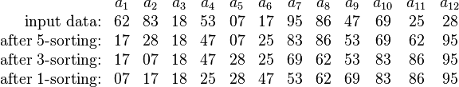
Shell Sort Example
Using gaps of size 5, 3, 1.

Slide 7
0
gap = 3/2.2 = 1
16
81
94
11
96
12
35
17
95
28
58
41
75
15
85
87
38
20
15
11
12
12
gap = 17/2 = 8
11
15
81
94
11
96
12
35
17
95
20
58
11
75
12
35
17
38
17
17
28
58
41
75
15
85
87
38
sort
28
94
41
96
15
85
87
95
38
20
20
81
28
28
gap = 8/2.2 = 3
20
sort
35
41
38
20
58
11
15
12
11
35
41
75
12
35
sort
17
38
28
75
58
17
38
28
20
41
35
58
75
94
41
96
75
58
87
87
81
15
85
87
94
81
96
94
85
95
81
95
85
81
87
96
94
95
95
85
96

Slide 8
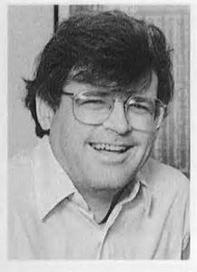
Computer Scientist of the Week
Robert Sedgewick
Studied under Donald Knuth, Professor at Princeton
Much work in sorting:
Thesis on Quick Sort
Determining ideal Gap for Shell Sort
Derived the red-black tree from the symmetric binary B-tree
Wrote the series entitled, Algorithms
You can take his courses on Coursera
Algorithms Part I and Part II,
Analysis of Algorithms
Analytic Combinatorics

Slide 9
for (int gap = size / 2; gap > 0; gap = (gap == 2) ? 1 : int(gap / 2.2))
{
for (int i = gap; i < size; i++)
{
int tmp = arr[i];
int j = i;
for ( ; (j >= gap) && (tmp < arr[j - gap]); j -= gap)
{
arr[j] = arr[j - gap];
}
arr[j] = tmp;
}
}
http://en.wikipedia.org/wiki/Shellsort#mediaviewer/File:Sorting_shellsort_anim.gif

Slide 10
Mind the Gap

Slide 11
Mind the Gap (more)

Slide 12
for (int gap = size / 2; gap > 0; gap = (gap == 2) ? 1 : int(gap / 2.2))
{
for (int i = gap; i < size; i++)
{
int tmp = arr[i];
int j = i;
for ( ; (j >= gap) && (tmp < arr[j - gap]); j -= gap)
{
arr[j] = arr[j - gap];
}
arr[j] = tmp;
}
}
http://en.wikipedia.org/wiki/Shellsort#mediaviewer/File:Sorting_shellsort_anim.gif

Slide 13
Efficiency comparisons of Sorts
http://www.sorting-algorithms.com/
https://www.youtube.com/watch?v=kPRA0W1kECg

Slide 14

Algorithm Efficiency
BIG O

Slide 15
Big O Resources
Carrano Chapter 10
Problems published on Canvas
Summations:
https://www.youtube.com/watch?v=8i9-9zHbW6g
https://www.youtube.com/watch?v=WVfiBnzM3vQ

Slide 16
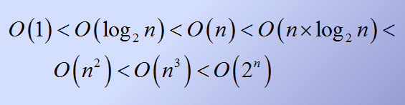
Order of growth of common functions

Slide 17
Empirical Overview of Efficiency*
All algorithms take approximately same time for N = 10
Any algorithm with N! running time is useless for N ≥ 20
2^{N} is intractable for n ≥ 40
O(N²) is usable for N = 10,000 but horrendous for N ≥ 1,000,000
O(N) and O(N log N) are practical for inputs of size 1,000,000,000
O(log N) was okay for any input size
*From “The Algorithm Design Manual”

Slide 18
Counting operations (redux) How many times is Task() called?
for (i = 1; i <= n; i++)
{
for (j = 1; j <= i; j++)
{
for (k = 1; k <= 5; k++)
{
Task();
}
}
}

Slide 19
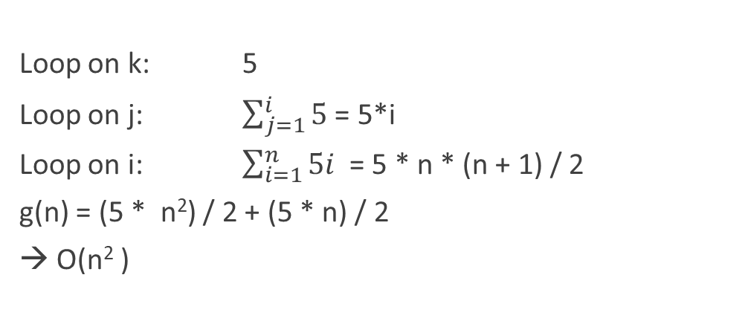
Counting operations
for (i = 1; i <= n; i++)
{
for (j = 1; j <= i; j++)
{
for (k = 1; k <= 5; k++)
{
Task();
}
}
}
Loop on k: 5
Loop on j: $\sum_{j=1}^{i}{5}$ = 5*i
Loop on i: $\sum_{i=1}^{n}{5i }$= 5 * n * (n + 1) / 2
g(n) = (5 * n²) / 2 + (5 * n) / 2
→ O(n² )

Slide 20
Complexity calculations
g(n) = (5 * t * n²) / 2 + (5 * t * n) / 2
Find k and n₀ such that k*n² > f(n) for all n>n₀
k = 3t, n₀=5
3tn² > 2.5tn² + 2.5tn
3 > 2.5 + 2.5/n, n>5
g(n) is O(n²)

Slide 21
Proving an algorithm / code snippet is O( f(n) )
Determine a formula for the number of important operations in algorithm or snippet as a function of n.
Express this as g(n).
Show there is a constant, k, such that k * f(n) > g(n) for all n greater than some number.
You have proven g(n) is O(f(n))
Rejoice!

Slide 22
What is Big-O complexity of this snippet
j = n;
while (j >= 1)
{
Call.Task();
j = j / 3;
}
g(n): number of calls to Call.Task()
g(n) = log₃n + 1
Snippet is O(log₃n)

Slide 23
In-Class Discussion Big-O complexity: Program Three
Determine the efficiency of your + operator on program three
Count operations assuming two lists of size n
How about one list of size n and one of size m
How about Merge operator?
BuildList Operator?

Slide 24

Computer Scientist of the week
Aaron Swartz
Born in Chicago!
Developed RSS as a teenager
Developed Markdown: markup standard derived from HTML
Early version of Reddit; joined Wired and quit
Wrote Guerilla Open Access Manifesto
Key activist in stopping SOPA (Stop Online Privacy Act)
Legally released millions of court documents from PACER
JSTOR controversy lead to overzealous prosecution
For more info watch: “The Internet’s own Boy”

Slide 25
What is Big-O complexity of this algorithm
j = n;
while (j >= 1)
{
for (i = 1; i <= j; i++)
{
Call.Task();
}
j = j / 2
}
g(n): number of calls to Call.Task()

Slide 26
In the 1st while-loop, j = n. for-loop executes Call.Task() n times.
In the 2nd while-loop, j <= n/2, n/2 times
In the 3rd while-loop, j <= n/4, n/4 times
In the z^{th} while-loop, j <= n/2^{z} n/2^{z} times = 1
g(n) = n + (n/2) + (n/4) + (n/8) + …. + (n/2^{z}) where z = log₂n
Geometric Sum:
a + ar + ar² + …. + ar^{m} = a(r^{m+1} – 1)/(r – 1), where r != 1.
g(n) = n + n/2 + n/4 + … + n/2^{z}
= n + n*(1/2) + n*(1/2)² + … + n * (1/2)^{z}
= n( (1/2) ^{z+1} -1)/(1/2 – 1) = n( (1/2) ^{z-1}-1)/(-1/2)
= 2n(1-1/2^{z+1}) = n(2 – 1/2^{z}) = n(2 – 1/n) = 2n - 1
let k = 2, n₀ = 1
g(n) is O( n )

Slide 27

Program 5 Jolly Banker
Introduction

Slide 28
Class Bell.
11/25/2024

Slide 29

Now let’s move from code snippets to algorithms
BIG-O

Slide 30
Binary Search
x
low =0
mid = (15 + 0)/2 = 7
high=15
10
a
1
5
10
13
14
21
29
37
43
46
52
69
75
88
91
99
new high=7–1=6
int BinarySearch(const vector<int>& a, int x)
{
}
Write code for binary search

Slide 31
Binary Search
x
low =0
mid = (15 + 0)/2 = 7
high=15
10
a
1
5
10
13
14
21
29
37
43
46
52
69
75
88
91
99
new high=7–1=6
int BinarySearch(const vector<int>& a, int x)
{
int low = 0;
int high = a.size( ) – 1;
int mid;
while ( low <= high ) {
mid = ( low + high ) / 2;
if ( a[mid] < x )
low = mid + 1;
else if ( a[mid] > x )
high = mid – 1;
else
return mid;
}
return NOT_FOUND; // NOT_FOUND = -1
}
Write code for binary search

Slide 32
Complexity: Binary Search
1
5
10
13
14
21
29
37
43
46
52
69
75
88
91
99
1st step
2nd step
3rd step
Hit!
DATA SIZE # Calls
N = 2 1
N = 4 2
N = 8 3
N = 16 4
N = 2^{k} K
2^{K} < N < 2^{K+1} K+1
K < log₂N < K+1
O(log₂N)
4th step

Slide 33
Worst, Best, and Average-case Analysis
Worst-case analysis:
Algorithm A requires no more than k * f(n) time units.
It might happen rarely, if at all, in practice.
Best-case analysis:
Like worst-case analysis, it might happen rarely.
Average-case analysis:
A requires no more than k * f(n) time units for all but a finite number of values of n
Difficulties: determining probability and distribution of size n and input data

Slide 34
Efficiency of Sequential Search
29
10
14
37
13
52
46
75
5
43
21
69
88
1
Hit!
Best case
O(1)
Hit!
Worst case
O(n)
Hit!
Average case
O(n/2) = O(n)

Slide 35
Minimum Element in an Array
Given an array of N items, find the smallest item.
What order (in big O) will this problem be bound to?
1
N
3
9
1
8
5
2
0
7
4
6
-1
10
-2

