Slide 1
CSS 342
Data Structures, Algorithms, and Discrete Mathematics I
Lecture 17.
CARRANO CHAPT 10

Slide 2
Announcements/Agenda 11/27/2024
Announcements
Agenda
Algorithm Efficiency / Big O
Design: 12/2
Program: 12/9
Binary Search Tree
Final Exam: 12/11
Program 5: Questions
Course Evals: https://uwb.iasystem.org/survey/31953
Office Hours start 10am next week
Program 5

Slide 3

Happy Thanksgiving

Slide 4
Big O Resources
Carrano Chapter 10
Problems published on Canvas
Summations:
https://www.youtube.com/watch?v=8i9-9zHbW6g
https://www.youtube.com/watch?v=WVfiBnzM3vQ

Slide 5
BigO: pop quiz
If func2() is O(1), what is the bigO of the code snippet?
Prove it.
for (int i = -n; i < n; i++)
{
func(i);
}
int func(int a)
{
int b = 0;
for (int i = 0; i < a; i++)
{
b += func2(i*i);
}
return b;
}

Slide 6

Program 5 Jolly Banker
Questions.

Slide 7

Algorithm Efficiency
BIG O

Slide 8

Now let’s move from code snippets to algorithms
BIG-O

Slide 9
Binary Search
x
low =0
mid = (15 + 0)/2 = 7
high=15
10
a
1
5
10
13
14
21
29
37
43
46
52
69
75
88
91
99
new high=7–1=6
int BinarySearch(const vector<int>& a, int x)
{
}
Write code for binary search

Slide 10
Binary Search
x
low =0
mid = (15 + 0)/2 = 7
high=15
10
a
1
5
10
13
14
21
29
37
43
46
52
69
75
88
91
99
new high=7–1=6
int BinarySearch(const vector<int>& a, int x)
{
int low = 0;
int high = a.size( ) – 1;
int mid;
while ( low <= high ) {
mid = ( low + high ) / 2;
if ( a[mid] < x )
low = mid + 1;
else if ( a[mid] > x )
high = mid – 1;
else
return mid;
}
return NOT_FOUND; // NOT_FOUND = -1
}
Write code for binary search

Slide 11
Complexity: Binary Search
1
5
10
13
14
21
29
37
43
46
52
69
75
88
91
99
1st step
2nd step
3rd step
Hit!
DATA SIZE # Calls
N = 2 1
N = 4 2
N = 8 3
N = 16 4
N = 2^{k} K
2^{K} < N < 2^{K+1} K+1
K < log₂N < K+1
O(log₂N)
4th step

Slide 12
Worst, Best, and Average-case Analysis
Worst-case analysis:
Algorithm A requires no more than k * f(n) time units.
It might happen rarely, if at all, in practice.
Best-case analysis:
Like worst-case analysis, it might happen rarely.
Average-case analysis:
A requires no more than k * f(n) time units for all but a finite number of values of n
Difficulties: determining probability and distribution of size n and input data

Slide 13
Efficiency of Sequential Search
29
10
14
37
13
52
46
75
5
43
21
69
88
1
Hit!
Best case
O(1)
Hit!
Worst case
O(n)
Hit!
Average case
O(n/2) = O(n)

Slide 14
Complexity of Binary Search
x
low =0
mid = (15 + 0)/2 = 7
high=15
10
a
1
5
10
13
14
21
29
37
43
46
52
69
75
88
91
99
new high=7–1=6
int BinarySearch(const vector<int>& a, int x)
{
int low = 0;
int high = a.size( ) – 1;
int mid;
while ( low <= high ) {
mid = ( low + high ) / 2;
if ( a[mid] < x )
low = mid + 1;
else if ( a[mid] > x )
high = mid – 1;
else
return mid;
}
return NOT_FOUND; // NOT_FOUND = -1
}
Write code for binary search

Slide 15
1
5
10
13
14
21
29
37
43
46
52
69
75
88
91
99
1st step
2nd step
3rd step
Hit!
DATA SIZE # Calls
N = 2 1
N = 4 2
N = 8 3
N = 16 4
N = 2^{k} K
2^{K} < N < 2^{K+1} K+1
K < log₂N < K+1
O(log₂N)
4th step

Slide 16
Minimum Element in an Array
Given an array of N items, find the smallest item.
What order (in big O) will this problem be bound to?
1
N
3
9
1
8
5
2
0
7
4
6
-1
10
-2

Slide 17
Closest Points in the Plane
Given N points in a plane (that is, an x-y coordinate system), find the pair of points that are closest together.
What order (in big O) will this problem be bound to?
y
sqrt( (x₂ – x₁)² + (y₂ – y₁)² )
2,1
1,4
1,6
4,5
4,7
5,4
5,6
6,3
6,7
7,1
x
8,4

Slide 18
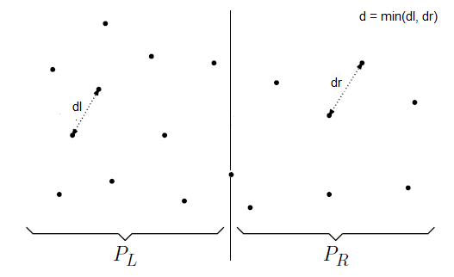
nlogn solution
Sort input array by x cords
Find the middle point P[n/2]
Divide array into two halves: P_{L} and P_{R}
Recursively find the min in each array, distL and distR. Let dist = min(distL, distR)

Slide 19
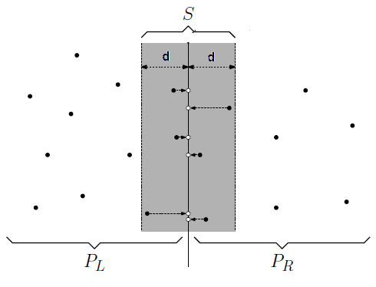
nlogn solution
dist is an upper bound on distance. Need to consider pairs of points one in P_{L} and one in P_{R} . But we do not need to consider points outside this .
Build array s whose x coord is close to middle line at P[n/2]
Sort the array s by y coord; for each point in strip we need to check only 7 points (beyond scope, but see this: http://people.csail.mit.edu/indyk/6.838-old/handouts/lec17.pdf

Slide 20
Intractable, Unsolvable, and NP problems
Tractable problems
Their worst-case time is proportional to a polynomial (class P)
However, sometimes this can take a long time
Intractable problems
Their worst-case time cannot be bounded to a polynomial.
Unsolvable algorithms:
They have no algorithms at all.
Turing’s Halting problem
NP(Non-Polynomial) problems
No solution with polynomial worst-case performance, but when solved can be checked polynomial time
NP-Complete Problems
Class of problems that if any can be solved with polynomial worst-case, all can be solved
Ex, Traveling salesperson problem

Slide 21
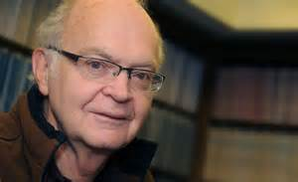
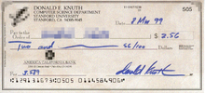
Computer Scientist of the week
Donald Knuth
Born Milwaukee, WI. 1938
Professor Emeritus at Stanford
Father of Analysis of Algorithms
Formalization of mathematical study of complexity of programs
Wrote “Art of Computer Programming”, the definitive text on computer algorithms.
Creator of TeX
Won Grace Hopper Award, Turing Award, John von Neumann Medal.
Opposed to granting computer patents

Slide 22
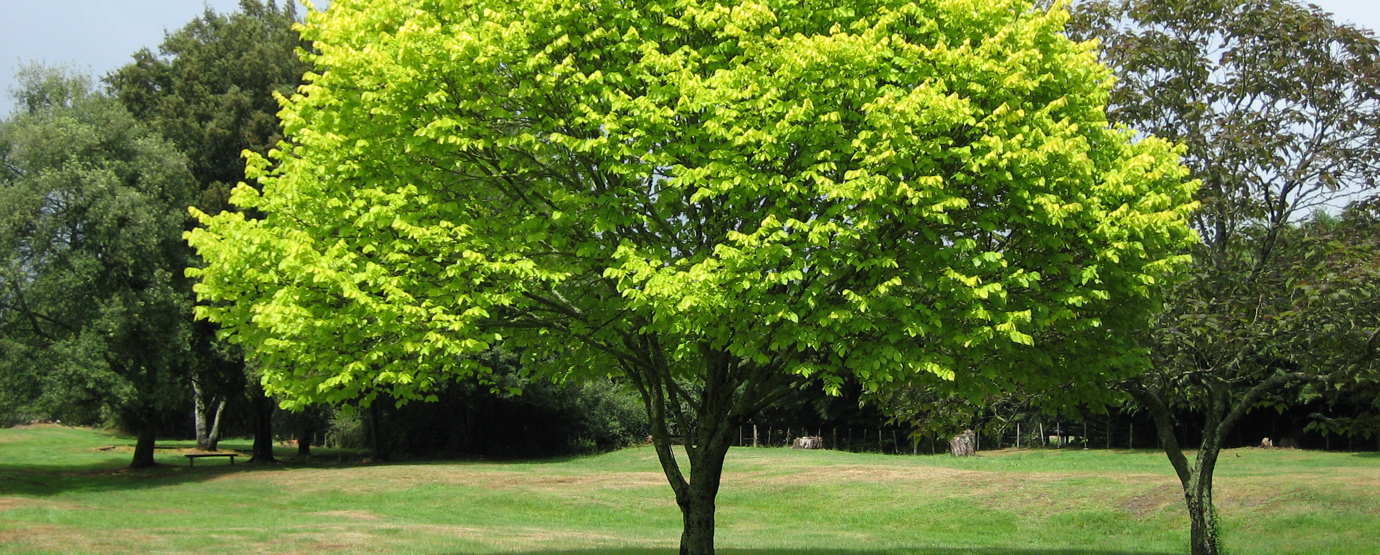
Trees

Slide 23
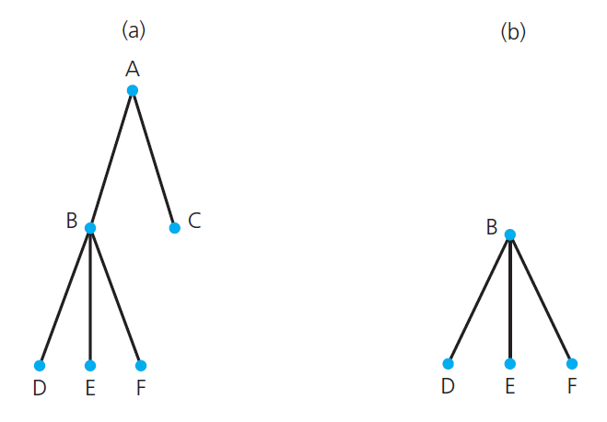
Terminology
Root
Parent
Child
Ancestor
Descendent
Height
Subtree
N-ary tree
Binary Tree
FIGURE 15-1 (a) A tree; (b) a subtree of the tree in part a

Slide 24
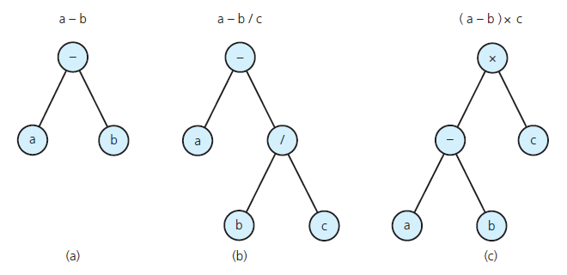
Binary Tree: Algebraic Expressions.

Slide 25
Binary Search Tree
For each node n, a binary search tree satisfies the following three properties:
n ’s value is greater than all values in its left subtree T _{L} .
n ’s value is less than all values in its right subtree T _{R} .
Both T _{L} and T _{R} are binary search trees.
Well suited for searching
Data Structures and Problem Solving with C++: Walls and Mirrors, Carrano and Henry, © 2013

Slide 26
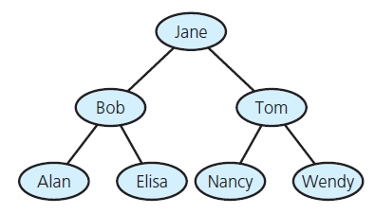
Binary Search Tree: Example

Slide 27
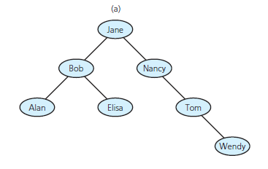
Binary Search Tree: Example
FIGURE 15-14 Binary search trees
with the same data as in Figure 15-13

Slide 28
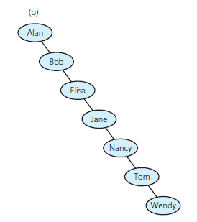
Binary Search Tree: Example
FIGURE 15-14 Binary search trees
with the same data as in Figure 15-13
Data Structures and Problem Solving with C++: Walls and Mirrors, Carrano and Henry, © 2013

Slide 29
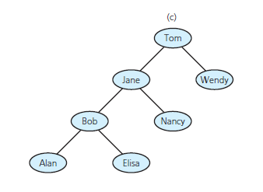
Binary Search Tree: Example
FIGURE 15-14 Binary search trees
with the same data as in Figure 15-13
Data Structures and Problem Solving with C++: Walls and Mirrors, Carrano and Henry, © 2013

Slide 30
In Class Exercise
Design BST class – what methods would you expose?

Slide 31
class BinarySearchTree
{
friend ostream& operator<<(ostream stream, BinarySearchTree& rhs);
public:
BinarySearchTree();
BinarySearchTree(const BinarySearchTree& bst);
~BinarySearchTree();
int get_height() const;
bool IsEmpty() const;
int count() const;
void Flush();
bool Retrieve(int acct_number, Account*& account);
bool Insert(int acct_number, Accout* account);
bool Remove(int acct_numer);
BinarySearchTree operator+(const BinarySearchTree& rhs) const;
BinarySearchTree operator=(const BinarySearchTree& rhs);
private:
struct Node
{
Account* p_account;
Node* right;
Node* left;
};
Node* root_;
int count_;
};

Slide 32
Templatizing

Slide 33
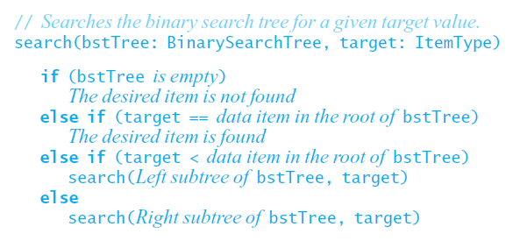
Searching a Binary Search Tree
Data Structures and Poblem Solving with C++: Walls and Mirrors, Carrano and Henry, © 2013

Slide 34
Searching a Binary Search Tree: pseudo-code
Item Search(Node* root, Item target)
{
if (root == nullptr) return nullptr;
else if (target == *(root->p_item))
{
return *(root->p_item);
}
else if (target < *(root->p_item))
{
return Search(root->left);
}
else
{
return Search(root->right)
}
}

Slide 35
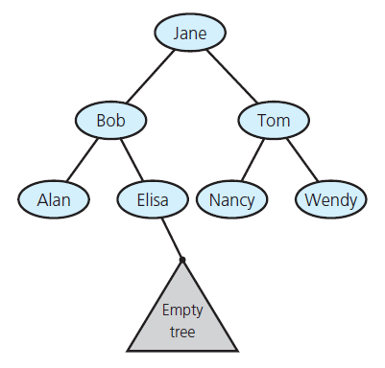
Creating a Binary Search Tree
FIGURE 15-16 Empty subtree where the search algorithm terminates when looking for Frank
Data Structures and Problem Solving with C++: Walls and Mirrors, Carrano and Henry, © 2013

Slide 36
In Class Problem
What Binary Search Tree is created with the following input:
Steve
Jill
Frank
Abby
Dev
Zeek
Christina
Yann
Saurabh
Iris
Tanya
What Binary Search Tree is created with the following input:
Jill
Tanya
Frank
Zeek
Christina
Yann
Steve
Saurabh
Iris
Abby
Dev

Slide 37
Efficiency of BST Operations
Retrieve:
Insert:
Removal:
Traversal:

