Slide 1
CSS 342
Data Structures, Algorithms, and Discrete Mathematics I
Lecture 19.

Slide 2
Announcements/Agenda 12/4/2024
Announcements
Agenda
Program 5 Questions
Warm Up Problems
Final Exam: 12/11
Program 5: Due 12/9
Fill out Course Evals:
Final Exam Prep Deck Posted
Final Exam Discussion
https://uwb.iasystem.org/survey/31953
Final Exam Practice Test Posted
Course Eval
Propositional logic will NOT be on final
BigO questions

Slide 3
Last Class!
CELEBRATE

Slide 4
Program 5: What to turn in
Turn in:
All .cpp and .h files for your project
Output file called which is your program run against sample input on site
jolly_bank bank_trans_in.txt > bank_trans_out.txt
jolly_bank bank_trans_in.txt 2> bank_trans_err.txt
How will we grade this?
Place all of your .cpp/.h in a directory in the linux lab
g++ *cpp –o jolly_bank
Run the created jolly_bank executable with different input files
./jolly_bank my_test_case.txt
PLEASE PRACTICE THIS YOURSELF BEFORE TURNING IN

Slide 5

Program 5 Jolly Banker
Questions

Slide 6
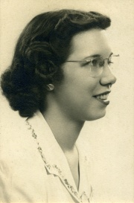
Computer Scientist of the week
Betty Snyder Holberton
Moore School of Engineering as Human Computer to determine ballistic trajectories
One of first programmers of the ENIAC
Chief of the Programming Research Branch, Applied Math lab at the David Taylor Model Basin
Helped develop UNIVAC w/John Mauchly
Created the Breakpoint
Worked with Grace Hopper on COBOL and FORTRAN
Credited with making the computer beige

Slide 7
Write a member function, MoveToEnd which takes in an item by value, finds the first occurrence and moves it
to the end of the list. Return false if item could not be found; otherwise true.

Slide 8
bool MyList::MoveToEnd(Item it)
{
Node *current = head;
Node *p_found = nullptr;
if (current == nullptr)
{
return false;
}
while ((current != nullptr) && (p_found == nullptr))
{
if (*(current->pItem) == it)
{
p_found = current;
}
else
{
current = current->next;
}
}
if (p_found == nullptr)
{
return false;
}
while (current->next != nullptr)
{
current = current->next;
}
Item *temp = current->pItem;
current->pItem = p_found->pItem;
pFound->pItem = temp;
}

Slide 9
BigO
What is counter as a function of n?
What is the BigO
Prove It.
int counter = 0;
int main(int argc, char** argv)
{
int n;
if (argc == 2)
{
n = atoi(argv[1]);
}
else
{
cin >> n;
}
int i = 1;
while (i < n * n)
{
function1(n);
i *= 2;
}
cout << counter << endl;
}
void function1(int x)
{
for (int i = 0; i < x; i++)
{
counter++;
}
}

Slide 10

Final Exam: 12/11
Questions???

Slide 11
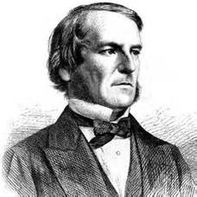
Computer Scientist of the week
George Boole
English Mathematician, Philosopher and Logician
Wrote: “An Investigation of the Laws of Thought (1854), on Which are Founded the Mathematical Theories of Logic and Probabilities”
Found of Boolean Algebra, the Algebra of logic
Logical propositions expressed as algebras
bool keyword named after him
Died by the fever started by walking to class in the rain to lecture

Slide 12
Course Evaluation
https://uwb.iasystem.org/survey/

