Slide 1
CSS 342 Data Structures, Algorithms, and Discrete Mathematics I
Lecture 3.
Reading: Carrano Carrano Ch. 3.1-3.2, Appendix D, C++ Book

Slide 2
Announcements/Agenda
Announcements
Program 1: Due 10/09
Some C++ Beginner Material:
https://www.codecademy.com/enrolled/courses/learn-c-plus-plus
https://www.youtube.com/@ProfessorHankStalica
https://learn.codesignal.com/course-paths
C++ Fundamentals
Value, Reference, Const Reference
Constructors
CONST key word
Encapsulation: Public, Private, Friend
Playing Card Example
Program 1 Questions
Unit Tests

Slide 3
C++ Fundamentals
REFERENCE, Value, CONST REFERENCE
Constructors
CONST KEY WORD

Slide 4
In class code
int main()
{
string name1 = "sue";
string name2 = "ravi";
cout << name1 << " " << name2 << endl;
MySwap(name1, name2);
cout << name1 << " " << name2 << endl;
}
Output:
sue ravi
ravi sue

Slide 5
Call by Value, Reference, and Constant Reference
typedef struct
{
int width;
int length;
} Rectangle;
int Area(Rectangle &rect);
int main()
{
int result;
Rectangle my_yard = {5, 7};
result = Area(my_yard);
cout << "Area of Rectangle(" << my_yard.width << "," << my_yard.length << "): " << result << endl;
}
//int Area(Rectangle rect)
int Area(Rectangle &rect)
//int Area(const Rectangle &rect)
{
int area;
area = rect.width * rect.length;
rect.width = 0;
return area;
}

Slide 6
Call by Value, Reference, and Constant Reference
Arrays, Pointers, and Structures
Which of swap functions is appropriate?
void swap(string a, string b)
{
string tmp = a;
a = b;
b = tmp;
}
void swap(string& a, string& b)
{
string tmp = a;
a = b;
b = tmp;
}
void swap(const string& a, const string& b)
{
string tmp = a;
a = b;
b = tmp;
}
Which of findMax functions is appropriate?
int findMax(vector<int> a)
{
int max = a[0];
int i;
for (i=1; i < a.size(); i++)
if (a[i] > max)
max = a[i];
return max;
}
int findMax(vector<int>& a)
{
int max = a[0];
int i;
for (i=1; i < a.size(); i++)
if (a[i] > max)
max = a[i];
return max;
}
int findMax(const vector<int>& a)
{
int max = a[0];
int i;
for (i=1; i < a.size(); i++)
if (a[i] > max)
max = a[i];
return max;
}

Slide 7
Constructor
Uses same name as class is constructs
Nothing returned; not even void
Default constructor created
Function executed on creation of object
Arrays: constructors called in increasing order Arr[0], Arr[1], Arr[2],…
Signature chooses constructor
Casting of call parameters done using normal casting rules
What’s in a constructor?
Normally used initialize private data as built-in types in C++ are undefined
C++11: Member initializer lists are generally utilized
http://en.cppreference.com/w/cpp/language/initializer_list
Generally, side-effecting is not done

Slide 8
CONST keyword usages
Global definition of value which does not change
const int kCardsInDeck = 52
(can also be done with preprocess #define but do not use)
Modifier on member function which does not change data in object
void MyFuntion(int p) const;
const reference to save space on passing in variable
void MyFunction(const MyParamType& mpt);
There are other usages but the above are the most common/useful

Slide 9
Programming Guidelines
https://google.github.io/styleguide/cppguide.html

Slide 10

Encapsulation
Abstraction
Encapsulation
Hierarchy
Polymorphism

Slide 11
Encapsulation and Information Hiding
Wall: Not only encapsulate the entire implementation but also make it invisible/inaccessible.
Slit: Interface of the implementation such as arguments and a return value.
Program
that uses
method S
Function call with arguments
Implementation
of method S
Return a value

Slide 12
Class
Classes: a new data type formed of a collection of data and a set of operations on the data
Data Structures: a construct within a programming language that stores a collection of data
Behave as a new data type
add
Examples:
student lists
rational numbers
complex numbers
currency (cents/dollars)
length measurement (inches/feet)
weight measurement (oz/lbs)
Program
that uses
a class
remove
query

Slide 13
Encapsulation at ground level
Program consists of
Driver file (main) – keep this quite small
Classes: MyClass
my_class.h -- interface
my_class.cpp -- implementation
definition (.h file)
public: functions called by others
private: data, helper functions
Implementation (.cpp file)
MyClass::Function()

Slide 14
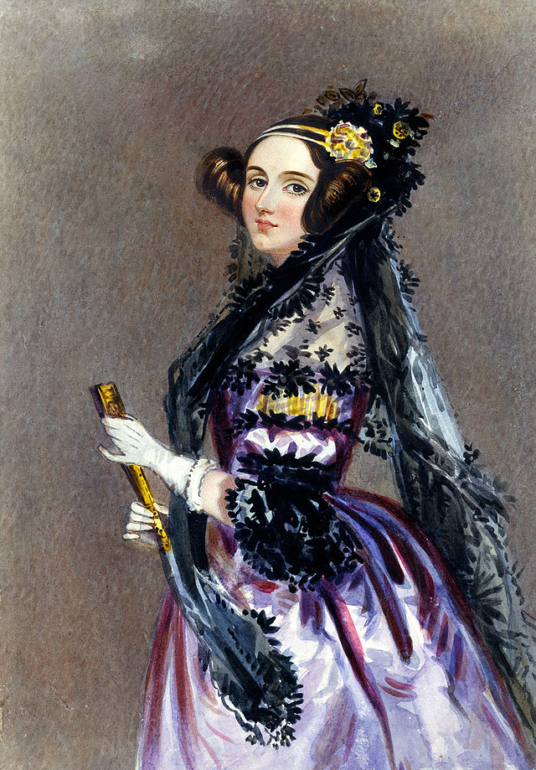
Computer Scientist of the week
Ada Lovelace
Aka, Augustus Ada Byron, aka Augustus Ada Lovelace, aka the Countess
of Lovelace
Daughter of the famous Poet, Lord Byron
Partnered with Charles Babbage on Analytical Engine
Devised / Imagined first computer program!
Algorithm to be executed by the analytical machine
Computer Bernoulli numbers
First Computer programmer
Also contributed to mathematics and phrenology

Slide 15
Encapsulation and Data Review
public: contract exposes functions for class
The What
Actions
Designed first
Private: All data, helper functions
Base types like int, double, …
Arrays, Vectors, Linked Lists
Queues, Stacks, Trees, Graphs

Slide 16

Example
Design a class representing playing card that can be used in a Card DECK

Slide 17
Class Design Checklist
Constructors
Setters/Getters
Actions (verbs)
Operator Overloads
Private Data Types

Slide 18
Card.h
#include <string>
#include <iostream>
using namespace std;
enum Suit {kHeart, kDiamond, kClub, kSpade};
const string kSUITS[4] = {"heart”, "diamond”, “club”, “spade”};
class Card
{
public:
//Constructors
Card();
Card(int value, Suit suit);
//getters-setters
int value() const;
Suit suit() const;
//Operator Overloads
friend ostream& operator<<(ostream& stream, const Card& card);
private:
int value_;
Suit suit_;
};

Slide 19
Card.cpp
ostream& operator<<(ostream& stream, const Card& card)
{
string card_value, card_suit;
card_suit = kSUITS[card.suit()];
switch (card.value())
{
case 1:
card_value = "ace";
break;
case 11:
card_value = "jack";
break;
case 12:
card_value = "queen";
break;
case 13:
card_value = "king";
break;
default:
card_value = to_string(card.value());
}
stream << card_value << " of " << card_suit;
return stream;
}
#include "card.h"
Card::Card() : value_(1), suit_(kSpade)
{
}
Card::Card(int value, Suit suit) : value_(value), suit_(suit)
{
if ((value < 1) || (value > 13))
{
value_ = 1;
}
}
Suit Card::suit() const
{
return suit_;
}
int Card::value() const
{
return value_;
}

Slide 20

Program 1
TimeSPAN INTRO

Slide 21
Class Bell.
10.2.2024

Slide 22
Program 1 FAQ
VendingBank
Use Class Design Checklist
Should I worry about inventory?
TimeSpan
Can I get away with a single constructor?
Where should I place const definitions?
What do I need to turn in?
Why .h and .cpp; What about .hpp
How many test cases?

Slide 23

Testing 101
UNIT TEST

Slide 24
Unit Tests
Simple, automated tests which test fine-grained aspects of your code
Tests smallest components of application
Encourages modularity
Allows for
Maintainability
Incremental Development
Development scale
Test Code Coverage
Tests are created as development is going on
Unit-Tests are run whenever code is incrementally changed to make sure no regressions added
Continuous Integration which runs Unit Tests
Blocks check-ins when Unit Tests do not run
IDEs provide multiple frameworks for creating and utilizing Unit Tests
https://www.youtube.com/watch?v=3kzHmaeozDI

Slide 25

Rational Class
Create a class to represent a rational number

Slide 26
Class Exercise: Rational Class
Design a class to represent a rational number
This should allow for
multiplication, division, addition, subtraction.
Comparison (eg, ==, !=)
Printing out to stream

Slide 27
Interface Design Checklist
Constructors
Setters/Getters
Actions (verbs)
Operator Overloads
Private Data Types

Slide 28
Rational.h: w/o Operating Overloads
#ifndef RATIONAL_H_
#define RATIONAL_H_
class Rational
{
public:
Rational();
Rational(int num, int den);
int numerator() const;
int demnominator() const;
bool set_value(int num, int den);
Rational Multiply(const Rational& rat) const;
Rational Divide(const Rational& rat) const;
Rational Subtract(const Rational& rat) const;
Rational Add(const Rational& rat) const;
void PrintDetails(ostream& stream) const;
private:
int numerator_;
int denominator_;
void reduce();
};
#endif

Slide 29
Rational.cpp w/o Operator Overloads
Rational::Rational() : numerator_(0), denominator_(1)
{
}
Rational::Rational(int num, int den) : numerator_(num), denominator_(den)
{
if (den == 0)
{
numerator_ = 0;
denominator_ = 1;
}
reduce();
}
int Rational::numerator() const
{
return numerator_;
}
int Rational::demnominator() const
{
return denominator_;
}
bool Rational::set_value(int num, int den)
{
if (den == 0)
{
return false;
}
numerator_ = num;
denominator_ = den;
reduce();
return true;
}

Slide 30
Rational.cpp w/o operator overloads
void Rational::reduce()
{
int gcd = 1;
int minimum = min(numerator_, denominator_);
for (int i = 2; i <= minimum; i++)
{
if (((numerator_ % i) == 0) && ((denominator_ % i) == 0))
{
gcd = i;
}
}
if (gcd > 1)
{
numerator_ /= gcd;
denominator_ /= gcd;
}
}
Rational Rational::Multiply(const Rational& rat) const
{
Rational temp;
temp.numerator_ = numerator_ * rat.numerator_;
temp.denominator_ = denominator_ * rat.denominator_;
temp.reduce();
return temp;
}
Rational Rational::Add(const Rational& rat) const
{
Rational temp;
temp.numerator_ = (numerator_ * rat.denominator_) + (rat.numerator_ * denominator_);
temp.denominator_ = denominator_ * rat.denominator_;
temp.reduce();
return temp;
}

Slide 31
Operator Overload
Allowing for operators to work on classes in intuitive ways.
Key Examples:
Arithmetic: +, -, *, /
Comparison: ==, !=, <, >, <=, >=
Input: <<, >>
General rules for overloading
Whenever the meaning of an operator is not obviously clear and undisputed, it should not be overloaded
Always stick to the operator’s well-known semantics
Always provide all out of a set of related operations
Operators retain their precedence order

Slide 32
Overloading +,-,*,/ as member functions
class Rational
{
public:
// Op Overloads
Rational operator*(const Rational& rhs) const;
Rational operator/(const Rational& rhs) const;
Rational operator-(const Rational& rhs) const;
Rational operator+(const Rational& rhs) const;
};

Slide 33
Overloading +=,-=,*=,/= as member functions
class Rational
{
public:
// Op Overloads
Rational& operator*=(const Rational& rhs);
Rational& operator/=(const Rational& rhs);
Rational& operator-=(const Rational& rhs);
Rational& operator+=(const Rational& rhs);
};

Slide 34
But wait…
Given we overloaded +, is there a better way to implement +=?
Actually, one should implement += first, and then used it to implement +
Same for -=/-, *=/*, and / /=

Slide 35
Using += overload to implement +
MyClass & MyClass::operator+=(const MyClass& rhs)
{
... // Do the compound assignment work.
return *this;
}
MyClass MyClass::operator+(const MyClass& rhs) const
{
MyClass result = *this;
result += rhs;
return result;
}

Slide 36
Overloading input/output <<, >>
class Rational
{
public:
friend ostream& operator<<(ostream& stream, const Rational& rat);
friend istream& operator>>(istream& stream, Rational& rat);

