Slide 1
CSS 342
Data Structures, Algorithms, and Discrete Mathematics I
Lecture 7.
CARRANO Carrano Ch 2

Slide 2
Announcements/Agenda
Announcements
Program 1: Graded
Test One: 10/21
Program 2: 10/23 -> 10/25
Agenda
Vending Bank Example
Test One Questions
Arrays / Pointers
Recursion
Program 2 Intro

Slide 3
Class Design Checklist
Constructors
Setters/Getters
Actions (Verbs)
Operator Overloads
Private Data Types

Slide 4
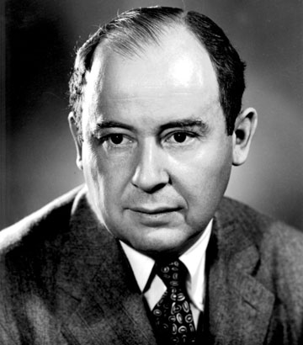
Computer Scientist of the week
John Von Neumann!
Innovations in Set theory, Geometry, Quantum Mechanics, Economics, Statistics
Founded Game Theory
Monte Carlo Method
EDVAC: data and program both in same address space
ENIAC: First computer to use a stored program
Von Neumann Architecture!
Manhattan Project
MAD: Mutually Assured Destruction
Merge Sort Algorithm

Slide 5
Test Topics
C++ core tenets
Class Design
ADT
Following checklist for class design
C++ Language
Coding Guidelines
Operator Overloading
pass by ref, const ref, value
References
Stack v. Heap allocations
Constructors
Object Lifetime
Templates
Vectors, Strings
Sorting: Bubble, Insertion
C++ program lifecycle: preprocessor, compiler, etc
Computer Scientist of the Week
Arrays (and pointers w/arrays)

Slide 6

C++ Fundamentals
ARRAYS (Pointers)

Slide 7
Array Examples
int AddItUp(int arr[], int length);
// Which of the next two definitions of MAX_HATS is better?
const int kMaxHats = 100;
#define kMaxHats 100
int main()
{
int x = 7;
int arr1[kMaxHats];
int arr2[3] = { 34, 7, 34 };
char c_arr1[7];
char c_arr2[10][5];
// Pointer Dereferencing
int* arr_ptr;
arr_ptr = &arr2[0];
cout << AddItUp(arr2, 3) << endl;
}
//int AddItUp(int* arr, int length)
int AddItUp(int arr[], int length)
{
int answer = 0;
for (int i = 0; i < length; i++)
{
//answer += arr[i];
answer += *arr;
arr = arr++;
cout << (int)arr << endl;
}
return answer;
}

Slide 8

Practice Problem
Gears be clicking…

Slide 9
In-Class Challenge
Write a function which has two arguments (Array of integers, Length of array) and returns the sum of the integers in the array
Write the same function with using [ or ] symbols

Slide 10

Recursion
Recursion

Slide 11
In order to understand recursion, it helps to understand recursion.
In order to understand recursion, it helps to understand recursion

Slide 12
In order to understand recursion, it helps to understand recursion.
In order to understand recursion, it helps to understand recursion

Slide 13
Recursive Solutions
Recursion breaks a problem into smaller identical problems
Some recursive solutions are inefficient, impractical
Complex problems can have simple recursive solutions

Slide 14
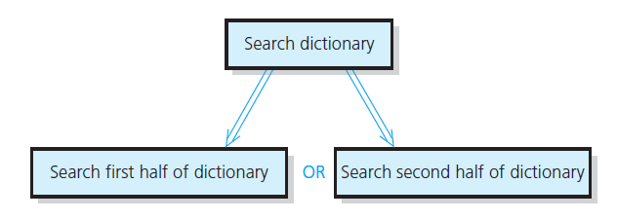
Dictionary Search

Slide 15
Recursive Solutions
A recursive solution calls itself
Each recursive call solves an identical, smaller problem
Test for base case enables recursive calls to stop
Eventually one of smaller calls will be base case

Slide 16
Compute n! recursively
Base Case: n=1
Recursive: n! = n * (n-1)!
CODE
int Factorial(int n)
{
if (n < 0)
{
return 0;
}
else if (n == 0)
{
return 1;
}
else
{
return Factorial(n - 1) * n;
}
}

Slide 17
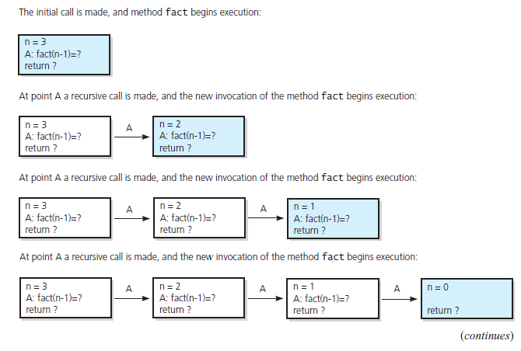
The Box Trace
FIGURE 2-5 Box trace of fact(3)

Slide 18
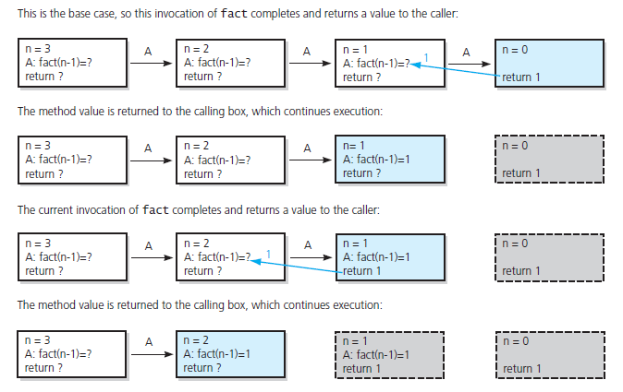
The Box Trace
FIGURE 2-5 Box trace of fact(3) … continued

Slide 19
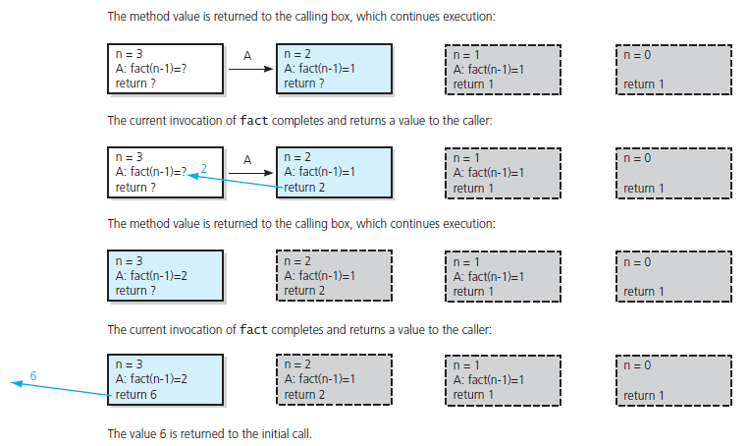
The Box Trace
FIGURE 2-5 Box trace of fact(3) … continued

Slide 20
The Stack (and recursion)
Stack
Location in process which stores temp variables, call stack frames,
One per thread of execution
Heap
Location in process which stores dynamically allocated memory (coming soon)
Recursion
Each call to a function creates stack frame
Frame holds temp variables and locals
Data in the BOX of the BOX trace
Deep Recursion can allocate lots of space on the stack

Slide 21

Program II
Questions

Slide 22

Class Bell.
10.16.2024

Slide 23
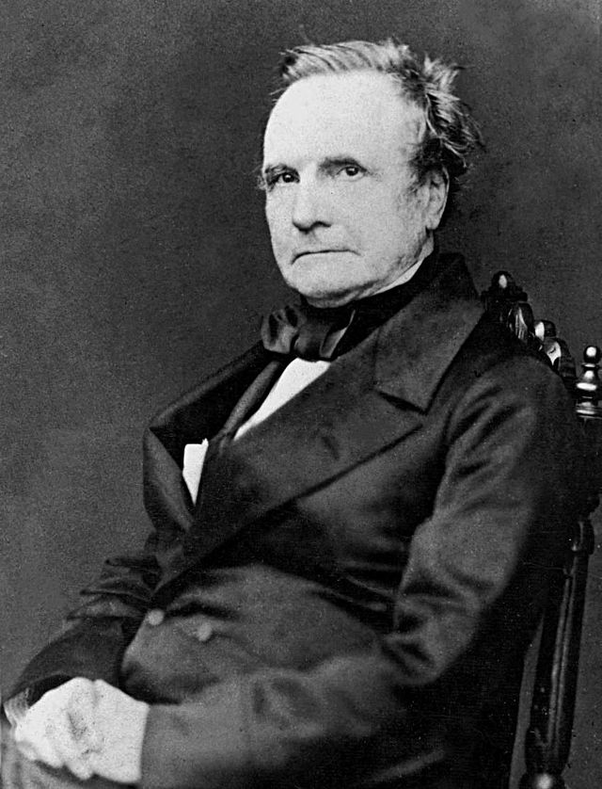
Computer Scientist of the week
Charles Babbage
Mathematician, Philosopher, Mechanical Engineer
Invented the first mechanical computer
Difference Engine: Computed values of polynomial functions
If completed at the time would have had 25000 parts
Finished in 1991
Analytical Engine
Punch card based
Branching and looping supported
Currently being built: 7Hz and 675 Bytes

Slide 24
Recursive example Quiz: Code in class.
The maximum number of leaves in a tree can be expressed by the following formula:
$$f\left(1, b\right)=1$$
$$f\left( h, b\right)=b∗f(h−1, b)$$
h = height of the tree
b = max number of branches per node.
Write a recursive function which computes$f\left( h, b\right)$.

Slide 25
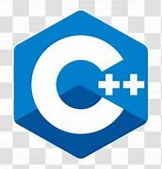
Fundamentals

Slide 26
Simple command line arg program
int main(int argc, char* argv[])
{
if (argc == 4)
{
for (int i = 1; i < argc; i++)
{
cout << argv[i] << endl;
}
}
}

Slide 27
Printing Numbers in Any Base
How to convert a decimal to a hexadecimal
Dividend Remainder
16) 123456790₍₁₀₎……..…
16) 7716049₍₁₀₎………6
16) 482253₍₁₀₎………1
16) 30140₍₁₀₎…13(D)
16) 1883₍₁₀₎…12(C)
16) 117₍₁₀₎…11(B)
16) 7₍₁₀₎……....5
16) 0₍₁₀₎……....7
1. Divide by a base(16)
2. Print each remainder from
the bottom: 75BCD16(16)

Slide 28
Quick review of base conversions
100101₂ = 32 + 4 + 1 = 37
more on board…

