Slide 1
CSS 342
Data Structures, Algorithms, and Discrete Mathematics I
Lecture 8.
CARRANO Carrano Ch 2

Slide 2
10.21.2024
Announcements
Agenda
Program 2: Questions
Recursion
Binary, Octal, Hex
Test One
Program 2: Due 10/25
Arguments from Command Line

Slide 3
Recursive example Quiz: Code in class.
The maximum number of leaves in a tree can be expressed by the following formula:
$$f\left(1, b\right)=1$$
$$f\left( h, b\right)=b∗f(h−1, b)$$
h = height of the tree
b = max number of branches per node.
Write a recursive function which computes$f\left( h, b\right)$.

Slide 4

Program II
Questions

Slide 5

Fundamentals

Slide 6
Simple command line arg program
int main(int argc, char* argv[])
{
if (argc == 4)
{
for (int i = 1; i < argc; i++)
{
cout << argv[i] << endl;
}
}
}

Slide 7

Black Box Testing Program II

Slide 8
Black Box Testing
Testing without knowledge of implementation of software
Tester does not know arch, functions; does not look at internal code
Tester just sends inputs and checks outputs
Techniques
Boundary Value Testing : testing with edge cases
Equivalence Partitioning Class : breaking input into similar groups/partitions of data
Decision Table : matrix of constraints to create inputs
State Transition : following transition of application with different inputs
Error Guessing : Using intuition to find breaking cases
Comparison Testing : comparing with similar product
https://www.youtube.com/watch?v=9sVcvyCaCU8

Slide 9

Creating a test script on windows
Use notepad to create a file that ends with .bat

Slide 10
Test Time…
10.21.2024

Slide 11

Recursion
Recursion

Slide 12
Printing Numbers in Any Base
How to convert a decimal to a hexadecimal
Dividend Remainder
16) 123456790₍₁₀₎……..…
16) 7716049₍₁₀₎………6
16) 482253₍₁₀₎………1
16) 30140₍₁₀₎…13(D)
16) 1883₍₁₀₎…12(C)
16) 117₍₁₀₎…11(B)
16) 7₍₁₀₎……....5
16) 0₍₁₀₎……....7
1. Divide by a base(16)
2. Print each remainder from
the bottom: 75BCD16(16)

Slide 13
Quick review of base conversions
100101₂ = 32 + 4 + 1 = 37
more on board…

Slide 14
In Class Exercise
Change 2452 to Binary, Octal and Hexadecimal

Slide 15
Printing Numbers in Any Base
How to convert a decimal to a hexadecimal
Dividend Remainder
16) 123456790₍₁₀₎……..…
16) 7716049₍₁₀₎………6
16) 482253₍₁₀₎………1
16) 30140₍₁₀₎…13(D)
16) 1883₍₁₀₎…12(C)
16) 117₍₁₀₎…11(B)
16) 7₍₁₀₎……....5
16) 0₍₁₀₎……....7
1. Divide by a base(16)
2. Print each reminder from
the bottom: 75BCD16(16)

Slide 16
Printing numbers in any base (recursively)
Base Case:
if (num < base) { print out num }
Recursive:
Pre-pend to the answer ( num % base )
Recursively call with num/base

Slide 17
Printing numbers in any base (recursively)
bool PrintBase(int num, int base, string &ans)
{
string static DIGIT_ARRAY = "0123456789ABCDEF";
if ((num < 0) || (base <= 0) || (base > 16))
{
return false;
}
if (num < base)
{
ans = DIGIT_ARRAY[num] + ans;
return true;
}
else
{
ans = DIGIT_ARRAY[num % base] + ans;
PrintBase(num / base, base, ans);
}
}

Slide 18
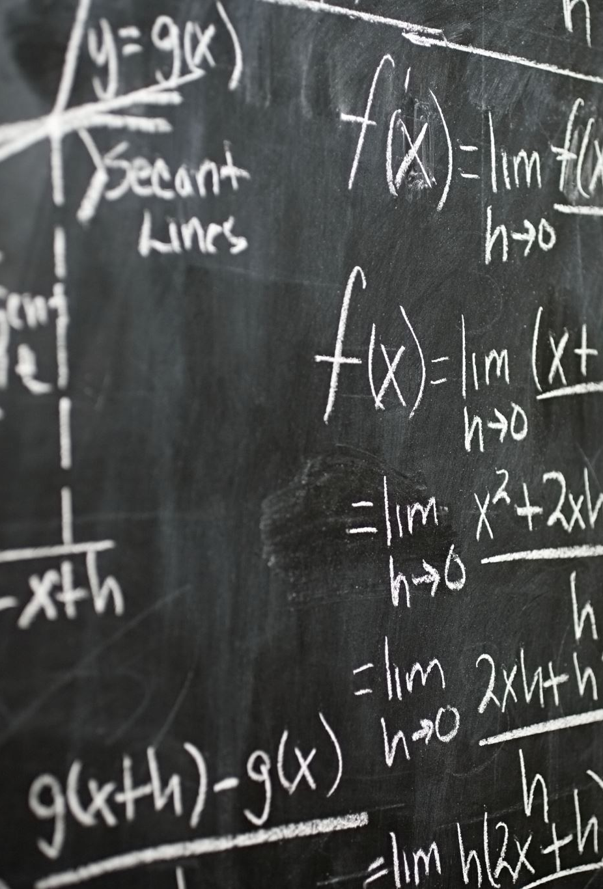
Base Conversions:: binary, octal, hex
100101₂ = 32 + 4 + 1 = 37
Full work on board and at desk
video on decimal to binary: https://www.youtube.com/watch?v=gGiEu7QTi68
video on hexadecimal: https://youtu.be/t_kA5KQxByc

