Slide 1
CSS 342
Data Structures, Algorithms, and Discrete Mathematics I
Lecture 9.
CARRANO Ch 5.3-5.4

Slide 2
10.23.24
Announcements
Agenda
Binary, Octal, Hex
Dynamic Memory
Program 2: Questions
Recursion
Program 2: Due 10/25
I will publish Program 3 over weekend
In-Class Warmup

Slide 3

Program II
Questions

Slide 4
Warm-Up
Convert 1967 to binary

Slide 5

Creating Test Scripts
Windows: Use notepad to create a file that ends with .bat
Use chmod +x to make a shell executable

Slide 6

Recursion
Recursion

Slide 7
Printing Numbers in Any Base
How to convert a decimal to a hexadecimal
Dividend Remainder
16) 123456790₍₁₀₎……..…
16) 7716049₍₁₀₎………6
16) 482253₍₁₀₎………1
16) 30140₍₁₀₎…13(D)
16) 1883₍₁₀₎…12(C)
16) 117₍₁₀₎…11(B)
16) 7₍₁₀₎……....5
16) 0₍₁₀₎……....7
1. Divide by a base(16)
2. Print each remainder from
the bottom: 75BCD16(16)

Slide 8
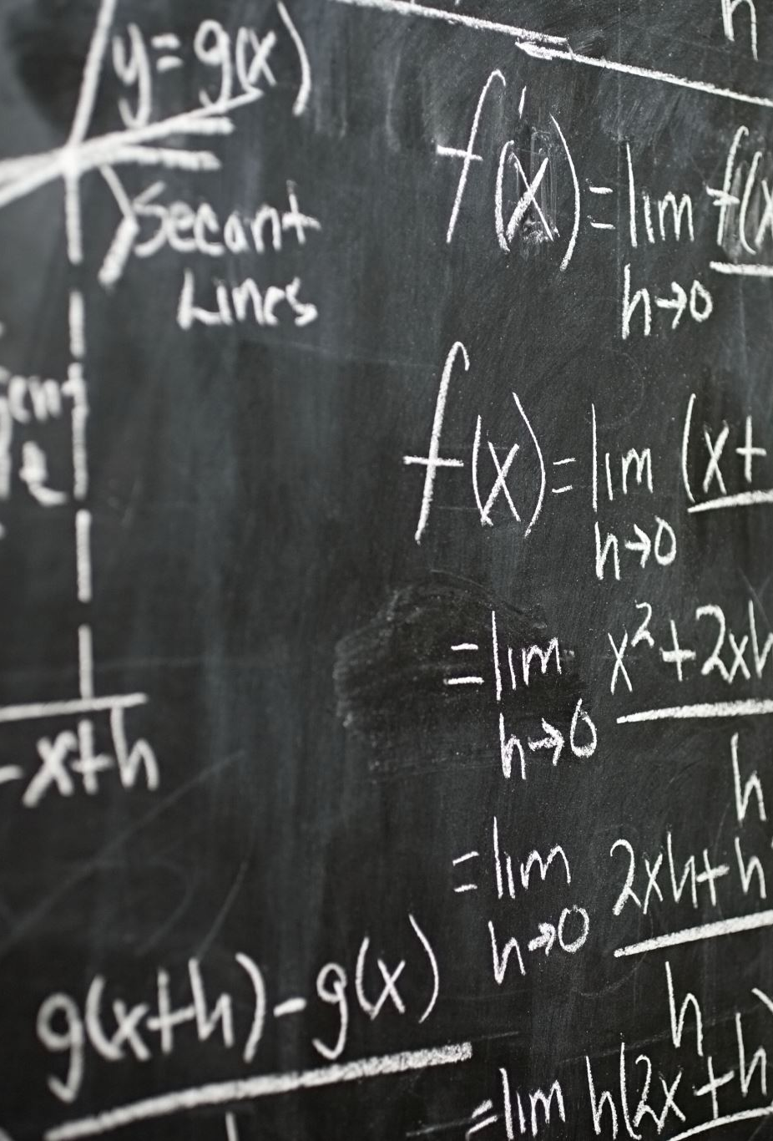
Base Conversions:: binary, octal, hex
100101₂ = 32 + 4 + 1 = 37
Full work on board and at desk
video on decimal to binary: https://www.youtube.com/watch?v=gGiEu7QTi68
video on hexadecimal: https://youtu.be/t_kA5KQxByc

Slide 9
Printing numbers in any base (recursively)
Base Case:
if (num < base) { print out num }
Recursive:
Pre-pend to the answer ( num % base )
Recursively call with num/base

Slide 10
Printing numbers in any base (recursively)
bool PrintBase(int num, int base, string &ans)
{
string static DIGIT_ARRAY = "0123456789ABCDEF";
if ((num < 0) || (base <= 0) || (base > 16))
{
return false;
}
if (num < base)
{
ans = DIGIT_ARRAY[num] + ans;
return true;
}
else
{
ans = DIGIT_ARRAY[num % base] + ans;
PrintBase(num / base, base, ans);
}
}

Slide 11
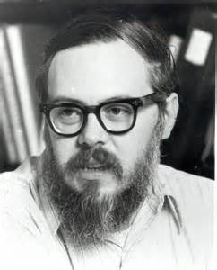
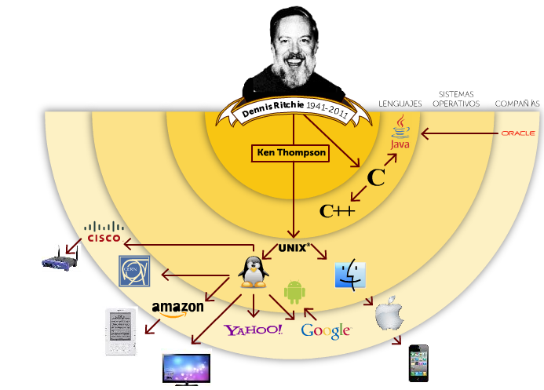
Computer Scientist of the week
Dennis Ritchie
Inventor of Unix with Ken Thompson
Kernel, Shell, Utilities
Goals: simple, communal
Inventor of C
Turing award in 1983
https://www.youtube.com/watch?v=JoVQTPbD6UY

Slide 12
Typical types of recursion
Returns Value (n!, …)
Performs an action (adds to a string, …
Divides in half recursively (binary search, …
Tail Recursion
Backtracking (will introduce in future slides)

Slide 13
Binary Search
An entire sorted list
First half
Second half
First half
Second half
First half
Find a value in an array.

Slide 14
Binary Search: Class Challenge!
Base Case:
low or high index finds number
Recursive:
Determine midpoint (high+low)/2
Search either lower or upper array

Slide 15
Binary Search
int BinarySearch(int value, int arr[], int index1, int index2)
{
if (value == arr[index1]) return index1;
else if (value == arr[index2]) return index2;
else if (index2 <= index1 + 1) return -1;
else
{
int midpoint = (index1 + index2) / 2;
if (arr[midpoint] > value)
return BinarySearch(value, arr, index1, midpoint);
else
return BinarySearch(value, arr, midpoint, index2);
}
}

Slide 16
Backtracking as a problem solving technique
While (solution not complete)
{
if (in good state) “move forward guessing at solution”
else “backtrack to last good state”
}
Often used in combination with Recursion

Slide 17
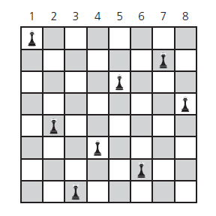
Backtrack: 8 queens problem
Place 8 queens on a 8 * 8 chessboard so that no queen can attack any other queen.

Slide 18
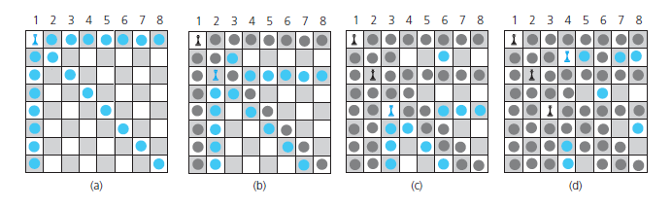
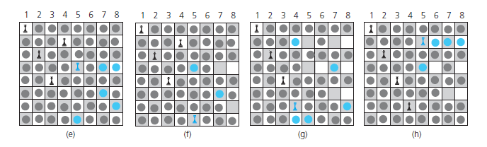
Place one queen in one column at a time.
Backtrack when problems occur.
*from Carranno

Slide 19
8 Queens: Pseudo-code
bool addQueen(bool t[SIZE][SIZE], int col)
{
if (col >= SIZE)
{
return true;
}
for (int row = 0; row < SIZE; row++)
{
if (safeLocation(t, row, col))
{
t[row][col] = true; // place a new queen in the row
if (addQueen(t, col + 1))
{
return true; // all the following cols were filled
}
else
{
t[row][col] = false; // A wrong position. Try the next row
}
}
}
return false; // all rows examined, but no candidates
}

Slide 20
Recursive Applications
Discrete Mathematics (Combinatorics, Puzzles, Coding Theory)
Tower of Hanoi and Gray Code
Divide and Conquer
Mergesort, Convex Hall, and Fast Fourier Transform
Backtrack
8 Queens, Maze and Classic Chess Program
Fractal Figures
Koch, Sierpinski Allowhead, Gosper, Hilbert, and Dragon curves

Slide 21
Dynamic Memory

Slide 22
Dynamic Allocation
Pointer declaration Bird *p, *q;
Dynamic allocation p = new Bird(); q = new Bird();
p->set_weight(3);
Deallocation delete p;
p = NULL;
Memory leak q = new Bird();
1
?
2
?
3
NULL
4
NULL
p
p
p
p
Leak!
?
?
?
?
q
q
q
q
?

Slide 23

Class Bell.
10.23.2024

Slide 24

Bonus Material
ONE MORE Recursion Problem

Slide 25
Choosing k out of n.
A child can have one sweet a day while on vacation. The vacation lasts k days and there are n total different types of sweets. How many different combination of sweets can the child enjoy assuming order is not important and the child does not repeat sweets.
(k)
n
Let’s use recursion to determine the answer.

Slide 26
Choosing k out of n.
Hint: think of an array of n items; item i is either in chosen (k) or not.
Recursion: f(n, k) = f(n-1, k-1) + f(n-1, k)
Possible Base cases:
f(n,0) = 1
f(n, 1) = n
f(n,n) = 1

Slide 27
K out of N (Recursive)
# Recursive solution to choosing k out of n no dups order is not important
def k_out_of_n(k, n):
if k < 0 or n < 1 or k > n:
return None
if k == 0:
return 1
if k == n:
return 1
return k_out_of_n(k - 1, n - 1) + k_out_of_n(k, n - 1)

