Slide 1
Theory, Practice & Methodology
of Relational Database
Design and Programming
Copyright © Ellis Cohen 2002-2009
Introduction to
Designing & Programming
Database Applications
These slides are licensed under a Creative Commons Attribution-NonCommercial-ShareAlike 2.5 License.
For more information on how you may use them, please see http://www.openlineconsult.com/db

Slide 2
Overview of Lecture
User Operations in Database Applications
Job Board Database Design
Identifying User Operations
Queries Following Actions
Operation Parameters
User Operations and Conceptual ER Models
Database Application Programming & Design

Slide 3
User Operations in Database Application

Slide 4
Client/Server Architecture
SQL Statements are passed through API & protocol
User
DB
Application
API
Database
Server
DB
Application
Client
DB Client
Implements DB Operations
Client-Side
Server-Side

Slide 5
Web-Based 3-Tier Architecture
Handles overall DB mgt, formatting &
page navigation
DB
Application
API
Database
Server
User
Web
Browser
Web or
Application
Server
Implements User Operations
Implements DB Operations
Presentation Tier
Data Tier
Middle Tier
(DB) Client-Side
(DB) Server-Side

Slide 6
Invoking User Operations
Typically, in a web browser
  A user makes some choices
  Fills in data entry fields
  Then CLICKS a BUTTON
The button click
  submits a request to the web server, which, then
  invokes a user operation in the middle tier
  provides the choices the user made, and the data the user filled in as input parameters to the user operation

Slide 7
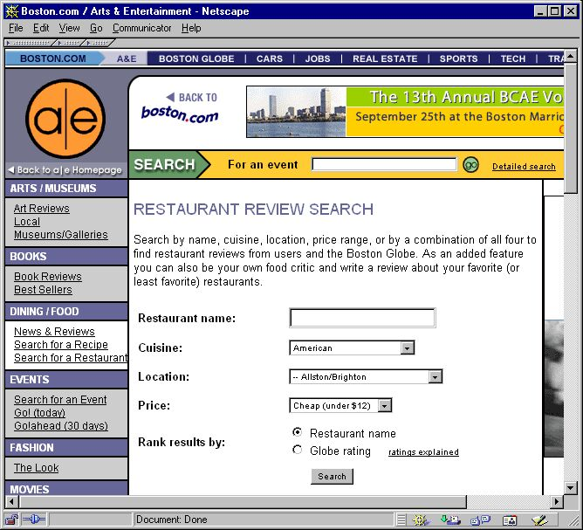
User Query Operation
Invokes operation
Provides parameters

Slide 8
User Operation Parameters
User operations have parameters
ShowMatchingRestaurants(
:cuisine, :loc, :price, :orderBy )
The user operation parameters
(named starting with a :colon) are provided from values filled in or chosen by the user

Slide 9
ShowMatchingRestaurants Operation
Name of the
user operation
  ShowMatchingRestaurants
    :cuisine = American
    :loc = Allston/Brighton
    :price = 12.00
    :orderBy = restName
Parameter values passed to the operation

Slide 10
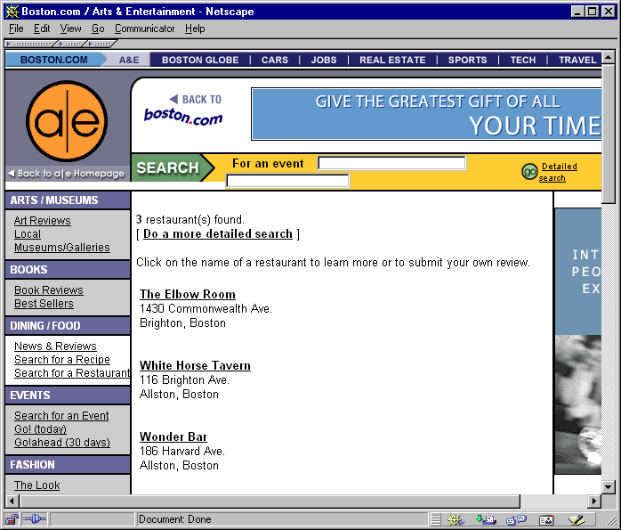
User Query Results

Slide 11
User Query Operation
Information Flow
DB
Query
Database
Server
DB
Application
API
Query
Results
User Query
Web
Browser
Web
Server
Results Page

Slide 12
Restaurants Table
To satisfy the previous query, these are the attributes of the Restaurants Table, which need to be stored in the database
Restaurants
  restName – restaurant name
  restAddr – its address
  cuisine – primary type of cuisine
  loc – neighborhood it is in
  price – typical price for a meal
  rating – restaurant rating (0-5)
Using the choices the user made, the middle-tier code generates a SQL command to produce the results

Slide 13
User & DB Query Operations
User Query Operation:
  ShowMatchingRestaurants
    :cuisine = American'
    :loc = Allston/Brighton
    :price = 12.00
    :orderBy = restName
DB Query Operation:
  SELECT restName, restAddr
  FROM Restaurants
  WHERE cuisine = 'American'
  AND loc = 'Allston/Brighton'
  AND price < 12.00
  ORDER BY restName

Slide 14
User Operations
Just as it is useful to categorize
a DB Operation as a
  DB Query
  DB Action
It is also useful to categorize
a User Operation as a
  User Query
    just displays information
  User Action
    modifies the application state and/or
    the data in the database

Slide 15
User/Database Operations
User Query
DB
Query
User enters data, makes choices, clicks a button
Note: A few User Actions might only do DB Queries or not access the DB at all
User Action
DB
Action
User Operations
DB Operations
DB
Application
API
Database
Server
Web
Browser
Web or
Application
Server
Presentation Tier
Middle Tier
Data Tier

Slide 16
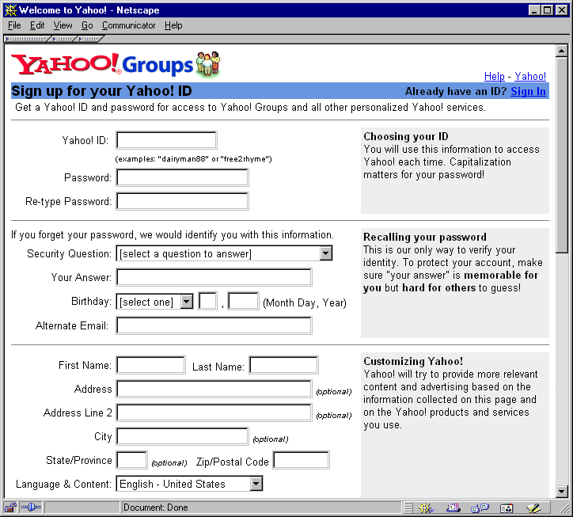
User Action: Register

Slide 17
User Action Information Flow
DB
Action
Database
Server
DB
Application
API
Ack
User Action
Web
Browser
Web
Server
Ack
Page
Instead of just showing an Ack Page, the middle tier often navigates automatically to some other useful page

Slide 18
Job Board
Database Design

Slide 19
Job Board Application Requirements
An Online Job Board Application allows job candidates to provide
  personal information
  information about the job they are seeking, including the industry and title they are looking for, and the location they would prefer to work (let's assume just one location to keep things simple)
  a job history, each entry of which describes a job they had, including the company they worked for, and the dates they worked for them.
Company representatives post information about their company, (including the single industry they are in) and can post open jobs (and remove them when they are filled).
  Each open job posting includes the location and title of the job, as well as other information.

Slide 20
Job Board User Roles
Different users of the system play different roles. The two roles we've discussed are
  Job Candidate
  Company Representative
There are other roles as well (which we won't discuss now)
  Administrator (too complicated)
  UnknownUser
  (someone who is not logged in, but perhaps can still get some job board information)

Slide 21
Job Board Application:
Detailed ER Diagram
job history includes
Candidate
JobEntry
candid
name
descr
industryWanted
titleWanted
locationWanted
entryid
jobno
title
location
startDate
endDate
details
occurred
at
JobPosting
open at
Company
postid
title
location
descr
postdate
compid
compname
industry
descr
status

Slide 22
Possible Entity Classes
Candidate
  someone looking for a job
Company
  a company that people work for
Job Posting
  description of an open job
Job Entry
  a description of a single job that a candidate had
Industry
  description of an industry
Company Representative
Job History
  a candidate's job history
We definitely need these classes
Should we add these classes or not?
Why?

Slide 23
Adding Industry
job history includes
Candidate
JobEntry
candid
name
descr
titleWanted
locationWanted
entryid
jobno
title
location
startDate
endDate
details
wants
job
in
occurred
at
Industry
has
Company
industrynam
compid
compname
descr
status
JobPosting
open at
postid
title
location
descr
postdate

Slide 24
Entity Classes With
Only Primary Key Attributes
If we did not have an Industry class, both Company and Candidate would have industry attributes
  the industry the company is in
  the industry the candidate wants to work in
Should we instead make Industry an entity class?
YES: Industry meets the criteria of substance & extensibility & possibly association
NO: Industry has no other attributes now, and in the context of this application, it is not clear that Industry would be extended. Current engineering practice puts less emphasis on designing for extensibility. So keep industry as an attribute for now, and refactor the design later if needed.
IMPORTANT NOTE: We will revisit this issue when we discuss the use of Referential Integrity and Check Constraints in the Relational Model

Slide 25
Roles vs Entity Classes
Company Representative represents a role that a user can play.
But does that mean it should automatically be used as an entity class?
Perhaps, but not necessarily:
  First of all, there are no attributes we need to keep about Company representatives, except their login ID.
  All representatives of the same company could share a single company login ID. Nothing in our requirements suggests we need to distinguish between the various representatives of a company.
Company
has
Company Representative

Slide 26
Entity Classes Without Attributes in 1-1 Relationships
Candidate
has
Job History
contains
Job Entry
candno
The relationship between Candidate & Job History is a
1-1 relationship, with two interesting characteristics:
  Every Job History has an associated Candidate
  While a Job History has a collection of Job Entries, it has no attributes; it doesn't really need to have its own primary key, since whatever uniquely identifies a job candidate (candno) also uniquely identifies that candidate's job history.
So there really is no reason to keep Job History. Replace the model above by
Candidate
has
Job Entry
candno

Slide 27
Identifying
User Operations
(a simplified approach
to Use Cases)

Slide 28
Job Board Requirements: Job Candidates
An Online Job Board Application allows job candidates to provide
  personal information
  information about the job they are seeking, including the industry and title they are looking for, and the location where they would prefer to work (let's assume just one to keep things simple)
  a job history, each entry of which describes a job they had, including the company they worked for, and the dates they worked for them.

Slide 29
Login Page
User operations result from user interactions
login id
password
LOGIN
Not Yet Registered?
Register
Corresponds to the
Login user action

Slide 30
User Operation Parameters
User operations have parameters
Login( :userid, :pwd )
-- this user action logs in the user and -- also remembers the user's userid
The parameters are provided from values filled in or chosen by the user

Slide 31
Home Page
Welcome Joe Candidate
View/Edit Personal Info
View/Edit Job Desired
View/Edit Job History
Corresponds to the
GetJobHistory user query

Slide 32
My Jobs Page
HOME
Delete
Edit
1941-1947 GE
Delete
Edit
1948-1984 Smith & Barney
Delete
Edit
1984-2001 Smith & Wesson
Delete
Edit
2001-2006 Wesson Oil
New Job Entry
If Edit is pressed, what's the operation?
Is it a Query or an Action?

Slide 33
Job Entry Page
Add
Company
Company
Smith & Barney
Location
New York, NY
Start
1948
End
1984
Description
Started as Jr Accountant. Eventually became Chief Financial Officer.
Update
What operation corresponds to the Update button?

Slide 34
Identifying Queries & Actions
We have already identified
Queries
GetJobHistory
GetJobEntry
Actions
Login
UpdateJobEntry
What additional user query and action operations are needed just to support viewing and modifying candidate information?

Slide 35
Candidate User Operations
Queries
GetPersonalInfo
GetJobDesired
GetJobHistory
GetJobEntry
Actions
Login
Logout
RegisterCandidate
RemoveCandidate
UpdatePersonalInfo
UpdateJobDesired
AddJobEntry
UpdateJobEntry
DeleteJobEntry
AddCompany
Note: I use Get in the operation name to imply that the information will be editable by the user
Are there other queries which would be
useful for job candidates?

Slide 36
Additional Candidate User Queries
Queries (continued)
ShowCompaniesWithPostings
ShowCompanyInfo
ShowPosting
ShowMatchingPostings
ShowPostingsThatMatchMyDesires
etc.
Note: I use Show in the operation name to imply that the information will NOT be editable by the user

Slide 37
Job Board Requirements:
Company Representatives
Company representatives post information about their company, (including the industry they are in) and can post open jobs (and remove them when they are filled).
  Each open job posting includes the location and title of the job, as well as other information.
What user query and action operations are needed just to support viewing and modifying company representative information?

Slide 38
Representative User Operations
Queries
GetCompanyInfo
GetPostings
GetJobPosting
Actions
Login
Logout
RegisterCompany
RemoveCompany
UpdateCompanyInfo
AddJobPosting
UpdateJobPosting
DeleteJobPosting
Are there other actions or (especially) queries that are not required, but are likely to be desired by company reps?

Slide 39
Additional Representative User Queries
Queries (continued)
Show CandidatesMatchingPosting
ShowCandidateInfo
ShowJobEntry
ShowCompaniesWithPostings
ShowCompanyInfo
ShowPosting
ShowMatchingPostings
etc.
Might as well allow a company representative to show things a job candidate can. After all, they can always register as a job candidate and get that information anyway!

Slide 40
Queries
following
Actions

Slide 41
Interactive User Action Execution
(Get user input from browser and provide as parameters for user action)
Invoke DB actions to update the DB as necessary
Either
Choose a completed acknowledgement page or some other generic useful page to display to the user, or
Automatically choose a User Query to be executed which will determine the contents of the page to be shown to the user

Slide 42
Action Followup Queries
Actions
Login
Logout
RegisterCandidate
RemoveCandidate
UpdatePersonal Info
UpdateJobDesired
AddJobEntry
UpdateJobEntry
DeleteJobEntry
AddCompany
For each action, what would you choose as the followup query?

Slide 43
User Action Followups
Login: Home
Logout: Login
RegisterCandidate: Home
RemoveCandidate: Login
UpdatePersonalInfo: Home
UpdateJobDesired: Home
AddJobEntry: GetJobHistory
UpdateJobEntry: GetJobHistory
DeleteJobEntry: GetJobHistory
AddCompany: GetJobEntry

Slide 44
Operation
Parameters

Slide 45
Hidden Parameters
Not all parameters to an operation are chosen or entered by the user
Some values are hidden on the page (placed there by the application when the page is constructed)
Hidden parameters can be passed as values to the user

Slide 46
Buttons & Parameters
HOME
Delete
Edit
1941-1947 GE
Delete
Edit
1948-1984 Smith & Barney
Delete
Edit
1984-2001 Smith & Wesson
Delete
Edit
2001-2006 Wesson Oil
New Job Entry
What happen when Delete is pressed?

Slide 47
Hidden Values
Clicking on any Delete button invokes the User Action Operation
DeleteJobEntry( :jobno )
Clicking the 2nd Delete button calls
DeleteJobEntry( 2 ) indicating that the user's 2nd job entry should be deleted
When GetJobEntryHistory passed the HTML for My Job Page to the user, it associated 2 (in the HTML) with the 2nd Delete button.
The 2 is hidden from the user, but when the button is pressed, the HTML code uses the associated hidden value as the parameters.

Slide 48
Identifying the Current User
The middle tier application can retain information about each user it is interacting with.
When a user logs in, the user's login id is remembered by the middle tier application, and is available to the implementation of every user operation!
Because a user's Job Entry can only be updated by that user, the implementation of DeleteJobEntry can simply get the remembered id of the current user and use that to determine whose job entry to delete

Slide 49
My Jobs Page
HOME
Delete
Edit
1941-1947 GE
Delete
Edit
1948-1984 Smith & Barney
Delete
Edit
1984-2001 Smith & Wesson
Delete
Edit
2001-2006 Wesson Oil
New Job Entry
The user clicks the Edit button
next to the 2nd entry

Slide 50
Job Entry Page
Add
Company
Company
Smith & Barney
Location
New York, NY
Start
1948
End
1984
Description
Started as Jr Accountant. Eventually became Chief Financial Officer.
Update
What are the parameters passed to UpdateJobEnty, and what are their values?

Slide 51
UpdateJobEntry Parameters
UpdateJobEntry( :jobno, :compid,
:loc, :startdate, :enddate, :descr )
  :jobno = 2
  :compid = 61
  (the company id for Smith & Barney)
  :loc = New York, NY
  :startdate = 1948
  :enddate = 1984
  :descr = Started as Jr Accountant. Eventually became Chief Financial Officer.
The code on the HTML page directed it where to get the parameters when UPDATE was pressed, including getting 2 from a value hidden on the page.
How was 61 passed for Smith & Barney?

Slide 52
Constructing GetJobEntry
The code of GetJobEntry builds the HTML for the Job Entry page
In addition to showing the company name, loc, startdate, enddate & descr, it also
  hides the # of the job entry (e.g. 2) on the page
  builds a pulldown list of
    every known company name (shown)
    their corresponding company id (which is hidden – e.g. 61 for 'Smith & Barney')

Slide 53
Some Candidate User Operations
GetJobHistory
RegisterCandidate
RemoveCandidate
AddCompany
What are the parameters for each of these?

Slide 54
Operations with Parameters
GetJobHistory – no parameters, if only a candidate get their own job history, so assumes the current user
GetJobHistory( :userid ) – if can be used either by a Job Candidate or a Company Representative (to get the job history of an arbitrary employee)
RegisterCandidate( :userid, :pwd, :name, :descr )
RemoveCandidate – no parameters, only a user can remove themselves, so assumes the current user
AddCompany( :compname, :industry, :descr ) – don't provide the id, the implementation will automatically create a new id

Slide 55
Obtaining Parameters
User Operations do NOT necessarily get all their inputs from the parameters passed to them when they are invoked
  In a web-based, popup windows,
  (also known as modal dialogue windows) can request additional info
  In a text-based system, the user can be prompted for additional info
  Web Services can make requests of their clients to obtain additional info
To simplify examples, assignments & testing in this course, we will assume/require that operations get ALL of their inputs from the parameters passed to them when they are initially invoked!

Slide 56
User Operations and
Conceptual ER Models

Slide 57
Conceptual ER Models & User Operations
Conceptual ER Models
  Represent the data that needs to be persisted in the database
User Operations
  Use the data that is persisted (represented both by entity classes and relationships)
  Queries access the data
  Actions additionally update some of the data

Slide 58
Relationships & Instances
works for
Employee
Dept
Relationships correspond to links between instances
They are queried to find which instances are linked together
They are modified to add, delete or update a link
7499 | ALLEN | 1600 | 300
7654 | MARTIN | 1250 | 1400
10 | SALES
7844 | TURNER | 1500 | 0
7698 | BLAKE | 2850
30 | ACCOUNTING
7986 | STERN | 1500
Entity classes & relationships reflect data which is persisted in the database to answer queries & perform actions.

Slide 59
Using the Conceptual Model
Entity classes and relationships reflect information that must be persistently retained in the database
To check if the conceptual model is complete
  Consider various queries and actions
  See if any other entity classes and relationships are needed to answer
  the query or perform the action
  Don't include entity classes or relationships unless they're needed to implement the required queries and actions

Slide 60
Job Board Application:
Easy Crow Magnum Diagram
job history includes
Candidate
JobEntry
candid
name
descr
industryWanted
titleWanted
locationWanted
entryid
jobno
title
location
startDate
endDate
details
occurred
at
JobPosting
open at
Company
postid
title
location
descr
postdate
compid
compname
industry
descr
status

Slide 61
Queries Access
Relationships & Entities
Suppose a logged in company rep invokes
the User Query: Get Postings (i.e. show me the postings for our company, e.g. company 3042)
Which relationships and entity classes in the DB
must be used to answer the query?
JobPosting
NO access to Company needed!
postid title location desc
Company
447 | Clerk | NY | …
compid compname …
448 | VP Sales | Boston | …
3042 | OM Mfg | …
449 | Artist | SF | …
1
2
To get displayable info on each posting
To find out which job posting are posted by our company

Slide 62
Queries Access Data Model
Suppose a logged in company rep invokes
the User Query: Get Postings
Which relationships and entity classes in the data model need to be accessed?
job history includes
Candidate
JobEntry
occurred
at
1
2
JobPosting
open at
Company
postid
title
location
descr
postdate
To find out which job posting are posted by our company
compid
compname
industry
descr
status
To get displayable info on each posting

Slide 63
Data Model Access Exercise
Suppose a candidate logs in and invokes
the User Action: Show Companies With Postings
What information (relationships & entity classes) represented by the DB model needs to be accessed?
job history includes
Candidate
JobEntry
candid
name
descr
industryWanted
titleWanted
locationWanted
entryid
jobno
title
location
startDate
endDate
details
occurred
at
JobPosting
open at
Company
postid
title
location
descr
postdate
compid
compname
industry
descr
status

Slide 64
Data Model Access Answer
Suppose a candidate logs in and invokes
the User Action: Show Companies With Postings
job history includes
Candidate
JobEntry
To find out which companies have postings
occurred
at
1
JobPosting
open at
Company
2
But we don't need to know anything specifically about the job postings themselves!
postid
title
location
descr
postdate
compid
compname
industry
descr
status
To get displayable info on each company

Slide 65
Actions Access/Update Data Model
Suppose a candidate logs in and invokes
the User Action: Add Job Entry
What information represented by the DB model needs to be accessed/updated?
To associate that job entry with the candidate
job history includes
2
Candidate
JobEntry
1
To add a new job entry
To associate the job entry with the company worked at for that job entry
4
occurred
at
JobPosting
open at
Company
To check whether the company is in the DB
3

Slide 66
Complex Data Model Exercise
Suppose a candidate logs in and invokes
the User Action: Show Postings that Match My Desires
What information represented by the DB model needs to be accessed?
job history includes
Candidate
JobEntry
occurred
at
JobPosting
open at
Company

Slide 67
Queries Can Access Unrelated Data
Suppose a candidate logs in and invokes
the User Query: Show Postings that Match My Desires
job history includes
Candidate
JobEntry
1
To determine the desires of that candidate
occurred
at
4
JobPosting
open at
Company
2
3
To find which of those postings match the desired location and job title
To find the companies that match the desired industry & get company name
To find job postings at those companies

Slide 68
Database Application
Programming
& Design

Slide 69
Embedded SQL
Integration of SQL with a general purpose programming language – e.g. PL/SQL
Allows complex combinations of database operations to be specified
BEGIN
INSERT INTO ExEmps
SELECT * FROM Emps
WHERE termdate IS NOT NULL;
DELETE FROM Emps
WHERE termdate IS NOT NULL;
END;
Also provides support for conditionals, iteration, exceptions, procedures, functions, packages, triggers, etc.
This is a good example of why transactions are used. We don't want a crash to allow the insert to be done without the delete.
What does this do?

Slide 70
Client-side Execution Model
PL with embedded SQL
Compile
Executable
API
Library
(Oracle)
Database
Server
or an interpreter
could be used
DB Client-side
DB Server-side

Slide 71
Embedded SQL Procedures
Suppose that when an employee is terminated, that employee's termdate attribute is set to the termination date.
Once a week, all the terminated employees are moved from the Emps table to the ExEmps table.
It would be useful to define a procedure that implements the move.

Slide 72
Defining Stored DB Operations with Embedded SQL
DB operations can be defined and stored at the database server ➔ can be much more efficient
Stored DB Operations:
  Stored Procedures
  Stored Functions
PROCEDURE MoveTerminatedEmployees IS
BEGIN
INSERT INTO ExEmps
SELECT * FROM Emps
WHERE termdate IS NOT NULL;
DELETE FROM Emps
WHERE termdate IS NOT NULL;
END;

Slide 73
Database Server Architecture
API/Protocol includes request to execute a Stored DB Operation
Embedded SQL
Engine
Executable
API
Library
Database
Server
Core SQL
Database
Engine
Implements DB operations
Implements core DB operations
(i.e. SQL commands)
DB Client-side
DB Server-side

Slide 74
Database Operations:
Queries & Action
 | Core DB Operations (i.e. SQL) | Stored DB Operations
Queries | SQL Queries | Stored DB Functions
Actions | SQL Insert/Update/Delete SQL DDL (e.g. create table) SQL DCL (e.g. grant access) | Stored DB Procedures

Slide 75
Web-Based 3-Tier Architecture
Handles overall DB mgt, formatting &
page navigation
Handles complex queries, updates & integrity maintenance
Stored
DB Operations
DB
Application
API
Database
Server
Web
Browser
Web or
Application
Server
Implements User Operations
Implements DB Operations
Presentation Tier
Middle Tier
Data Tier

Slide 76
Database Application Design
What kinds of user operations are required and by whom?
What functionality should be placed in the middle tier vs. the data tier?
How should pre-, post- and output-conditions be enforced?
Core and Stored
DB Operations
User Operations
User enters data, makes choices, clicks a button
User Query
DB
Query
User Action
DB Action
Presentation Tier
Middle Tier
Data Tier

