Slide 1
Hw3
Require >
Bundled in
Added in
Customer
PatchRequestItem
Patch
Branch
Post ^
Fixed by
Engineer

Slide 2
Unknown User
User
Known User
engineer
developer

Slide 4
Hw4
Require >
Bundled in
Added in
Customer
PatchRequestItem
Patch
Branch
cid
cname
revenue
prid
commit_date
estimate_date
status
priority
description
bugid
pno
patchname
release_date
branchid
bname
frs
eol
Post ^
Fixed by
Engineer
eid
ename
role

Slide 5
Unknown User
Support
engineer
User
engineer
developer
Develop
manager

Slide 6
Entity-Relationship Diagram HW7
Requires
Bundled in
Added in
Customer
PatchRequest
Patch
Branch
cid
cname
revenue
prid
priority
bugid
tdate
edate
pid
pname
targetdate
releasedate
bid
bname
frs
eoe
eol
Post ^
Fixed by
Engineer
engid
ename

Slide 7
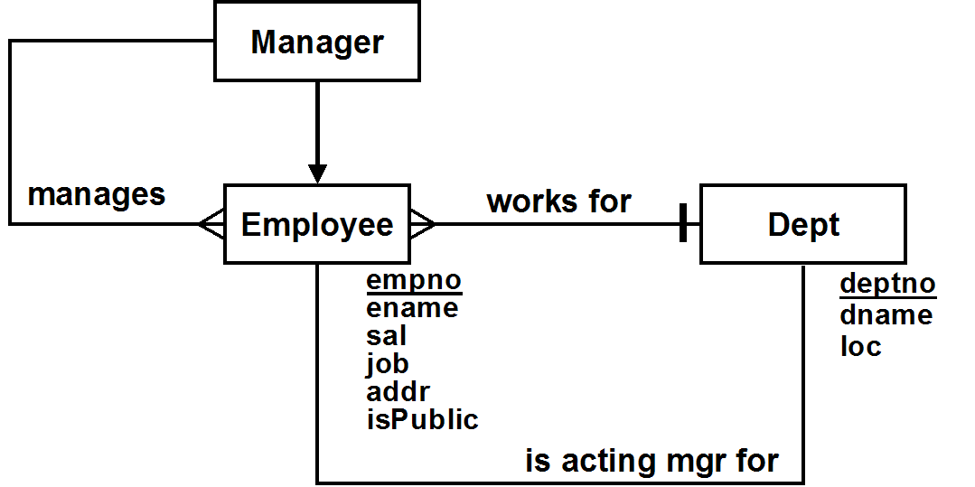

Slide 8
Relational Schema Diagram hw7
Customers
PatchRequests
cid
cname
revenue
prid
priority
bugid
tdate
edate
cid
pengid
dengid
pid
Ptaches
Branches
bid
pid
pname
tdate
rdate
bid
bname
frs
eoe
eol
Engineers
engid
ename

Slide 9
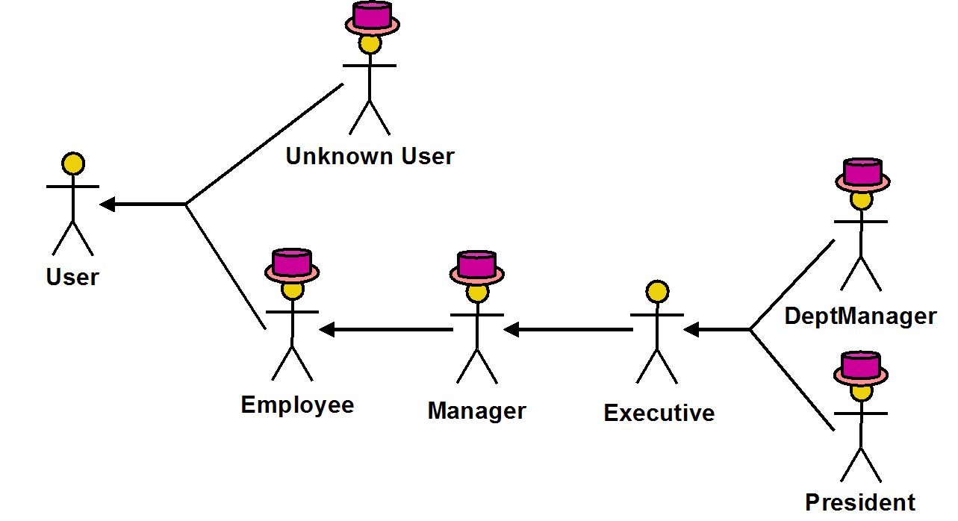

Slide 10
Hw7
Unknown User
Support Engineer
User
Engineer
Developer
DevManager

Slide 11
Hw8
Depts
Toys
Employees
empno
ename
sal
job
deptno
deptno
dname
toyno
descr
empno
DeptMgrs
empno
bonus !
Salesmen
Clients
Teams
empno
comm !
teamno
clno
clname
empno
teamno
tname

Slide 12
Depts
Toys
Employees
empno
ename
sal
job
deptno
bonus
comm
teamno
deptno
dname
toyno
descr
empno
Clients
clno
clname
empno
Teams
teamno
tname

Slide 13
DeptMgrs
Depts
Toys
empno
ename
sal
bonus !
deptno
deptno
dname
toyno
descr
mgrno
stafno
smno
Staffs
empno
ename
sal
job
deptno
Clients
Salesmen
clno
clname
empno
empno
ename
Sal
comm !
teamno
deptno
Teams
teamno
tname

Slide 14
G
type
Game
Member
Reservation
Person
date
slot
type
L
pid
name
address
phone
kind
Lesson
Instructor

Slide 15
Staffs
GraduateEmployees
empno
ename
sal
empno
ename
sal
collegeName
DeptMgrs
PoshEmployees
empno
ename
sal
bonus
empno
ename
sal
poshness

