Slide 1
Theory, Practice & Methodology
of Relational Database
Design and Programming
Copyright © Ellis Cohen 2002-2009
Designing &
Programming
Database Applications
These slides are licensed under a Creative Commons Attribution-NonCommercial-ShareAlike 2.5 License.
For more information on how you may use them, please see http://www.openlineconsult.com/db

Slide 2
Overview of Lecture
Database Application Architecture
User Operations in Database Applications
Session-Based Implementation
of User Operations
Database Client-Side Execution
Server-Side Execution &
Stored DB Operations
Implementing Database Applications

Slide 3
Database Application Architecture

Slide 4
Client/Server Architecture
SQL Statements are passed through API & protocol
User
DB
Application
API
Database
Server
DB
Application
Client
DB Client
Implements DB Operations
DB Client-side
DB Server-side

Slide 5
Web-Based 3-Tier Architecture
Handles overall DB mgt, formatting &
page navigation
DB
Application
API
Database
Server
User
Web
Browser
Web or
Application
Server
Implements User Operations
Implements DB Operations
Presentation Tier
Data Tier
Middle Tier
(DB) Client-Side
(DB) Server-Side

Slide 6
UI's and Web Services
Web
Service
Client
Web
Service
Interface
SOAP
DB
Application
API
Database
Server
Distributed
Application
Environment
UI
Management
User
(Interactive
Client)
Web
Browser
Web or
Application
Server
Presentation Tier
Middle Tier
Data Tier

Slide 7
User Operations in Database Application

Slide 8
Invoking User Operations
Typically, in a web browser
  A user makes some choices
  Fills in data entry fields
  Then CLICKS a BUTTON
The button click
  invokes a user operation in the middle tier
  the choices the user made, and the data the user filled in are provided as parameters to the user operation

Slide 9
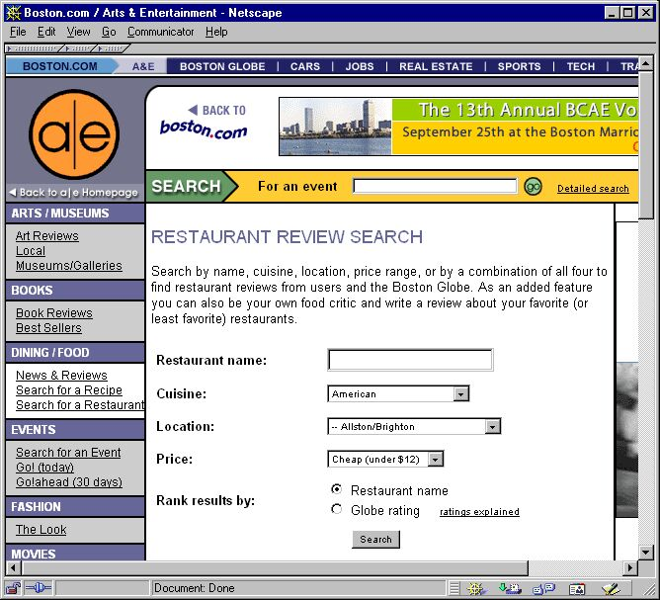
User Query Operation
What's the user operation and the parameters passed to it?

Slide 10
Show Matching Restaurants Operation
Name of the
user operation
  ShowMatchingRestaurants
    :cuisine = American
    :loc = Allston/Brighton
    :price = 12.00
    :orderBy = restName
Parameter values passed to the operation
The job of the user operations in the middle-tier is to use the parameters to construct SQL statements to be passed to the database for execution

Slide 11
Obtaining Parameters
User Operations do NOT necessarily get all their inputs from the parameters passed to them when they are invoked
  In a web-based, popup windows,
  (also known as modal dialogue windows) can request additional info
  In a text-based system, the user can be prompted for additional info
  Web Services can make requests of their clients to obtain additional info
To simplify examples, assignments & testing in this course, we will assume/require that operations get ALL of their inputs from the parameters passed to them when they are initially invoked!

Slide 12
User Query Operation
Information Flow
DB
Query
Database
Server
DB
Application
API
Query
Results
User Query
Web
Browser
Web
Server
Results Page

Slide 13
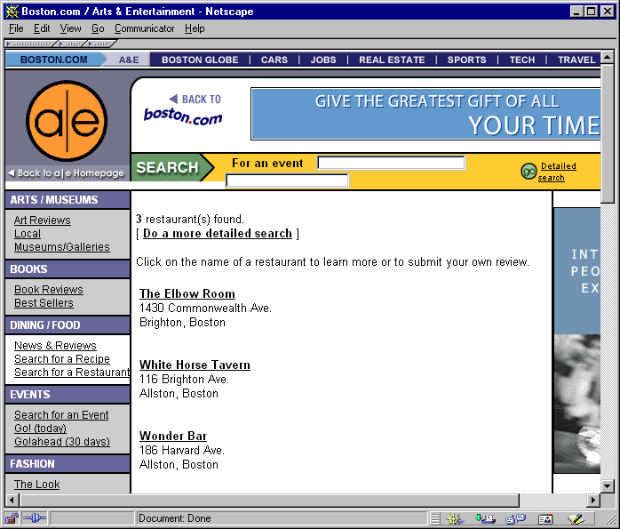
User Query Results

Slide 14
Restaurants Table
Restaurants
  restName – restaurant name
  restAddr – its address
  cuisine – primary type of cuisine
  loc – neighborhood it is in
  price – typical price for a meal
  rating – restaurant rating (0-5)

Slide 15
User & DB Query Operations
User Query Operation:
  Show Matching Restaurants
    :cuisine = American
    :loc = Allston/Brighton
    :price = 12.00
    :orderBy = restName
DB Query Operation:
  SELECT restName, restAddr
  FROM Restaurants
  WHERE cuisine = 'American'
  AND loc = 'Allston/Brighton'
  AND price < 12.00
  ORDER BY restName

Slide 16
Session-Based Implementation of
User Operations

Slide 17
Sessions
Session: a sequence of interactions
between
  a middle-tier application service and
  an interactive user or a distributed (e.g. web service) client
Session Identification:
  When a user/client starts a session, the application service typically returns a unique session id (e.g. via a cookie) to the user/client's agent (e.g. a web browser).
  On subsequent requests which are part of the same session, the agent automatically sends that session id along with the request to the application service; this identifies the session.
  We won't generally make session id's visible; they're just the mechanism used to ensure that the middle tier connects together multiple requests from the same user

Slide 18
Middle-Tier Session Data
The middle tier can retain session data
  data retained from one user operation
  which will be needed to implement some subsequent operation
Session Data Retained:
  In this system, after the user logs in, the middle tier retains :curuser and :currole

Slide 19
Login Operation
Login
:userid
:passwd
SELECT role
FROM KnownUsers
WHERE userid = :userid
AND pwd = :passwd
IF error,
return Login Error Page
ELSE
build & return Home Page & remember :userid & role
LOGIN
Assuming database is responsible for user authentication – e.g. via table KnownUsers
:curuser
:currole
Presentation Tier
Middle Tier
Data Tier

Slide 20
Application ER Model
job history includes
Candidate
JobEntry
jobno
occurred
at
Company
Rep
Company
represents
compid
C
R
role
open at
requires
KnownUser
Assumes each user can only play a single role
JobPosting
userid
pwd
role
postid

Slide 21
Application Relational Model
Candidates
JobEntries
userid
name !
info
industryWanted
titleWanted
industryWanted
userid
jobno
compid !
title
location
startdate
enddate
details
CompanyReps
JobPostings
userid
compid !
Companies
postid
compid !
title
location
descr
postdate !
compid
compnam
industry
descr
status
KnownUsers
userid
pwd
role

Slide 22
Get Job History Operation
Welcome
Joe
Candidate
:curuser
View/Edit
Personal Info
GetJobHistory
SELECT jobno, compnam,
startdate, enddate
FROM (JobEntries
NATURAL JOIN
Companies)
WHERE userid = :curuser
ORDER BY startdate
View/Edit
Jobs Desired
Build & return
My Jobs Page
View/Edit
Job History
View/Edit
Qualification
Presentation Tier
Middle Tier
Data Tier

Slide 23
My Jobs Page
HOME
Delete
Edit
1931-1947 GE
Delete
Edit
1948-1984 Smith & Barney
Delete
Edit
1984-2001 Smith & Wesson
Delete
Edit
2001-2004 Wesson Oil
New Job

Slide 24
Database Client-Side
Execution

Slide 25
UI's and Web Services
Web
Service
Client
Web
Service
Interface
SOAP
DB
Application
API
Database
Server
Distributed
Application
Environment
UI
Management
User
(Interactive
Client)
Web
Browser
Web or
Application
Server
(DB) Client Side
(DB) Server Side

Slide 26
Using SQL from Java
Compiled
Java
JDBC
Library
Database
Server
DB Client-side
DB Server-side
Compiled Java code makes
function calls to the JDBC library
  Connects to the database
  Passes SQL statements as strings
  If a query, gets back results

Slide 27
Java/JDBC Update Example
To execute:
INSERT INTO Projs( pno, pname, pmgr )
VALUES ( 30420, 'My Project', 4493 )
Creates a connection to the database
Connection conn = …;
Statement stmt = conn.createStatement();
String sqlstr =
"INSERT INTO Projs( pno, pname, pmgr )" +
" VALUES ( 30420, 'My Project', 4493 )";
stmt.executeUpdate( sqlstr );
Passes the SQL string to the database, which executes it

Slide 28
Parameterized Operations
To execute the parameterized user action
Add Project( :pno, :pname, :pmgr )
Connection conn = …;
Statement stmt = conn.createStatement();
int aPno = …; -- get from browser input data
String aPname = …; -- get from browser input data
int aPmgr = …; -- get from browser input data
String sqlstr =
"INSERT INTO Projs( pno, pname, pmgr )" +
" VALUES ( " + aPno + ", " +
quote(aPname) + ", " +
aPmgr +" )";
stmt.executeUpdate( sqlstr );
This is prone to
injection attacks.
Suppose a user provided
(SELECT …) for :pno.
Requires careful middle-tier checking!

Slide 29
SQL Queries using Java
2
Server executes SQL query and produces a result set
1
Program sends SQL query to server
Compiled
Java
JDBC
Library
(Oracle)
Database
Server
Client-side
Server-side
4
Client iterates through the result set to get the data
3
Server ships the result set back to the client

Slide 30
Java/JDBC Query Example
SELECT empno, ename FROM Emps
Connection conn = …;
Statement stmt = conn.createStatement();
String sqlstr = "SELECT empno, ename FROM Emps";
ResultSet rs = stmt.executeQuery( sqlstr );
while (rs.next())
{
int num = rs.getInt("empno");
String s = rs.getString("ename");
System.out.println( " " + num + " \t " + s );
}
This code just emits the results to standard output. typical middle tier code would instead use num & s to build the page to be sent back to the browser
Write the Java code for GetJobHistory

Slide 31
Java Code for GetJobHistory
Connection conn = …;
Statement stmt = conn.createStatement();
int curuser = …; -- get from session state
String sqlstr =
"SELECT jobno, compnam, startdate, enddate" +
" FROM (JobEntries NATURAL JOIN Companies)" +
" WHERE userid = " + curuser +
" ORDER BY startdate)";
ResultSet rs = stmt.executeQuery( sqlstr );
while (rs.next())
{
…

Slide 32
Using Java for Database Programming
Full Programming Language
JDBC: Standard Interface
Vendor-specific extensions to support vendor-specific DB capabilities
SQL Integration is UGLY at best
  Piecemeal construction of paramerized queries is ugly, awkward & error-prone
  Extraction and use of data from query results is also annoying
  Other standard/commercial frameworks help (discuss JDO later)

Slide 33
SQLJ: Embedding SQL in Java
int aPno = …;
String aPname = …;
int aPmgr = …;
…
#sql{
INSERT INTO Projs( pno, pname, pmgr )
VALUES( :aPno, :aPname, :aPmgr ) };
Specially set off
SQL code
Bind variable:
programming variables bound to SQL code

Slide 34
Client-Side
SQLJ Development Model
SQLJ
Precompile
Java
Compile
Java
Program
JDBC
Library
(Oracle)
Database
Server
DB Client-side
DB Server-side

Slide 35
Embedded SQL
Integration of SQL with a general purpose programming language – e.g. PL/SQL
aPno int := …;
aPname varchar(18) := …;
aPmgr int := …;
…
INSERT INTO Projs( pno, pname, pmgr )
VALUES( aPno, aPname, aPmgr )
SQL commands are keywords of the programming language
Programming language variables can be used directly in SQL commands

Slide 36
Embedded SQL Programming
Allows complex combinations of
database operations to be naturally specified
Also provides support for conditionals, iteration, exceptions, procedures, functions, packages, triggers, etc.
BEGIN
INSERT INTO ExEmps
SELECT * FROM Emps
WHERE termdate IS NOT NULL;
DELETE FROM Emps
WHERE termdate IS NOT NULL;
END;
This is a good example of why transactions are used. We don't want a crash to allow the insert to be done without the delete.
What does this do?

Slide 37
Client-Side Development Model for Embedded SQL
PL with embedded SQL
Compile
Executable
API
Library
(Oracle)
Database
Server
or an interpreter
could be used
DB Client-side
DB Server-side

Slide 38
Middle-Tier PL/SQL Code for GetJobHistory
BEGIN
FOR rec IN (
SELECT jobno, compnam, startdate, enddate
FROM (JobEntries NATURAL JOIN Companies)
WHERE userid = :curuser
ORDER BY startdate)
LOOP
pl( rec.compnam || ' ' ||
rec.startdate || '-' || rec.enddate );
END LOOP;
END;
Maintained as a middle-tier session variable
This just outputs the information to the terminal output window; we really want to build the HTML result page instead

Slide 39
Server-Side
Execution &
Stored DB
Operations

Slide 40
Client-Side Multiple Inserts
SQL> insert into project( pno, pname, pmgr )
values ( …, …, … );
SQL> insert into project( pno, pname, pmgr )
values ( …, …, … );
…
SQL> insert into project( pno, pname, pmgr )
values ( …, …, … );
Imagine middle-tier code that needs to insert 100 tuples

Slide 41
Multiple Round Trips
Insert #1
(Oracle)
Database
Server
Client-Side
Program
Insert #2
Insert #3
…
Insert #100
DB Client-side
DB Server-side
It would be way more efficient to send all 100 requests to the server at once!
Time for 100 round trips dominates

Slide 42
Defining Stored DB Procedures
SQL> CREATE PROCEDURE insert_100_projects( … ) AS
BEGIN
insert into project( pno, pname, pmgr )
values ( …, …, … );
insert into project( pno, pname, pmgr )
values ( …, …, … );
…
insert into project( pno, pname, pmgr )
values ( …, …, … );
END;
/
A SQL Command to create a stored DB procedure which is stored & executed on the server

Slide 43
Stored DB Operations
Stored DB Operations
include both
Stored DB Procedures
& Stored DB Functions
Library of
Stored DB
Operations
SQL> EXECUTE insert_100_projects( … )
PL/SQL
Engine
Ship down request to execute
stored procedure
Oracle
Database
Server
Client-side
Program
Core SQL
Database
Engine
DB Client-side
DB Server-side
100 insert requests are still made to the SQL Engine, but without the round trips!

Slide 44
Database Operations:
Queries & Action
 | Core DB Operations (i.e. SQL) | Stored DB Operations
Queries | SQL Queries | Stored DB Functions
Actions | SQL Insert/Update/Delete SQL DDL (e.g. create table) SQL DCL (e.g. grant access) | Stored DB Procedures

Slide 45
Implementing Database Applications

Slide 46
Basic Implementation Issues
What programming environments should be used for implementing the application?
What functionality should be placed in the middle tier vs. the data tier?
How & where should constraints be enforced?
Core and Stored
DB Operations
User Operations
User enters data, makes choices, clicks a button
User Query
DB
Query
User Action
DB Action
Presentation Tier
Middle Tier
Data Tier

Slide 47
Client vs Server Side Languages (Oracle)
Server-side (Data Tier)
  Typically use PL/SQL
  Can also use Java or SQLJ
Client-side (Middle Tier)
  Typically use Java or SQLJ
  or C or Pro*C or C++ or C# or …
  Can also use PL/SQL
  (Using client-side PL/SQL
  development environment & engine)

Slide 48
Project Implementation Approach
Server-Side Implementation
  We will use PL/SQL
  for stored procedures/functions
Client-Side Implementation
  We will use PL/SQL for the client-side code
    However, since client-side PL/SQL engines are expensive, we will use a "trick", and actually will arrange to have the client-side code implemented by Oracle's built-in server-side PL/SQL engine.
User Interface Implementation
  We will use SQL*Plus for a command line oriented user interface

