Slide 1
Theory, Practice & Methodology
of Relational Database
Design and Programming
Copyright © Ellis Cohen 2002-2009
Introduction to
Relational Databases
& SQL
These slides are licensed under a Creative Commons Attribution-NonCommercial-ShareAlike 2.5 License.
For more information on how you may use them, please see http://www.openlineconsult.com/db

Slide 2
Overview of Lecture
Overview of Databases
Introduction to SQL
Oracle SQL Tools

Slide 3
Overview
of
Databases

Slide 4
What's a Database
Persistent Structured
Information Repository
Provides
  API (Application Programming Interface)
  Protocol
  Language (SQL for Relational DB's)
  for Storing & Retrieving Information
Built-in Support for
  Security & Access Control
  Constraints & Triggers
  Transactions
  Performance Tuning

Slide 5
Client/Server Architecture
API includes:
executeQuery( sqlstr )
SQL Statements are passed through API & protocol
User
DB
Application
API
Database
Server
DB
Application
Client
DB Client
Implements DB Operations
Client-Side
Server-Side

Slide 6
Data in Relational Databases is Stored in Tables
(also known as Relations)
Employees
empno ename sal comm
7499 | ALLEN | 1600 | 300
7654 | MARTIN | 1250 | 1400
7698 | BLAKE | 2850
7839 | KING | 5000
7844 | TURNER | 1500 | 0
7986 | STERN | 1500
rows,
tuples,
records
columns, attributes, fields

Slide 7
Relational Database Applications
Typical relational database applications use multiple tables
For example, a company project management database application might use tables for
  Employees
  Departments
  Projects
  Assignments
  etc.

Slide 8
SQL
Structured Query Language for Relational DB's
SQL Query (using SELECT command)
EMPNO ENAME
----- ------
7499 ALLEN
7654 MARTIN
7844 TURNER
7986 STERN
SELECT empno, ename
FROM Employees
WHERE sal < 2000
ORDER BY empno
Other SQL commands are used to create, modify & manage
the data in the database

Slide 9
Database Features
Security & Access Control
  Allows control over which users can access which information
Constraints & Triggers
  Allows database to automatically take actions based on changes it monitors
Transactions
  Makes it possible to ensure related changes are all made together, or not at all (atomicity)
  When operation is completed, changes are actually stored persistently (durability)
  Ensures concurrent users cannot "step on each other's toes" (isolation)
Performance Tuning
  Allows control over aspects of how information is stored, and how storage and retrieval operations are executed

Slide 10
Introduction
to SQL

Slide 11
Emps Table
Primary
Key
empno ename job hiredate sal comm
----- ------ --------- --------- ---- ----
7369 SMITH CLERK 17-DEC-80 800
7499 ALLEN SALESMAN 20-FEB-81 1600 300
7521 WARD SALESMAN 22-FEB-81 1250 500
7566 JONES DEPTMGR 02-APR-81 2975
7654 MARTIN SALESMAN 28-SEP-81 1250 1400
7698 BLAKE DEPTMGR 01-MAY-81 2850
7782 CLARK DEPTMGR 09-JUN-81 2450
7788 SCOTT ANALYST 19-APR-87 3000
7839 KING PRESIDENT 17-NOV-81 5000
7844 TURNER SALESMAN 08-SEP-81 1500 0
7876 ADAMS CLERK 23-MAY-87 1100
7900 JAMES CLERK 03-DEC-81 950
7902 FORD ANALYST 03-DEC-81 3000
7934 MILLER CLERK 23-JAN-82 1300

Slide 12
SQL Queries
SELECT ename
FROM Emps
WHERE empno = 7499
SELECT empno
FROM Emps
WHERE ename = 'ALLEN'
SELECT empno, ename
FROM Emps
WHERE sal > 2975
ORDER BY ename
ENAME
------
ALLEN
Note symmetry of lookups
EMPNO
-----
7499
EMPNO ENAME
----- ------
7902 FORD
7839 KING
7788 SCOTT
Query
Query Result

Slide 13
Ordering
Relational Database tables are not intrinsically ordered in any way.
SELECT empno, ename
FROM Emps
  (which generates the employee number and name of every employee in the table)
may come out in one order today and a different one tomorrow (if the DBA reorganizes the database)
You MUST use ORDER BY if you want your results to come out in a specific order:
SELECT empno, ename
FROM Emps
ORDER BY ename

Slide 14
Boolean Expressions
< less than <= less than or equal
> greater than >= greater than or equal
= equal <> != not equal
SELECT empno, ename
FROM Emps
WHERE (sal > 1200)
AND (sal <= 1500)
AND (comm > 200)
What will this generate?

Slide 15
Boolean Expressions Answer
SELECT empno, ename, sal
FROM Emps
WHERE (sal > 1200)
AND (sal <= 1500)
AND (comm > 200)
EMPNO ENAME SAL
----- ------ ----
7521 WARD 1250
7654 MARTIN 1250

Slide 16
Basic Query Parts
*
SELECT empno, ename
FROM Emps
WHERE sal > 2000
ORDER BY ename
2. Projection
1. Restriction
2. Ordering
It is possible to order query results by attributes which are not projected.
However, it is also possible to define and name computed attributes, and then order the results based on them

Slide 17
SQL Exercise
Note: this represents a date; not just a year!
Write SQL to query
Emps( empno, ename, job, hiredate)
  List the employee #, employee name and job of all non-clerks hired after 1991.
  Sort the output by job; within employees with the same job,
  sort by employee name

Slide 18
SQL Exercise Answer
SELECT empno, ename, job
FROM Emps
WHERE hiredate > '31-DEC-91'
AND job <> 'CLERK'
ORDER BY job, ename
Sorts by job, and then,
within employees with the same job,
sorts by employee name
Assumes every employee's job is specified, otherwise this doesn't necessarily work
When the Emps table was created, hiredate was specified to be a DATE, so Oracle knows to automatically convert '31-DEC-91' to a date
hiredate >= '1-JAN-92' would work as well
This is the default date format; it can be changed

Slide 19
SQL Updates and Deletes
UPDATE Emps
SET sal = 2000, comm = 100
WHERE sal = 0
UPDATE Emps
SET sal = sal + 500
WHERE job = 'DEPTMGR'
DELETE FROM Emps
WHERE sal = 0

Slide 20
SQL
A language for dealing with tables
  DML: Data Manipulation Language
    Querying: Extracting data from tables
    Modification: Inserting, updating, deleting rows in a tables
  DDL: Data Definition Language
    Defining new tables, views (VDL), etc.
    Altering & dropping old ones
  DCL: Data Control Language
    Security: Access Control
    Transaction Mgt
    Performance (e.g. Indexing (SDL))

Slide 21
Query-Based Create & Insert
Example DDL command
CREATE TABLE RichEmps AS
SELECT empno, ename
FROM Emps
WHERE sal > 3000
INSERT INTO RichEmps
SELECT empno, ename
FROM Emps
WHERE (sal > 2000)
AND (sal <= 3000)
AND (comm > 200)
Emps
empno, ename
RichEmps

Slide 22
SQL Database Operations:
Queries & Actions
 | SQL DB Operations
Queries | SQL Queries
Actions | SQL Insert/Update/Delete SQL DDL (e.g. create table) SQL DCL (e.g. grant access)

Slide 23
History of Standard SQL
SQL-89 (SQL1)
  First standard version of SQL
  Based on IBM's SQL
SQL-92 (SQL2) [primary focus of CS579]
  Added major extensions
  Basis of all major commercial RDB SQLs
SQL-99 (SQL3)
  Adds Programmability and OO extensions
  Not generally implemented
    Oracle: PL/SQL, Oracle OO extensions
    SQL Server: Transact-SQL

Slide 24
Oracle
SQL Tools

Slide 25
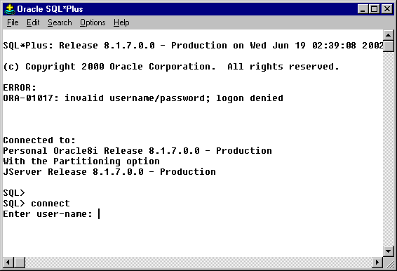
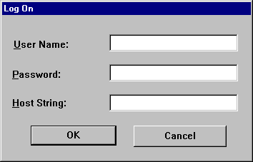
Connect to SQL*Plus
1) type
scott
2) type
tiger
3) click
OK

Slide 26
SQL*Plus Example
prompts
Start with these SQL*Plus set commands
SQL> set linesize 125
SQL> set pagesize 1000
SQL> select empno, ename, sal, comm
2 from emp where deptno <> 20
3 order by sal;
EMPNO ENAME SAL COMM
------- ------ ---- ------
7900 JAMES 950
7521 WARD 1250 500
7654 MARTIN 1250 1400
7934 MILLER 1300
7844 TURNER 1500 0
7499 ALLEN 1600 300
7782 CLARK 2450
7698 BLAKE 2850
7839 KING 5000
9 rows selected.
SQL>
End SQL command with ;
Query Result
also called
the Result Set

Slide 27
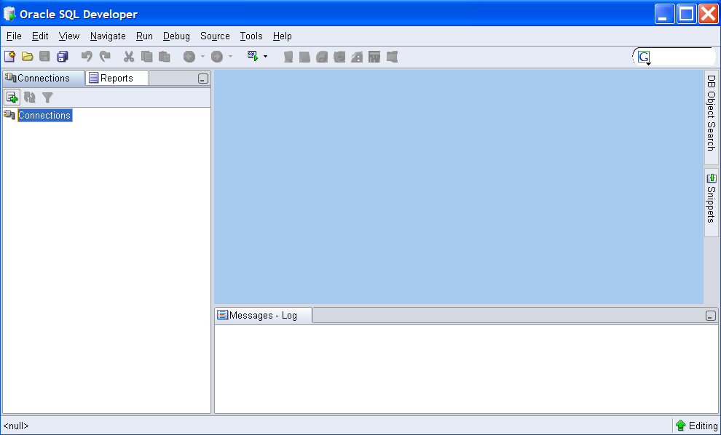
Oracle SQL Developer
Click here to define a new connection
Download from www.oracle.com

Slide 28
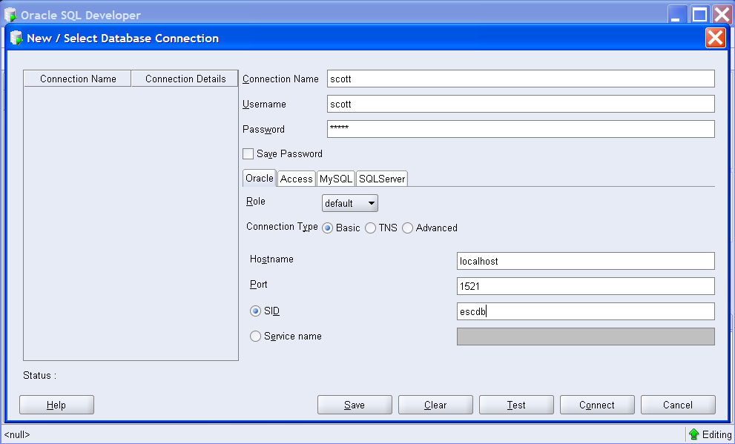
Create a Connection for SCOTT
Fill in SCOTT as the connection and user name
1. Fill in the all the fields
The password is TIGER
The SID is the name of the database you used when you installed Oracle
2.

Slide 29
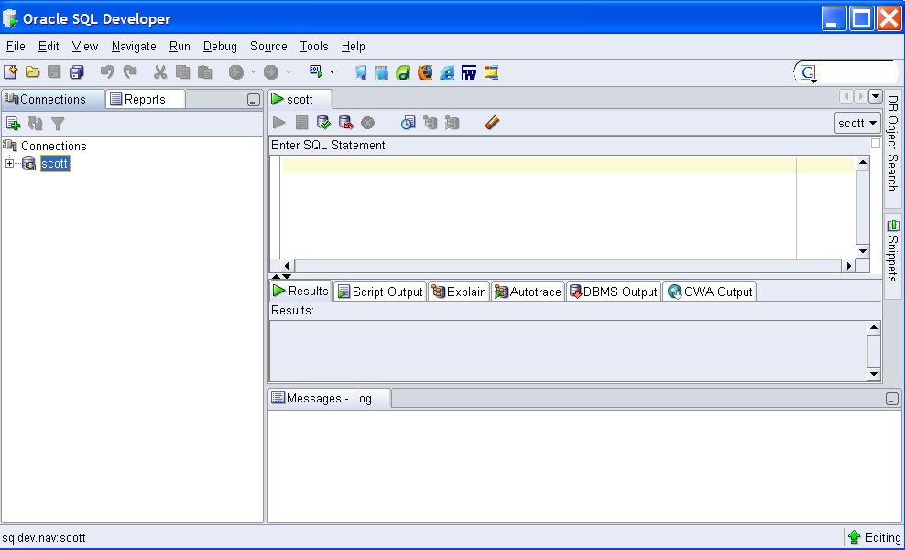
After SCOTT is Connected
Open
SCOTT

Slide 30
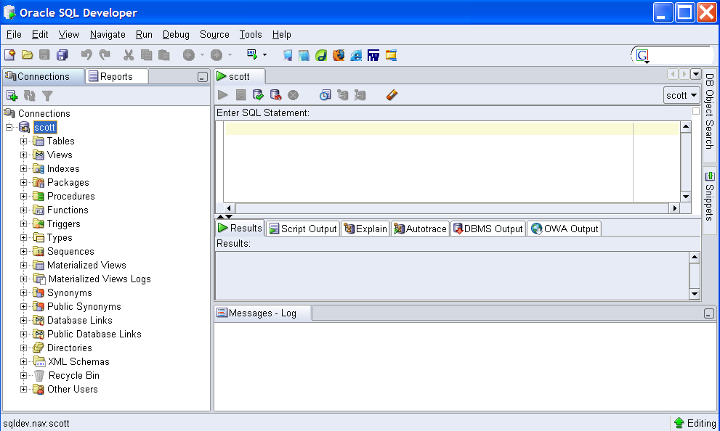
Connection Elements
Look at SCOTT's Tables

Slide 31
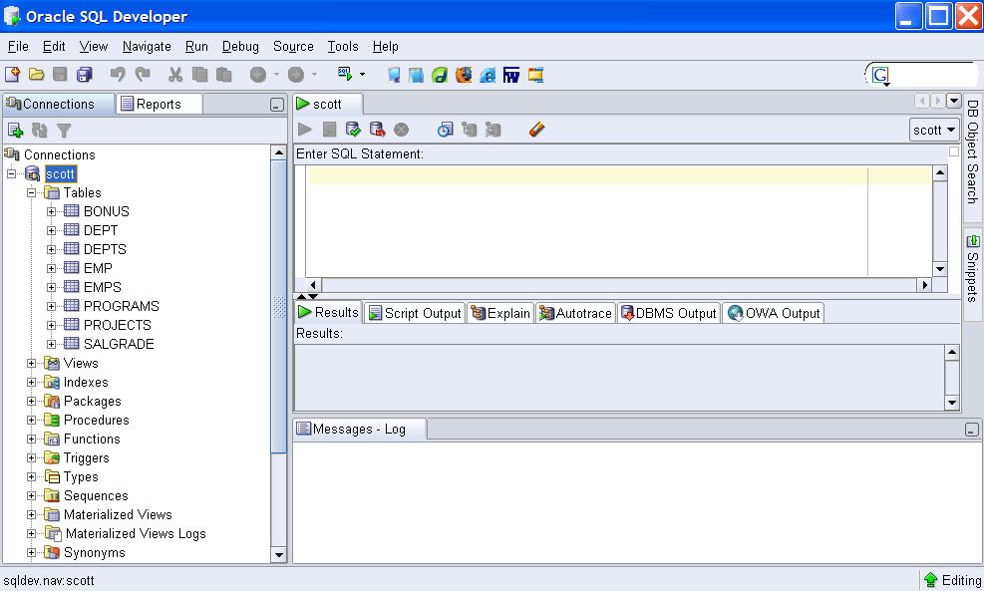
SCOTT's Tables
View the definition of the Emps table

Slide 32
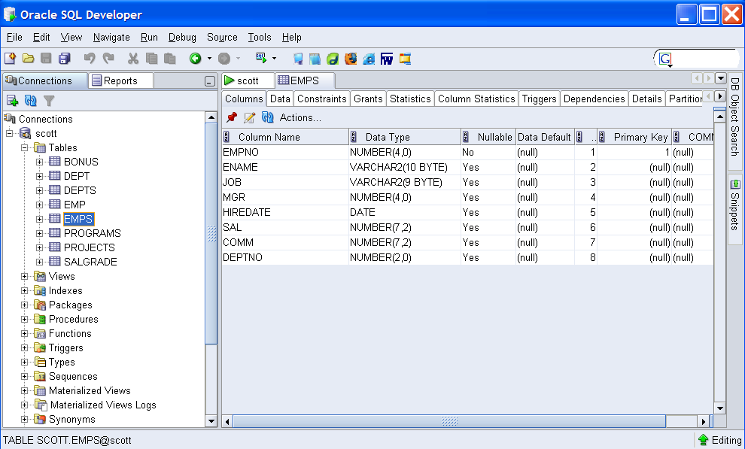
The Emps Table Definition
Look at the Data in the table

Slide 33
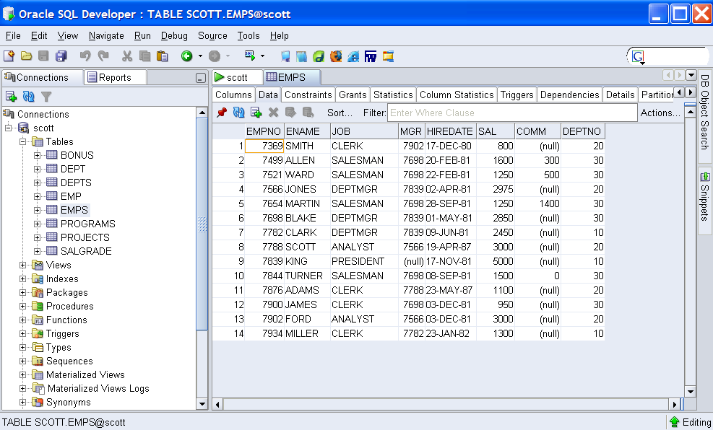
The Emps Table Data

Slide 34
Tools & Client-Side Access
Passes SQL to
Database Server
Understands SQL*Plus Commands
SQL*Plus
(Oracle)
Database
Server
Oracle SQL Developer
DB
Application
API
Library
Implements database operations
Client-side
Server-side

