Slide 1
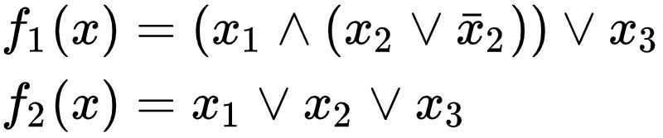
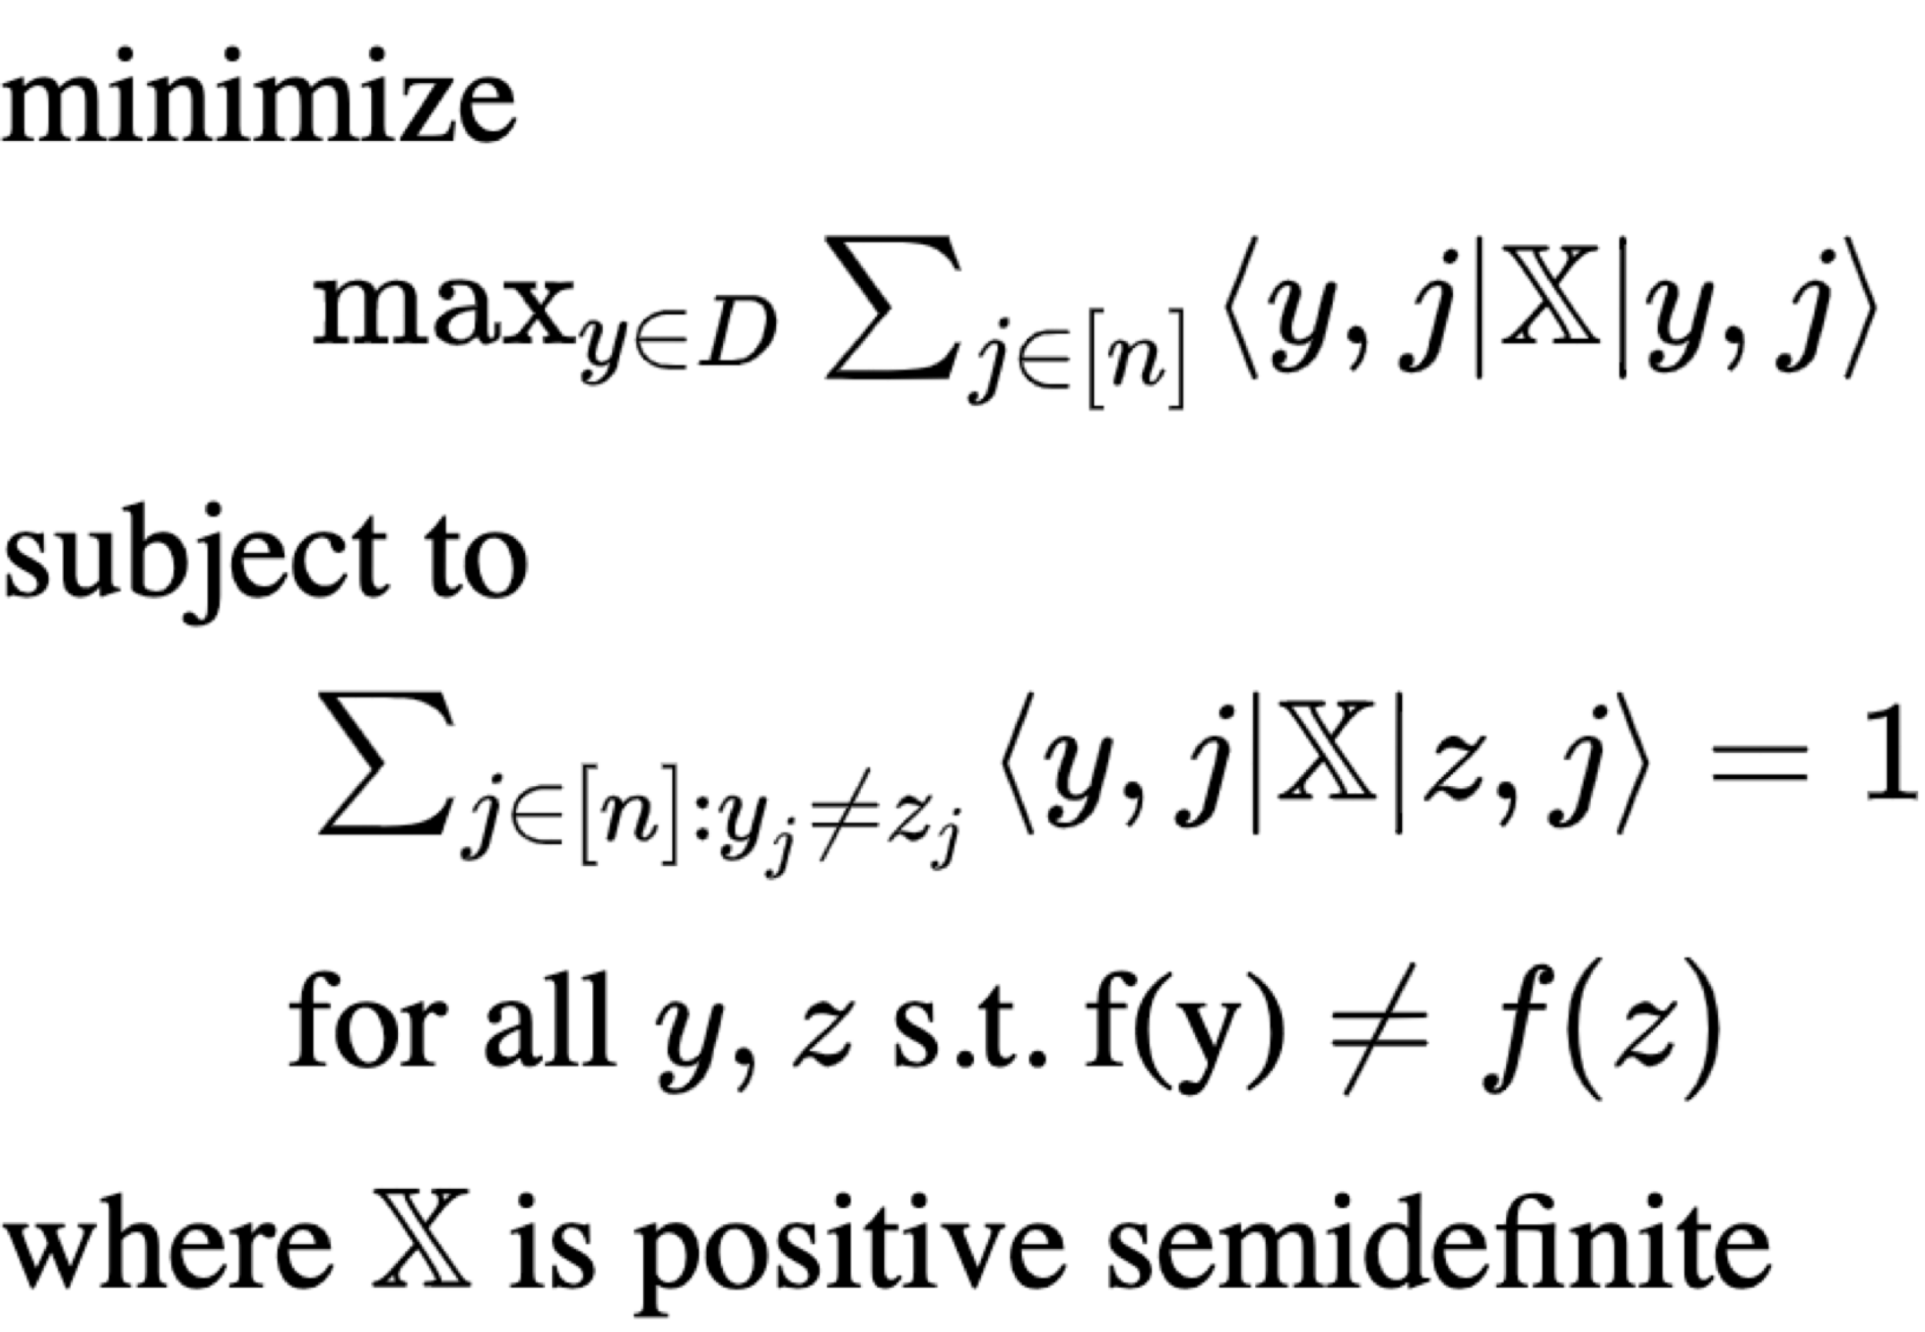
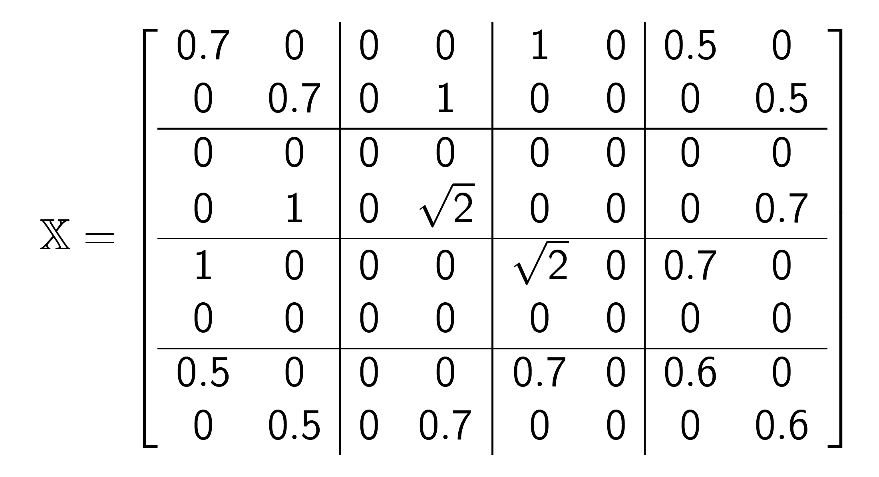
Quantum Algorithms via Semidefinite Programming
Michael Czekanski ‘20 & R. Teal Witter ‘20
Abstract
Problem
Let f be a Boolean function and x be a bitstring input to f. We consider the query model where an algorithm evaluates f(x) by asking an oracle about the bits of x. The optimal quantum query complexity of f is the fewest queries any quantum algorithm takes to determine f(x) over all inputs x. We determine the optimal quantum query complexity of f by solving a semidefinite programming (SDP) problem. This solution also provides a span program that evaluates f in optimal quantum query complexity on a quantum computer.
Given a Boolean function f…
1. What is the optimal quantum query complexity of f?
2. What algorithms meet the optimal quantum query complexity?
Query Complexity
Semidefinite Program (SDP)¹
Minimize
x | f₁(x) | f₂(x) | I(x) | Span?
000 | 0 | 0 | 0,0,0 | False
010 | 0 | 1 | 0,1,0 | True
001 | 1 | 1 | 0,0,1 | True
subject to
Quantum Query Optimizer
github.com/rtealw/QuantumQueryOptimizer
# Example 1
D = ['00', '01', '10', '11']
E = ['0', '1', '1', '1']
qqo.runSDP(D=D, E=E)
# Example 2
qqo.runSDPForN(
getD=qqo.getDAll, getE=qqo.getEOR,
n_end=2, n_start=2)
Span Programs
Do the input vectors I span to the target vector τ?
For OR, I(x) = x and τ = 1.
Results²
Complexity of OR by Input Size
Solution to SDP for 2-bit OR
¹Reichardt, Ben W. "Span programs and quantum query complexity: The general adversary bound is nearly tight for every boolean function." 50th Annual IEEE Symposium on Foundations of Computer Science. IEEE, 2009.
²Wen, Zaiwen, Donald Goldfarb, and Wotao Yin. "Alternating direction augmented Lagrangian methods for semidefinite programming." Mathematical Programming Computation 2.3-4 (2010): 203-230.

