Slide 1


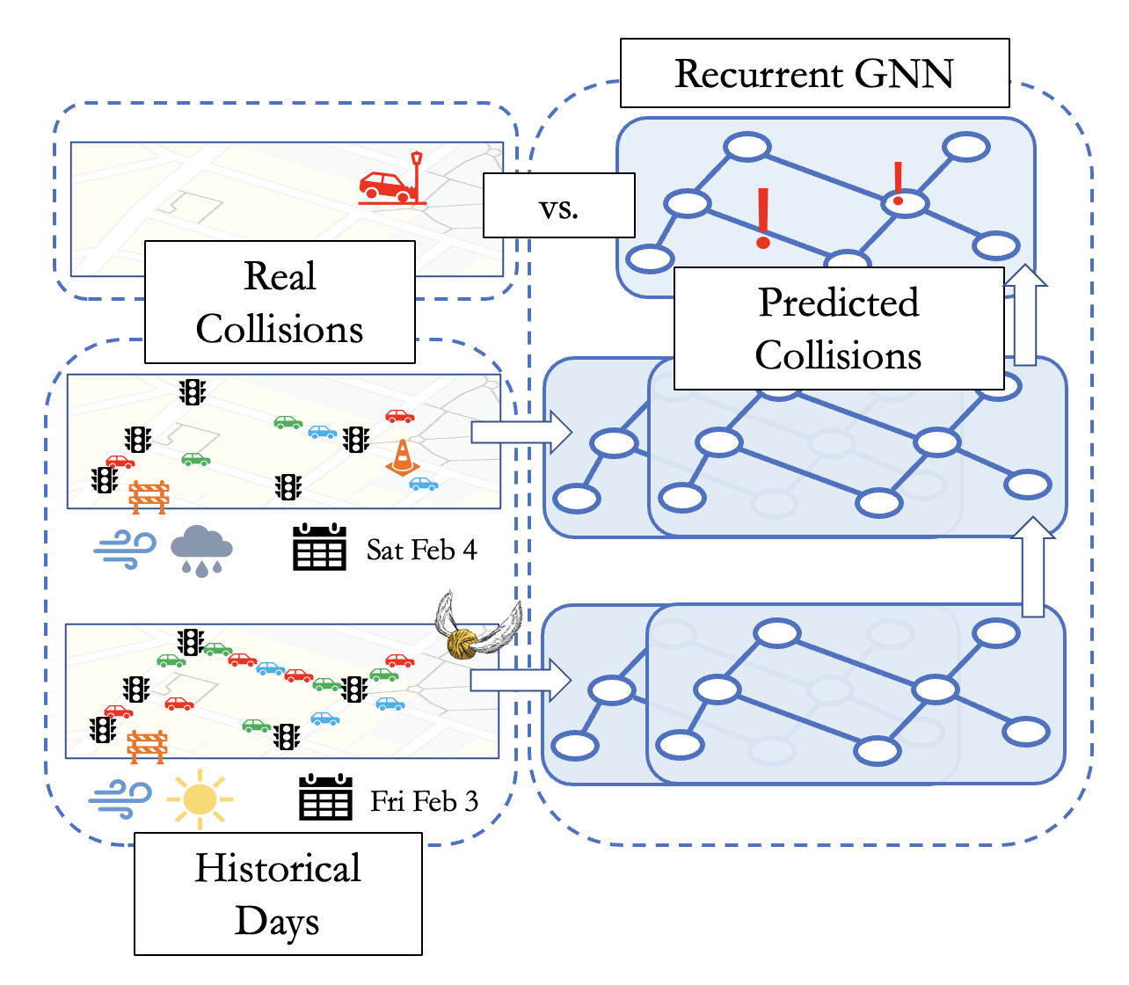
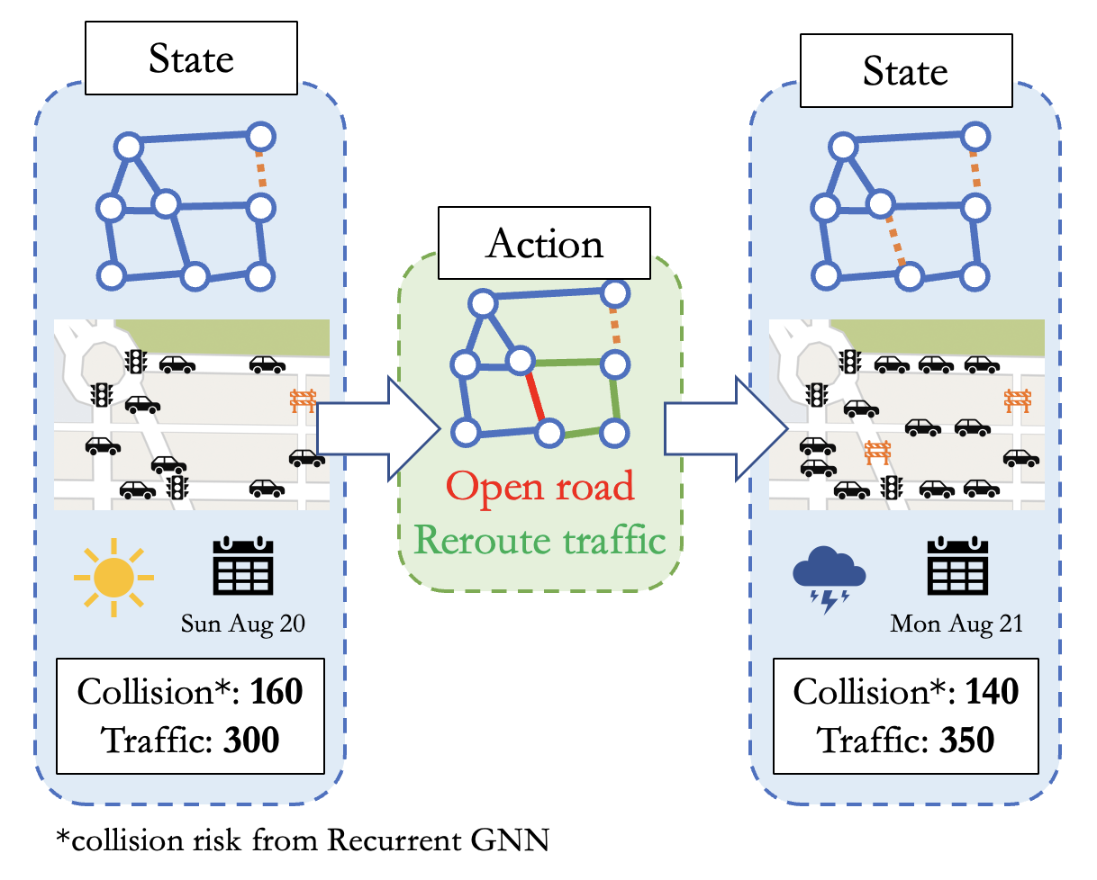
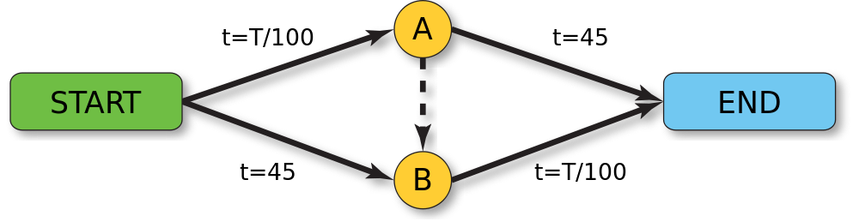
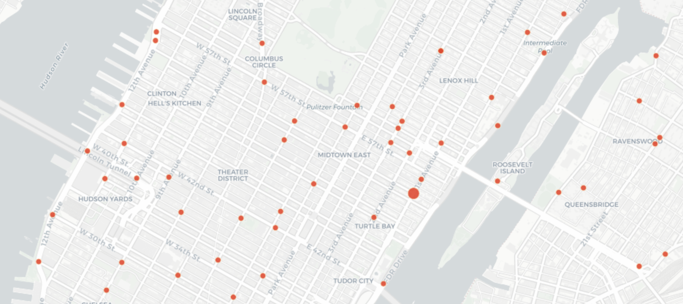
I Open at the Close: A Deep Reinforcement Learning Evaluation of Open Streets Initiatives^{1,2}
R. Teal Witter and Lucas Rosenblatt
New York University
Introduction
Part I: Predicting Collisions
Part II: Reinforcement Learning
Open streets programs “open” streets to pedestrians and bicyclists by closing them to motor vehicles. Open streets initiatives are a cost-effective way to:
Provide public space in urban settings,
Host cultural events,
Build community,
Increase pedestrian and bicycle mobility.
But streets are often selected by an application process, biasing the benefits to well-resourced communities and organizations.
Our Question: Can we objectively choose which streets to open so that all citizens benefit?
We train a recurrent graph neural network (RGNN) to predict where and when collisions occur in Manhattan. We build a data set from motor vehicle collision, infrastructure, weather, and taxi trip data.
We train a deep model to predict Q-values: the average expected reduction in traffic and collisions of opening a street segment.
Objectives
Reducing Traffic
Braess’s paradox tells us that removing a street in a road network can sometimes reduce traffic. For example, a shortcut can reduce the travel time of every driver that takes it while increasing the travel time for everyone overall.
We find opening streets based on their Q-values reliably leads to a reduction in traffic and collisions.
We find that our RGNN can simultaneously capture spatial dependencies (e.g., dangerous speed differentials between nearby streets) and short-term temporal dependencies (e.g., prior rain and current cold temperatures leading to icy conditions today).
Future Work
“Interpretability”
More work is needed before deploying!
Source: Wikipedia
Measuring traffic: We assume taxi data (and shortest path trips) are representative.
Near-collision events: Collisions are sparse but near-collision sensors are rare.
Other cities: Our model is widely applicable but data varies.
Interpretability: Deep models are difficult to interpret.
Reducing Collisions
Some intersections are more dangerous than others. The figure below shows collision fatalities by intersection from 2013 to 2016.
The directed average predicted effect of street attributes on collision risk, computed via the integrated gradient method. For example, more cars on a road segment generally reduce the risk of collisions.
Streets with the highest Q-values (blue) and streets in the NYC Open Streets program (red). The Q-value streets are more evenly distributed.
Source: NYC Crash Mapper
¹github.com/rtealwitter/OpenStreets
²RTW and LR were supported by the National Science Foundation Graduate Research Fellowship under Grant No. DGE-2234660. We thank Suzana Duran Bernardes for helpful discussions and direction to data sources.

