Slide 1
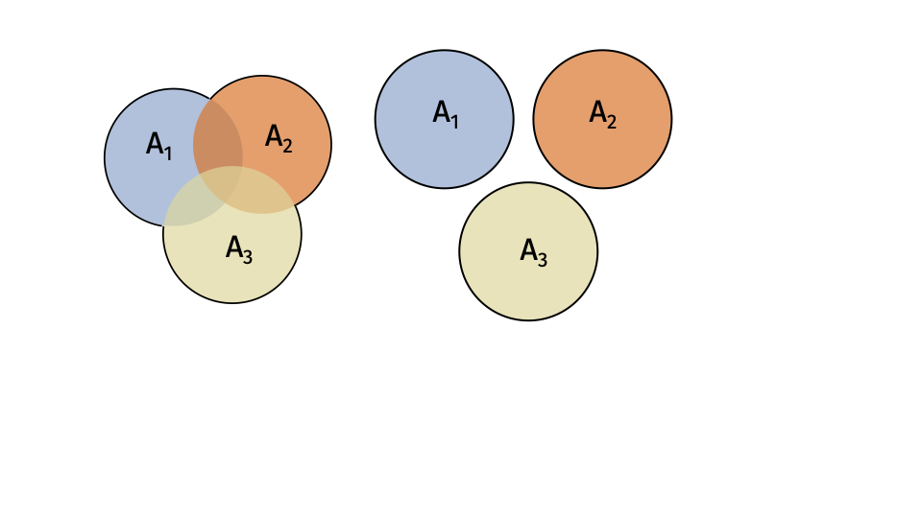

Slide 2
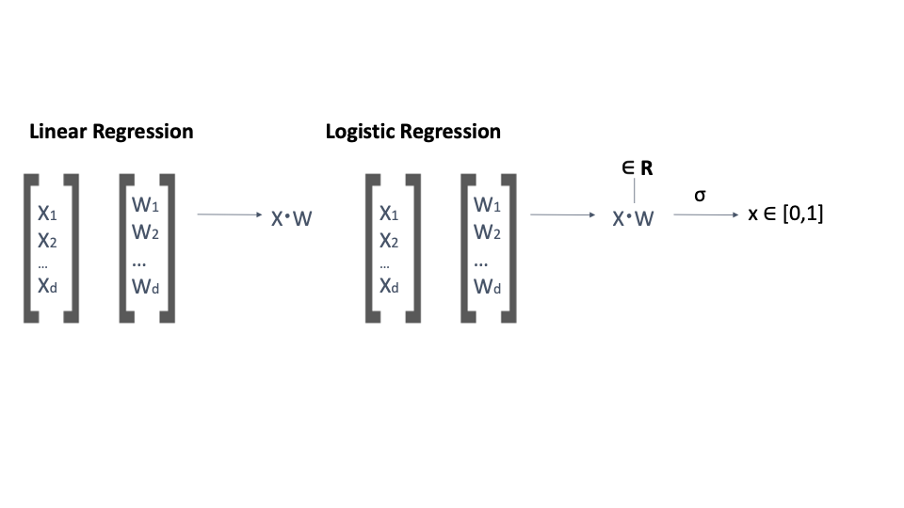

Slide 3
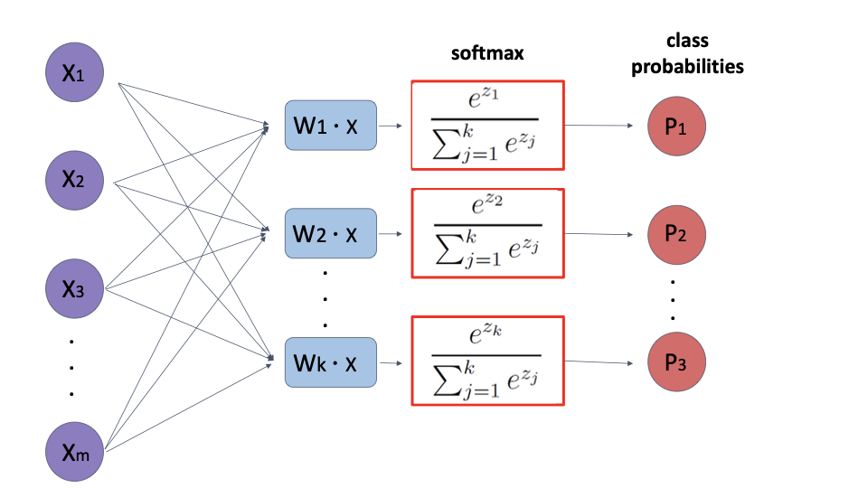

Slide 4
x⁽¹⁾
x⁽²⁾
x⁽³⁾
x^{(n)}
. . .
∈ℝ^{(n)}
SELF-ATTENTION LAYER
∈ℝ^{(n)}
. . .
y⁽¹⁾
y⁽²⁾
y⁽³⁾
y^{(n)}

Slide 5
x
xW^{(q)T}
Query
W^{(q)}
^{rxd}
nxd
nxr
W^{(k)}x^{T}
Softmax
Key
W^{(k)}
^{rxd}
x
rxn
nxn
W^{(v)}
Value
W^{(v)}
x
nxd
nxd

Slide 7
x
xW^{(q)T}
Query
W^{(q)}
^{rxd}
nxd
nxr
z
W^{(*)}x^{T}
Softmax
Key
W^{(k)}
^{rxd}
x
mxd
rxm
nxm
zW^{(*)}
Value
W^{(v)}
x
mxd
nxd

Slide 8
Input Text Vector Encoding
Self-Attention
. . .
. . .
. . .
Self-Attention
Cross-Attention
Cross-Attention
. . .
. . .
Self-Attention
. . .
. . .
. . .
Self-Attention
Cross-Attention
Cross-Attention
Probability Distribution of Next Word

