Slide 1
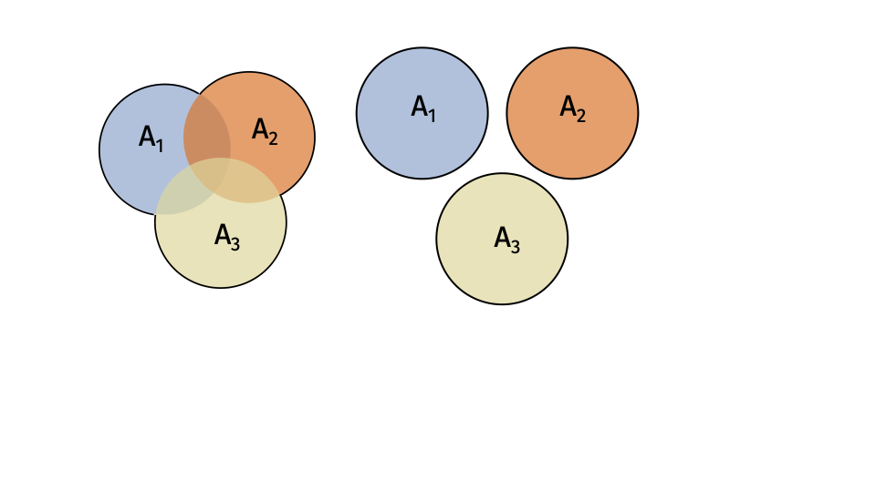

Slide 2
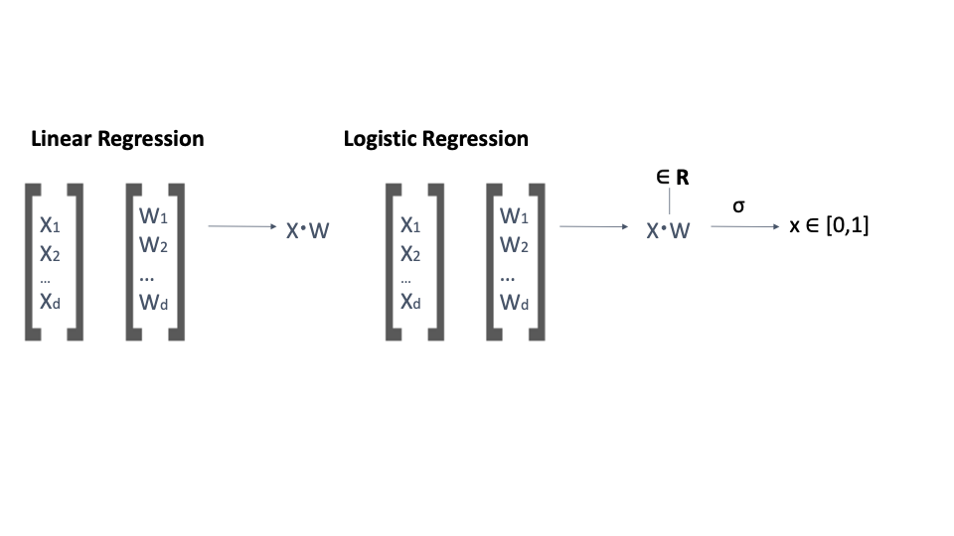

Slide 3
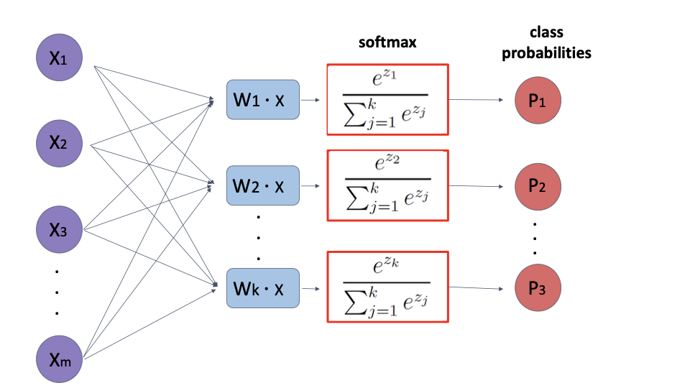

Slide 4
x⁽¹⁾
x⁽²⁾
x⁽³⁾
x^{(n)}
. . .
∈ℝ^{(n)}
SELF-ATTENTION LAYER
∈ℝ^{(n)}
. . .
y⁽¹⁾
y⁽²⁾
y⁽³⁾
y^{(n)}

Slide 5
x
xW^{(q)T}
Query
W^{(q)}
^{rxd}
nxd
nxr
W^{(k)}x^{T}
Softmax
Key
W^{(k)}
^{rxd}
x
rxn
nxn
W^{(v)}
Value
W^{(v)}
x
nxd
nxd

Slide 7
x
xW^{(q)T}
Query
W^{(q)}
^{rxd}
nxd
nxr
z
W^{(*)}x^{T}
Softmax
Key
W^{(k)}
^{rxd}
x
mxd
rxm
nxm
zW^{(*)}
Value
W^{(v)}
x
mxd
nxd

Slide 8
Input Text Vector Encoding
Self-Attention
. . .
. . .
. . .
Self-Attention
Cross-Attention
Cross-Attention
. . .
. . .
Self-Attention
. . .
. . .
. . .
Self-Attention
Cross-Attention
Cross-Attention
Probability Distribution of Next Word

Slide 9








Linear Layer
$$X_{1}$$
$$X_{1}$$
$$X_{2}$$
$$X_{2}$$
$$X_{3}$$
$$X_{3}$$
.
.
.
.
.
.
$$W ⊆ ℝ^{d^{′} x d}$$
$$d$$
$d$’

Slide 10








Convolution (1D)
$$X_{1}$$
$$Y_{1}$$
$${(X}_{1}∗ Y_{1})+(X_{2}∗Y_{2})$$
Z₁
$$X_{2}$$
$$Y_{2}$$
$${(X}_{2}∗ Y_{1})+(X_{3}∗Y_{2})$$
Z₂
$$X_{3}$$
$$W ⊆ ℝ^{w′}$$
$${(X}_{3}∗ Y_{1})+(X_{4}∗Y_{2})$$
Z₃
$$X_{4}$$
KERNEL
$$d′$$
$$d$$

Slide 11





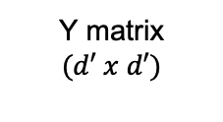







$$X_{11}$$
$$X_{21}$$
$$w_{11}$$
$$w_{21}$$
$$X_{12}$$
$$X_{22}$$
$$w_{12}$$
$$w_{22}$$
IMAGE
Kernel $(w′ x w′)$
$$Y_{11}$$
Y matrix
$$(d′ x d′)$$
Pixel
X matrix
$$(d x d)$$
Convolution (2D)

Slide 12


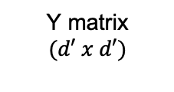








$$X_{11}$$
$$X_{12}$$
$$w_{11}$$
$$w_{12}$$
$$X_{12}$$
$$X_{22}$$
$$w_{21}$$
$$w_{22}$$
IMAGE
$$Y_{11}$$
S
S
Y matrix
$$(d′ x d′)$$
X matrix
$$(d x d)$$

Slide 13

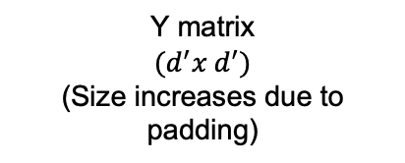








$$0$$
$$0$$
$$w_{11}$$
$$w_{12}$$
$$0$$
$$X_{22}$$
$$w_{21}$$
$$w_{22}$$
IMAGE
0 | 0 | 0 | 0 | 0 | 0 | 0 | 0 | 0 | 0 | 0
0 |  |  |  |  |  |  |  |  |  | 0
0 |  |  |  |  |  |  |  |  |  | 0
0 |  |  |  |  |  |  |  |  |  | 0
0 |  |  |  |  |  |  |  |  |  | 0
0 |  |  |  |  |  |  |  |  |  | 0
0 |  |  |  |  |  |  |  |  |  | 0
0 |  |  |  |  |  |  |  |  |  | 0
0 | 0 | 0 | 0 | 0 | 0 | 0 | 0 | 0 | 0 | 0
$$Y_{11}$$
Y matrix
$$(d^{′}x d^{′})$$
(Size increases due to padding)
X matrix
$$[\left(d+p\right) x \left(d+p\right)]$$

Slide 14


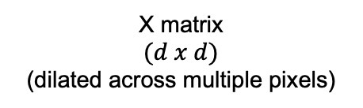




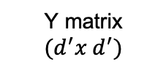

$$X_{11}$$
$$X_{13}$$
$$w_{11}$$
$$w_{13}$$
$$X_{31}$$
$$X_{33}$$
$$w_{31}$$
$$w_{33}$$
IMAGE
$$Y_{11}$$
Y matrix
$$(d^{′}x d^{′})$$
X matrix
$$(d x d)$$
(dilated across multiple pixels)

Slide 15
f
g
ENCODER
DECODER
Z
Channels of Image

Slide 16
Z₂
collisions
Z₁

Slide 17
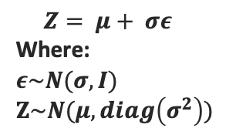
IMAGE
μ
ENCODER
DECODER
σ
Z
$$Z= μ+ σε$$
Where:
$ε\sim N(σ, I)$
$$Z\sim N(μ, diag\left(σ^{2}\right))$$

